Slide 1
Africa benefits from climate change via access to affordable, reliable and clean energy
Paul van Aalst, Director E+Co Europe
African Economic Conference 27 October 2011 Addis Abbaba

Slide 2
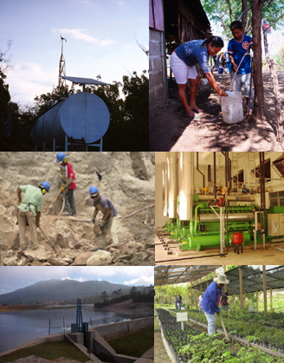
Investing in “Access to Clean Energy”
Ø Services and Capital
Ø 200 local energy enterprises
Ø 20 developing countries
Ø $46 million invested
Ø $56 million under management
Ø $213 million mobilized
Ø 7.8 million people served annually
Ø 4.8 million tons of CO₂ displaced annually
Ø 23m ton CO₂ displaced over investment life
Ø 8 Offices in Africa, Asia, Latin America, NL and USA: 45 Staff
www.eandco.net
2
Notes:
2

Slide 3
Clean Energy = Market Place
Self propelling : willingness and capacity to pay
Private sector (SME) for sustainable and equitable delivery
Technologies: proven, affordable, flexible
Critical: Financing and Business Support Services
Local investment and support
Global funding and market development
Notes:
Q: Why SMEs
A: 1) Local SMEs work at local cost levels (efficient)
2) Offer differentiated supply – refining how to meet local needs
3) Deliver today
4) Sustainable
5) Once market is proven, institutional change easier to realize
Q: Price of clean energy too high
A: Price of off-grid energy is much higher per unit of energy, compared to US/EU. Price comparison is with ‘opportunity costs’ and comparative fuels / options.
But the matter is really: there is a market as soon as the energy is reliable, affordable and clean

Slide 4
Green Economy enables Structural Transformation
StructuraI Impact for Africa:
Climate Change spurred development of Clean Energy technologies in Europe, America, Japan
Energy Demand enables commercial application in developing countries
Environmental Impact includes:
CO₂ – reductions and monetization of offsets
Reforestated Land
Charcoal and Firewood Displaced
Kerosene and Oil Displaced

Slide 5
Reaching the Base of the Pyramid
BoP spend 25% of income on energy (charcoal, batteries).
Access to Clean Energy” saves time and money
Energy-ladder: clean, safe, affordable, available
Users living from <$2 per day have access to clean energy …:
When direct cash available:
Cookstoves
Small solar lamps
Grid connection with subsidized cost of connecting to the system
When micro-loans or other financing are available
Solar home systems
Biogas digester
Grid connection
Once higher income groups generate baseload / break-even turnover

Slide 6
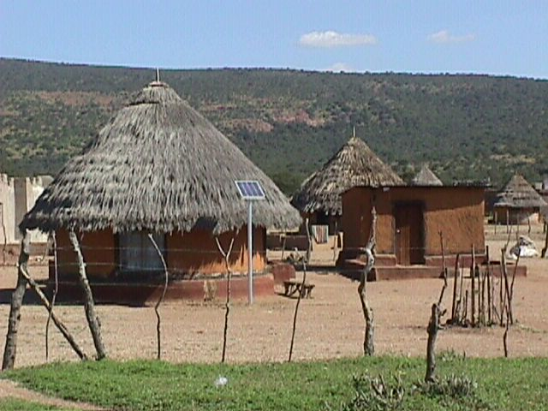
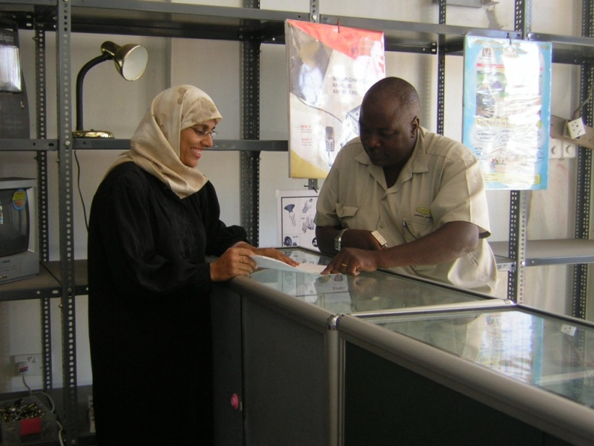
Zara Solar
Zara Solar provides solar home systems to rural households in the Mwanza Lake Region of Tanzania.
E+Co Loans: US$ 50,000 (2001)
US$100,000 (2004)
US$200,000 (2006)
Impacts:
Over 20,000 households served
Jobs: from 2 to more than 50
Winner of several Awards
Notes:
Seasoned entrepreneur; just new to solar business

Slide 7
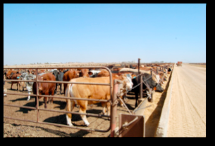
Bio2Watt Biogas in South Africa
3MW biogas plant
First industrial biogas plant in South Africa
USD 12.5 mln dollar investment
Cow manure from a feedlot of 20,000 cattle
Financial structuring support from E+Co and DBSA during pre-feasibility study: 2007 – 2009
E+Co sourced grant from NL-Agency of €600,000 to defray initial costs.
The long awaited implementation of South Africa’s feed in tariff regime (REFIT) system is beginning to take shape, with the SA government appointing transactional advisors and requesting project documentation
7

Slide 8
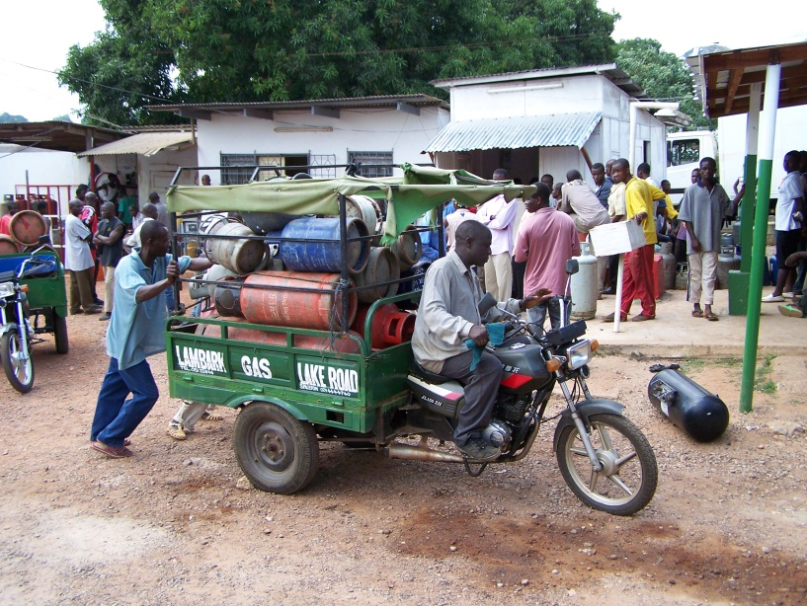
Lambark LPG (Ghana)
Lambark Gas is a twelve-year-old liquefied petroleum gas (LPG) distribution company
Operates 4 LPG filling plants with a total storage capacity of 100 metric tons, 2 bulk LPG haulage trucks and 15 delivery motor cycles
Acquired license to purchase LPG directly from the Tema Oil Refinery and retail directly to households, commercial and automobile customers. This license eliminates third party operators in the LPG supply chain, expands customer base, and improves profit margins to 21.5%’.
Required by license to manage and maintain a minimum of 5 filling stations. Also required bank guarantees or cash to procure products from the refinery
8

