Slide 1
A Federated Information System for the SDGs
United Nations Statistics Division

Slide 2
Context

Slide 3
The 2030 Agenda: What do we want to achieve?
Declaration
Vision and shared principles for people, planet, prosperity, peace and partnership
Results Framework
17 integrated and indivisible goals and 169 aspirational targets
Follow-up and Review
Global indicators underpin an integrated follow-up and review framework
Means of implementation
Governments, civil society, industry, the UN System, science and technology
Notes:
In adopting the 2030 Agenda for Sustainable Development in September 2015, the UN General Assembly decided that the 17 Goals and 169 Targets of the Agenda will be followed up and reviewed using a global indicator framework to be developed by the Inter-Agency and Expert Group on Sustainable Development Goal Indicators (IAEG-SDGs) under the direction of the UN Statistical Commission.
The global indicator framework has been endorsed by the Economic and Social Council (ECOSOC) and the General Assembly, and presently consists of 232 global indicators.
These will be complemented by indicators at the regional and national levels, and will be developed by Member States according to their individual national circumstances and priorities.

Slide 4
Multilevel SDG data reporting
National and subnational reporting is the most significant level of the SDG review process
The global SDG monitoring system builds on national data reporting
Data derived from national sources is the foundation for SDG reviews at all levels
It is crucial to create opportunities for countries to directly contribute to global reporting
Notes:
Aggregate data on global SDG indicators often mask or confuse national and subnational realities
There is a need for a multi-level SDG reporting system that would work from the subnational level up to the national and global levels.
This research provides an opportunity for countries to directly provide national contributions to the global reporting system.

Slide 5
Decision by Statistical Commission
At its 49th session in March 2018, the Statistical Commission welcomed the efforts to establish a federated system of national and global data hubs for the SDGs to:
facilitate integration of different data sources,
promote data interoperability
foster collaboration among partners from different stakeholder groups, including the geospatial community and other data providers,
improve data flows and global reporting of the SDGs.

Slide 6
How does the Federated System work?
It is a country-led “system of systems”
Implemented through
Open standards and principles for data interoperability
Geospatial information systems (GIS) and data analytics capabilities
Web-based collaboration, communication and user engagement
Supports NSOs in managing statistical and geospatial data, integrating new and innovative data sources with traditional ones
Enables local/national decision makers to access, understand and use SDG data
Empowers countries to directly contribute to global SDG reporting through innovative applications.

Slide 7
Federated data governance model
Based on the principle of national ownership,
National Statistical Systems coordinate the implementation of a common set of global policies, standards and procedures around the production, dissemination and use of data to support the implementation of the 2030 Agenda, while addressing country-specific SDG data needs and priorities.
Implementation of a multi-layered set of standards and procedures from local to national to global levels.

Slide 8
Federated information systems architecture
High-level conceptual and logical data models provide a consistent view of SDG-related data across countries and organizations.
Common data models, data definitions and data flows allow for data interoperability and integration across multiple systems into a network of federated data hubs
Each hub independently publishes and shares authoritative data using a common schema, thus contributing to a global catalog of standardized open SDG data and information
Users can access the data they need while the traceability and accountability of the originating data sources is ensured.

Slide 9
Interoperability and web-based collaboration
The interface to each SDG data hub is based on open standards and the use of common vocabularies for describing and organizing data content.
Web-based technology enables collaboration within and across organizations.
Anyone within and outside a data provider’s organization can directly access data and applications made publicly available through the organization’s open data hub
Users with proper credentials can access content shared with specific user groups.
Data providers document best practices and share them with other organizations providing a collaborative environment for the entire SDG data life-cycle

Slide 10
UN SDG Data Hub
Initiatives
Senegal
Philippines
Linked to a global network to share data, templates and common initiatives
Enabled by Web GIS and open standards
Partner
Partner
Mexico
UN SDG Hub Network
Data
Qatar
Policy
Initiatives
S. Africa
Ireland
Partner

Slide 11
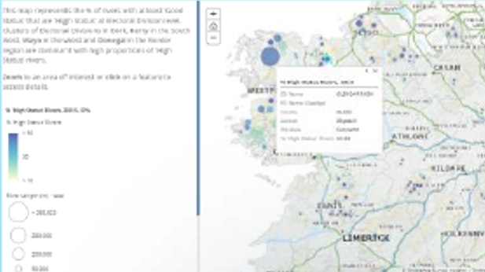
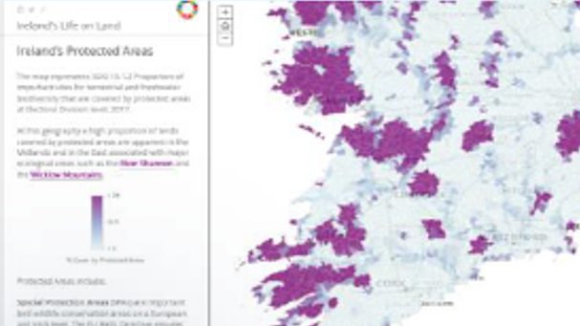
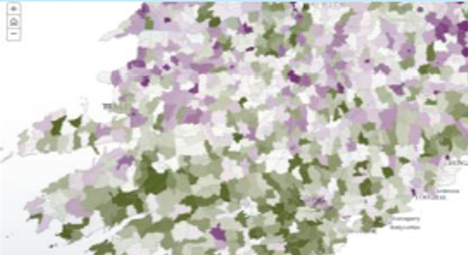
A network of national SDG Data Hubs
Initiatives
Province
Academia
Supporting national partnerships around data and policy initiatives
Providing an inclusive and enabling environment for all stakeholders
Partner
Partner
National Data Hub
Data
Ministry
City
Policy
Initiatives
Partner
Partner
NGO
Notes:
Enable collaboration and data sharing across stakeholders and members of National Statistical System
Multiple ways to access the data – tailored to the needs of diverse audiences (policy makers, statisticians, general public, developers)

Slide 12
Implementation : initial steps
Small initial group of countries initiated the research exercise in May 2017 followed by a second group in October 2017
Deployed a limited number of National SDG Data Hubs that are “country owned and country led”
Deployed a Global UN SDG Data Hub for the SDG indicator framework

Slide 13
The way forward
A proof of concept of the Federated Information System for the SDGs was presented at the Friday Seminar before the start of #UN49SC
As the initiative enters full implementation, there is need to:
Mobilize resources and expand the network of partners
Strengthen the role of NSOs as enablers and coordinators of SDG data dissemination and reporting at the national level
Develop strategies on modern IT infrastructure and technical and statistical standards
Implement statistical geospatial frameworks at the country level for the integration of SDG data and information
Promote engagement with policy makers and users from multiple stakeholder groups

Slide 14
Deliverables at the country level
A national SDG Data Hub that transform local and national statistical data and geospatial information into accessible web services
A comprehensive architecture to support the integration of loosely coupled metadata-driven systems to deploy SDG data and information at the local, national and global levels
Country-specific information products and applications based on the needs of policy and decision makers at the local, national and global levels
Improved capacity of local institutional and human resources to implement, operate and further develop the national SDG data platforms

Slide 15
Roadmap for setting up a country SDG data hub
Define national strategic objectives for SDG data
Identify and obtain buy-in from key stakeholders, explaining the process of creating and maintaining a national SDG data hub
Mobilize resources and acquire IT infrastructure
Identify priority statistical datasets and assess data availability
Document data flows of priority datasets
Prepare datasets for publication
Publish datasets along with their respective metadata and derived applications as data services on an open data site.

Slide 16
Global UN SDG Data Hub
Implementation

Slide 18
Initial setup
Setup the technological platform
Define an authoritative source of geometries that represent geographic location of each record in the data set.
Define an authoritative source of statistical data and metadata on SDG indicators to be published.

Slide 19
Preparation of datasets for publication
Extract data for individual SDG indicators and join them with their corresponding geometries
The structure of the resulting datasets is designed to facilitate the representation of the data in maps (e.g., each row represents one geographic feature, and all areas are included, regardless of whether they have data or not)

Slide 20
Publication
Collect information describing the nested structure and content of the global SDG indicator framework (code, title, and description of each node on the goal > target > indicator > series hierarchy)
Collect the list of tags assigned to each series:
Define renderer parameters for each item (i.e., data field to be mapped by default, color, max/min values, breaks, transparency, etc.)
Upload each item as a data layer
Share with open data sites, groups and applications

Slide 21
Publication Process
https://github.com/UNStats-SDGs/sdg-publisher
GitHub
2
Geo Areas (with coordinates)
SDG icons
ArcGIS online
SDG database
R script (csv generator)
CSV files
Python script (publisher)
Feature layers (hosted)
SDG API
3
5
1
MetadataAPI.json (incl. tags)
6
4

Slide 22
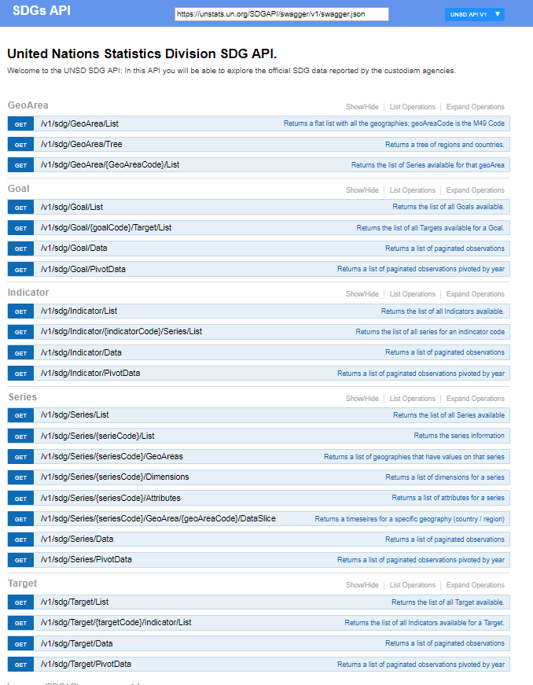
SDG API
1
General info (size, pages)
List of attributes (id, code lists)
List of dimensions (id, code lists)
Data records:
Goal, Target, Indicator
Series (code, description)
Geo Area (code, description)
Period
Value
Footnotes (time detail, source, other footnotes)
Attribute values
Dimension values
https://unstats.un.org/SDGAPI/swagger/
https://unstats.un.org/SDGAPI/v1/sdg/Series/Data?seriesCode=AG_FPA_MILLET

Slide 23
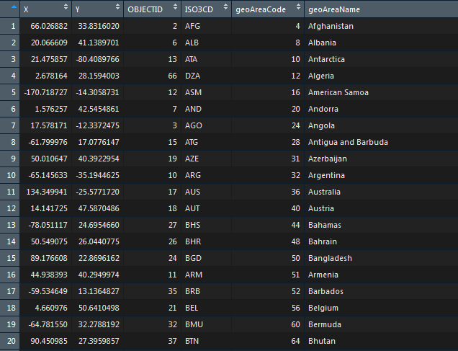
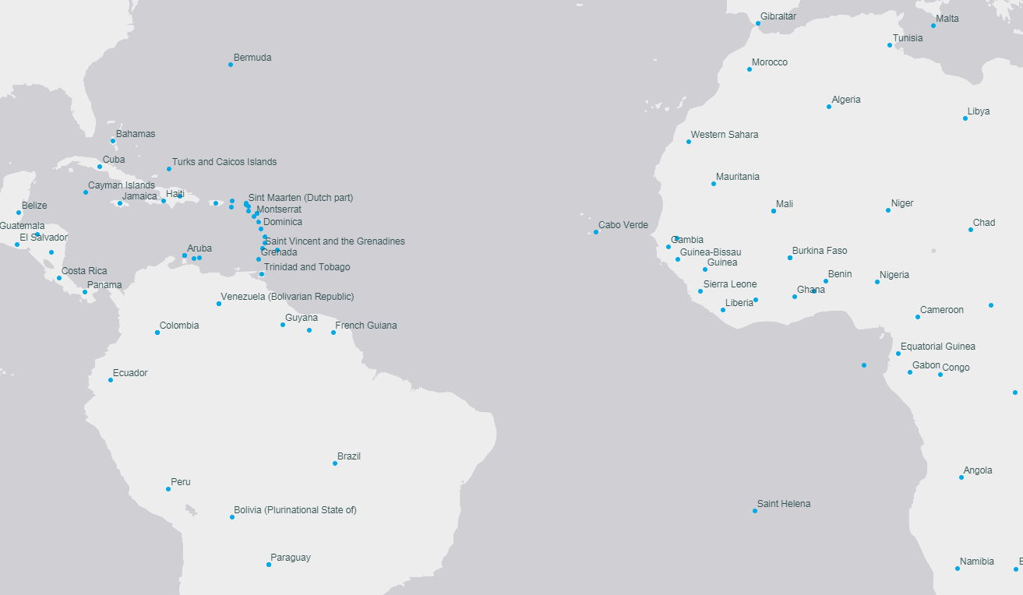
Geo Areas
2

Slide 24
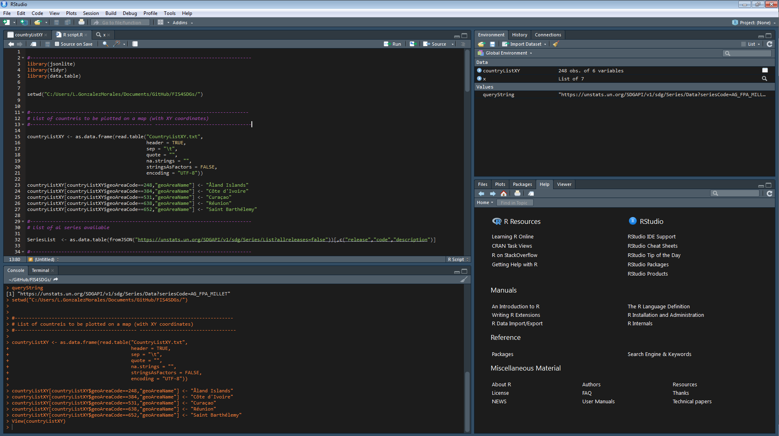
R script
3
Create “long” and “wide” views of a series data cube:
Geographic Areas
×
years
×
unique dimension values (“slice”)
Values and attributes
+

Slide 25
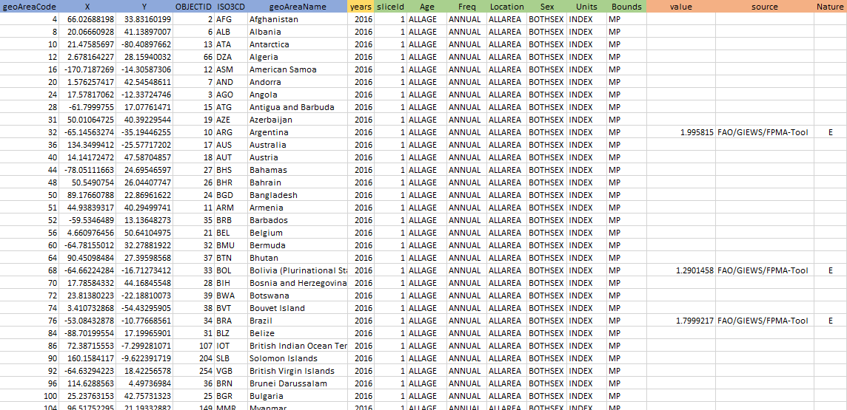
CSV file
4

