Slide 1
DevInfo to DSD migration – case study (using python, R scripts and ArcGIS online)
Sub-regional workshop on data and metadata sharing and exchange for English-speaking African countries
19-21 September 2018
Kigali, Rwanda
Daniel Eshetie
United Nations Statistics Division

Slide 2
ChildInfo 1995 - 2003
UNICEF developed a database to monitor the World Summit for Children
DevInfo 4.0 2004
ChildInfo upgraded and launched in April 2004
UN Endorsement 2004
Endorsed by the UN to assist Member States in monitoring MDGs
DevInfo 7.0 2012
DevInfo 5.0 2006
Included first web-enabled version; May 2006
DevInfo 6.0 2009
Apr 2009
Notes:
Source: UNICEF’s presentation on NRP in NY January, 2028

Slide 3
DevInfo support ending soon ?
Strong UN backing of initiative was beneficial
UNICEF feels a need to revisit technology platform, incentive structure and model for country support with a view toward sustainability
ongoing activities by the UN system to support the SDG data system in countries through
NRP conference
Pilot NRP implementation happening in selected countries
UNICEF/OECD/UNSD
Country initiatives

Slide 4
A case in data migration attempt
Starting from the DevInfo backend data storage – in most cases the data is sitting in access database

Slide 5
Workflow
ArcGIS online
Export the geographic layers into
Shape files
geojson
Python script (publisher)
Feature layers (hosted)
DevInfo database
Process the CSV file using R
Produce csv file with DSD like mapping
Export all data in a single CSV format
Pre Processed data ready for migration
( .Stat or AIH )

Slide 6
Tools used

Slide 8
SELECT
UT_Data.Indicator_NId AS INDICATOR_ID, UT_Indicator_en.Indicator_Name AS INDICATOR, UT_Data.Data_Value AS OBS_VALUE,
UT_Unit_en.Unit_NId AS UNIT_ID, UT_Unit_en.Unit_Name AS UNIT, UT_Area_en.Area_ID AS REF_AREA_ID,
UT_Area_en.Area_Name AS REF_AREA, UT_TimePeriod.TimePeriod AS TIME_PERIOD,
UT_Indicator_Classifications_en.Publisher AS PUBLISHER, UT_Area_Map_Layer.Layer_NId AS LAYER_ID, UT_Area_Level_en.Area_Level_Name AS AREA_LEVEL_NAME,
UT_Area_en.Area_Level AS AREA_LEVEL, UT_Indicator_Classifications_en.IC_Name AS IC_NAME,
UT_Subgroup_Vals_en.Subgroup_Val AS SUBGROUP_VAL,
UT_Subgroup_Type_en.Subgroup_Type_Name AS SUBGROUP_TYPE_NAME
FROM
((((UT_Area_Map_Layer INNER JOIN ((UT_Area_Level_en INNER JOIN (UT_Subgroup_Vals_en INNER JOIN
(UT_Unit_en INNER JOIN (UT_Indicator_en INNER JOIN (UT_Indicator_Unit_Subgroup INNER JOIN
(UT_TimePeriod INNER JOIN (UT_Indicator_Classifications_en INNER JOIN (UT_Area_en INNER JOIN UT_Data
ON UT_Area_en.[Area_NId] = UT_Data.[Area_NId])
ON UT_Indicator_Classifications_en.IC_NId = UT_Data.Source_NId)
ON UT_TimePeriod.TimePeriod_NId = UT_Data.TimePeriod_NId)
ON UT_Indicator_Unit_Subgroup.IUSNId = UT_Data.IUSNId)
ON UT_Indicator_en.Indicator_NId = UT_Indicator_Unit_Subgroup.Indicator_NId)
ON UT_Unit_en.Unit_NId = UT_Indicator_Unit_Subgroup.Unit_NId)
ON UT_Subgroup_Vals_en.Subgroup_Val_NId = UT_Indicator_Unit_Subgroup.Subgroup_Val_NId)
ON UT_Area_Level_en.Area_Level = UT_Area_en.Area_Level)
INNER JOIN UT_Area_Map ON UT_Area_en.Area_NId = UT_Area_Map.Area_NId)
ON UT_Area_Map_Layer.Layer_NId = UT_Area_Map.Layer_NId)
INNER JOIN UT_Area_Map_Metadata_en ON UT_Area_Map_Layer.Layer_NId = UT_Area_Map_Metadata_en.Layer_NId)
INNER JOIN UT_Subgroup_Vals_Subgroup ON UT_Subgroup_Vals_en.Subgroup_Val_NId = UT_Subgroup_Vals_Subgroup.Subgroup_Val_NId)
INNER JOIN UT_Subgroup_en ON UT_Subgroup_Vals_Subgroup.Subgroup_NId = UT_Subgroup_en.Subgroup_NId)
INNER JOIN UT_Subgroup_Type_en ON UT_Subgroup_en.Subgroup_Type = UT_Subgroup_Type_en.Subgroup_Type_Nid
ORDER BY
UT_Data.Indicator_NId

Slide 9
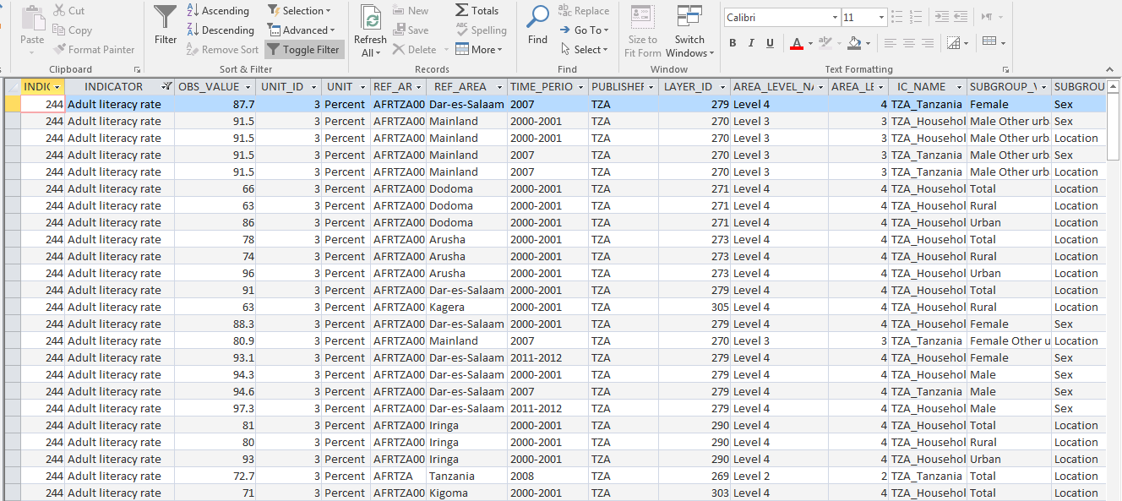

Slide 10
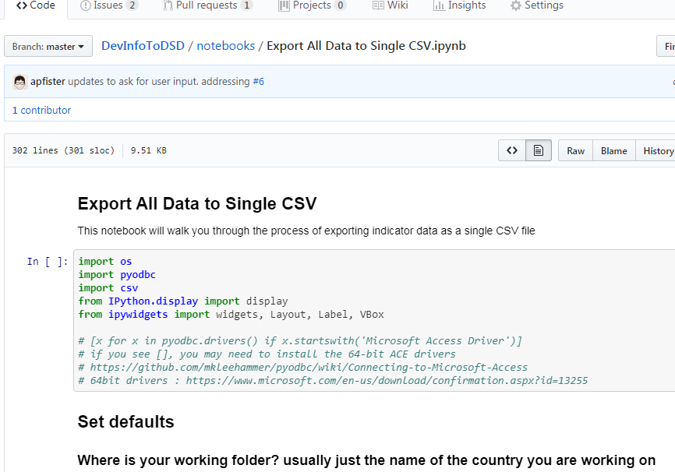
https://github.com/UNStats/DevInfoToDSD

Slide 11
DEMO

Slide 12
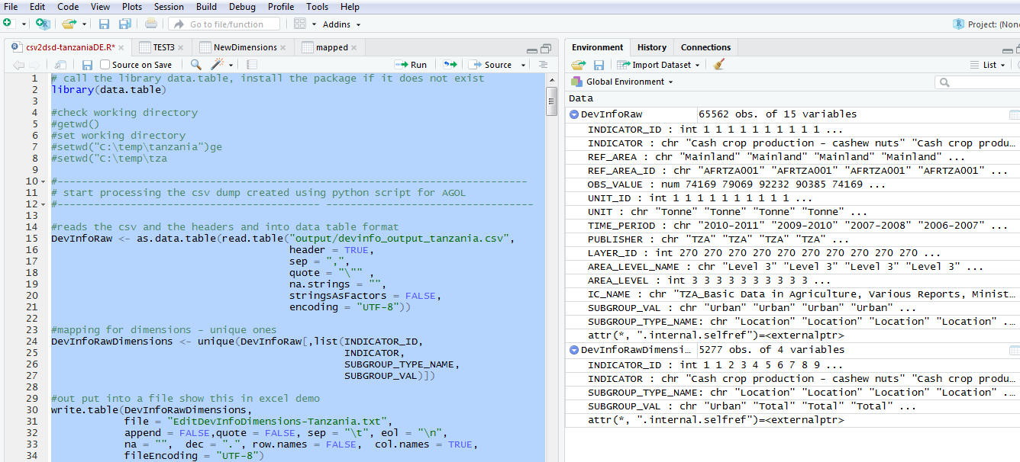
First Block

Slide 13
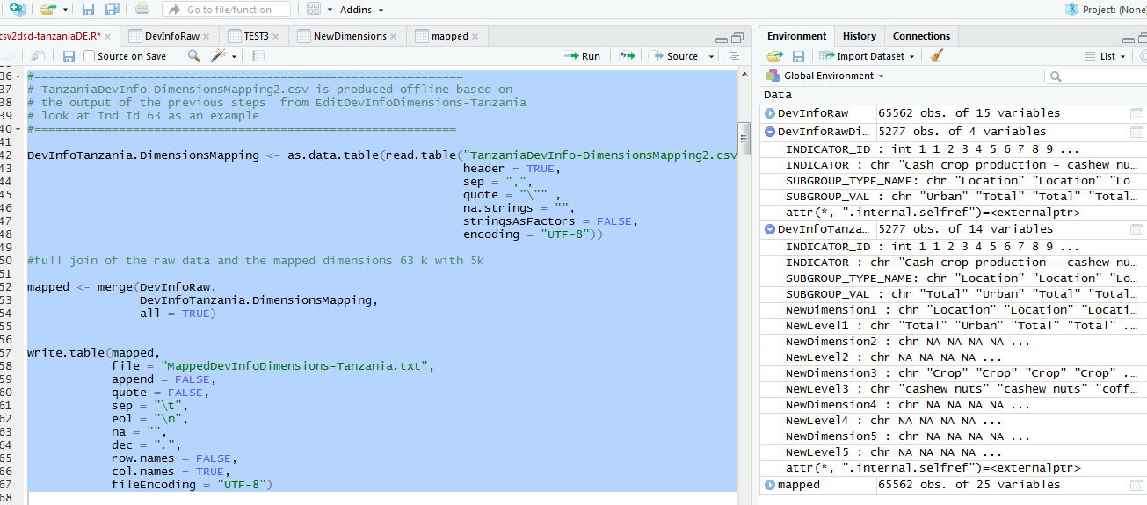
Second Block

Slide 14
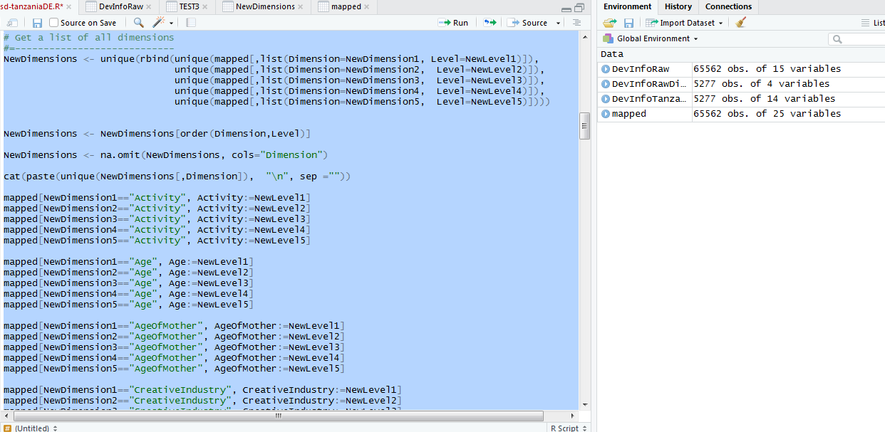
Third Block

Slide 15
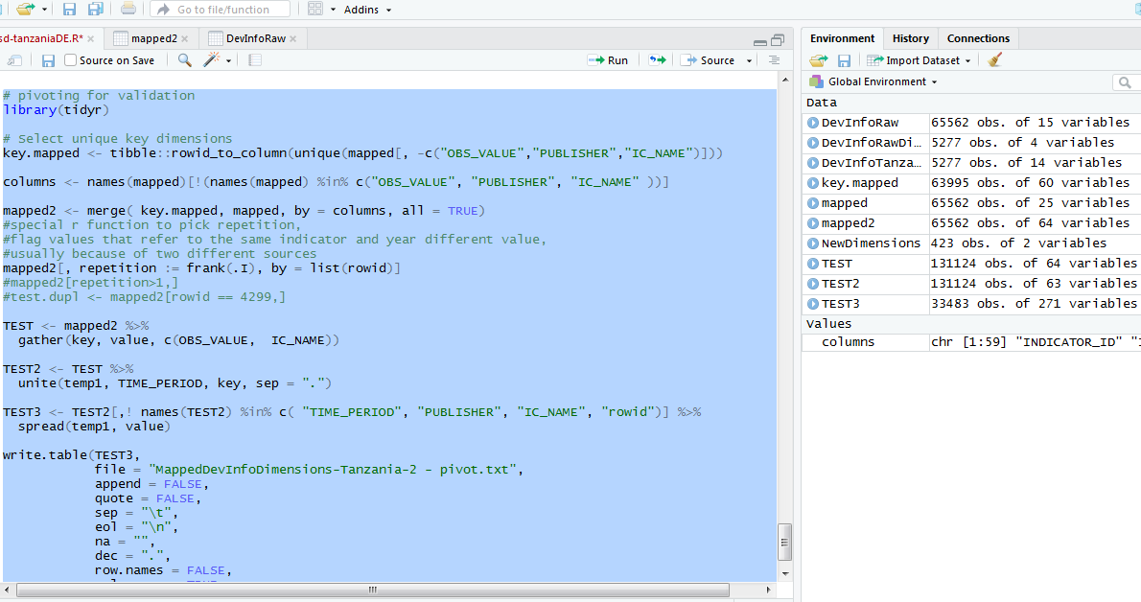
Fourth Block

Slide 16
DevInfo-Dimensions Mapping

Slide 17
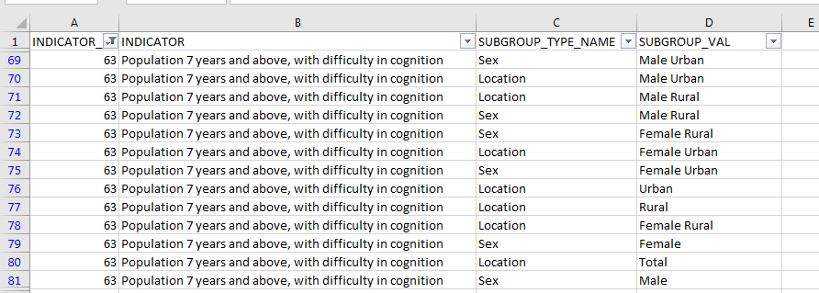
DevInfo-Dimensions Mapping

Slide 18
THANK YOU

