Slide 1
SDMX Reference Infrastructure
Abdulla Gozalov
United Nations Statistics Division

Slide 2
What is SDMX-RI?
Software suite developed by Eurostat
Simplifies SDMX export from existing databases
Includes several distinct applications
  Mapping Assistant
  Web Service
  Web client
  and others
Open-source implementation in Java and .Net

Slide 3
Why use SDMX-RI?
The re-use of software
  reducing costs
  increasing productivity
Provides statistical organisations re-usable building blocks:
  .NET and Java implementations
  Well defined API
  Open Source package under the EUPL licence
  Minimize installation effort
  that enable production of SDMX data from existing
  reference / dissemination databases
Source: Eurostat

Slide 4
SDMX-RI: Implementation
The greatest effort is spent on configuring mappings using the Mapping Assistant
  Mapping Assistant works with any DSD and database
Other modules such as Web Service, use mappings from the Mapping Store and require a very small effort on configuration and maintenance.

Slide 5

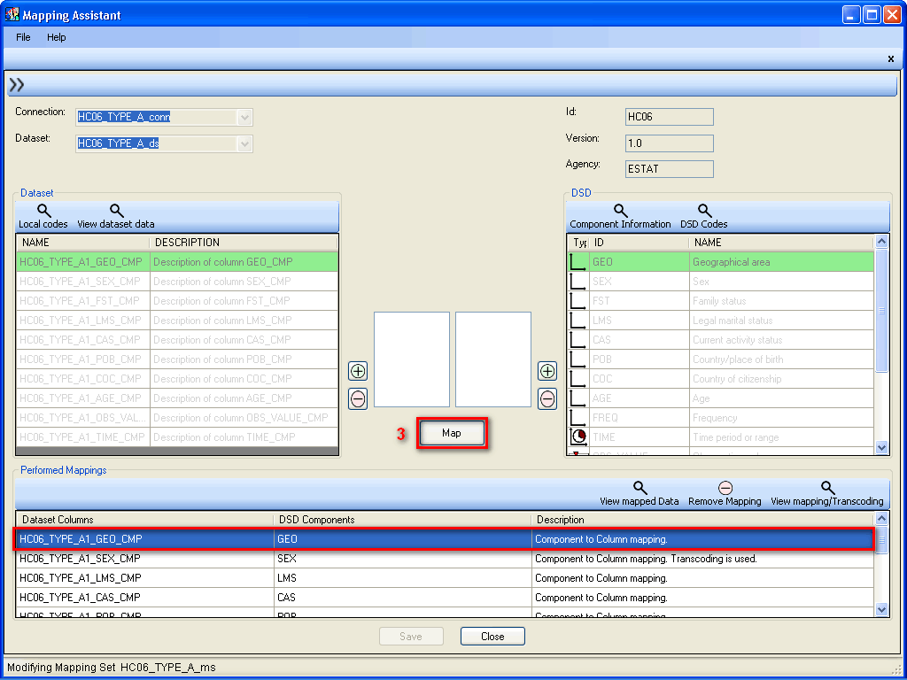



How it works
mappings
Mapping Store
mappings
?
sdmx data
data
Indicator Database
Web Service

