Slide 1
Making official statistics open by default
African Centre for Statistics, UNECA

Slide 2
Outline
Definition of “Open data”
What makes data open?
Requirements for an open dataset to be useful
Do we need “open official statistics”?
Benefits of “open official statistics”
Status of open data in Africa
Open data initiatives in Africa
Way forward

Slide 3
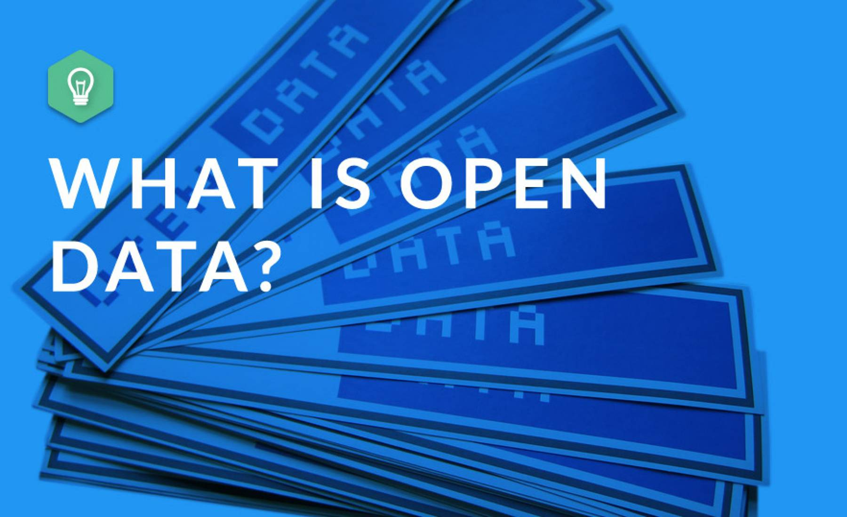

Slide 4
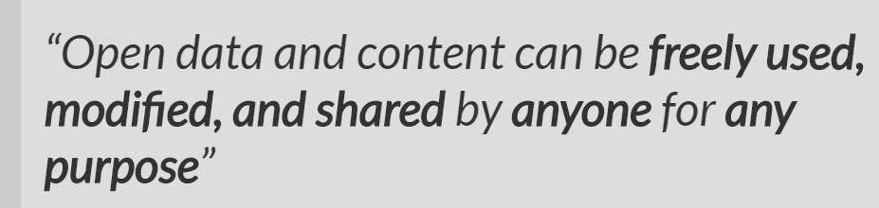
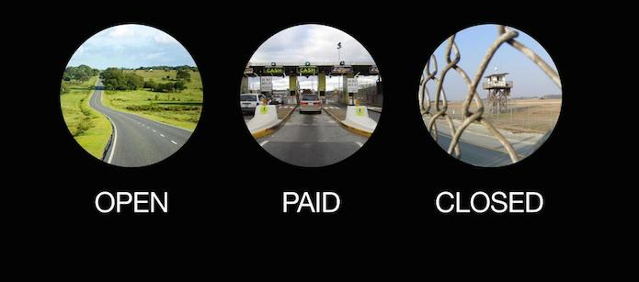
What is open data
opendefinition.org
Notes:
Don’t read this. Put it up and talk about how statisticians have been forward looking and ahead of everybody else.

Slide 5
What is open data (cont’d)
Open data becomes usable when made available in a common, machine-readable format.
Open data must be licensed. Its license must permit people to use the data in any way they want, including transforming, combining and sharing it with others, even commercially.
Notes:
https://www.europeandataportal.eu/elearning/en/module1/#/id/co-01

Slide 6
What makes data open?
Anyone can access.
Be licensed. Its license must permit people to use the data in any way they want, including transforming, combining and sharing it with others, even commercially
Available in a common, machine-readable format. A human can understand it and a machine can manipulate it
Notes:
Open data must be free to use, but this does not mean that it must be free to access.
There is often a cost to creating, maintaining and publishing usable data.
Ideally, any fee for accessing open data should be no more than the reasonable reproduction cost of the unit of data that is requested.
This reproduction cost tends to be negligible for many datasets.
Live data and big data can incur ongoing costs related to reliable service provision.

Slide 7
Requirements for an open dataset to be useful
Quality requirements
  Legal requirements: open license, sensitive information protected, data owners rights preserved, correct use of the data promoted
  Technical requirements: the format in which the data is published, the structure of the data, the channels through which the data is available
  Social requirements: data use to be sustainable - an engaged community of users-, with the highest possible level of granularity, timely available
The 5 Stars requirements
  1st star - An open license
  2nd star - Re-usable format
  3rd star - Open format
  4th star - open identifiers to reference things on the Web
  5th star - linked data (linking individual data points together)
Notes:
The 5 Stars guideline for linked open data is a way to measure how well data is integrated into the Web.
It examines the accessibility and technical usability of a dataset ranging from being available online (1 star) to being part of the web of data (5 stars). Each star must be awarded sequentially and none can be skipped.

Slide 8
Do we need “open official statistics”?
What is official statistics
“Official statistics are statistics published by government agencies or other public bodies such as international organizations as a public good. They provide quantitative or qualitative information on all major areas of citizens' lives, such as economic and social development, living conditions, health, education, and the environment. Such agencies might be either centralised or decentralized”
UN Fundamental Principles of Official Statistics

Slide 9
Do we need “open official statistics”? (Cont’d)
“Official statistics provide an indispensable element in the information system of a democratic society, serving the government, the economy and the public with data about the economic, demographic, social and environmental situation. To this end, official statistics that meet the test of practical utility are to be compiled and made available on an impartial basis by official statistical agencies to honour citizens' entitlement to public information”
UN Fundamental Principles of Official Statistics - #1

Slide 10
Benefits of “open official statistics”
In addition to benefits of open data (Opportunities for government, unlocking new social value and enabling better targeted public policies, Benefiting culture and the environment, etc.), “open official statistics”:
Maintains the trust of the providers of data and the credibility of the statistics
Is incentive for users to rather refer to official statistics (open license)
Promotes multi-usage of official statistics
Notes:
Opportunities for government: Supporting growing economies; Improved service delivery; Cost savings in key areas such as healthcare, education and utilities

Slide 11
Status of open data in Africa
“The results of the 2015 ODB show that Africa is lagging behind other regions in the use and impact of open data. No Sub-Saharan African country ranks in the top 40, while there are six counties in the bottom ten. Globally, there is still much work to be done: only 10% of the 1,380 datasets analyzed were open. Alarmingly, only two of these datasets were in Africa.”
http://opendatabarometer.org
Notes:
The 2017 edition is going to be released on 23 May 2017…

Slide 12












Open Data Initiatives in Africa
Ghana
Nigeria
Kenya
South Africa

Slide 13
Way forward
The Cape Town Global Action Plan for Sustainable Development
  recognizes the need to facilitate the application of modern technologies and new data sources in mainstream statistical activities to support the implementation of the 2030 Agenda
  calls for the modernization of the statistical standards, including those aimed to facilitate data integration and automation of data exchange
A road map and action plan to open official statistics?
  Open Data Roadmap of Ukraine
  Open Data Roadmap for the UK 2015
  Open Data Roadmap in Kenya
  Etc.

Slide 14
Learn more on the European Data Portal e-learning programme https://www.europeandataportal.eu/elearning/en/#/id/co-01

Slide 15
Thank you

