Slide 1
Value added of regional and global indicator frameworks as compared to national frameworks in the context of violence, crime, access to justice, and corruption
Angela Me Chief Research and Trend Analysis Branch
UNODC

Slide 2
SDG targets
5.2, 8.7 16.3 end trafficking in persons
5.2 eliminate all forms of violence against all women and girls
11.7 provide universal access to safe, inclusive and accessible, green and public spaces
15.7 to end poaching and trafficking of protected species of flora and fauna and address both demand and supply of illegal wildlife products
16.1 reduce all forms of violence and related death rates
16.2 end abuse, exploitation, trafficking and all forms of violence against children
16.3 promote rule of law and ensure access to justice
16.4 reduce illicit financial and arms flows, strengthen the recovery and return of stolen assets and combat all forms of organized crime
16.5 substantially reduce corruption

Slide 3
National indicators
to trigger national actions
Regional indicators
to trigger regional actions
Any value at national level?
Global indicators
to trigger global actions
Any value at national level?

Slide 4
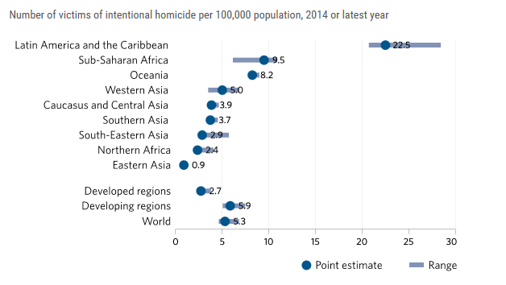
Global homicide rate is between 4.6 and 6.8 per 100,000 people

Slide 5
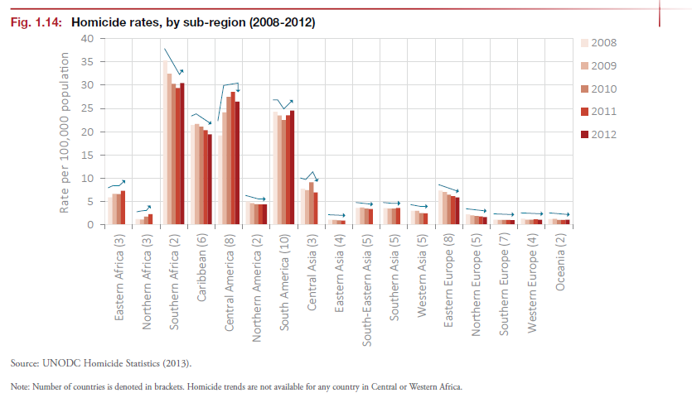

Slide 6
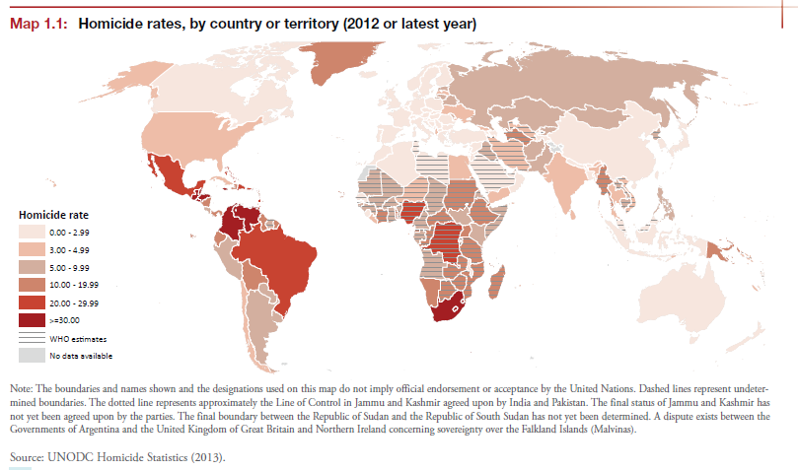
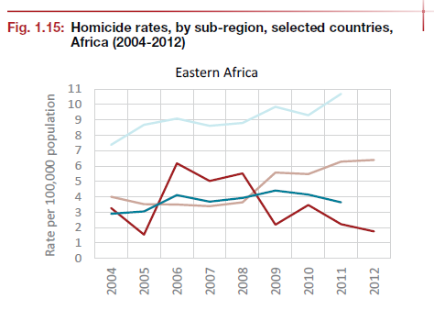
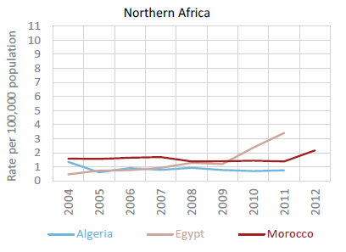
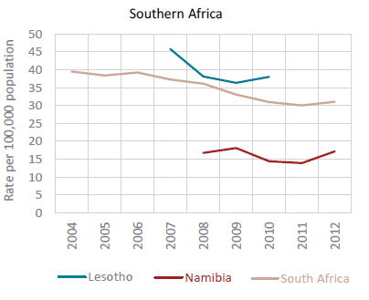

Slide 7
Global monitoring as aggregation of national data
Useful if data can be compared across countries
Requirements: comparability, quality, coverage
Role of global monitoring is ONLY to add up national data ensuring that they are comparable and of good quality

Slide 8
This is true for violence, access to justice, corruption, phenomena that evolves at national level
But more is needed for issues such as trafficking in persons, trafficking of firearms, wildlife trafficking, and illicit financial flows

Slide 9
Difficult to measure because they relate to hidden phenomena
Transnational nature of the problem
The problem evolves in different geographical areas
The problem can not be understood in national isolation

Slide 10
In order to be properly understood, these problems require a global analysis, beyond just a collation of national data

Slide 11
Illicit Supply
Trafficking
Licit/illicit Demand
Transnational dimension of the problem
Source
Transit
Destination
Differently from licit trade statistics, each country can describe only partially one of the three elements. What is not measured is not a statistical omission but it is part of the problem.

Slide 12
Transnational crime
Detected in country X
Detected in country H
Detected in country Z
Detected in country A
Detected in country D
Detected in country A
Hidden problem
Detected in country W
Detected in country Q
Detected in country K
Detected in country J
Detected in country S

Slide 13
Measuring the cloud
Connect the dots to describe everything that comes to surface (examples: wildlife, illicit financial flows, trafficking in persons)
Helps to partially overcome data gaps
Define statistical methodology to describe the hidden part (trafficking in persons)

Slide 14
Supply
Estimated populations
CITES Trade Database
Demand
Internet sales surveillance
Price data
Consumer surveys
CITES Trade Database
Legal use data
Trafficking
World WISE
Triangulated model

Slide 15
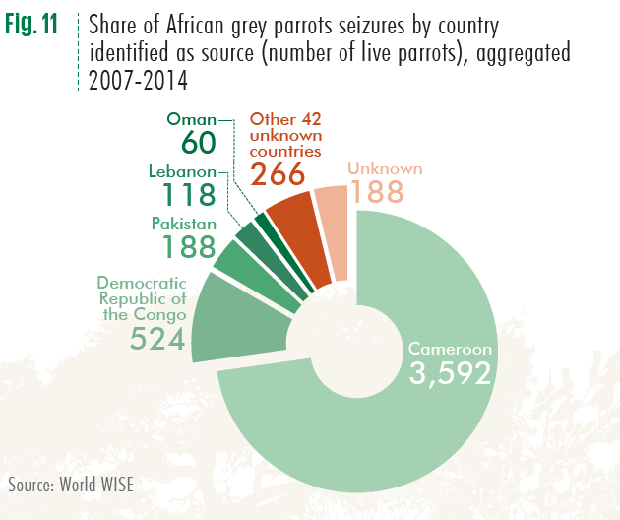
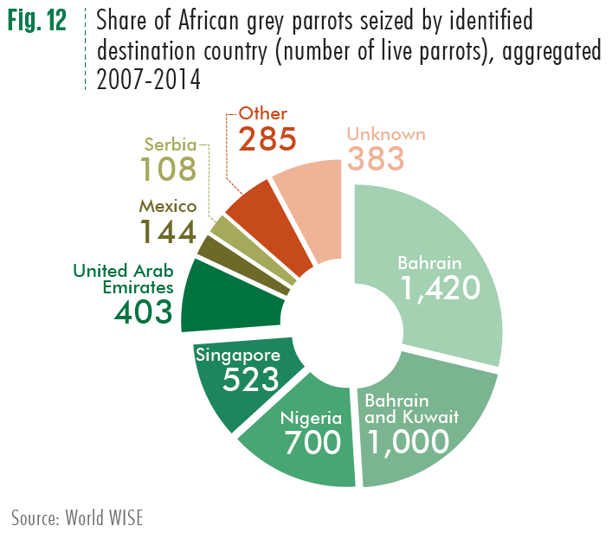

Slide 16
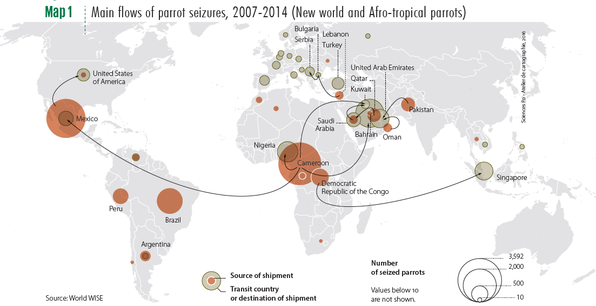
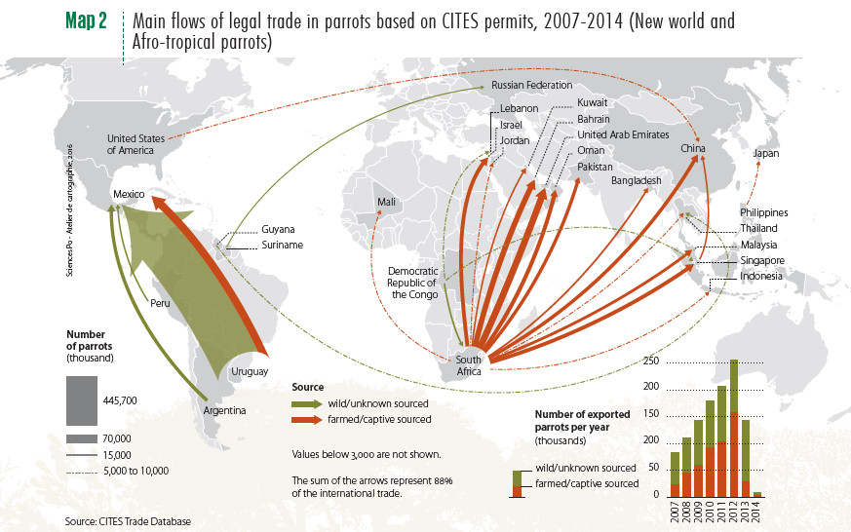

Slide 17
National statistics can be improved with data from other countries and can help national authorities to address the problem

Slide 18
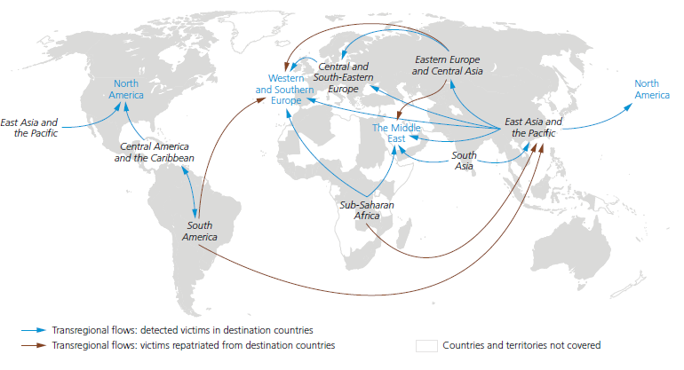
Main destinations of transregional flows and their significant origins, 2012-2014
16 % of all victims detected in Western and Southern Europe are from Sub Saharan Africa, especially West Africa

Slide 19
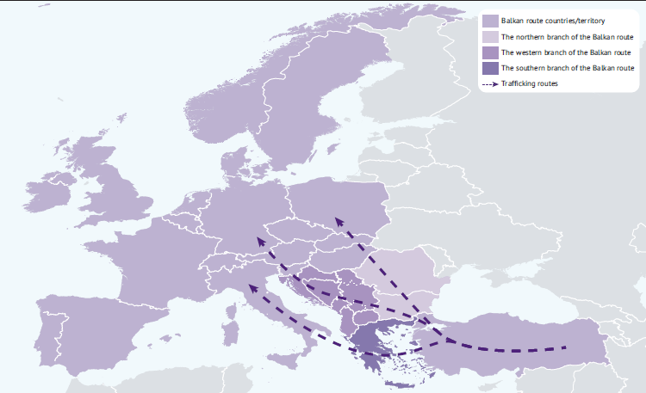
In some cases national statistics can not be compiled without information from other countries: IFF

Slide 20
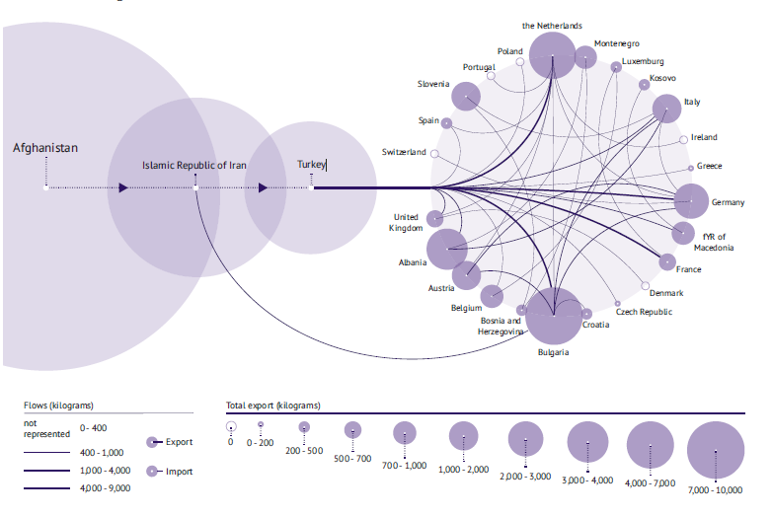

Slide 21
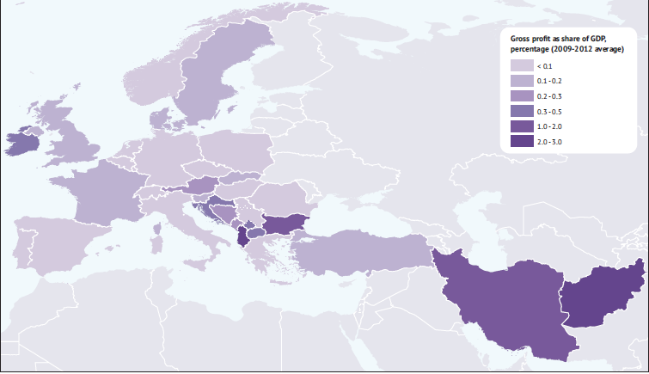
Gross profit as a share of GDP (percentages) in the Balkan route countries/territory, 2009-2012 average

Slide 22
Innovative ways to estimate the hidden number of human trafficking victims
Multiple Systems Estimate (MSE)
Based on at least 2-3 lists of detected and recorded victims
Kind of capture/recapture methodology
In the pilot phase: in the Netherlands ten times more victims than those recorded
Network-scale approach
Population-based surveys
More suited for “origin” countries
In the design phase

Slide 23
Conclusions
Need for regional and global data exchange
From national data to regional and global analysis
The role of NSOs:
Ensure quality
Coordinate different data providers (police, ministries of justice, NGO (TiP victims), boarder control agencies)
Test new survey and other estimation methodods

Slide 24
Thank you for your attention

