Slide 1
10th Tranche UN Development Account Programme (DA10)
Bolster Data for the SDGs:
UNSD Capacity Building Initiatives
Session 5
Sub-regional workshop on data disaggregation for SDG Indicators
24-27 October 2017, Victoria, Seychelles

Slide 2
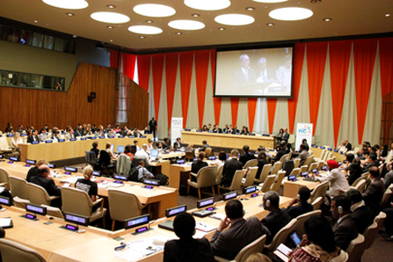
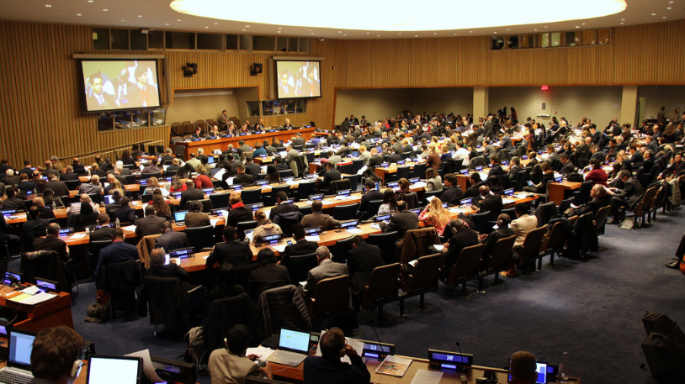
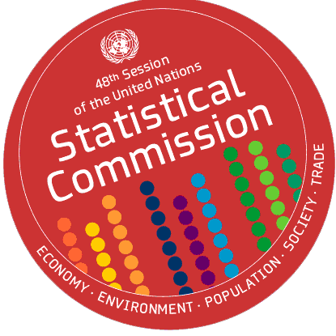
193 Member States
54 Member States
Indicators
24 Member States
Liaison Group
HLG
Capacity Development
IAEG
Methodology & Standards
22 + 1 members
26 + 1 members

Slide 3
HLG-PCCB High-level Group for Partnership, Coordination and Capacity-building
HLG-PCCB tasked with:
Provides leadership for SDG indicators implementation process
Promotes national ownership and fostering capacity-building, partnership and coordination
Fosters the modernization and harmonization of data infrastructures
Provides guidance on the content and organization of the United Nations World Data Forums
Composition of the HLG-PCCB:
22 Member States
Africa: Angola, Rwanda, South Africa, Senegal, Morocco
Chair of the Statistical Commission (Brazil)

Slide 4
Cape Town Global Action Plan (CT-GAP) for Sustainable Development Data
Framework for the design and implementation of country-led statistical capacity building activities necessary to achieve the 2030 Agenda
Consists of key actions under six strategic areas:
Coordination and strategic leadership
Innovation and modernization of NSS
Basic statistical activities and programmes
Data dissemination and use
Multi-stakeholder partnerships
Resource mobilization
Developed by HLG-PCCB and launched at the 1st UN Data Forum in Cape Town, South Africa in January 2017
Adopted by the Statistical Commission at its 48th Session in 2017

Slide 5
UN World Data forum (UN-WDF)
Recommendation from the United Nations Secretary-General’s Independent Expert and Advisory Group: “A World That Counts”
Platform for cooperation, dialogue and partnership with the data community, users, the civil society and stakeholders
1st UN-WDF hosted by Statistics South Africa from 15 to 18 January 2017 in Cape Town
Six thematic areas:
New approaches to capacity development for better data
Innovations and synergies across different data ecosystems
Leaving no one behind
Understanding the world through data
Data principles and governance
The way forward
1,400 participants, over 80 sessions and 322 speakers

Slide 6
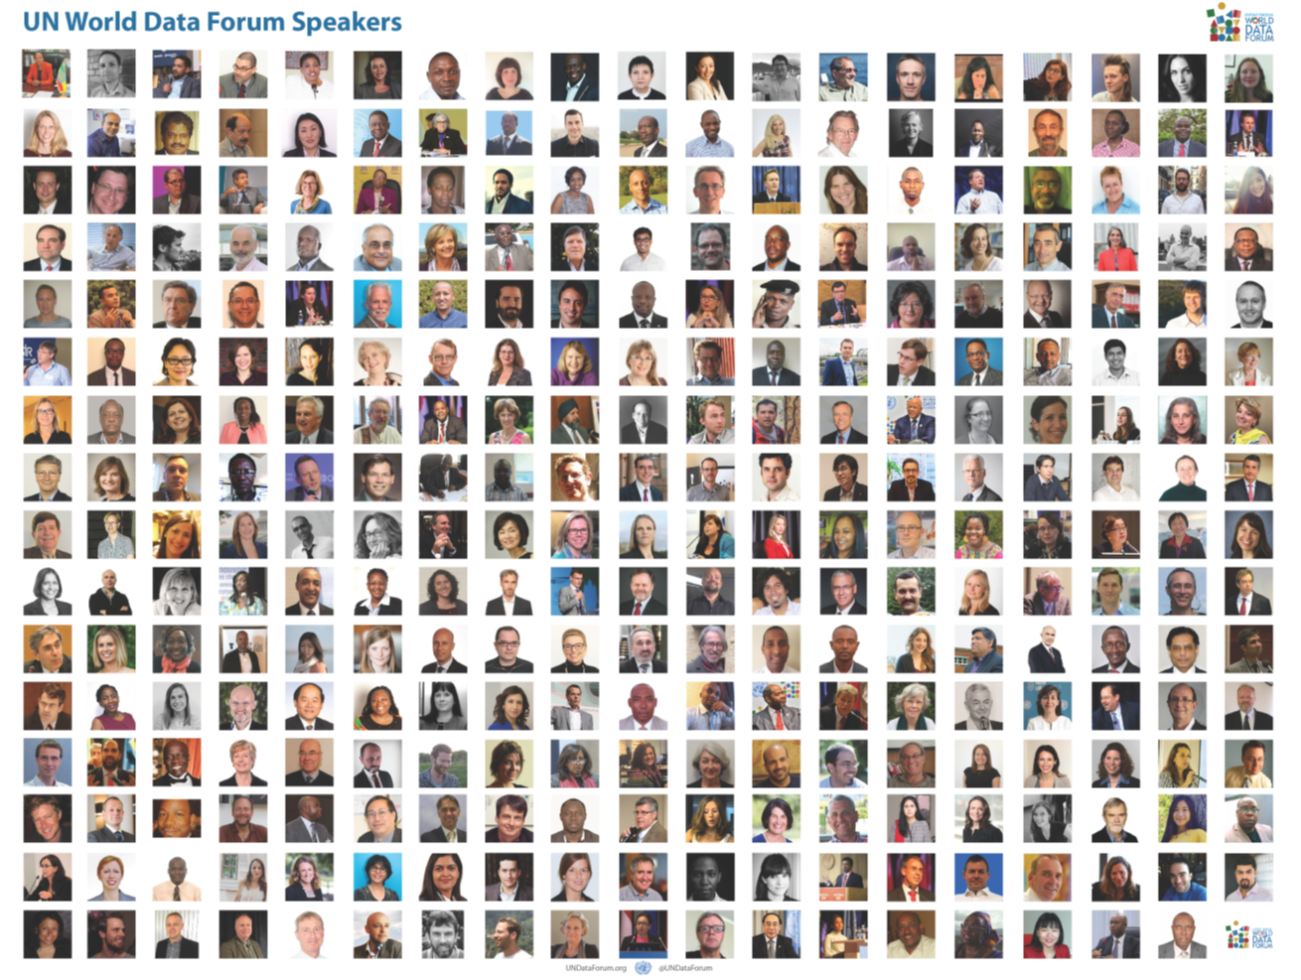

Slide 7
10th Tranche Development Account Programme on Statistics and Data (DA10)
Objective:
To strengthen the statistical capacity of developing countries to measure, monitor and report on the sustainable development goals in an accurate, reliable and timely manner for evidence-based policymaking
Principles:
Adapt to the needs of the countries and the evolving agenda
Build on comparative advantages of and close cooperation between the Development Account implementing entities
Build on existing initiatives and programmes (coordination)
Encourage external participation and funding (partnership)

Slide 8
DA10: activities and deliveries
Regional, sub-regional and national workshops / seminars / trainings
Expert group / technical group meetings
Advisory services / country missions
Guidelines / methodology / tools
Training material / e-learning / case studies / best practices
DA10: budget and timeframe
USD 10M
Sept 2017 – Dec 2019
Subsequent tranches of DA could complement or extend the DA10
DA10: 10 implementing entities
Global: UNSD, UNEP, UNODC, UNCTAD, UN-Habitat
Regional: ECA, ECE, ECLAC, ESCAP, ESCWA

Slide 9
DA10 Structure and Related Initiatives and Tools
Global Action Plan [HLG-PCCB]
Framework for reflection, planning, and implementation of statistical building programmes to achieve the scope and intent of the 2030 Agenda.
Transformative Agenda for Official Statistics
Environmental pillar
Social & demographic pillar
Economic pillar
Guidelines to support SDG country reporting [UNDG]
Global Indicator Framework - Tiers I / II / III [IAEG-SDGs]
Means of Implementation
1
2
3
4

Slide 10
Other Key on-going UNSD Projects
Development Account 9 (DA9)
Enhancing national statistical capacity to measure, monitor, assess and report on progress on achieving post-2015 goals and targets for sustainable development
Supporting Member States in developing and strengthening environment statistics and integrated environmental-economic accounting for improved monitoring of sustainable development
UNSD-DFID project on Monitoring the SDG
Making Sustainable Development Goals indicators available to the broadest possible audience
Strengthening capacity of partner countries in the compilation and use of these indicators

Slide 11
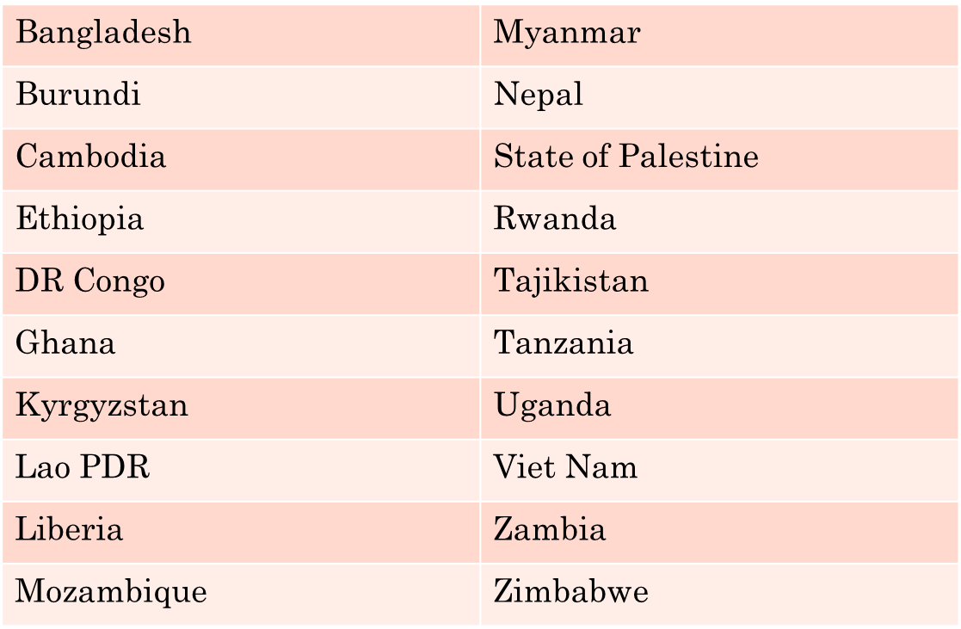
UNSD-DFID project on Monitoring the SDG /1
Project countries:

Slide 12
UNSD-DFID project on Monitoring the SDG /2
Major Activities:
Research and analysis of country capacities
Develop National SDGs Monitoring Strategies
Create or upgrade national repositories of SDG indicators
Technical assistance; missions; workshops at national and international level; study visits
Development of the SDG Data and Visualization Platform/Country Data Lab; setting up automated data exchange

Slide 13
Other Global Initiatives Institutional, organizational and technical capacity for Sustainable Development Data
To regularly review and update the Global Indicator Framework and related metadata
To produce an implementation guide for the Cape Town Global Action Plan
To organise and facilitate the 2nd UN-WDF to be held in October 2018 in Dubai, United Arab Emirates
To update the 3rd edition of the Handbook of Statistical Organization
To revise the Generic National Quality Assurance Framework (NQAF) and its Guidelines
To review the current implementation guidelines of the Fundamental Principles of Official Statistics
…

Slide 14
For questions and comments:
Gabriel Gamez | Inter-regional Adviser
Organisation and management of NSSs | Statistics Division
Department of Economic and Social Affairs | United Nations
2 UN Plaza | Room DC2-1676 | New York, NY 10017, USA
Email: gamezg@un.org | Tel: +1-917-367-5443 | Cell: +1-646-944-3735
Notes:
14

