Slide 1
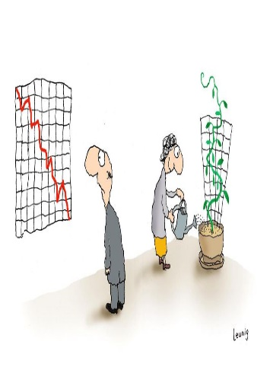

Data Disaggreagation for SDGs
Geospatial Context
United Nations Economic Commission for Africa
___________________
Geoinformation & Spatial Statistics
___________________
Andre Nonguierma
United Nations Regional Workshop on the 2020 World Programme p
Dar-es-Salam, Tanzania
12 April 2017

Slide 2
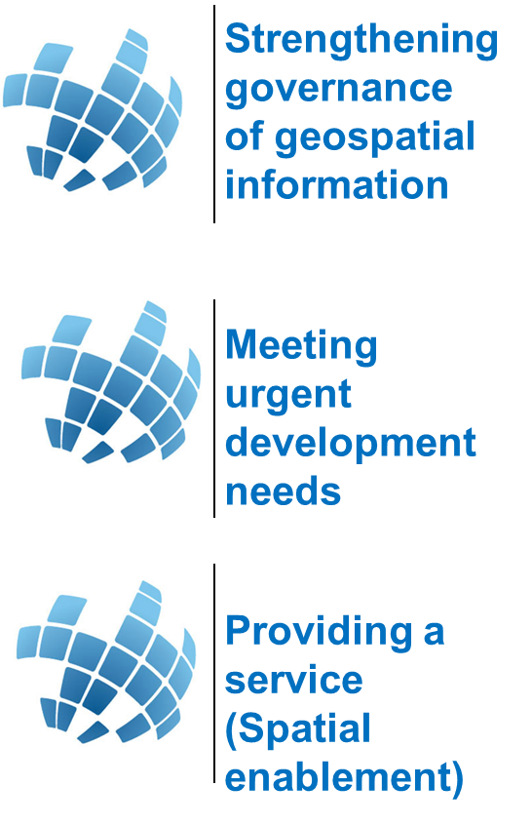
Outlines – Spatially-Enabled Statistics
A right decision making requires the gathering and reviewing of up-to-date, cold &hard facts.
For the facts to be interpreted, understood, and linked to our goals and to our decisions, this needs to bring together data linked with the one thing they have in common: Location (Where)
Overview
Everything that happens, happens somewhere over space and time
Most decisions need to be anchored to geography
Where is “it”?
How far is A from B?
What is the extent/territory of some phenomenon?
How do I get from A to B?
What areas are suitable for a certain activities?
Purpose
in the 2010 round, has drastically changed census cartographic methodology in areas including, and not limited to: the use of mobile devices, satellite imagery and Global Positioning System; sampling frames, address register and field verification methods.
The presentation aims to raise awareness of the benefits of geospatial tools in dealing with timeliness and data quality issues, which will encourage and provide the basis for policy dialogue on the use of the technology between decision makers, geospatial information specialists, and other stakeholders.
Issues and Challenges
Availability
Finding the appropriate information at the required time and at the relevant scale of aggregation.
Accessibility
Even where information is available, it may not be easily accessible, either because of the lack of technology for effective access or because of associated costs
Transformability
There is a general lack of infrastructure capacities for the collection and assessment of data, for their transformation into useful information and for their dissemination.
Governance
There is also need for improved coordination among environmental, demographic, social and developmental data information, applications and services.
Data Disaggregation
Updating the Enumeration Areas
Post-enumeration:
GIS, Census Database, Web maps, Atlases
Visualize, analyze, present and disseminate census results:
Used during analysis as a unit for aggregation / disagregation
Report generation by different levels of administrative units (Admin 1(State/region), Provinces, District, …EA.)
Web maps used for dissemination of census results
Resulted in gains in timeliness, accuracy and effectiveness of the census operation
Permitted data disaggregating (by geography) to the lowest administrative unit
Way Forward
..
Policy : Institutional mechanisms aligned with national efforts, while taking into account international perspectives
Data democracy : Ubiquitous availability of relevant spatial data/information as common goods. Adhering to agreed standards : metadata, data models, encoding, interoperability
People : High Level Education to empower African youth in geospatial science and technology culture at all education levels (schools, universities)

Slide 3
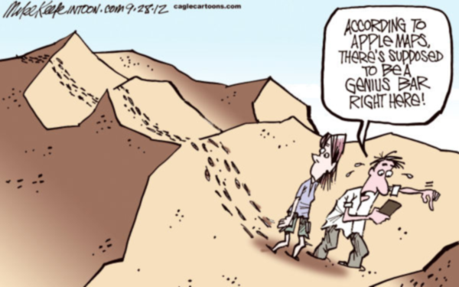
Why We Need Geography: Unleashing the Power of ‘Where’
◆
Everything that happens, happens somewhere over space and time. And everything time is related to
  80% of all human decisions involve a “Where?” question
You cannot count what you cannot locate
  Location affects nearly everything we do in life
A right decision making requires the gathering and reviewing of up-to-date, cold &hard facts.
  For the facts to be interpreted, understood, and linked to our goals and to our decisions, this needs to bring together data linked with the one thing they have in common : Location (Where)
❖
⬥

Slide 4




The Policy Drivers : Global Need for Spatially-Enabled Complex Information
Economic, social, and environmental challenges facing governments require innovation and collaboration
Data/Information is key enabler for development policy
Achieving sustainable development require reliable information at global, regional and local level.
A right decision making requires the gathering and reviewing of up-to-date, cold &hard facts.
For the facts to be interpreted, understood, and linked to our goals and to our decisions, we need to bring together data linked with the one thing they have in common : Location (Where)
2020 Round of Censuses
UN Principles & Recommendations for Population and Housing Censuses, Rev.3, “… to ensure complete integration of statistical and geospatial information…” (para. 349, UNSD, 2015)
Agenda 2063
The Africa We Want
National Development Plan

Slide 5
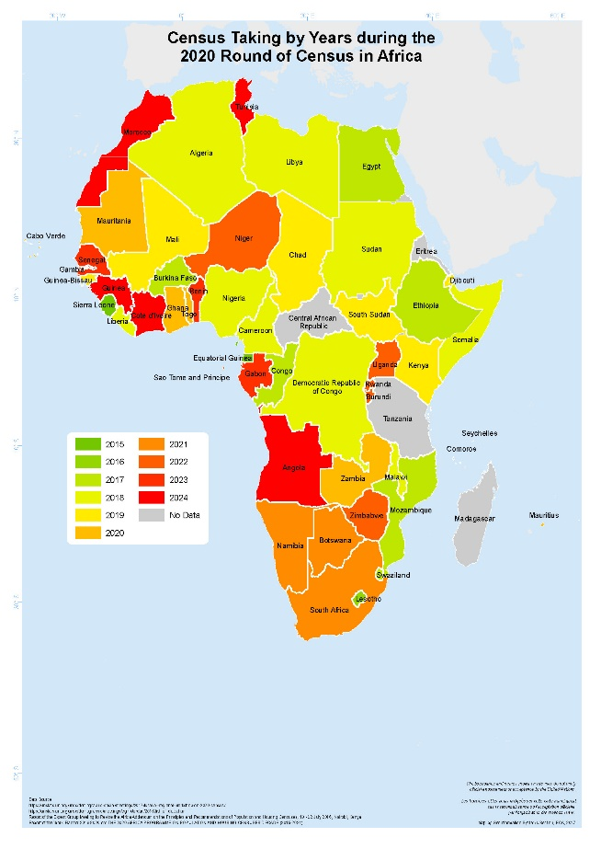
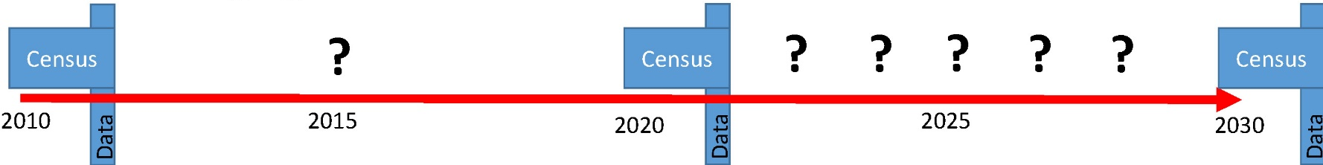
The Challenge : Counting and Locating
National census data will continue to be our most important data source
Provides denominators and numerators for all SDGs, and requisite subnational detail
But, the 2015-2030 SDG period typically includes just one census data point
And in some settings the situation is more challenging

Slide 6
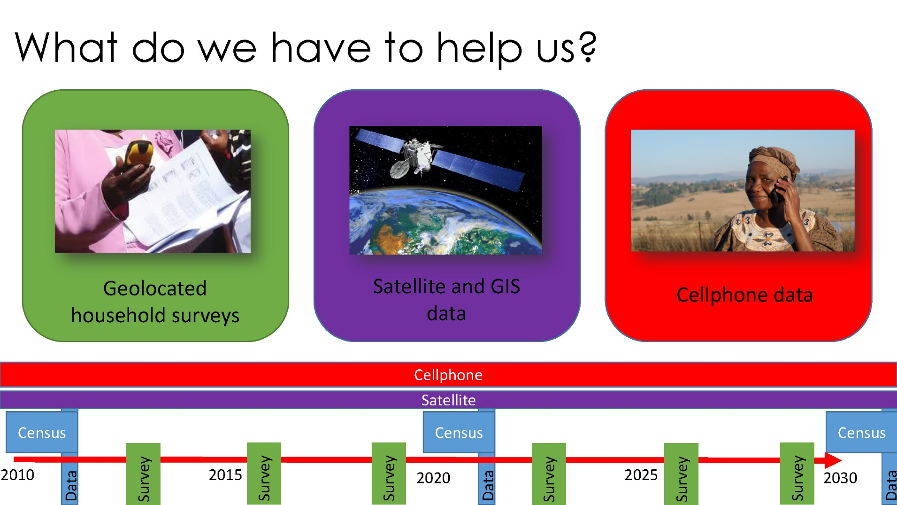
Challenges : Counting in Real Time : Spatially-Enabled Surveys
All SDGs are based on ensuring a certain percentage of the population has access to specific services or resources, or achieves a certain level of social, economic, or environmental health
Need for accurate, subnational, ongoing data on denominators
Translating complex cycle of data acquisition, processing, analysis, visualisation and decision making into real time monitoring and management
Geospatial industry is moving from analyzing and presenting discrete data sets towards working with streams of spatially-enabled data (e.g. real time location-based mobile services).

Slide 7
Status of Mainstreaming Geospatial into Statistical Processes
How can we get there with census data plus these newer datasets?
The question is no longer about the ingestion of geospatial technology, but what are some of challenges and commonalities in Africa
Aerial Photography | 37%
Satellite Images | 65%
GIS | 67%
GPS | 67%
GPS
Degree of ingestion
GIS
Enable tabulations and spatial aggregations to be referenced to any small geographic or administrative subdivisions and, if possible, population grids.
Fundamental role in the creation of Enumeration Area (EA) maps for a seamless collection of census data
Satellite
Imagery
For most census applications, 5m or better spatial resolution is needed to identify housing units.
Aerial
Photograph
Seamless mosaic coverage of very large part of a territory and that can be used for census cartography and other analytical processes.
Time

Slide 8
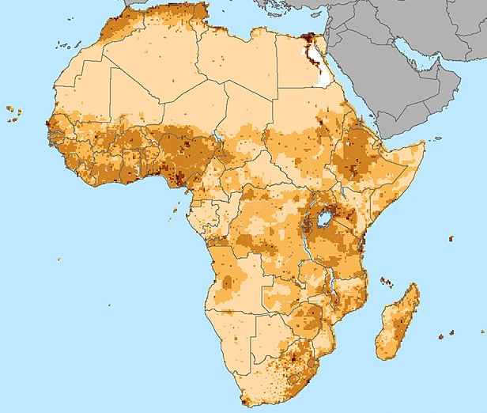
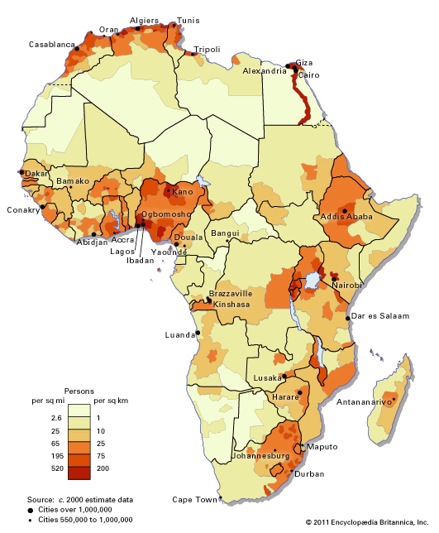
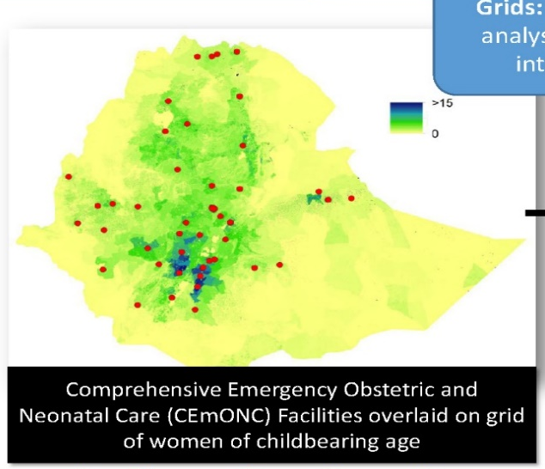

Benefits of Geospatial technology : Building Fundamental Data [Demographic Gridding]
As data in itself –geospatial data is used directly for the indicator construction (geospatial data = indicator)

Slide 9
Benefits of Geospatial technology : Deconvolution [Du Global au Local]
Post-enumeration:
GIS, Census Database, Web maps, Atlases
Visualize, analyze, present and disseminate census results:
Used during analysis as a unit for aggregation / disaggregation
Report generation by different levels of administrative units (Admin 1(State/region), Provinces, District, …EA.)
Web maps used for dissemination of census results
Resulted in gains in timeliness, accuracy and effectiveness of the census operation
Permitted data disaggregating (by geography) to the lowest administrative unit

Slide 10
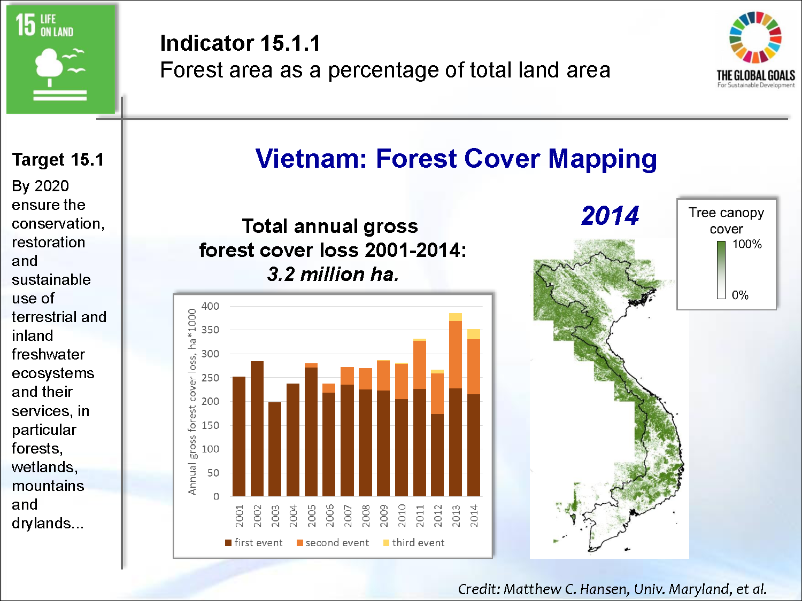
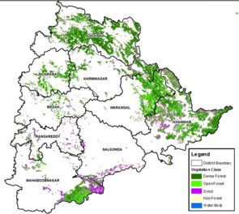
Benefits of Geospatial technology : Looking at the spatial variability [Forests]
To monitor the SDGs we need accurate, up-to-date and reliable information
One single data entry for country does not reflect the reality.
The proposed SDGs, indicated the importance of geospatial information technology to get disaggregated data to reflect the subnational spatial differences.
Data Needed
High repetition rates to acquire large data coverage in short time periods, which will lead to improved consistency, accuracy, timeliness and thematic detail of forest maps for e.gNFI, GHG, illegal logging
•High spatial resolution to assess also forest stands with low canopy closure and map small disturbances of forests and forest degradation (MMU < 1 ha)
•High spectral resolution with dedicated bands (red–edge) to discriminate between forest and spectrally similar vegetation types
100% of forest cover
0% of forest cover

Slide 11
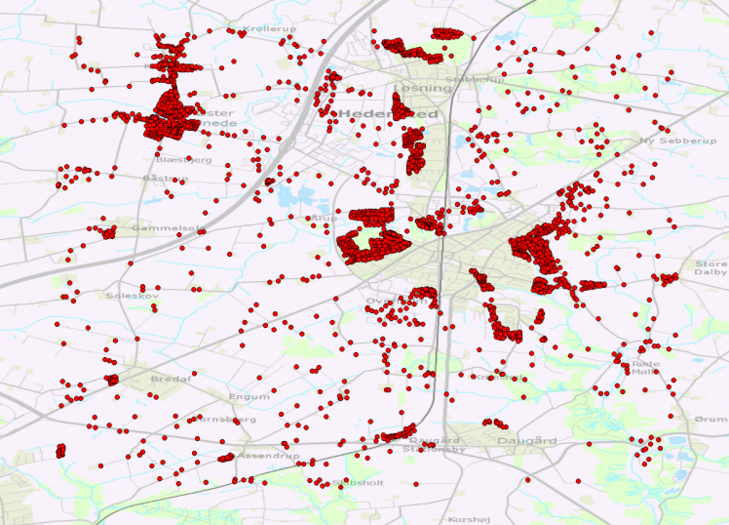
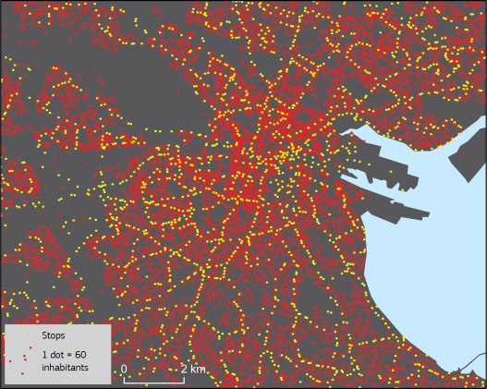
Benefits of Geospatial technology : Enriching statistical data [Infrastructures]
Geospatial analysis
Target 11.2 indicator example
11.2.1. Proportion of the population that has a public transit stop within 0.5 km
Data sources needed:
•Population distribution (grid/addresses)
–include data on a spatially detailed distribution of residential population inside the cities or regions.
•Road network
–The roadsegments should include attributes allowing for a selection of streets accessibleby pedestrians.
•Public transport data
–the location of stops and stations (frequency of departures at these stops)

Slide 12
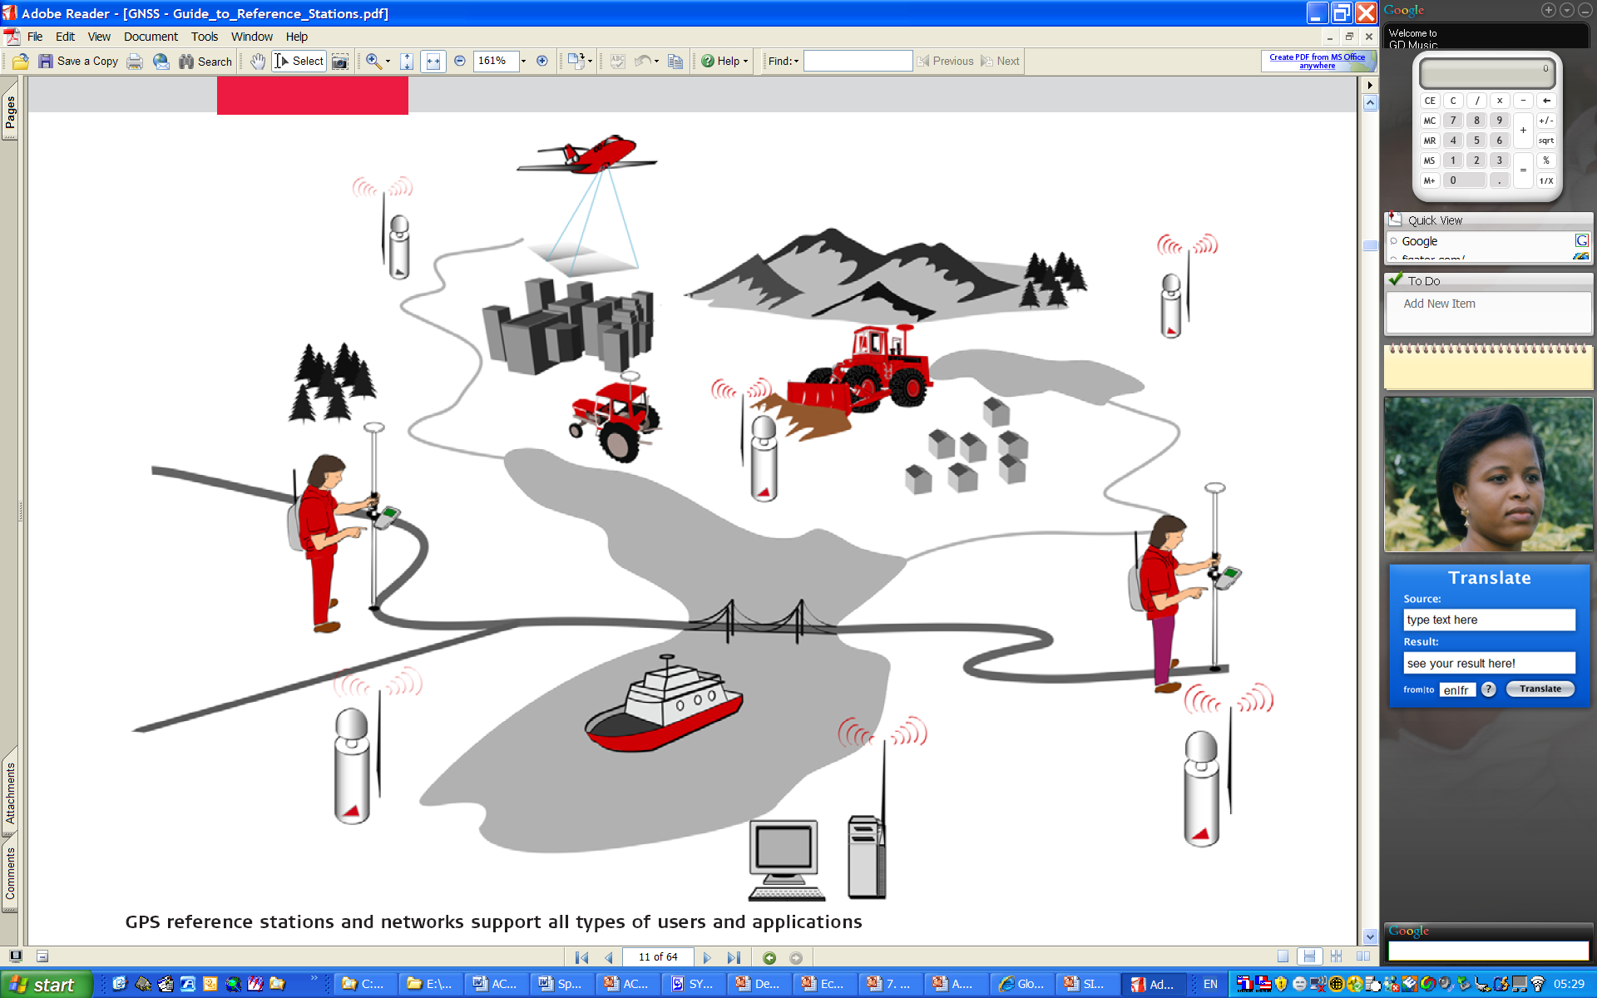
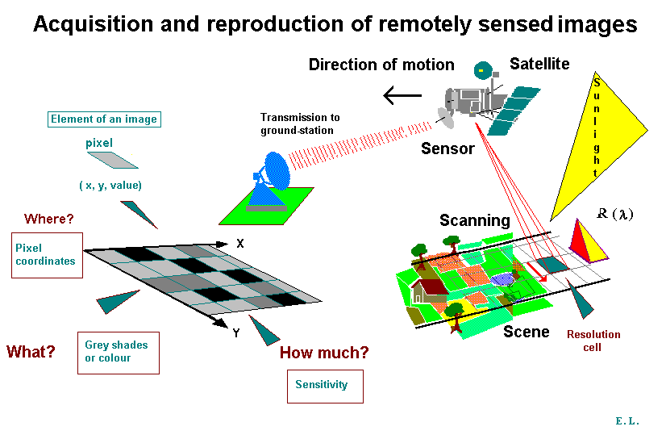
What we Have to Helps Us… GIT
Three different technologies that are all related to mapping features on earth
GPS | More accuracy in data collection Recording locations
GIS | Data analysis and visualisation Data mining into information, knowledge and decision-making
RS | Primary data acquisition Data processing Data interpretation

Slide 13
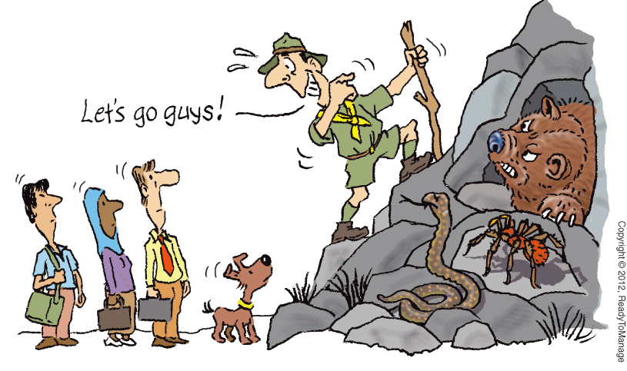

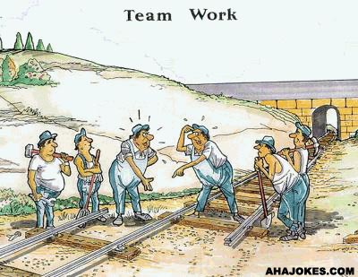


Nexus Issues in Linking Geography an Statistics
systems: most countries in Africa lacked the address register system, most streets have no names/street addressing system
Lack of suitable base maps in scale and currency
Lack of coordination: there is no linkages between the statistical systems and the geospatial systems and infrastructures
Duplication of Effort: the statistical offices create their own data on administrative boundaries and topographic maps
Cooperation
institutional arrangements for operationalizing an integrated and coherent approach with other information infrastructures
Leadership
Leadership: Establishment of effective national leadership
Resources
Mobilization of resources needed to effectively produce development information
Capabilities
Member States capabilities to ensure geospatial data, products and services are readily available

Slide 14
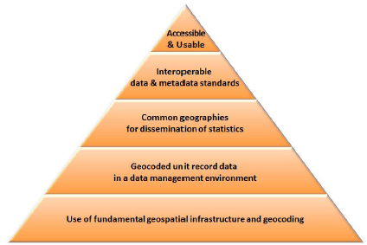
Avenues for Future Prospect:
A Global Statistical Geospatial Framework
Integration of Statistical and Geospatial Information : Overarching Principles
Mainstreaming the enabling capabilities of geospatial technology into National Statistics Offices activities (all the way through training, data and processes)
Linking NSDs and NSDI: National statistical, planning and cartographic authorities have effective collaboration between them in the development of respective data infrastructures and systems.
Principle 5
(Analysis, policy impact)
Demand for small geography data.
More frequent data.
Policy impact
Principle 4
(Technical standards, data sharing)
ISO Standards
OGC Standards
Statistics Principles
Principle 3
(Output geographies )
Standard geographic administrative boundaries (province, municipality, etc.).
Tips:
High-level framework
Not a one-size-fits-all
Start anywhere
Principle 2
(Unique identifiers)
No PIN.
Link mainly through the geography.
Geography not always standardised.
Principle 1
(NSDI, Seamless integration)
Policies
More institutional
Political leadership and support

Slide 15
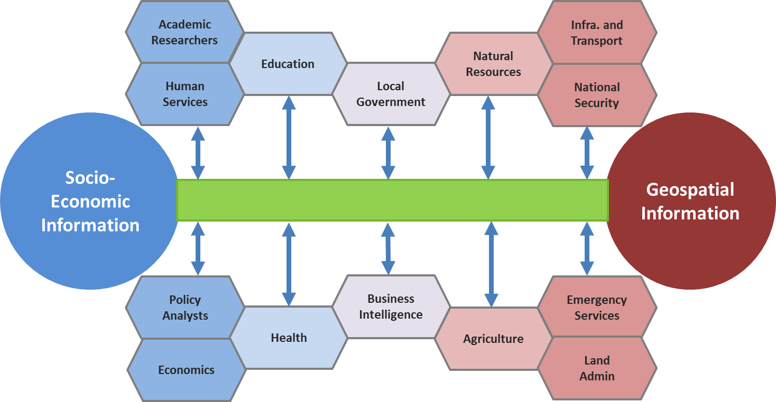
Quick Wins : Information Infrastructure
A New Paradigm : The National Development Information Infrastructure (NDII)
  The foundational, authoritative and up-to-date spatially-enabled statistical information that are consistently available and accessible over time for informed decision-making at the local, national, regional, and global levels.
The Global Statistical Geospatial Framework
  Integration of geospatial and statistical information, NSDI and NSDS Linked
SALB Project :
  Building, updating and sharing common administrative boundaries.
2020 Round of Censuses
  Promote Geospatially enabled censuses in Africa. Build geo-referenced dwelling frame

Slide 16

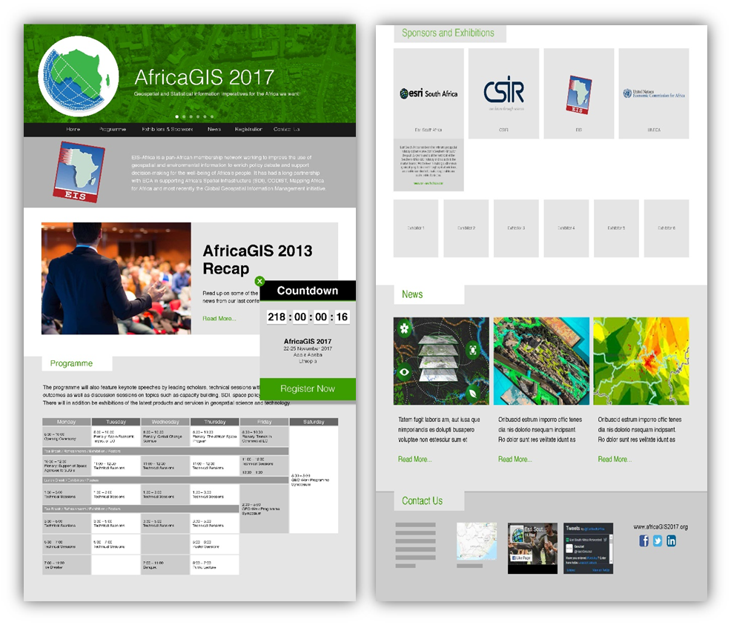
Everything that happens, happens somewhere over space and time
AfricaGIS 2017 Conference
20-24 November 2017
United Nations Conference Center, Addis Ababa, Ethiopia
www.africagis2017.org
http://geoinfo.uneca.org/sdiafrica/
https://twitter.com/UNGGIMAFRICA
https://www.facebook.com/UN-GGIMAfrica-1160537057297511/

