Slide 1
Slide Title
National Experiences and Challenges in producing Disaggregated Data
October, 2017
Sheena Saldanha
Statistician
National Bureau of Statistics

Slide 2
Contents
Introduction
National Statistical System
Importance of disaggregated data for SDGs
Disaggregated Data and Data Sources
Challenges
Opportunities and Way forward

Slide 3
Introduction
The National Bureau of Statistics (NBS) was established in July 2010, under the new National Bureau of Statistics Act, 2010 and operates as a semi- autonomous government agency.
The Bureau is responsible for collecting, compiling, analyzing and publishing statistical information.
In addition, the bureau is also responsible for coordinating, monitoring and supervising the National Statistical System.
The Bureau produces a variety of data ranging from economic, social, population and environmental matters, covering government, business and the community.

Slide 4
Introduction
Mission
Continuously build and develop a coherent, reliable, efficient and demand driven “National Statistical System” to encourage and support informed decision and policy making.
Vision
Become the centre of excellence in production and dissemination of statistics in Seychelles.
Objectives
Strengthen and assist in the development of the National Statistical System (NSS) to meet the challenges of emerging data needs;
Improve the quality of our products and services and be the primary source of “official statistics”; and
Improve data dissemination.

Slide 5
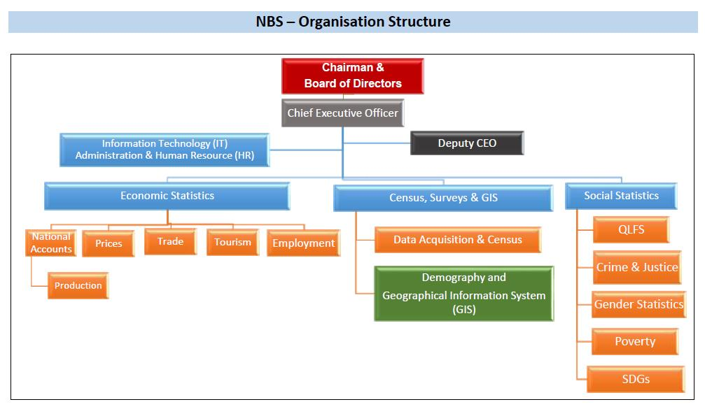
Introduction
NBS comprise of 3 sections with different units: ‘Economic Statistics’, ‘Census,
Surveys and GIS’ and ‘Social Statistics’ units

Slide 6
Introduction
Role of NBS is to actively promote the UN Fundamental Principles of Official Statistics (FPOS) which was adopted by the Statistical Commission 1994.
As per FPOS, focus on data sources are stipulated in:
Principle 5
Data for statistical purposes may be drawn from all types of sources, be they statistical surveys or administrative records. Statistical agencies are to choose the source with regard to quality, timeliness, costs and the burden on respondents.

Slide 7
National Statistical System
NBS works in close collaboration with other official bodies that form the National Statistical System (NSS).
The NSS is a framework within which all units which generate information play their part and complement each other’s work through exchanges of information, standards, frameworks based on international recommendations
The NSS regroups all Seychelles government agencies and official bodies in a coordination role in regard to statistical activities.

Slide 8
National Statistical System
NBS
Other Statistical Units
Users & Producers of Statistics

Slide 9
National Statistical System
The National Bureau of Statistics (NBS)
is at the apex of the
National Statistical System
Key Partners in Economic Statistics compilation
Seychelles Revenue Commission (SRC)
Central Bank of Seychelles (CBS)
Ministry of Finance, Trade and Economic Planning
Parastatal Organisations
Immigration Department
Businesses
Key Partners in Social Statistics compilation
Individuals and Households
Civil Status Office
Ministry of Health
Ministry of Education
Ministry of Land Use & Housing
NSS

Slide 10
Importance of disaggregated data for SDGs
Based on the 2030 Agenda towards the Sustainable Development Goals (SDGs), disaggregation needs to be applied when relevant across all indicators, in line with the targets themselves.
“SDG indicators should be disaggregated where relevant by income, sex, age, race, ethnicity, migratory status, disability and geographic location, or other characteristics, in accordance with the Fundamental Principles of Official Statistics.”
The “leaving no one behind” principle means that goals and indicators should have full coverage for all stakeholders, especially for vulnerable groups such as the disabled.

Slide 11
Disaggregated Data and Data Sources
Primary data: (Statistical surveys)
Available disaggregated data | Data Sources
Age | Population & Housing Census & household surveys
Sex | Population & Housing Census & household surveys
Geographical Location | Population & Housing Census & household surveys
Nationality | Population & Housing Census
Employment | Population & Housing Census, Labour Force & other household surveys
Education | Population & Housing Census & household surveys
Unemployment | Household Surveys
Disability | Population & Housing Census & Surveys
Household head (female or male headed household) | Population & Housing Census & household surveys

Slide 12
Disaggregated Data and Data Sources
Administrative data:
Available disaggregated data | Data Sources
Education Enrolment (Age & Sex) Teaching staff (Sex and Nationality) | Ministry of Education
Vital Statistics (Age & Sex) | Ministry of Health and Civil Registration Office
Health (In-patient / Out-patient and other health indicators) (Age & Sex) | Ministry of Health
Employment (Sex & Local/Expat) | Treasury Payroll & Parastatals
Crime, Justice & Security Statistics (Age & Sex) | All CJS related agencies (Police, Prison, AG’s Office, Judiciary, Family Tribunal, Employment Tribunal)
Migration | Immigration records

Slide 13
Challenges
Deliver on increasing demand for the availability of relevant, timely, disaggregated and better quality statistics with limited resources
Periodicity of data collection and reporting (administrative data providers)
Human resource constraint and lack of suitably qualified staff
Methodological constraints – need to train all personnel involved in producing data to conform to international statistical standards and methodology
Detecting data deficiencies from administrative sources e.g. misclassifications, missing data, duplications
Lack of modern mechanism/capability to collect, store and manage large volumes of data
Limited budget to meet increasing costs to collect and analyse data e.g. internet costs, investment in IT equipment and infrastructure and software
Administrative source data collection tool: Some stakeholders do not initially collect disaggregated data – need to improve data collection tools
Confidentiality and sensitivity: Obtaining disaggregated data from key stakeholders, companies and institutions may be a problem due to the nature of the business (e.g. various monopoly companies, sole sellers of goods, in Seychelles – not willing to cooperate)

Slide 14
Opportunities and Way forward
Transformation & Modernisation - Foster the optimal use of information technology and meet the increasing demand for statistics e.g. automation of data collection and compilation
Capacity reinforcement - Recruit more qualified staff and increase capacity building in relation to international statistical standards and methodology (within the NBS and other agencies in the NSS)
Stakeholder engagement: Continue working with stakeholders on producing/updating data collection forms
Quality control: Inform administrative sources on quality issues detected with their data and assist them resolve these for future and long lasting improvements
Obtain financial support to meet increasing survey costs (costs of data collection and processing)
Consider other sources of data captured by the private sector to overcome data gaps
Maintain working collaboration with key stakeholders, companies and institutions and communicate strategically to reassure them of maintenance of confidentiality of information provided
Strengthen coordination of the National Statistical System to ensure consistency, timeliness and production of better quality statistics
International cooperation and collaboration required UNECA / AUC Support –partnership

Slide 15
Thank you!

