Slide 1
Statistical Capacity Development
at the World Bank
Gero Carletto
Development Data Group
The World Bank
UNECA – Sixth Statistical Commission for Africa
(StatCom-Africa-VI)
Addis Ababa, 1-4 October 2018

Slide 2
The WB’s agenda on statistics
Statistical standards and tools
E.g. ISWGHS, IAEGs, ...
Improve statistical capacity of member countries
Financing: Grants (TFSCB, SRF-CF); Lending (IDA; IBRD); Reimbursable Advisory Services (RAS)
Support for NSSs/NSDS formulation
Training (on-the-job and classroom)
Technical Assistance
Household surveys (Survey design, CAPI)
National Accounts (Re-benchmarking, Implementation of QNA)
Innovations in statistics
WBG/GPSDD Support for Data Innovations under TFSCB
Gero Carletto
Manager, LSMS - Development Data Group

Slide 3
WBG SCB levels and trends: large- and small-scale financing
Large-scale support trending upwards
IDA/IBRD/SRF: 36 active projects, $766m committed, another $176m identified in new projects
Smaller-scale support remains significant
TFSCB: $35 million in active projects (~40 %) goes to Sub-Saharan Africa.
TFSCB: 12 AFR projects to test innovative collaborations in data production, dissemination, use.
Gero Carletto
Manager, LSMS - Development Data Group

Slide 4
TA provided by DEC EconStat
DEC EconStat is increasing its role as a provider of TA
TA in National Accounts
Ongoing (and increasing)
TA on specific issues, including rebasing, has over the last few months been provided to Comoros, Djibouti, Madagascar, Mauritania, Senegal, Tanzania, …
TA on Economic Surveys and Censuses
New initiative (pilot), joint with WBG lending operations
Will cover 8-10 countries in Africa over the next 2 years
ICP
Linking ICP capacity-building activities with statistical capacity
for SDG monitoring.
Gero Carletto
Manager, LSMS - Development Data Group

Slide 5
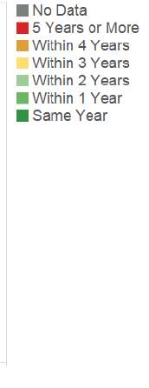
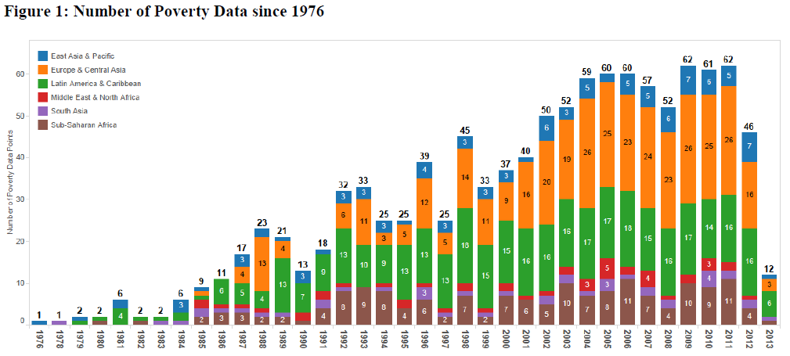
Ending Poverty Data Deprivation
In October 2015 World Bank’s President’s Jim Kim pledged to focus the Bank’s effort towards ending poverty data deprivation by working with countries and international partners to ensure that all the poorest nations conduct high-quality household surveys on a regular basis.
77 of 155 countries data deprived
2002–11: 29 countries had no poverty surveys while 28 countries had only one such survey
Where such data is available, long intervals between surveys
Lack of harmonization, comparability
Gero Carletto
Manager, LSMS - Development Data Group

Slide 6
Since JYK’s pledge ...
TFSCB – Pilot Household Survey Window
About $16m
Support to 40+ countries, 21 in SSA
$11m for data collection
$5m for TA
Significant increase in lending for stat operations supporting household surveys: 14 IDA and 4 IBRD for more than $650m
In FY18
Support to 60 countries (34 in SSA)
19 new surveys (10 in SSA)
Gero Carletto
Manager, LSMS - Development Data Group

Slide 7
Selected Capacity Development Initiatives
Partnership for Capacity Development in Household Surveys for Welfare Analysis
Global Rural and Agriculture Integrated Surveys Partnership
LSMS-ISA ... and now “50 by 30”
Gero Carletto
Manager, LSMS - Development Data Group

Slide 8
Final thoughts ...
Support and financing for statistical capacity development has increased substantially
So far, focus on selected priority areas
Big push to support household and farm surveys
Moving towards more systemic approach and support broader package of statistics
Working through regional institutions to amplify country engagement and increase impact
Gero Carletto
Manager, LSMS - Development Data Group

Slide 9
THE END

