Slide 1

PARTNERSHIP FOR CAPACITY DEVELOPMENT IN
HOUSEHOLD SURVEYS FOR WELFARE ANALYSIS
Eighth Meeting of the Forum on Statistical Development in Africa (FASDev-VIII)

Slide 2
C4D2-Training: Motivation
Household surveys source of one third of SDGs indicators
Also, main source of data for policy formulation especially in low & middle income countries.
However, survey data often suffer from low availability, poor quality and limited use
Data not easily comparable across countries as a result of lack of harmonization and standardization of survey methodologies.
The Partnership aims at supporting institutional and capacity development in household surveys for welfare analysis.
Launched in June 2017 with 9 participating institutions.

Slide 3
The Partnership
Notes:
The initial partner institutions are as follows: -
World Bank
Bank of Italy
Italian Ministry of Foreign Affairs and International Cooperation
Italian National Institute of Statistics
Italian National Institute of Health
African Center for Statistics – UN Economic Commission for Africa
Eastern Africa Statistical Training Centre
École Nationale Supérieure de Statistique et d’Économie Appliquée

Slide 4
C4D2-Training: The approach
Work with regional statistics training centers in SSA to further build capacity of trainers/instructors on household surveys (ToT)
Harmonize courses on household surveys across the training centers especially for welfare analysis
Hands-on experience through internships among participating institutions
Organize short courses at the regional training centers with participants from NSOs or NSS
Organize thematic workshops

Slide 5
C4D2-Training
One-year old initiative
Initial funding from Italian Government (AICS and BofI) and WBG
Two main courses are organized per year
Generally held in Italy – but will be held elsewhere as well
Courses based on Training of Trainers (ToT) approach
Build upon experience from the LSMS & other nationally representative surveys focusing on welfare analysis
Targeting instructors from the training centers

Slide 6
C4D2-Training: Progress to date
Recent topics include:
  Designing Household Surveys for Poverty Measurement
  Computer Assisted Personal Interviewing & Geo-referencing in Household Surveys using Survey Solutions
44 trainers/instructors have attended the courses so far
Training material posted on the website
Course syllabi on household surveys harmonized for the two training centers

Slide 7
C4D2-Training: Looking forward
Bi-annual courses (Dec 2018 & May/Jun 2019)
Dec course: Measuring Income and Wealth in household surveys
Short courses at the regional statistics training centers with participants from the NSOs (Nov 2018)
Thematic Workshop on Gender-disaggregated data from Household Surveys in collaboration with Data2X and AGROST secretariat (Dec 2018/Jan 2019).
Internship of the C4D2 training participants to the C4D2 (Oct 2018 & Mar 2019)
Continue to collaborate with AGROST in areas relating to training on household surveys

Slide 8
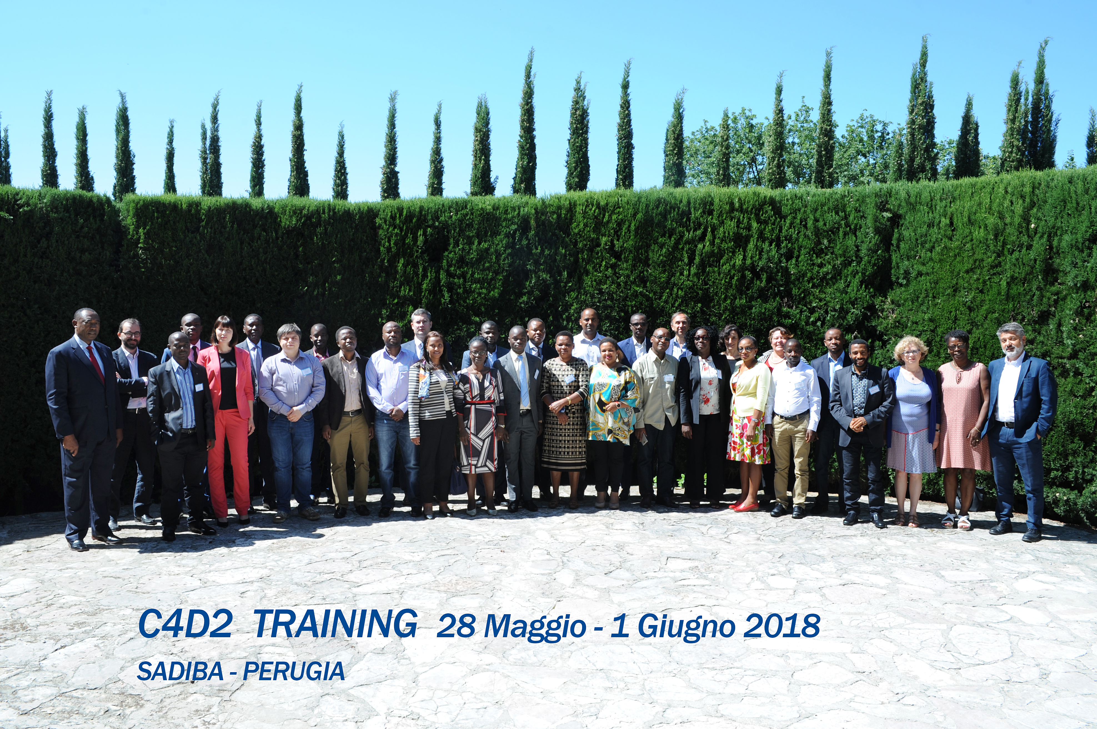
C4D2 Training

Slide 9

GLOBAL RURAL AND AGRICULTURE INTEGRATED SURVEYS PARTNERSHIP

Slide 10






Global Rural and Ag Integrated Surveys Partnership
A partnership to ...
  Increase capacity of national data systems and personnel to conduct integrated farm and household surveys and analyze survey data
  Improve methodologies for integrated surveys
  Increase availability and use of agricultural survey data
  Raise awareness and fundraise for ag statistics
Based at C4D2 in Rome
Gero Carletto
Manager, LSMS - Development Data Group

Slide 11

LSMS-ISA and “50 by 30” Initiative

Slide 12
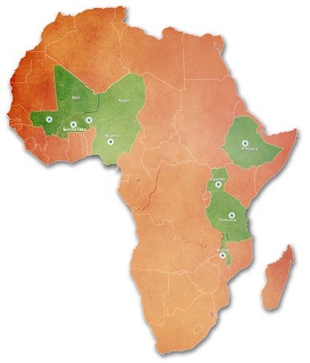
LSMS – Integrated Surveys on Agriculture (LSMS-ISA)
Working on four fronts:
Support countries in SSA in the collection & dissemination of multi-topic household survey data with a focus on agriculture
Improve methods in agricultural statistics based on rigorous experimentation and tool development
  Promote policy research in agriculture and rural development
  Build capacity in the production, analysis and dissemination of household survey data
Gero Carletto
Manager, LSMS - Development Data Group

Slide 13
LSMS – Integrated Surveys on Agriculture (LSMS-ISA)
Capacity development through on-the-job, classroom training and regional workshops
Since 2009, 26+ surveys, which ...
    Are integrated into national statistical systems
    Are nationally & regionally representative
    Track households & individuals
    Geo-reference household & plot locations
    Collect individual-level data
    Use field-based data processing (CAPI)
    Are open access
    To date, 40k+ data download and around 1k research papers published
Gero Carletto
Manager, LSMS - Development Data Group

Slide 14


The “50 by 30” Initiative
Building on WB’s LSMS-ISA and FAO’s AGRISurveys, SDG2 Donor Platform launched last week at UNGA “Data to End Hunger” aka “50 by 30 Initiative”
Coalition of bilateral and philanthropies, multilateral, countries and private sector
Objective: support 50 countries by 2030 in improving agricultural statistics (focus on SDG2: ag productivity and income)
Innovative financing model, using $200m pledge by donors to leverage additional $300m from countries, multilateral and private sector resources.
WB pledged to support countries through access to IDA resources and other ag investment projects
Gero Carletto
Manager, LSMS - Development Data Group

