Slide 1
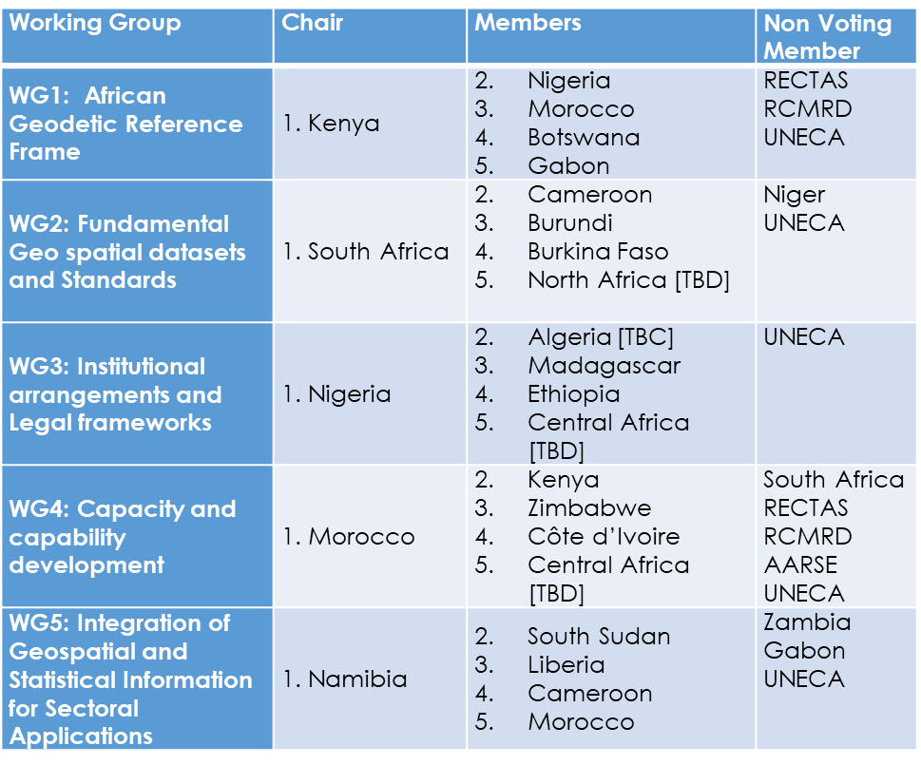
The African Action Plan : Mechanisms & Frameworks
UN-GGIM:Africa Pillars
SDI : Frameworks with related policies & structures
FDS : Fundamental Geospatial Datasets
AFREF : African Geodetic Reference Frame
SALB : Second Administrative Level Boundaries
GeoNyms : Geographic Names
Geo-Stats : Locate - Count
UN-GGIM Asia-Pacific
(2012)
UN-GGIM Africa
(2015)
UN-GGIM
Arab States
(2014)
UN-GGIM Americas
(2013)
UN-GGIM Europe
(2014)
Japan
ROK/Mongolia
China
Ethiopia, Burkina
South Africa, Morocco, Cameroon, ECA
Saudi Arabia
Algeria
Jordan
Mexico
Chile
Mexico
Sweden
Netherlands/
EuroGeographics
WG 1
Geodetic Reference Frame for SD
WG 1 Geodetic infrastructure Standards
WG
Institutional, Legal, Policy
WG
NSDI
European Commission
+ Eurostat
WG 2
Data Sharing & Integration for Disaster Mgt
WG 2
Fundamental Datasets and Standards
WG
Fundamental Data & Geo Standards
WG
Integration
Stat & Geo
Euro
Geographics
WG 3
Place-Based Information for Economic Growth
WG 3
Institutional
& Legal
WG
Geodetic Reference
WG
Regional Coordination & Cooperation
WG A
Core Data
WG 4
Capacity Building
WG
Integration Stat&Geo
WG
GI in DDR
WG B
Data Integration
WG 5
Integration of Geospatial & Stats
Working Groups

Slide 2
Challenges and Issues for Discussion
Making the WGs more effective
Why the WG are not fulfilling their functions? – Need for Evaluation
What are the best means of communication? Face-to-face meetings, WebEx, Online Platform – Need for a modus operandi
Matching the Terms of Reference
Are the current terms of reference fitting to the mandate?
Is the current membership fitting-for-purpose?
Engaging the WGs
Participation to the work of various Expert and Working Groups at global level: Updates, issues and opportunities.
Translating the African action plan into concrete actionable projects

