Slide 1
UN-GGIM:Africa
Meeting Objectives
United Nations Economic Commission for Africa
___________________
UN-GGIM: Africa
___________________
Andre Nonguierma
UN-GGIM:Africa 2018
Addis Ababa, Ethiopia
03 October 2018

Slide 2
A Continued Vision…
Coordinated approach for cooperative management of geospatial information that adopts common regional standards, frameworks and tools
Management of global geospatial information to address key global challenges including Sustainable development, climate change, disaster management, peace and security, and environmental stresses
Intergovernmental Process where the Member States play the key role
2017
UN-GGIM
Africa
Phased Approach
2014
UN-GGIM
Action Plan
Strategy for integration GIS & Stats
8/2015 - UN-GGIM-4 Resolution 5/112
Endorsed the formal establishment of the Regional Committee of UN-GGIM: Africa and welcomed UNECA as the Regional Committee’s Secretariat
2013
CODIST
Recommends that the oversight and supervisory functions of the geoinformation subcommittee of CODIST be transferred to an equivalent subcommittee of StatCom Africa with the name of GGIM-Africa.
2001
CODI.II
2001 – CODI.II
Resolution urging Member States to adopt National Spatial Data Infrastructures (NSDI) and Regional SDI (ARSDI)
Time

Slide 3
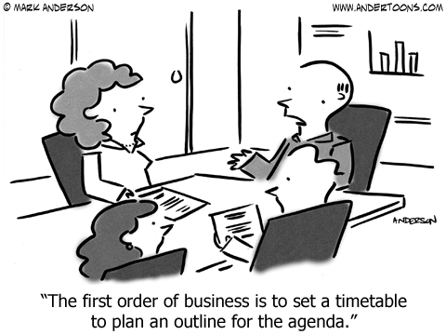
Meeting Objectives
Review progress achieved on the recommendations and actions of UN-GGIM: Africa previous meetings.
Share knowledge and best practices on development of geospatial information in the continent
Raise awareness on the benefits to be derived through the utilization of geospatial information for sustainable development
Look at policies, measures and steps that African countries could take to ensure a successful implementation of the UN-GGIM initiative in the region
Promote networking among institutions and practitioners
Generate synergy at national level to facilitate its management
Ensure linkages with partners and other regional subcommittees.

Slide 4
Topics to be considered
Governance and functional mechanisms for the management of UN-GGIM: Africa
Engendering participation of Member States at the UN-GGIM national, regional and global levels.
Alignment and prioritization of the regions work programme with that at the global level and also in line with the United Nations global agenda. Africa participation to the work of various Expert and Working Groups: Updates, issues and opportunities.
Defining the means of implementation of the activities outlined in the Action Plan of UN-GGIM: Africa.
Engaging the Working Groups to effectively develop activities on the ground.
Strategy for resources mobilization

Slide 5
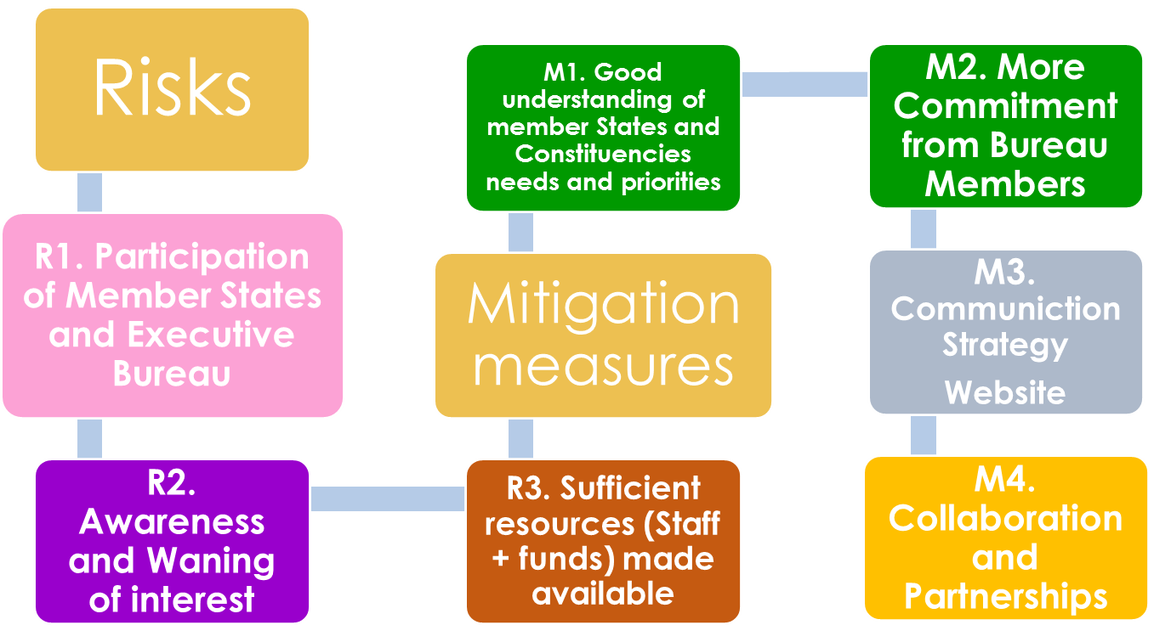
Expected Outcomes
Ensure that Africa region delivers its remit in achieving the UN-GGIM vision globally.
Contribute to consolidate the consensus and drive the political will
Strengthen and align specific needs and interests of Africa with international mechanisms
Encourage and facilitate the integration of statistics with geospatial information efforts.
Review the Executive Boards and Working Groups Structures.

Slide 6
Organization of Work : Pre-Events
1-2 October 2018
Partners & Industry: Presentation of innovative information resources.
Working Group closed meetings
Executive Board Consultative Meeting
Joint Sessions with StatCom-Africa

Slide 7
Organization of Work : Day 1
Opening : Welcome remarks & Good Will Message
UN-GGIM: Africa Chair
Director, ACS/ECA
African Union Commission
UN-GGIM Secretariat
Adoption of agenda and organization of work
Setting the Scene ▪ Report of UN-GGIM: Africa ▪ Meeting Objectives and Expected Outcomes ▪ Statutory and Governance Issues
Technicalities: Geospatial Information Management in Africa
IGIF
Geospatial Policies
National Experiences
UN-GGIM: Africa Key Pillars : SDI, SALB, AFREF, etc.
Discussions

Slide 8
Organisation of Work : Day 2
Joint Plenary with StatCom : Integration of Statistical and Geospatial Information
Working Groups Discussion Outcomes : Outlook and Perspective
Lessons learnt from best practices
Recommendations
Wrap-up and Reporting
Joint Closing Session with StatCom

Slide 9
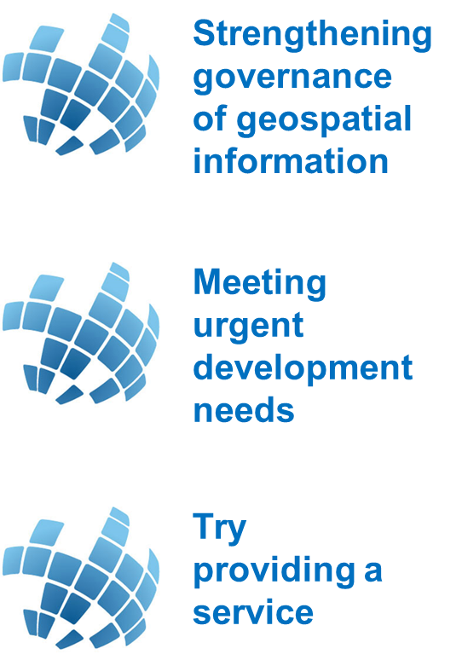
Thank You….

