Slide 1
2018 MALAWI POPULATION AND HOUSING CENSUS
BE COUNTED.LEAVE NO ONE BEHIND
BY
MRS. MERCY KANYUKA
COMMISSIONER OF STATISTICS, MALAWI NATIONAL STATISTICAL OFFICE
SEPTEMBER 2018

Slide 2
PRESENTATION OUTLINE
Brief background to 2018 Malawi Population and Housing Census
Preparations
Implementation
Field operations
Success stories
Challenges

Slide 3
BRIEF BACKGROUND
Like many countries, Malawi, conducts Population and Housing Census (PHC) every 10 years
National Statistical Office (NSO) in the Ministry of Finance and Economic Planning conducts censuses on behalf of the Malawi Government
Malawi conducted first comprehensive census in 1966, and subsequent ones were conducted in 1977, 1987, 1998, 2008
2018 Malawi PHC was conducted from 3-23 September under the Theme: Be counted. Leave No One Behind

Slide 4
PREPARATIONS
Preparations for 2018 PHC commenced in 2015
Developed comprehensive Census Plan and budget which was approved and funded by Malawi Government and development partners
Using high resolution satellite imagery, NSO mapped and demarcated Malawi into 42 census districts and 19,000 Enumeration Areas (EAs)
NSO successfully sought technical assistance from US Census Bureau early 2017
Developed new data collection application tool called Computer Assisted Personal Interview (CAPI) which was used during 2018 PHC
Procured state-of-art Server as Data Centre which was mounted at Head Office.
Procured the power backup system to support the server 24/7 without any power interruptions.
Installed 24/7 CCTV cameras to ensure security for PHC server and other materials

Slide 5
Data Centre Server

Slide 6
Solar Panels – For Power Backup System

Slide 7
Hybrid Power Inverter and Batteries

Slide 8
Mapping Equipment – Computer and Plotters

Slide 9
Satellite Images Field Maps

Slide 10
CCTV CAMERAS AT NSO HEAD OFFICE

Slide 11
PREPARATIONS’……………………….
Procured 20000 census tablets and 25,000 census materials (bags, reflectors, t/shirts, caps) and several boxes of chalk and tie-on-labels
15,000 tablets and solar power banks were procured by UNFPA (DFID/ UK Aid funding) and loaned to NSO. They will be shipped to Zambia early next year
Both CAPI tool and the whole census methodology were pretested and piloted in 10 districts in 2015 and all went perfectly well
In a phased approach, recruited 85 district supervisors (DSs), 485 control centre supervisors (CCSs), 4000 field supervisors (FSs)and 19,000 enumerators
Hired one Communications Consultant whose role was to coordinate and facilitate all communications/publicity activities for the census
Developed very comprehensive Communications Strategy which has Implementation Plan, Monitoring Plan & clear Crisis Communication Plan
Developed 2018 PHC logo which was used on all materials as part of census branding and marking

Slide 12
2018 MALAWI PHC LOGO

Slide 13
IMPLEMENTATION
Officially launched 2018 PHC publicity and countdown campaign on 6 June 218
Conducted 300 community-based sensitization meetings (one in each Traditional Authority/Chief’s area)
Conducted PHC community education sessions in all 28 districts using Ministry of Information public address (PA) system
Produced radio programmes that were aired through 15 different stations that included 5 major national stations and 10 community radios
Produced and aired TV jingles and programmes through 3 Malawi TV stations

Slide 14
OFFICIAL LAUNCH

Slide 15
IMPLEMENTATION CONT’……………
Produced various print materials that were disseminated even in the remotest parts of Malawi (posters, flyers, leaflets, media briefs etc.)
Produced and aired special TV and radio National Address by Malawi’s President, His Excellency Prof. Arthur Peter Mutharika who called all people living in Malawi to be counted

Slide 16
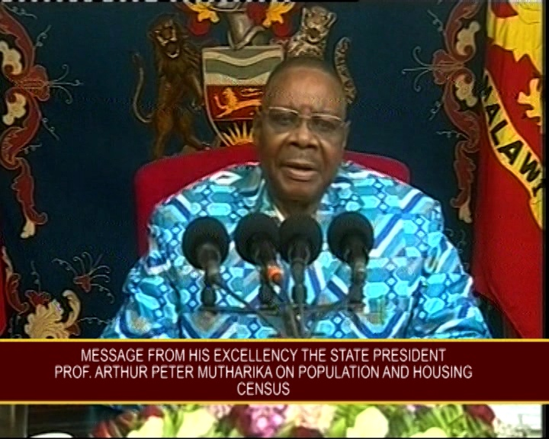
MALAWI’S PRESIDENT, PROF. MUTHARIKA GIVING TELEVISED ADDRESS ON 2018 PHC

Slide 17
TRAINING AND FIELD OPERATIONS
Trained 85 DSs, 500 CCSs, 4000 FSs, 19,000 enumerators in CAPI and field logistics
Each DS was responsible for about 6 CCSs; and each CCS was supervising 8-9 FSs; and each FS was supervising 5 enumerators
The 23,000 enumerators and field supervisors were recruited, trained and deployed to work in their home areas.
Each enumerator was responsible for one enumeration area (EA) of 200-300 households
Hired/sourced 600 vehicles that were deployed country-wide for DSs and CCSs
2018 PHC was conducted from 3-23 September + few days to cater for call backs
Data was being synchronized by each CCS and sent to NSO Server on daily basis

Slide 18
SUCCESSES STORIES
Use of digital census (tablets) proved to be real-time and cost-effective
Data capturing was faster and efficient
Data transfer to NSO Central Office was instant
No recruitment of data capturing assistants which was costly in past censuses
Recruitment and deployment of enumerators from their home areas proved to be efficient
Acceptability of enumerators among traditional leaders and community members was very high (as enumerators were locals too)
Enumerators had high accessibility to households (they knew people and households well and were able to continue working even after 5:00 pm)

Slide 19
SUCCESS STORIES CONT’……………
Use of community radios to disseminate PHC messages enhanced massive awareness
Community members were able to understand PHC messages easily as they were aired in a particular language(s) common around that radio station
Locals were able to related with various characters that were featured in various publicity programmes
Engagement of the State President to speak about PHC provided prominence to 2018 PHC
Local leaders were motivated to mobilize their subjects to be counted
Citizens were also eager to be counted following the President’s call

Slide 20
CHALLENGES
Boundary wrangles among traditional leaders in certain villages that forced Malawi National Statistical Office to temporarily stop counting in few areas until such issues were amicably resolved
Increased call-backs mainly in low density areas (cities and major towns) that forced Malawi National Statistical Office to extend enumeration period by about 3 days to ensure that every person was counted
Delays in the payment of training and field allowances due to incorrect bank accounts submitted by enumerators

Slide 21
WAY FORWARD
Data cleaning and analysis to start immediately
Release of preliminary results (Population by Age by Sub-district) mid December 2018 (Tabulation plan already prepared)
In time for preparation for Elections in May 2019
Main report – April 2019 (Tabulation Plan ready)
Thematic reports (Fertility, Mortality, Housing, Gender, Youth, Elderly, Disability, etc) by Dec 2019

Slide 22
THANK YOU

