Slide 1
Sub-regional workshop on integration of administrative data, big data and geospatial information for the compilation of SDG indicators for English-speaking African countries 23-25 April 2018, Addis Ababa, Ethiopia
On Non-traditional data sources:
A Handbook on the role of Civil Society in enhancing the scope of official statistics
Joseph Tinfissi ILBOUDO, Chief, Statistical Development Section
Khogali Ali khogali, Statistician, Statistical Development Section

Slide 2
CSOs as a Package of Resources
NSS
Complementary data
CSO
Advocacy
Validation
Funding
Technical Expertise
Notes:
CSOs can enhance the role of NSS by providing complementary data in the data production process;
CSOs can be seen as a source of funding for the production of official statistics, especially in areas where they have specific interest (e.g.: child labour in labour force studies – support from organisations that have interest);
CSOs as a source of technical expertise, especially in instances/areas where they may have greater expertise than the NSO;
Advocacy: CSOs taking an advocacy role in terms of sensitizing communities to participate in statistical data collection processes.
CSOs as (secondary) Source of Validation for NSOs: CSOs will help to counter-check and validate data collection sources, methods and findings of studies conducted by NSOs.

Slide 3
CSOs as a Package of Resources
CSOs as a Shaper
Contribution from CSOs would influence NSS into more human-centred, socially-oriented measures of national performance;
In the long run it could have a bearing on policy directions and frameworks of the key indicators used to measure progress;
Evaluation and monitoring deprivation and poverty levels in society.
Capturing social indicators;
Providing data on interventions on critical and untapped areas in society (e.g.: counter-terrorism, peace and security);
Shaping units of observations of the national statistical process.
Notes:
Facilitate the data collection;
Provide information in domains where NSS doesn’t have any;
Improve the accessibility to the statistics;
Improve the relevance of the statistics;
Improve the response rates
Provide feedback reports on uses and quality of the data.

Slide 4
CSOs as a Package of Resources (Cont.)
CSOs as Enabler
Increased visibility of government on the state of affairs, providing a fairer picture on major developmental issues;
Increases the credibility of data gathered, investors’ confidence and public trust, which in essence will positively affect the cycle of national statistical systems, especially at the data consumption end improving knowledge management and shared information.
Notes:
Facilitate the data collection;
Provide information in domains where NSS doesn’t have any;
Improve the accessibility to the statistics;
Improve the relevance of the statistics;
Improve the response rates
Provide feedback reports on uses and quality of the data.

Slide 5
Background
Handbook on the role of Civil society Organizations (CSOs) in statistical process [UNECA,2017].
https://ecastats.uneca.org/acsweb/LinkClick.aspx?fileticket=8LIcmc7Yd8I%3d&tabid=1375&portalid=0&mid=3268
Why there is a need to develop this handbook?

Slide 6
Justification of developing a handbook on the role of CS in statistical process
Mainstream CSOs data sources into NSS
Integrate, coordinate and disseminate data provided by CSOs in National Statistical Systems
propose mechanisms for integrating and coordinating the contribution of CSOs to NSSs;
Facilitate CSOs to use official statistics to support greater citizen participation in socio-economic and transparent political processes;
Advocate to users for the effective and efficient use of official statistics in the performance of their activities and the critical delivery of their services in the context of the implementation of development agenda including the Sustainable Development Goals, as well as to make official statistics provided by the CSO at the level of the NSSs and statistical authorities.

Slide 7
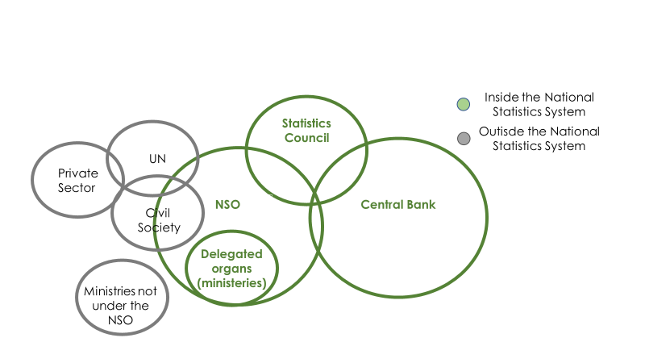
Mainstreaming CSOs within the NSS
The Handbook propose a model that will accommodate CSOs within the NSS in order to overcome the constraints of the existing models.

Slide 8
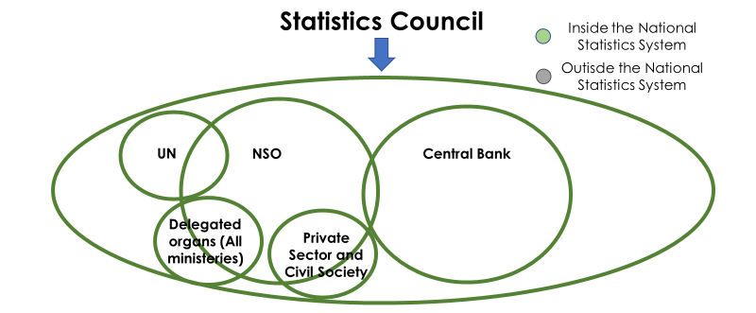
Mainstreaming CSOs within the NSS: Proposed Model: Vision of the handbook
This model requires a constant improvement in the coordination of the national statistical system, with adequate funding and sufficient human resources and effective support to the sectors.

Slide 9
The role the CSOs in enhancing the scope of the NSS
CSO
Relevance
Quality
Data collection
Accessibility
Others
CSOs are important players in the process of producing statistics, although most of the time they are not recognized as producers of official statistics.
Notes:
Facilitate the data collection;
Provide information in domains where NSS doesn’t have any;
Improve the accessibility to the statistics;
Improve the relevance of the statistics;
Improve the response rates
Provide feedback reports on uses and quality of the data.

Slide 10
Handbook content
Chapter II
The Context of Production of Statistics in Africa
Agenda 2063, SHaSA II, SDG, Busan Action Plan, Marrakech Plan of Action
Data Revolution, Big Data and Cartography
Chapter III
The Legal and Institutional Framework
Chapter IV
The Role of CSOs and NSOs on National, Regional, and Global development agenda

Slide 11
Handbook content
Chapter V
The Role of Civil Society Organizations as Data Producers
Mechanisms needed to link CSO to be component within NSS
Capacity requirements are needed for CSOs to channel their data to be a component of official statistics
Chapter VI
The Role of Civil Society Organizations as Users of Statistics
Chapter VII
Partnerships of Civil Society Organizations and National Statistics Institutes
CSOs perspective on Partnerships
NSOs perspective on Partnerships

Slide 12
CSOs as a non-traditional data source; CSOs and Data revolution
NON-TRADITIONAL DATA SOURCE (BIG DATA)
DATA
INFORMATION
STATISTICS
NOT OFFICIAL STATISTICS
Compliance with the Fundamental Principals for Official Statistics
Compliance with the National Statistics System Law
Producer must be inside the National Statistics System
Produced/Used in accordance with Concepts, classifications, and methodologies to be approved.
OFFICIAL STATISTICS
Notes:
The handbook articulates how CSOs can contribute to official statistics through the notion of Big data as shown in the following diagram

Slide 13
The way forward
The final version of the handbook will be share with all NSOs of our member states for their piloting and feedback
It is envisaged that UNECA and development partners to encouraging the countries in Africa in implementing the guidelines and recommendations contained in the handbook

Slide 14
Thank You

