Slide 1
The Global Statistical Geospatial Framework and the Global Fundamental Geospatial Themes
Sub-regional workshop on integration of administrative data, big data
and geospatial information for the compilation of SDG indicators
Addis Ababa, Ethiopia. 23-25 April 2018
United Nations Economic Commission for Africa

Slide 2
The 2030 Agenda
Declaration
Vision and shared principles for people, planet, prosperity, peace and partnership
Results Framework
17 integrated and indivisible goals and 169 aspirational targets
Follow-up and Review
Global indicators underpin an integrated follow-up and review framework
Means of implementation
Governments, civil society, industry, the UN System, science and technology
Notes:
In adopting the 2030 Agenda for Sustainable Development in September 2015, the UN General Assembly decided that the 17 Goals and 169 Targets of the Agenda will be followed up and reviewed using a global indicator framework to be developed by the Inter-Agency and Expert Group on Sustainable Development Goal Indicators (IAEG-SDGs) under the direction of the UN Statistical Commission.
The global indicator framework has been endorsed by the Economic and Social Council (ECOSOC) and the General Assembly, and presently consists of 232 global indicators.
These will be complemented by indicators at the regional and national levels, and will be developed by Member States according to their individual national circumstances and priorities.

Slide 3
Global SDG Indicator Framework
List of 232 unique indicators (nine indicators repeat under two or three different targets)
Developed by the Inter-Agency and Expert Group on SDG Indicators (IAEG-SDGs)
Agreed at the 48th session of the UN Statistical Commission in March 2017
Adopted by the General Assembly on 6 July 2017

Slide 4
Vision
Implementing the 2030 Agenda through the effective dissemination and use of integrated statistical and geospatial data, supported by technologies that facilitate data sharing and interoperability and collaboration to report on the SDGs across local, national and global levels.

Slide 5
2030 Agenda and statistical capacity building
“We will support developing countries, particularly African countries, least developed countries, small island developing States and landlocked developing countries, in strengthening the capacity of national statistical offices and data systems to ensure access to high-quality, timely, reliable and disaggregated data. We will promote transparent and accountable scaling-up of appropriate public-private cooperation to exploit the contribution to be made by a wide range of data, including earth observation and geospatial information, while ensuring national ownership in supporting and tracking progress.”

Slide 6
Cape Town Global Action Plan for Sustainable Development Data
Objective 3.4: Integrate geospatial data into statistical production programmes at all levels.
Promote the integration of modern geospatial information management systems within mainstream statistical production programmes by highlighting synergies between the two systems.
Promote the integration of geospatial and statistical metadata.
Encourage the use and adoption of technologies that promote integration of geospatial and statistical information.
Support the implementation of the Global Statistical and Geospatial Framework

Slide 7
New geospatial capabilities
Ability to collect more accurate and timely information about people, the economy and the environment
Advances in Global Navigation Satellite Systems (GNSS)
Availability of affordable aerial and satellite imagery
Powerful data analysis tools to identify patterns and inter-relationships
Geographic information systems (GIS)
More efficient and impactful dissemination of statistical data
Online access to geospatial data visualizations, including the ability to create maps and embed them in web applications

Slide 8
Global statistical geospatial framework
Adopted and endorsed by UN GGIM and UNSC in 2016
Goals:
Improve NSO’s capability to integrate geospatial data, methods and processes into mainstream statistical production
Support production of disaggregated data for small-area geographies
Link aggregate statistical outputs to standard geographies
Provide the basis for collaboration between NSO’s, Mapping Authorities, and other providers of geospatial and EO data

Slide 9
Global statistical geospatial framework
Principle 1: Use of fundamental geospatial infrastructure and geocoding
Assign to every statistical unit accurate and unambiguous location information from authoritative, relevant and nationally agreed fundamental data sources
So that they can be placed as points on the earth's surface (and therefore on a map)

Slide 10
Global statistical geospatial framework
Principle 2: Geocoded unit record data in a data management environment
Implement persistent storage of the geo-coded statistical microdata in a relational database management system
So it can be efficiently retrieved, analyzed, and combined into time-series and geographic aggregates.

Slide 11
Global statistical geospatial framework
Principle 3: Common geographies for dissemination of statistics
Make use of authoritative geographies to disseminate all statistical outputs
So users can discover, analyze and integrate different statistical datasets using common administrative or functional geographies

Slide 12
Global statistical geospatial framework
Principle 4: Statistical and geospatial interoperability
Overcome structural, syntactic and semantic barriers between statistical and geospatial data and metadata
So as to improve the potential for data sharing and re-use between different systems and applications within and across organizational boundaries

Slide 13
Global statistical geospatial framework
Principle 5: Accessible and usable geospatially enabled statistics
Support the release, access, analysis and visualizatoin of geospatially enabled information
So user can easily derive insights and fully use the data available for local action

Slide 14
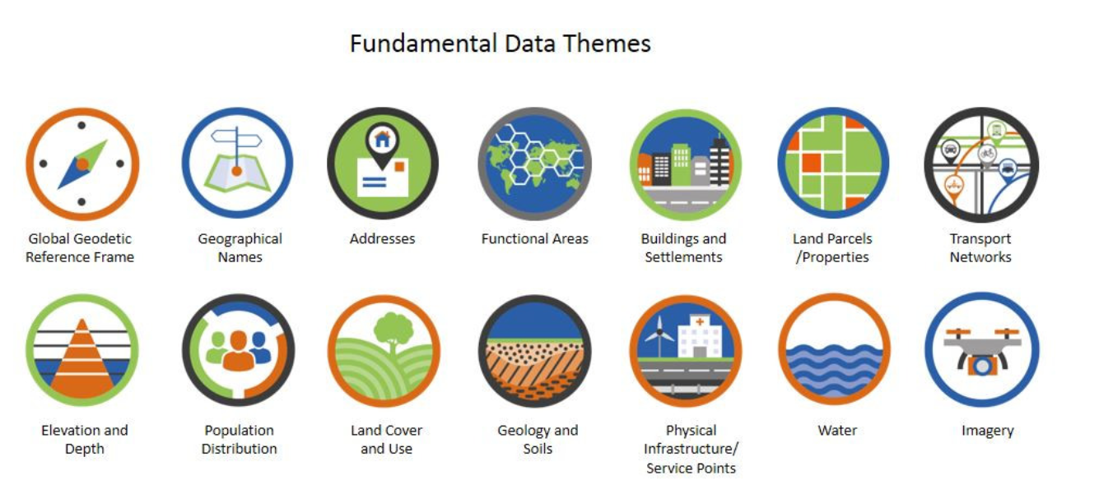
Fundamental Geospatial Data Themes
Location-based
Cross-sectoral
Universal – applicable across all regions
Used to reference other data
Comprehensive coverage
Documented methodology
Global standards
Official – authoritative – trusted
Critical data
Identified source
….
Designed to bridge the gap between the geospatial data community and other stakeholders, to make a difference in the achievement of the SDGs

Slide 15
A Federated Information System for the SDGs
Interoperability and web-based collaboration
The interface to each SDG data hub is based on open standards and the use of common vocabularies for describing and organizing data content
Web-based technology enables collaboration within and across organizations.
Anyone within and outside a data provider’s organization can directly access data and applications made publicly available through the organization’s open data hub
Users with proper credentials can access content shared with specific user groups.

Slide 16
Sample survey data
Census data
Statistical-Geospatial Integration
People
Businesses
Admin. Registers
Primary statistical registers
Statistical Indicators
Maps
Visualizations
Geo-coding
Common
geographies
Location
Standard classifications
Fundamental Geospatial Themes
EO
Other sources of data

Slide 17
