Slide 1
MAPPING AFRICA FOR AFRICA INITIATIVE
Dr Derek Clarke
Chair: UN-GGIM: Africa WG on Fundamental Geospatial Data and Standards
derek.clarke.dr@gmail.com
International Workshop on Fundamental Data Themes for Africa, April 2018

Slide 2
In the beginning …
Intergovernmental meetings of the national mapping organisations of Africa, organised by UNECA,
Each country provided a national report on progress with national mapping programmes and the meeting ended with well-structured resolutions.
National reports showed little achievement in the national mapping programmes and in the implementation of resolutions of the meetings. Meetings were reduced to ‘talk shows’.
In an effort to address the problem a meeting was held in Durban, South Africa in 2003, which resulted in the launch of the Mapping Africa for Africa Initiative.

Slide 3
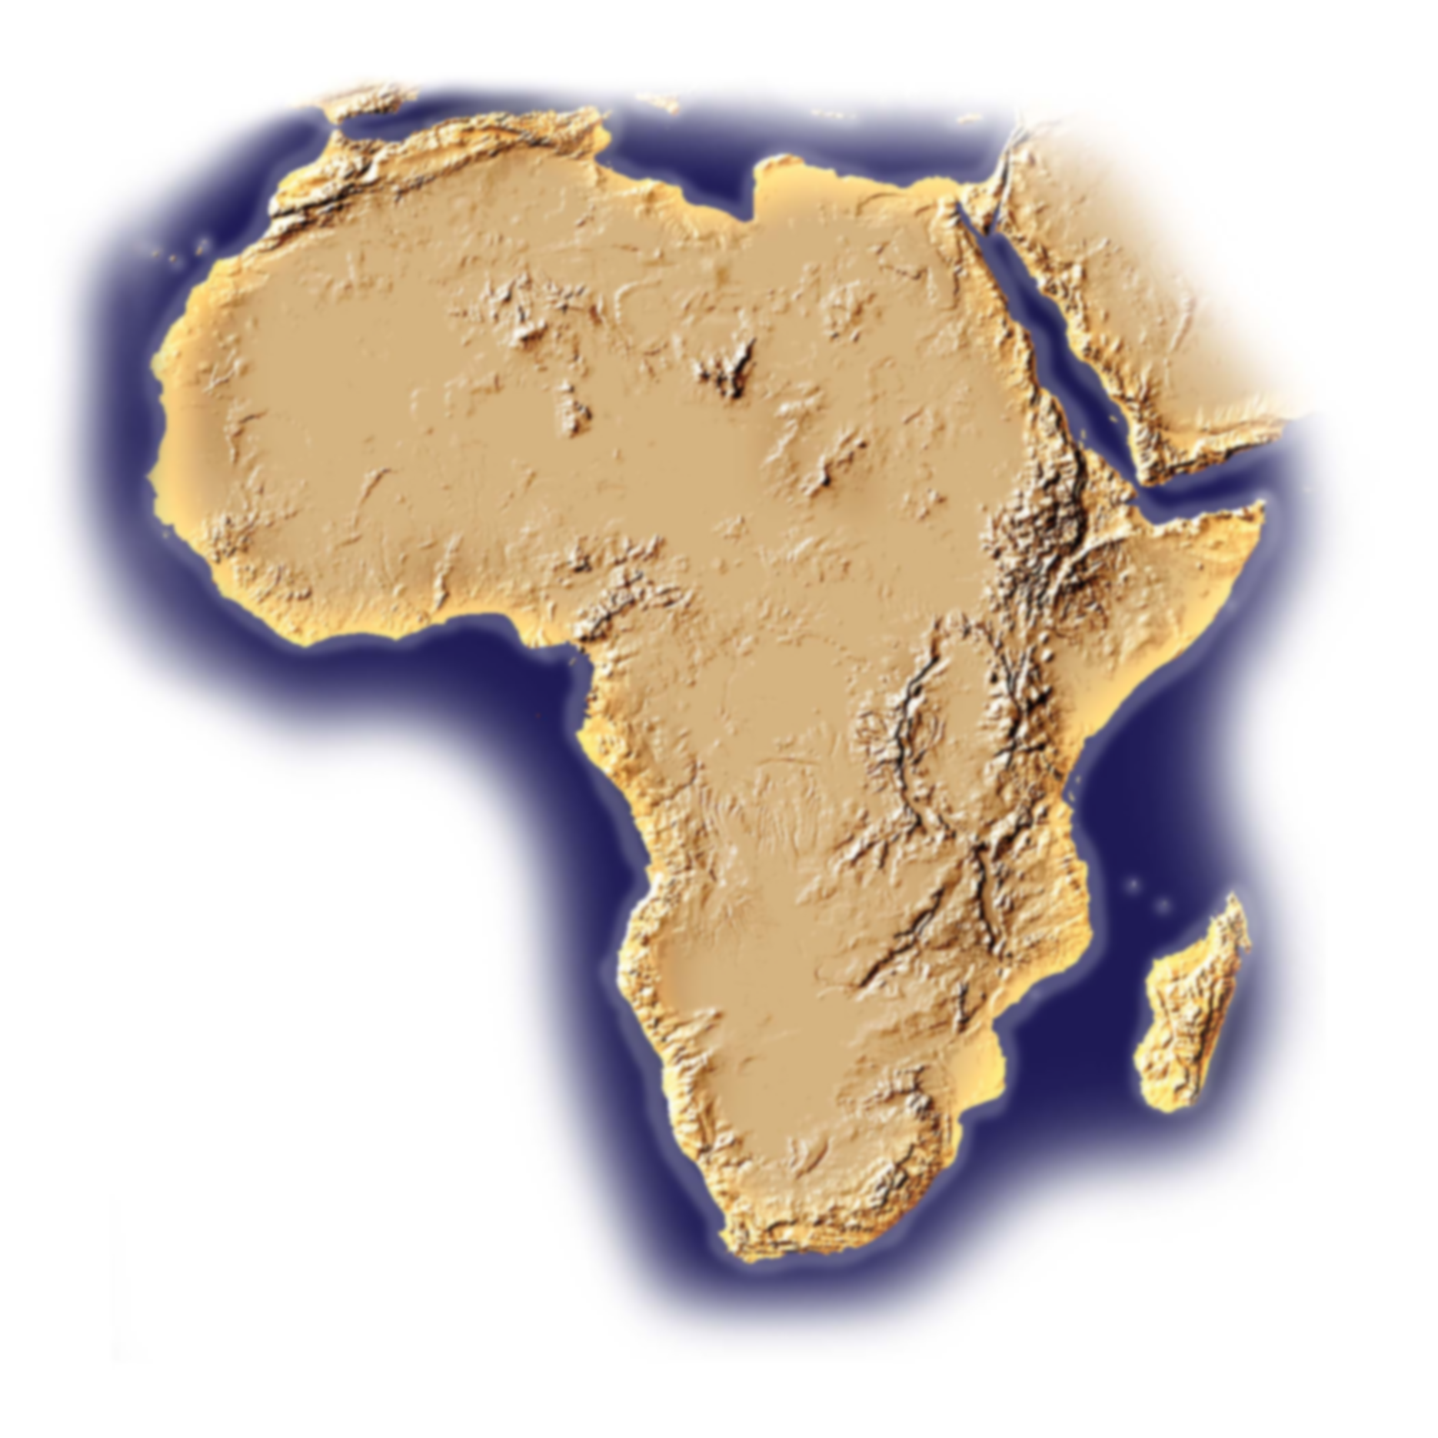
DURBAN STATEMENT ON MAPPING AFRICA FOR AFRICA
Recommendations:
The UNECA, under guidance of the Committee on Development Information’s Subcommittee on Geoinformation (CODI-Geo), implements activities relating to the “Mapping Africa for Africa”, in collaboration with the ICA and other institutions and organisations.
NEPAD Secretariat endorses and supports projects on “Mapping Africa for Africa”.
ICA creates a Commission or Working Group on “Mapping Africa for Africa”.
That mapping activities be prioritised in line with priority needs of NEPAD.

Slide 4
Recommendations (cont.):
5. Promotion of public-private partnerships to ensure that human capacity developed in the public sector that has moved to the private sector is still available in the overall national pool of human resources for mapping in the country.
6. That a minimum threshold be set for in-country execution of geoinformation projects to ensure development of institutional and human capacity.
7. To implement the resolution of CODI that each country should have frequent national level CODI meetings for effective coordination at national and regional levels in mapping activities.
8. An inventory of existing geospatial data sets and resources in each country with associated metadata be undertaken as a matter of urgency.

Slide 5
Recommendations (cont.):
9. That organisations and institutions working on mapping topics should ensure that documents are made available in major official languages, such as English and French.
10. To use regional centres and institutions to link up with countries to facilitate regional coordination, communication and dissemination of information on relevant projects and initiatives.
11. That all countries participate in the Global Mapping Project and other relevant regional and international initiatives.
12. That every country develops a national spatial reference framework that should be part of the African Reference Frame (AFREF), as a matter of urgency.

Slide 6
Recommendations (cont.):
13.That every country identifies its fundamental data sets, from which the consistent regional fundamental data sets should be derived, including geodetic framework, topography, land cover, settlements, administrative boundaries and transportation, which are envisaged to be part of the regional data sets.
14. That awareness of available data sets and potential uses be created to develop a user base and ensure a demand-driven approach to geo-information development in general and mapping in particular.
15. That every development project proposal identifies, up front, programmatic arrangements for continuous maintenance of resulting data sets at the conclusion of the project.
16. That every country develops or adopts mapping standards consistent with international standards.

Slide 7
MAfA PROJECT ACTION ITEMS:
Prepare detail project plan.
Determine fundamental geo-spatial datasets (national / regional).
Determine available fundamental geo-spatial datasets.
Standards for fundamental geo-spatial datasets.
Prepare “Best Practice for Collection and Maintenance of Fundamental Geo-spatial Data” (national / regional).
Determine gaps in available fundamental geo-spatial datasets.
Prepare action plan per country.
Agreement on action plan per country.
Prepare and submit project proposal to NEPAD Secretariat and AU.
Source funding.
Implement and monitor progress of action plan (long term).
Establish regional / sub-regional nodes for fundamental datasets.

Slide 8
COMPLETED TASKS:
Determine fundamental geo-spatial datasets for Africa.
Catalogue of available fundamental geo-spatial datasets (in-country and foreign).
Determine gaps in available fundamental geo-spatial datasets.
CURRENT WORK IN PROGRESS:
Work on the “Guidelines of Best Practice for the Acquisition, Storage, Maintenance and Dissemination of Fundamental Geo-spatial Datasets”:
Project plan complete;
Outline of content complete;
Writing of content commenced – but need more contributors and funding.

Slide 9
Determination of fundamental geo-spatial datasets for Africa
UNECA Publication: ECA/ISTD/GEO/2007/02E

Slide 10
(African) Definition of fundamental geo-spatial dataset:
Fundamental geo-spatial datasets are the minimum primary set of data that cannot be derived from other datasets, and that are required to spatially represent phenomena, objects or themes important for the realisation of economic, social and environmental benefits consistently across Africa at the local, national, sub-regional and regional level.

Slide 11
List of fundamental geo-spatial datasets for Africa:
Three levels:
Level 0 – Primary reference
Level 1 – Base geography
Level II – Administration and spatial organisation
Level II – Infrastructure
Level III – Environmental information

Slide 12
Level 0 – Primary reference
Geodetic control network
Geodetic control point
Height datum
Geoid model

Slide 13
Level 1 – Base geography
Rectified imagery
Aerial photography
Satellite imagery
Hypsography
Digital elevation model
Spot height
Bathymetry
Hydrography
Coastline
Natural water bodies

Slide 14
Level II – Administration and spatial organisation
Boundaries
Governmental units
Populated places
Enumeration areas
Geographic names
Place names
Feature names
Land management units
Land parcels/cadastre
Land tenure
Street address
Postal/zip code zone
Land use planning zone

Slide 15
Level II – Infrastructure
Transportation
Roads
Road centrelines
Railways
Airports and ports
Structures
Bridges and tunnels
Utilities and services
Power
Telecommunication

Slide 16
Level III – Environmental information
Natural environment
Land cover
Soils
Geology

Slide 17
Comparison of Fundamental Data Theme
UN-GGIM | AFRICA
Global geodetic reference frame | Geodetic control network
Geographical Names | Geographical Names
Addresses | (Addresses)
Functional Areas | Boundaries
Buildings and Settlements | Populated places
Land parcels | Land management unit
Transport Networks | Transportation
Elevation and depth | Hypsography
Population distribution | -
Land Cover and Land Use | Land Cover
Geology and soils | Geology, Soils
Physical infrastructure | Utilities and services, Structures
Water | Hydrography
- | Natural environment
Orthoimagery | Rectified imagery

Slide 18
The UN-GGIM: Africa WG on Fundamental Geospatial Data and Standards is contributing to the work of the UN-GGIM WG on Fundamental Geospatial Data.
Thank you

