Slide 1
Geospatial and Statistical Data Integration
Dr. Emmanuel Nkurunziza Director General

Slide 2
Outline
About RCMRD
Evolution of Rwanda’s geospatial and statistics systems
Statistics in Rwanda
Geospatial data development in Rwanda
Integration

Slide 3
About RCMRD
The Regional Centre for Mapping of Resources for Development (RCMRD) was established in 1975 under the auspices of the United Nations Economic Commission for Africa (UNECA) and the African Union (AU), previously known as the Organization of African Unity (OAU).
Our Vision: To be a premier Centre of Excellence in the provision of Geo-Information services.
Our Mission: To promote sustainable development through generation, application and dissemination of Geo-Information and allied Information Communication Technology (ICT) services and products in the Member States and beyond.

Slide 4
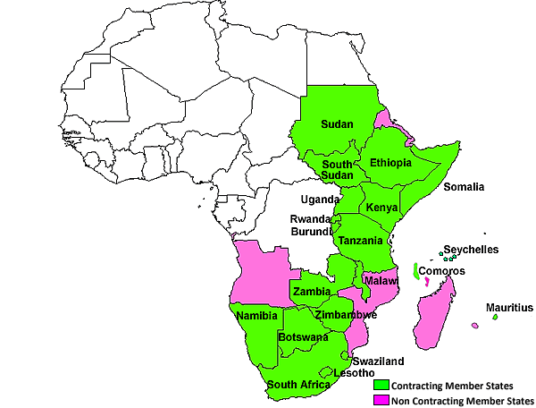
Geographical Coverage
RCMRD Fact Sheet
Centre is 43 years old this month
Inter-governmental, with 20 member states
Supports Member states specifically in development of the geospatial and earth observation capabilities

Slide 5
General view of Data integration in the region
Situation in most Member states in terms of statistical & geospatial data integration similar with exception of more advanced economies like S. Africa
Development and management of statistical and geospatial data invariably separate under different institutions with adhoc coordination;
The presentation here will use the case of Rwanda primarily because I understand it best, having been a central participant in the geospatial development in the country for close to 10 years as head of the country’s Natural Resources Authority

Slide 6
Statistical & Geospatial Data in Rwanda
Development of statistical & geospatial data evolved independent of each other out of immediate pragmatic needs for each
Following adoption of the country’s Vision 2020 in the year 2000, the subsequent years focused on developing sectoral policies and institutions to deliver it;

Slide 7
National Statistical system
Law on organization of statistics activities in Rwanda was enacted
A National Institute of Statistics of Rwanda (NISR) was set up in 2005 as main body to generate and manage national statistics
Development of National Statistical system (NSS) - ensemble of institutions
Initial focus of NISR was on production of mandatory statistics such as GDP, CPI, PPI, external trade figures etc but later started working on special purpose statistics such as DHS, Agric statistics etc
National Strategy for the Development of Statistics in Rwanda (NSDS); with 5 year cycles - now implementing second cycle NSDS 2

Slide 8
National Statistical system
Increasingly geospatial information became important to NISR particularly when they undertook population census, with need to map enumeration areas & admin boundaries
NISR tried to build in-house capacity to generate essential geo-data & the mapping institutions remained outside the NSS
Collaboration between NISR and mapping institution remained adhoc, informal and reliant on individual goodwill

Slide 9
Geo data development (1)
Started with promulgation of a national land policy in 2004 covering aspects of mapping & management of geo-information.
This was followed by a land law in 2005 and establishment of the National Land Centre in 2007 that brought together all mapping functions that were scattered in different institutions
National Land Centre began process of developing key geospatial information – aerial survey of the country generated high resolution of orthophotos. A new base map developed as well as National Land use & development master plan

Slide 10
Geo data development (2)
Development of national land use master plan required many sets of statistical data that necessitated close collaboration between the National Land Centre & NISR
The new base map and high resolution orthophotos became a template over which other geospatial & statistical data were developed;
The Land tenure regularisation programme undertaking by the Land Centre between 2009 & 2013 to demarcate, map and register all parcels in the country produced arguably the largest set of both geospatial & statistical data in one go.
The Land parcels data brought in a unique identifier (UPI) for each of the over 11 million parcels in the country that has now become an integrating element for most statistical data is made more meaningful by the geospatial/location dimension

Slide 11
Statistical & Geospatial Data integration (1)
Establishment of the Land administration Information system that integrates cadastral data with other data pertaining to owners and others with interest
This system is electronically connected to other key national registries e.g. National ID, taxation, mortgage registration, business registration etc
Specifically the connection of National ID (unique identifier of persons) and parcel data (with unique parcel identifier) has provided huge opportunity for generating all sorts of statistical reports/data
While statistical data continued to be coordinated under the NSS, similar efforts under NSDI is trying to bring together management of geodata

Slide 12
Statistical & Geospatial Data integration (2)
Joint activities between the geodata side and statistics have increased e.g the ongoing Natural capital accounting in which land accounts were recently published
A national geoinformation coordination committee has also been set up & NISR and the mapping institutions are the key drivers
National data revolution policy recently approved by Cabinet provides more possibility for this coordination

Slide 13
Way forward for the region
Developments towards integration described for Rwanda apply to most countries in Eastern & Southern Africa
UN-GGIM efforts around GFDTs should help focus and give impetus to national & regional initiatives
Different countries can develop implementation roadmaps for the GFDTs, identifying most priority themes & investing accordingly.

Slide 14
Thank you!
www.rcmrd.org

