Slide 1
Quick Assessment of the Readiness of African Countries in utilizing Fundamental Geospatial Data for Monitoring the SDGs
Workshop on Global Fundamental Data Themes for Africa
25-27 April, 2018
Addis Ababa, Ethiopia
Aster Denekew Yilma
African Center for Statistics
Economic Commission for Africa

Slide 2
Background
Fundamental datasets are the basic layers, upon which other thematic and core datasets are developed/ mapped.
These datasets are foundation data for Sustainable Development
To monitor the SDGs , data need to be up-to-date, and reliable
ECA, in an effort to support the implementation of the SDGs: Identified Geospatial datasets for the SDGs by targets and indicators;
Conducted survey on Fundamental datasets for monitoring SDGs

Slide 3
Questionnaire
Questionnaire sent to all our Member States (National Mapping/Geospatial Agencies)
Questionnaire aims to collect information about the countries readiness in the use of geospatial information in the implementation of the sustainable development goals (SDGs), targets and indicators.
Qualitative survey and assess on:
relevance of geospatial data for the SDGs
availability of data for measuring the targets and indicators, SDGs
level of difficulty in collecting relevant data
level of disaggregation
readiness of countries on the utilization of fundamental geospatial datasets
steps taken so far to incorporate geospatial information towards the implementation of the SDGs
what policies and strategies, action plans available to link goals and targets

Slide 4
Questionnaire …
Received response from: 13 countries
Botswana,
Namibia,
South Sudan
Zambia
Niger
Uganda
Burkina Faso
Mozambique
Madagascar
Seychelles
South Africa
Cote D’ivoire
Cameroon

Slide 5
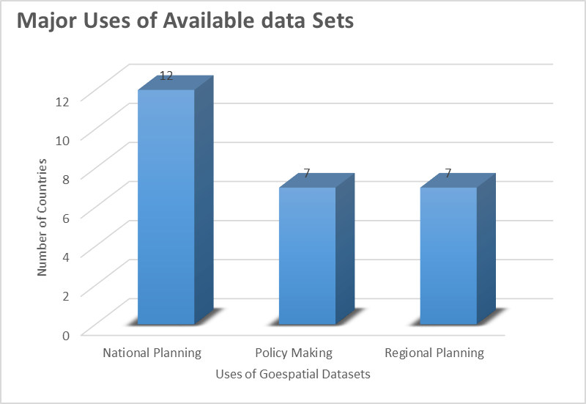
Result
Utilization/Relevance of Geospatial:
National Planning, (12 countries out 13 utilize geospatial data for national planning)
Policy making; Regional Planning (7 out of 13)
SDG Goals which requires utilization of Geospatial information/data:
(1, 2, 3, 4, 6, 7, 8, 9, 10, 11, 14, 15, 17)
Each Goals potentially need Geoinformation
All SDG indicators need Geoinformation

Slide 6
Result …
Countries have available fundamental geospatial datasets
Fundamental Data themes readily available:
Geodetic/Surveying data
Elevation/Bathymetry
Hydrography
Land Cover/Use
Administrative Data
Land Management Units
Imagery
Population Data
Infrastructure Data
Infrastructure data and land management units are missing in most cases

Slide 7
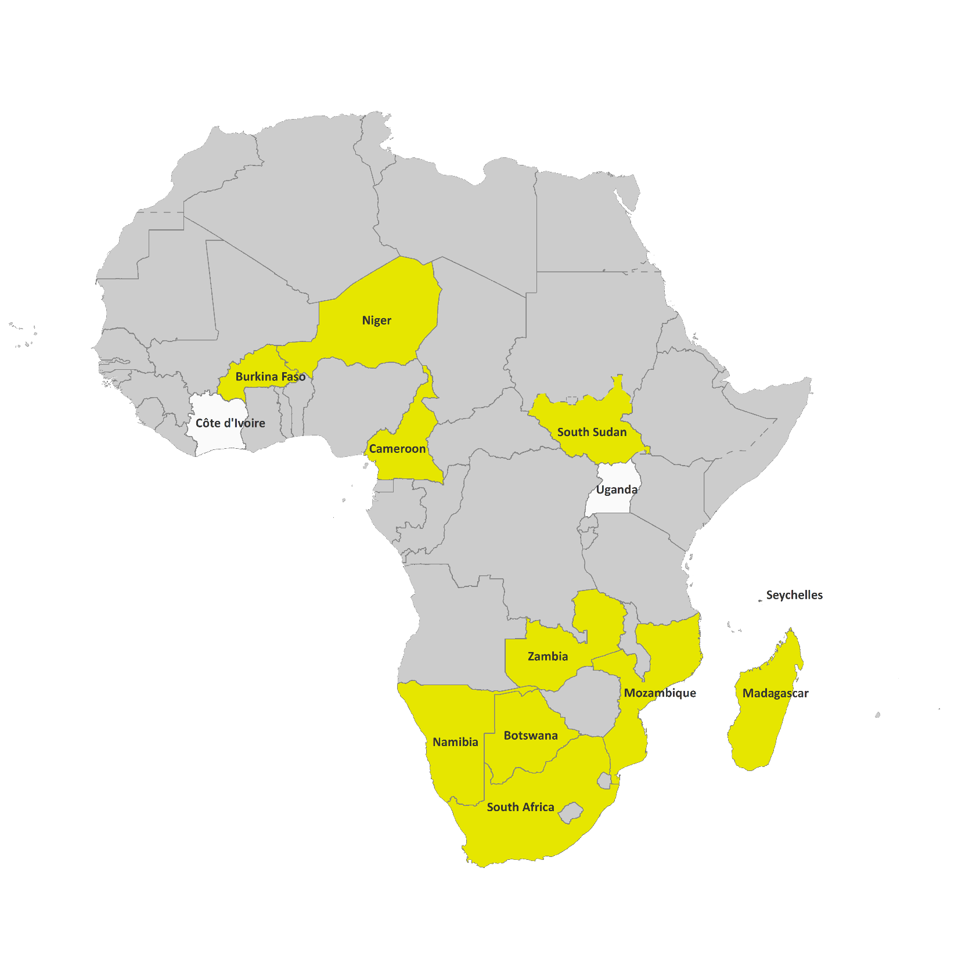
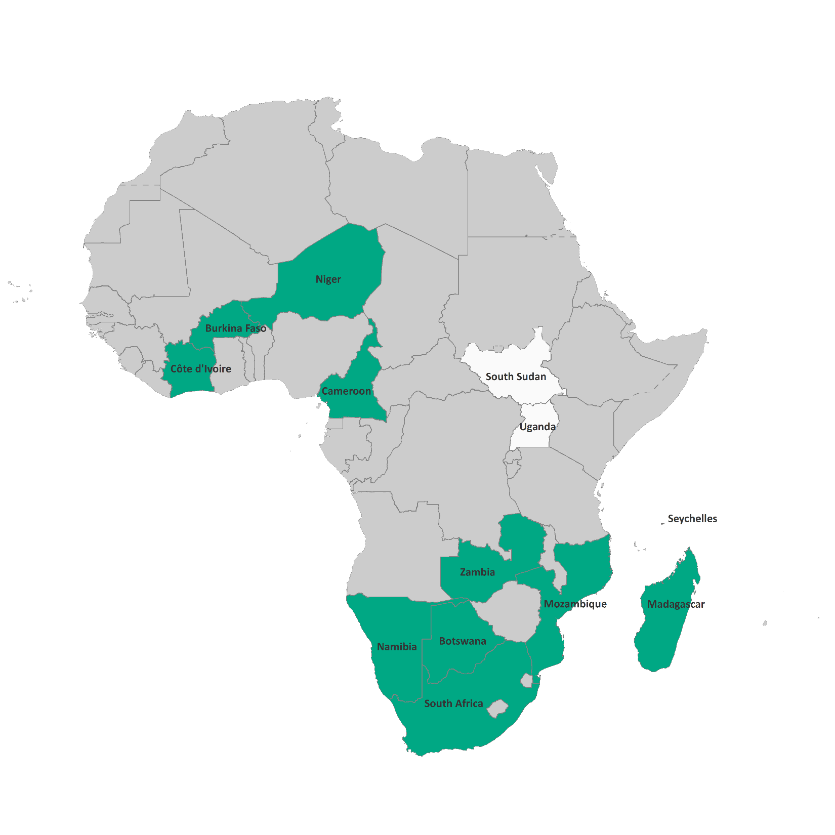
Fundamental geospatial datasets readily available
Geodetic /Surveying Data
Administrative Data

Slide 8
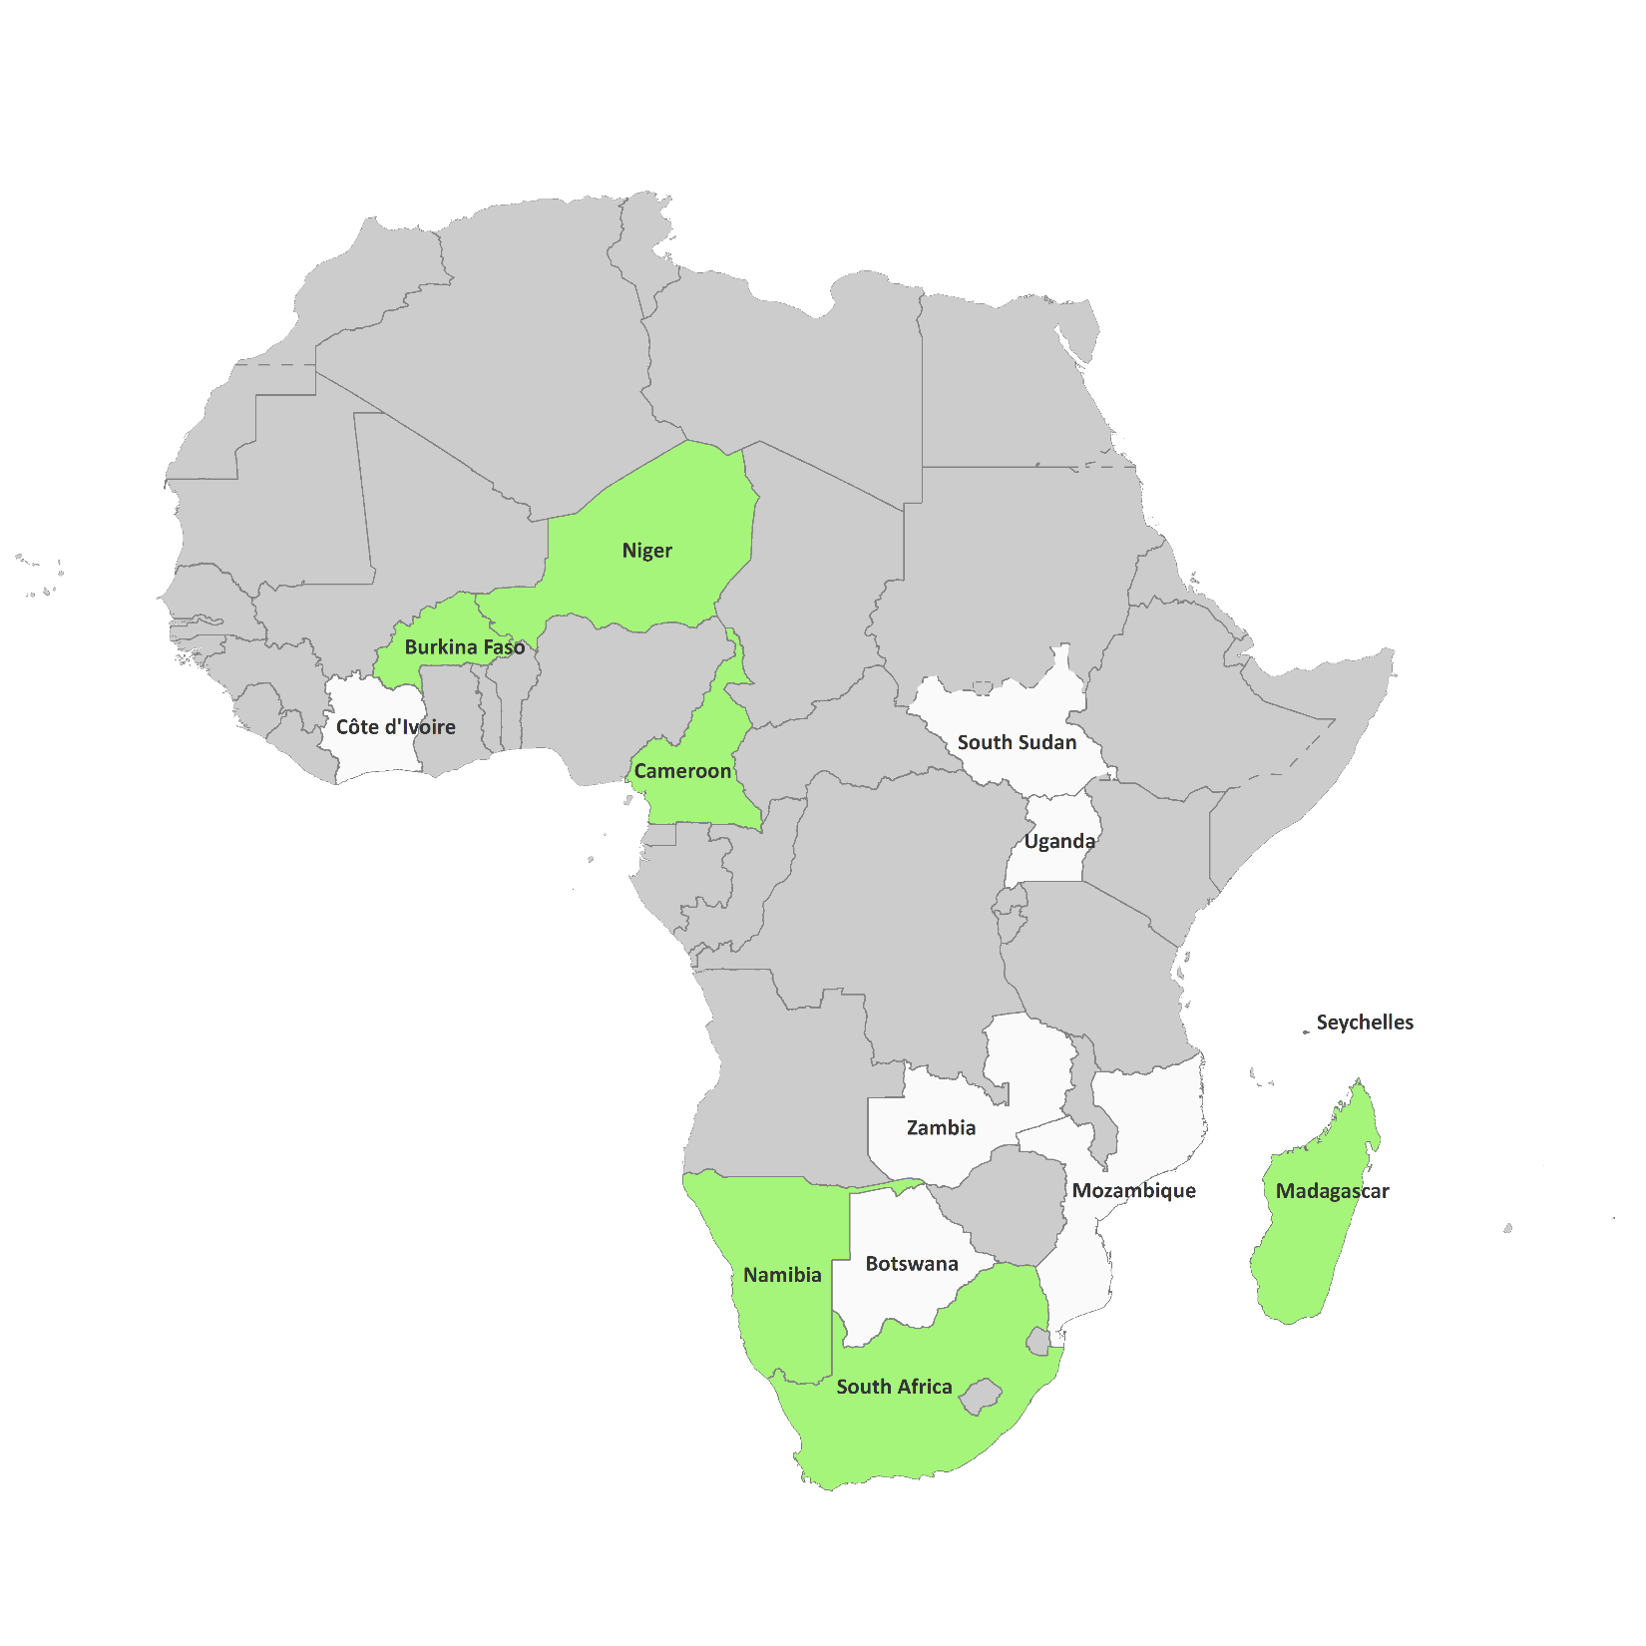
Fundamental geospatial datasets readily available
Infrastructure Data

Slide 9
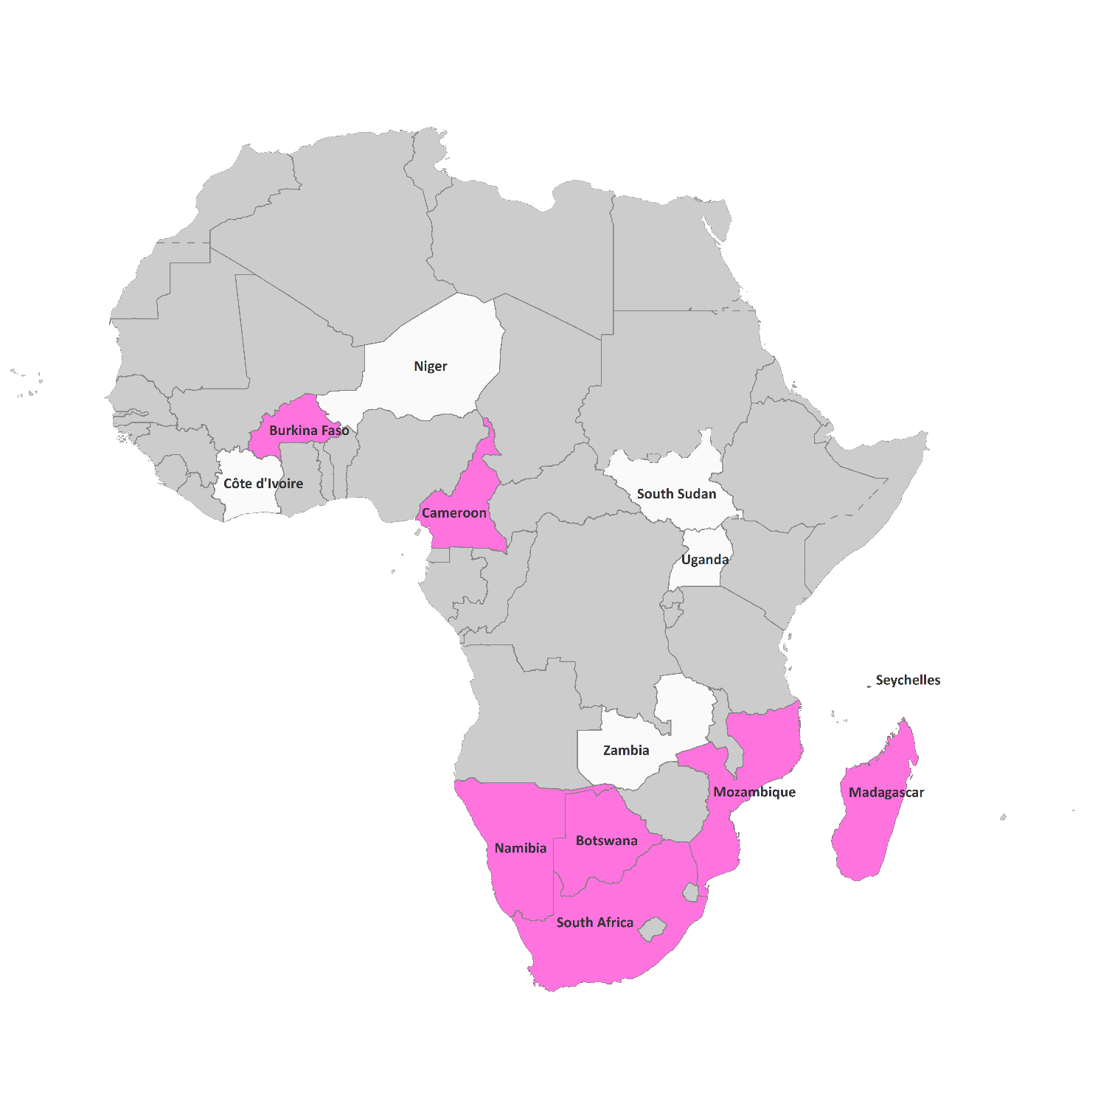
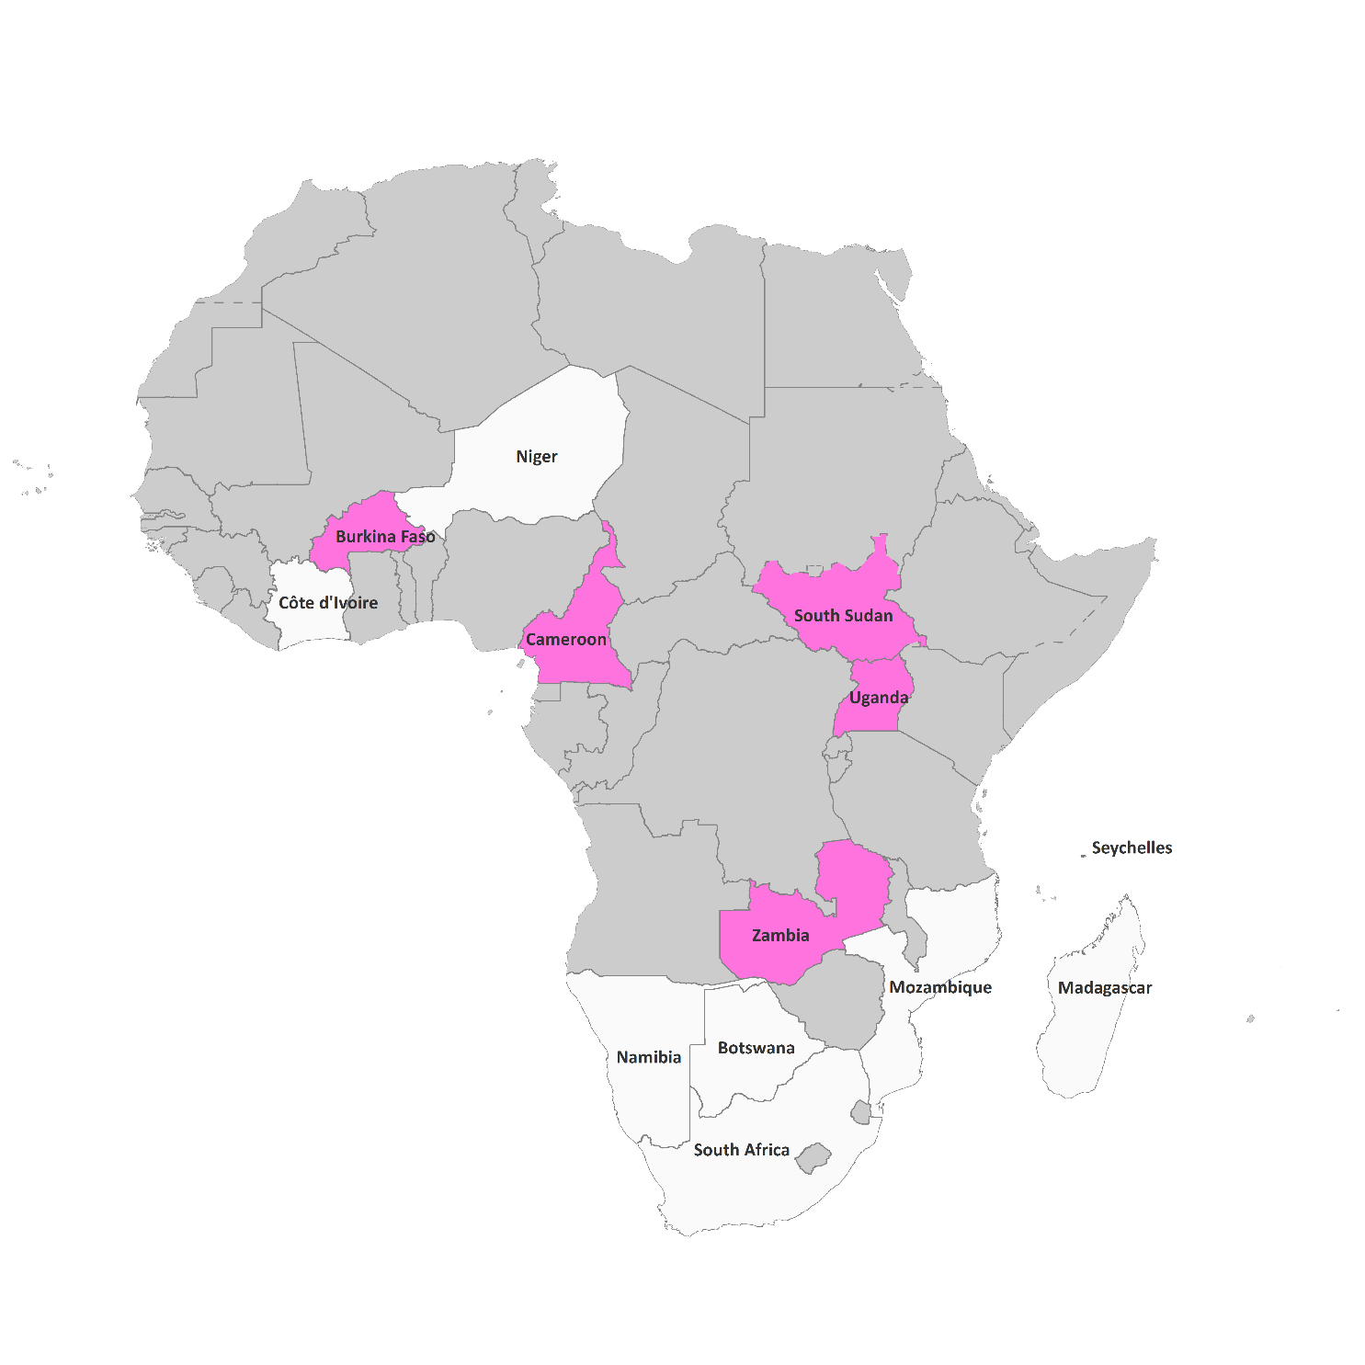
Fundamental geospatial datasets readily available Vs. Intention to collect
Intended to collect
Readily available
Land Management Units

Slide 10
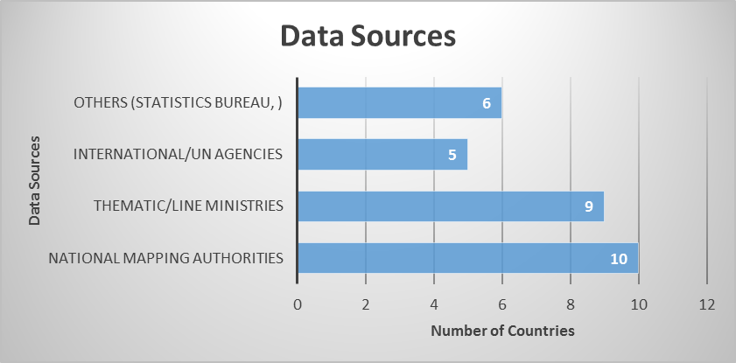
Result …
Availability: Existing geospatial data (Sources: National Mapping /geospatial Agencies; Thematic Line Ministries & NSO; International Org./UN )

Slide 11
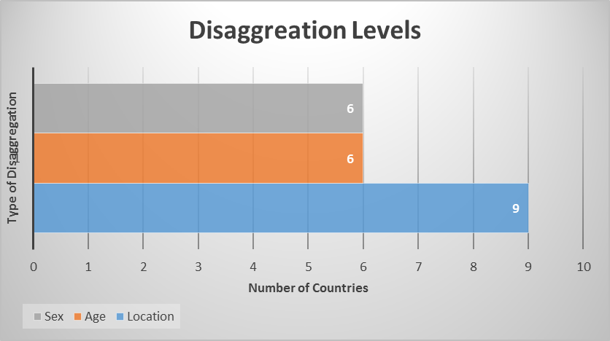
Result …
Disaggregation Level: Available datasets disaggregated by Location and in some cases by Age, Sex; 6 countries have data disaggregated by Age and Sex

Slide 12
Result …
Level of difficulty (Data Collection/Acquisition): mostly “Difficult”

Slide 13
Result …
Readiness of countries: Somehow Ready (availability of geospatial data/fundamental datasets; capacity to utilize available geospatial data) – 12 out of 13 responses are “3”.

Slide 14
Result …
Questions |  | No. of Responses (Countries)
Major uses of available geospatial datasets | National Planning Policy Making Regional Planning | 12 7 7
Data sources | National Mapping Authorities Thematic/Line Ministries International/UN agencies Others (Statistics bureau, ) | 10 9 5 6
Disaggregation levels | Location Age Sex | 9 6 6
Type of Fundamental datasets | Geodetic /Surveying Data Elevation/Bathymetry Administrative Data Hydrography Land Management Units Infrastructure Data Population Data Land Cover/Use Imagery | 11 9 11 10 7 7 10 10 11
Level of difficulty (Data Collection) | Very difficult – Easy (1-5) 1 2 3 4 | 1 5 6 2
Readiness on availability and capacity to utilize geospatial datasets | Not ready – Quite ready (1-5) 3 4 | 12 1

Slide 15
Result…
Policies and strategies, action plans are available
National Spatial Data Infrastructure is top priority: need to advance and support the establishment of national spatial data infrastructures in Africa
Existing policies supporting the implementation of SDGs:
NSDI policy;
Thematic policies (education, agriculture, national land policy, etc.);
Poverty Eradication policies;
National development plans

Slide 16
Result…
Steps taken so far to incorporate geospatial information towards the implementation of the SDGs
Development of Land information systems
periodic population census
thematic mapping
Establishment of the National Spatial Data Infrastructure
Defined and acquired fundamental geospatial data themes
Establishment of National Reference Frame
integrate geospatial information with statistics
incorporating geospatial information in their projects
Implementing the Integrated Indicator Framework
establishing a federated system for SDG reporting (e.g. South Africa)
geospatial data is being used to measure and monitor certain SDG indicators

Slide 17
Result …
Some Conclusion:
Most of the fundamental data will be highly relevant in assessments for SDG reporting. Countries are endeavoring to generate /acquire fundamental datasets
Efforts on establishment of Spatial data Infrastructure
Effort on integration of geospatial information with statistics (e.g: Namibia)
geospatial data has been widely used as a support for population and housing censuses (e.g. Madagascar, Ethiopia, Cameroon)
These census data will contribute to the implementation of SDGs
mainstreaming of geospatial data and statistical data need to be improved
Requires high level support and commitments from governments

Slide 18
THANK YOU!

