Slide 1
Use of administrative data for official statistics: The Global Perspective
Sub-regional workshop on integration of administrative data, big data
and geospatial information for the compilation of SDG indicators
Addis Ababa, Ethiopia. 23-25 April 2018
United Nations Economic Commission for Africa

Slide 2
Compilation of statistics based on administrative sources is increasingly common
To create/improve/maintain base statistical registers
To produce statistical outputs directly or in combination with other data sources
To assess and improve quality of statistical outputs (e.g., cross-validation through microdata comparisons)

Slide 3
Benefits of integrating administrative data sources into statistical production process
Reduced cost
Reduced response burden
Improved data coverage and availability
Ability to compile disaggregated statistics
Often, the results of sample surveys pertaining to population sub-groups cannot be presented due to unacceptably large sampling error
Improve the quality and efficiency across the entire statistical production system

Slide 4
Types of administrative data
Data reported to administrative authorities by individual persons / legal entities for legal compliance or to access government services
Data recording decisions made by administrative authorities
Data generated by administrative authorities to support planning, implementation, monitoring and evaluation of administrative programmes

Slide 5
Registers
A register is a complete list of all the members of a population, where each member has a unique identity
The identity of each entity represented in a register can be represented through any of the following:
A global identity number used across different registers
A local identity number that is specific to the register in question
A unique combination of attribute values (e.g., name, address, place of birth…)

Slide 6
Transforming administrative data into statistical data
Data from administrative sources needs to be adapted and processed to make it suitable for statistical compilation
Transform administrative populations into statistical populations
Transform administrative entities into statistical units (e.g., households, enterprises)
Transform administrative variables into statistical variables
Sample surveys
Adminis-trative registers
Statistical Outputs
Statistical registers
Census

Slide 7
Preconditions for effective integration of administrative data sources
Quality of administrative systems
Coverage, timeliness, reliability, documentation…
System of national identity numbers
For natural and legal persons, as well as of locations
Sound data governance
For data access and collaboration with administrative authorities
Statistical integration frameworks
Base statistical registers
Standard statistical classifications

Slide 8
System of national identity numbers
The same identity number should follow each person, enterprise or location over its life time
Identity numbers should have no relation to any characteristics of the objects they identify
A good system of national identity numbers improves efficiency of both administrative and statistical production systems, and allows to link records and make comparisons

Slide 9
Data governance
Legal framework determines
What data are generated by administrative systems, and how it is reported/recorded
The right to use data from administrative systems for statistical purposes
The authority to match data from different sources
Accountability mechanisms for data quality and the protection of data privacy and confidentiality

Slide 10
Data governance
Institutional arrangements enable NSOs to maintain close and long-term relations with administrative authorities
High-level contact to promote strategic changes in administrative systems with a view to improve statistical production
Technical-level cooperation to understand how administrative systems are organized
Coordination of changes in administrative and statistical systems

Slide 11
Base statistical registers
Together with standard classifications, they constitute the backbone of the national statistical infrastructure:
Define statistical units and populations to be used across the entire statistical system
Provide sampling frames for collection of survey data
Are a primary source for demographic statistics
Establish links between different sources of data

Slide 12
Base statistical registers
Population register
Identification of population units (persons, households, families…)
Relationships among population units (partners, ascendants, descendants)
Demographic characteristics (age, sex, marital status…)
Vital events (live births, deaths, marriages, divorces, adoptions, …)
Business register
Identification of business units (enterprise, establishment,…)
Relationships among business units (subsidiaries, head offices, …)
Demographic characteristics (size, main economic activity…)
Business demographic events
Cadaster / real-estate register
Identification of real estate units (land property, buildings, and dwellings,…)
Location (addresses, geographic coordinates, …)

Slide 13
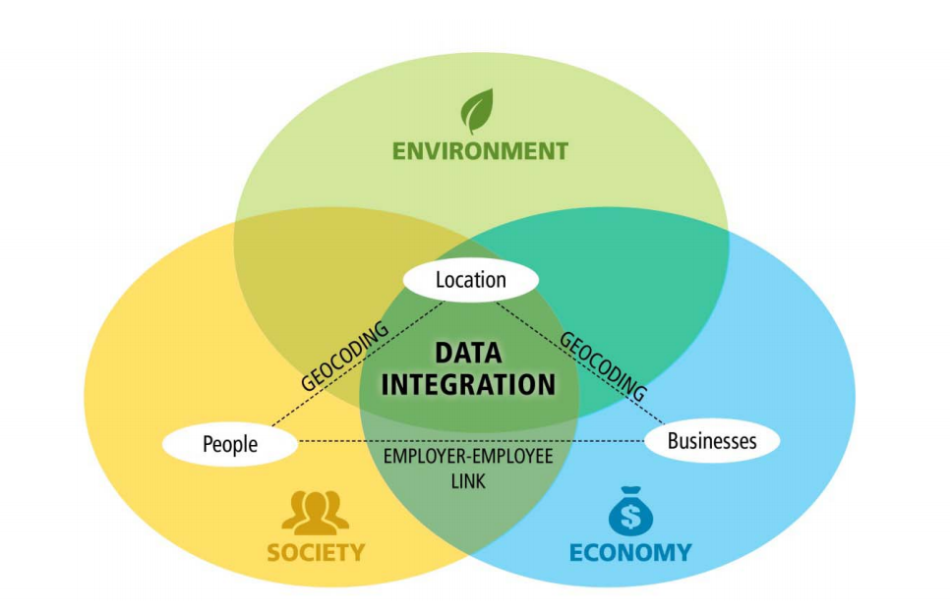

Slide 14
Steps to integrate administrative data in official statistics
Inventory of all administrative registers available
Mapping of administrative entity types to statistical units
Mapping of administrative variables to statistical variables
Establishing relationships among administrative registers
Development of statistical registers
Base statistical registers
Primary statistical registers (directly based on administrative registers)
Integrated statistical registers (derived from primary registers)
Linking microdata from statistical registers and other data sources

Slide 15
References
Register-based Statistics: Statistical Methods for Administrative Data. Wallgren A. and B. Wallgren (2014). John Wiley & Sons
Register-Based Statistics in the Nordic Countries: Review of Best Practices with Focus on Population and social Statistics. United Nations Economic Commission for Europe (2007)
Principles and Recommendations for a Vital Statistics System, Rev. 3. United Nations (2014)
Section 2.II - “Civil Registration as a source of vital statistics”
Section 2.III - “Use of population registers for vital statistics purposes”
Guidelines on Statistical Business Registers. United nations Economic Commission for Europe (2015)
Guidelines for Building Statistical Business Registers in Africa. African Development Bank (2014)

