Slide 1
USE OF ADMINISTRATIVE DATA AND RECORDS FOR OFFICIAL STATISTICS
by
Anne Labigah Ibrahim
National Bureau of Statistics

Slide 2
Outline of Presentation
Introduction
Producing of official statistics in Nigeria
Statistical Administration in Nigeria
Government’s commitment to the production of administrative
statistics
Administrative statistics as a major proportion of official statistics
Challenges
Way forward
Conclusion

Slide 3




SECTION A
A
A
Introduction
A
A
Notes:
3

Slide 4

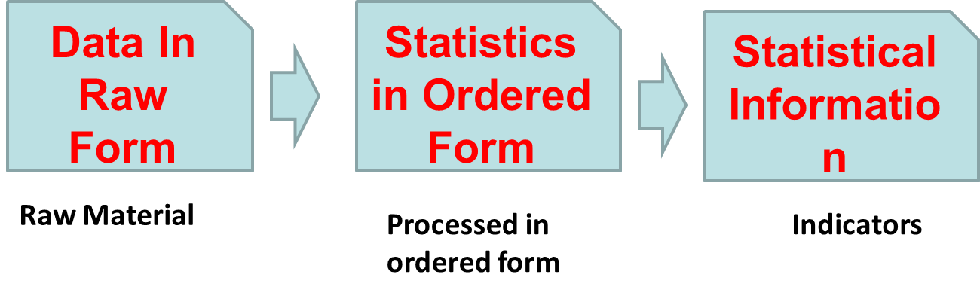
Introduction….
Data can be defined as raw figures collected
    They become useful when used to generate information for decision making
Thus, Information is processed data

Slide 5
Introduction
What is administrative data?
Data derived from records of administration
They are by-products of administrative system developed primarily for operational purposes
Can be found in files or organised formats and maintained by the agency responsible
Information generated in the course of daily transaction either by government Ministries, Departments and Agencies (MDAs) or any other organisation, usually during delivery of service.
Usually in the form of micro data records
When processed and analysed they become statistical information

Slide 6
SECTION B
B
B
Production of Official Statistics
B
B
Notes:
6

Slide 7
Production of Official Statistics in Nigeria
Official statistics are those statistics generated by an authoritative institution either alone or in collaboration with any other agency
Processed Administrative records constitute a major component of official statistics which are derived through the System of Administrative Statistics (SAS)
Administrative data contribute to the quantum of official statistics generated through other system of data production such as
    Household based Survey through NISH, and
    Establishment based Survey through NISE

Slide 8
Production of Official Statistics
NBS
3
2
SAS
NISH
NISE
Compendium of Statistical Terms, Concepts, Definitions and Methodologies
Directory of Industries & Businesses
EA/Hu. Frame & Maps

Slide 9
Production of Official Statistics in Nigeria…
In Nigeria, production of statistics takes place at each tier of government
    Federal
    State, and
    Local Government
At each level, there exists a Planning, Research and Statistics Department (PRSD) in Government Agencies
The PRSDs routinely gathers and processes data relating to the sector over which the Ministry has jurisdiction
In doing this however, standard templates provided by NBS are used for ease of harmonization

Slide 10
SECTION C
C
C
Statistical
Administration in
Nigeria
C
C
Notes:
10

Slide 11
Statistical Administration in Nigeria
Nigeria maintains a Federal System of Government
(Federal, State and Local Government Councils)
Statistics in Nigeria is on the concurrent legislative list, thereby placing the prerogative of statistical services on each tier of Government and their respective MDAs
  At the Federal level, there exists
      NBS and its branches in states and Zonal Offices
      National Population Commission and its State branches.
      Central Bank of Nigeria
      Statistical branches of Federal Ministries, Departments and Agencies (MDAs)
      Research Units of Tertiary Institutions
  At State level (36 States and FCT)
      The State Bureau of Statistics or State Statistical Agency
      Statistical branches of State Ministries, Departments and Agencies (MDAs)
  At the Local Government Level (774 LGAs)
      Statistics Units of Local Government Councils

Slide 12

Statistical Administration in Nigeria
Coordination
  The Statistical Act, 2007 empowers NBS to coordinate the entire NSS
Objective of Coordination
  Prevents duplication of efforts
  Promotes synergy and cost-effectiveness
  produces higher quality data

Slide 13
Statistical Administration in Nigeria
A Three-Tier Decentralised System
National Bureau of Statistics
State Bureaus of Statistics (SBS)
State MDAs Statistical Units
Local Government Areas Statistical Units
Federal Line MDAs

Slide 14
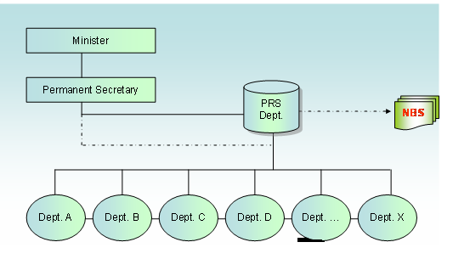
Statistical Administration in Nigeria
Coordination within an MDA takes the following form

Slide 15
Statistical Administration in Nigeria
Within a Sector
PRSDs saddled with the responsibility of collecting both internal and sectoral Statistics within the Ministry
MDA Coordinating Committee called Sector Statistics Consultative Committee
Membership includes
    Director PRS in the Ministry,
    Representatives of Departments within the Ministry,
    Director PRSD of Parastatals and Extra-Ministerial Departments affiliated to the Ministry

Slide 16
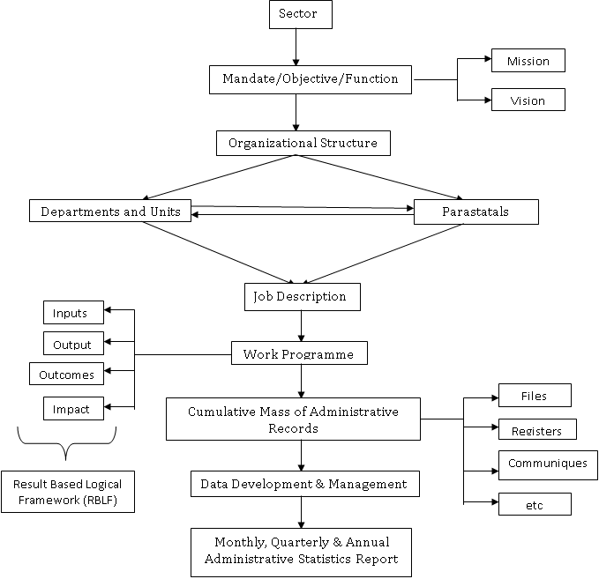
Statistical Administration in Nigeria
Coordination within a Sector

Slide 17
Statistical Administration in Nigeria
Coordination at the state level
Coordination at the State level requires a Coordinating Committee called State Consultative Committee on Statistics comprising
    The SG, SBS as Chairman
    D (PRSDs) of MDAs
    Heads of Statistics of Local Government Statistics Unit
    OPS
    CSOs
    Community Based Organizations (CBOs)
    Etc.
To carry similar functions as those of the National Consultative Committee on Statistics (NCCS)
PRSDs
OF MDAs
LGA Statistical
Units
OPS and CLOs
State Bureau of Statistics
National Bureau of Statistics

Slide 18

SECTION D
D
Government’s commitment in the
production of admin stat
D
D
D
Notes:
18

Slide 19
Government’s commitment in the production of admin. statistics
Governing Board
Separate Conditions
of Service
New Scheme of Service and Salary Structure
Common Statistical Service
Operationalization of the 2007 Statistics Act, which repealed the 1957 Statistics Act
Key Elements of the Act
“National Bureau of Statistics”
(NBS) which plays the role of coordinator of the NSS with power
s to collect, request and be provided with data throughout the country on a wide range of matters

Slide 20

Government’s commitment in the production of Admin. Statistics…..
Achievements so far: Legal Framework
At the Federal level
At the State level
Statistics Act
Statistics Edict
24 states have edict in place:
(3 states passed but yet to be accented to)
Abia
Adamawa
Anambra
Bayelsa
Benue
Borno
Cross River
Delta
Edo
Ekiti
Enugu
Gombe
Imo
Kaduna
Kano
Kwara
Lagos
Niger
Ogun
Ondo
Oyo
Rivers
Sokoto
Zamfara

Slide 21

Government’s commitment in the production of admin. Statistics…..
Achievements so far: Establishment of Bureaus of Statistics
At the Federal level
At the State level
NBS
SBS
21 states only:
Abia
Anambra
Cross River
Delta
Edo
Ekiti
Enugu
Gombe
Imo
Kaduna
Kano
Kwara
Lagos
Niger
Ogun
Ondo
Oyo
Plateau
Rivers
Sokoto
Zamfara

Slide 22
Government’s commitment in the production of admin. Statistics…..
Achievements so far: Strategic Framework
At the Federal level
At the State level
27 States with SSMP in place
Abia
Adamawa
Anambra
Bauchi
Bayelsa
Benue
Borno
Cross River
Delta
Edo
Ekiti
Gombe
Imo
Kaduna
Kano
Kebbi
Kwara
Lagos
Nasarawa
Niger
Ogun
Ondo
Oyo
Plateau
Rivers
Sokoto
Zamfara
NSDS
MDAs Sector Strategy

Slide 23
Government’s commitment in the production of admin. Statistics…..
Achievements so far: Status of the Strategy
Fed. Min. of Agriculture
Fed. Min. of Health
Fed. Min. of Education
Fed. Min. of Work
Fed. Min. Land Housing and Urban Dev.
Fed. Min. of Aviation
Fed. Min. of Interior
Fed. Min. of Environment
Fed. Min. of Finance
18 MDAS have their Sector Statistics in Place

Slide 24
Government’s commitment in the production of admin. Statistics…..
Achievements so far: Status of the Strategy…
Fed. Min. of Water Resource
Central Bank of Nigeria
Nigeria Custom Service
Nigeria National Petroleum
National Population Commission
Nigeria Immigration Services
Debt Management Office
Nigeria Port Authority
18 MDAS have their Sector Statistics in Place

Slide 25
Government’s commitment and steps taken so far contd….
Development of Data Bond and Supply Responsibility Framework for SDGs
Production of SDGs Baseline Report, 2016
Design of Framework for the Production of Administrative Statistics in Federal Ministries, Departments and Agencies (MDAs), 2016
Review and Production of the Compendium of Statistical Terms, Concepts, Definitions and Methodology as a back-bone to the management of the System of Administrative Statistics (SAS), 2015

Slide 26
Government’s commitment and steps taken so far contd….
Establishment of a functional web portal that houses all of the Bureau’s data that can be reached by all users of statistics all over the world (www.nigerianstat.gov.ng)
Installations of Virtual Private Network (VPN) Project with the aim of ensuring a seamless flow of statistical information amongst statistical producing states (NBS has a modern ICT Facility (National Data Centre) that houses all data)
Professionalization of the National Bureau of Statistics with a higher percentage of technical staff compared to support staff

Slide 27
Government’s commitment and steps taken so far contd….
Data Release Calendar
  NBS now publishes an online data release calendar at the start of every year
Increase in the Use of Statistical Data
  NBS is now part of several presidential and ministerial committees such as the Economic Management and Implementation Committee (EMIT), the Presidential Committee on Job Creation, Inter-Ministerial Committee on Data Harmonisation, etc

Slide 28
SECTION E
E
E
Administrative Statistics as a major
proportion of official statistics
E
E
Notes:
28

Slide 29
Examples of Administrative Statistics as a major proportion of official statistics
Some administrative data used as official statistics in Nigeria include;
Vital registration statistics: births, deaths, marriages, separation and divorces
Education statistics
Health statistics
Migration statistics, international tourism statistics immigration and emigration records
Crime statistics
Agricultural statistics
Government income and expenditure

Slide 30
Examples of Administrative Statistics as a major proportion of official statistics
External trade statistics (imports and exports)
Capital Importation statistics
State Internally Generated Revenue (IGR)
Vehicle registration statistics
Road accident statistics
Exchange rate data
Drug seizure and arrest statistics
Petroleum consumption statistics (Cooking gas, PMS,etc)
Transport Statistics
etc

Slide 31
SECTION F
F
F
Challenges
F
F
Notes:
31

Slide 32
Challenges
Inadequate funding
Poor Culture of good record keeping
Inadequate professionals
Slow pace of ICT development
Apathy towards statistics

Slide 33
SECTION G
G
G
Way Forward
G
G
Notes:
33

Slide 34
Way Forward
Need to build more synergy in statistical production among relevant stakeholders
Improved funding by both Government and Development Partners
Advocacy

Slide 35
SECTION H
H
H
Conclusion
H
H
Notes:
35

Slide 36
Conclusion
Administrative data are a key component of official statistics
There is need for intensive awareness on the importance of good record keeping of daily transactions
Governments commitment in ensuring the existence of competent personnel and infrastructure needed for the production of administrative data is highly commendable
There is need to maintain synergy and avoid working at cross purposes in statistical production
The PRSDs in MDAs as an arm of the NSS should be strengthened to carry out its mandate effectively
Increased and sustained funding is necessary

Slide 37

T H A N K Y O U

