Slide 1

SRO-CA: Towards a “Center of Excellence”
ECA
Economic Diversification Through Resource-based and Trade-induced Industrialization
APPR, July 2020

Slide 2


Towards a “Centre of Excellence”: The Mandates
UN Agenda 2030
AfCFTA and BIAT
ICE on “Made in Central Africa: From a Vicious to a Virtuous Circle” and Douala Consensus (Sep 2017):
Goal 8: “Promote sustained, inclusive and sustainable economic growth, full and productive employment and decent work for all”
Goal 9: “Build resilient infrastructure, promote inclusive and sustainable industrialization and foster innovation”
Goal 12: “Promote sustained, inclusive and sustainable economic growth, full and productive employment and decent work for all”
CEMAC Extraordinary Summits 2016 and 2017
PROCUREMENT
Faible digitalisation
Goal 4:
Transformed Economies and Job Creation
Strengthened fundamentals of trade as a conduit for growth in the manufacturing/industrial sector
Restore macro-economic stability and pursue economic diversification (PREF-CEMAC).
“From a resources for infrastructure to a resources for industrialization model”
ECCAS and individual member states’ requests: Chad, Cameroon, Equatorial Guinea
Notes:
According to the UN Secretary/UNESCO/ILO

Slide 3





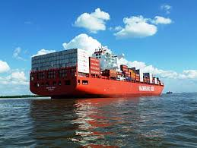
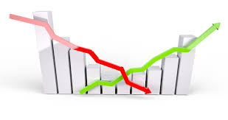
Towards a “Centre of Excellence”: The Ecosystem for Change
Enablers
Policy and fiscal space to pursue counter cyclical measures in the context of IMF led structural adjustment programmes
Adopting insights from nudge theory/behavioral economics and new institutional economics to put in place the right institutional and policy incentives for transformational change
Highest-level commitment and multistake-holder platforms for effective policy dialogue and common visioning processes
Increased competitiveness, enhanced productive capabilities and the emergence of domestic lead firms
Increased domestic resource mobiliza-tion
Well crafted sub-regional and national industrializa- tion frameworks
More granular understanding of growth drivers, national value proposition and potential competitive advantages
The realization of the AfCFTA: Accelerated pace of regional integration for sub-regional value chains and boosting intra-regional trade
Eeconomic diversification through resource-based and trade induced industrialization

Slide 4
Sustainable development
Impact
What are economic diversification policies?
Trade
Investment
Macroeconomic frameworks
Education and skill development
Industrialization
Agriculture and land rights
Labor markets
Regional integration
Structural transformation
Economic diversification
Critical assumptions
Inclusiveness of policies
Political leadership
Policy coherence and institutional cohesiveness
Stakeholder participation in policy formulation and implementations
Sufficient financial resources
SROC-C relevance, knowledge and capacity
Outcomes
Enhanced capacity of policy makers
Enhanced partnership
and coordination
Action plans for
institutional cohesiveness
Communication
Seminar
and
lectures
Formulation of
draft policies
Sub regional reporting on economic diversification
Partnership engagement and coordination platforms
Training public officials and stakeholders
Compendium of good practices and guidelines and toolkit
Models and tools
Outputs
Monitoring and evaluation systems
Platforms for exchange
Advocacy services
Study tours
Economic diversification through resource-based and trade induced industrialization

Slide 5
Stakeholders and partners
3
  MINISTRY OF PLAN
  MINISTRY OF AGRICULTURE
  MINISTRY OF FINANCE
  MINISTRY OF ECONOMY
  MINISTRY OF TRADE AND INDUSTRY
  GENERAL DIRECTORS OF MINISTRIES
  FOCAL PERSON
  CEMAC
  ECCAS
  Financial institutions
  Development agencies
  Parliaments
  Investors
Players
Context setters
Crowd
Subjects
  Universities
  Civil society
  Local communities
  Chambers of trade
  Students
  The population of the subregion
Economic diversification through resource-based and trade induced industrialization
UNECA.ORG

Slide 6

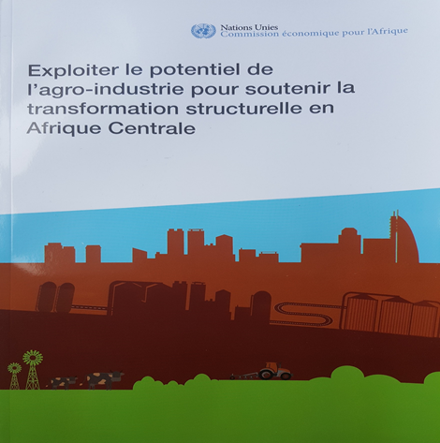



Towards a “Centre of Excellence”: Achievements
Made in Central Africa
Four ICEs (2017-2020)
STEPS and
Regional STEPS
Think piece and documentary:
Made in Central Africa: From a Vicious
to a Virtuous Circle
Four ICEs (2017-2020) on the building blocks of economic diversification (overall policy framework, financing, digital, skills and competencies, institutions in 2021)
A
Douala
Consensus
A coherent
campaign approach
AEGMs
and non-recurrent
publications
Adoption of the Douala Consensus on economic diversification (through resource-driven and trade-induced industrialization)
interviews, OpEds, seminars, 60th anniversary colloquium, high-level policy dialogues, etc
Economic diversification through resource-based and trade induced industrialization
Notes:
According to the UN Secretary/UNESCO/ILO

Slide 7

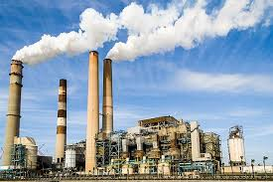
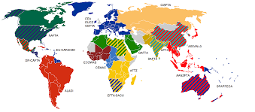


Towards a “Centre of Excellence”: Achievements
Mainstreaming of
economic diversification
issues )
Targeted recruitment
Mainstreaming of economic diversification issues in CCAs, Cooperation Frameworks, analysis of COVID-19 socio-economic impacts and formulation of response plans: Cameroon, Gabon, CAR and Equatorial Guinea
Proposals for
the SDG Fund
Advisory services
Capacity
development:
Chad PDIDE
TCHAD PDIDE, Cameroon PDI, national AfCFTA strategies, PDIDE-AC, surveillance on the state of economic diversification in Central Africa for CEMAC
Capacity building
of national officials
and other stakeholders
in trade and related tools
Economic diversification through resource-based and trade induced industrialization
Notes:
According to the UN Secretary/UNESCO/ILO

Slide 8





Towards a “Centre of Excellence”: Achievements
Contribution to SDGs
Stakeholders recognition
Plans for the future: toolkit, publication
of research papers in refereed journals
Economic diversification through resource-based and trade induced industrialization
Notes:
According to the UN Secretary/UNESCO/ILO

Slide 9




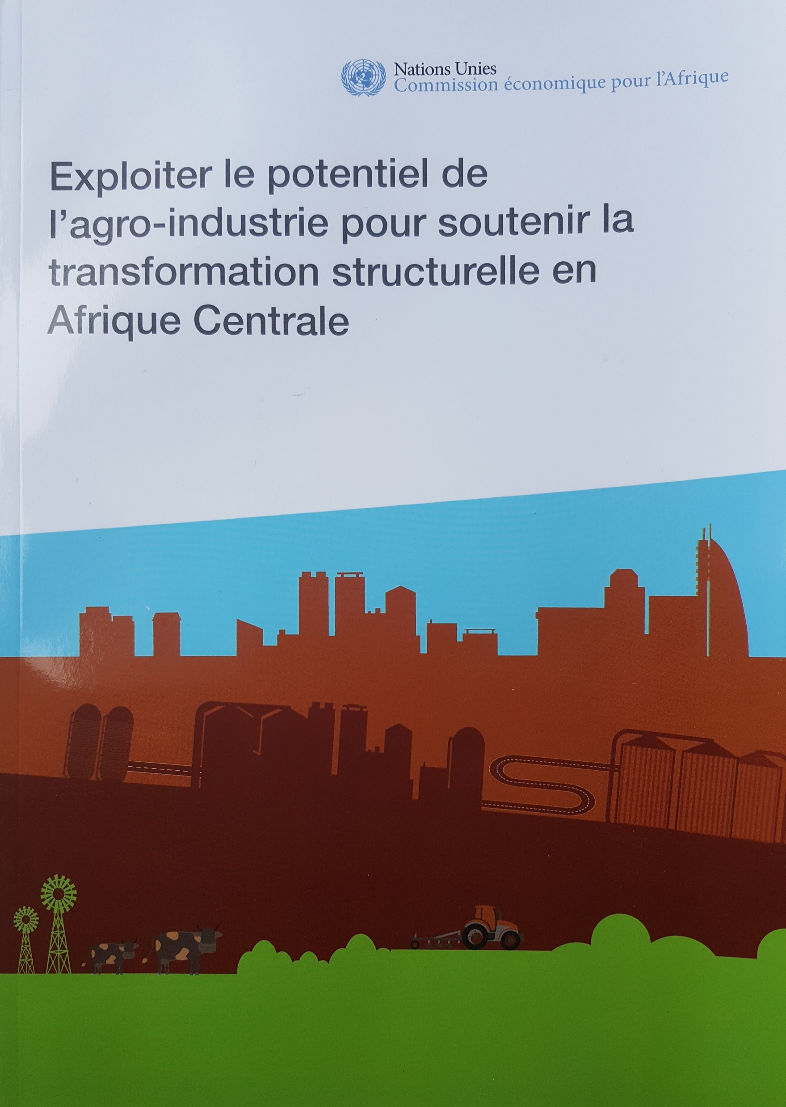


Think pieces and documentary
ACTIVITES 2017 - 2018 ET PROGRAMME DE TRAVAIL 2018 - 2019
Notes:
Les profils STEPS visent à fournir des données précises et une analyse des problématiques liées à la transformation structurelle perçue sous l’angle de la hausse du niveau d’emploi, du renforcement de la structure de production et de l’amélioration des conditions sociales en vue de promouvoir leur développement durable.

Slide 10

THANK YOU!
ECA

