Slide 1
Victor Konde OiC, Green Economy, Innovation and Technology Section Technology, Climate Change and Natural Resources Management Division.
2020 Second Quarter Accountability and Programme Performance Review Meeting
July 2020

Slide 2
2020 Progress on achievements (all budget sources: 18, 23, 11, 35)
Objective: Contribute to improved management of natural resource endowments, reducing the negative impacts of climate change by moving towards green transitions and climate-resilient development, and harnessing new technologies
Result Area 1: Enhanced capacity of member States to design and implement initiatives to harness new technologies and foster green economy for sustainable development
Progress made to achieving the result area: Increased number of initiatives undertaken by member States at national, subregional and regional level to harness new technologies, innovations and foster green economy in line with ECA recommendations [Baseline (2019) – 6, Target 10 – Actual 8]
Operational Support voluntary local reviews (VLRs) – Accra (Ghana), Harare and Victoria Falls (Zimbabwe) and Ngora (Uganda) with GPSPD and SROs Support operationalisation of the Africa Regional Mechanism of the Major Groups and other Stakeholders (ARMGOS) Advisory Services on digital transition strategies (Burundi, Zimbabwe, Cameroon) Think Tank Reports for the ARFSD and to the HLPF Two background reports (Rapid testing for COVID-19 is resource constrained area and 2. Medical Devices and PPES Design in Emergence Use Authorization).

Slide 3
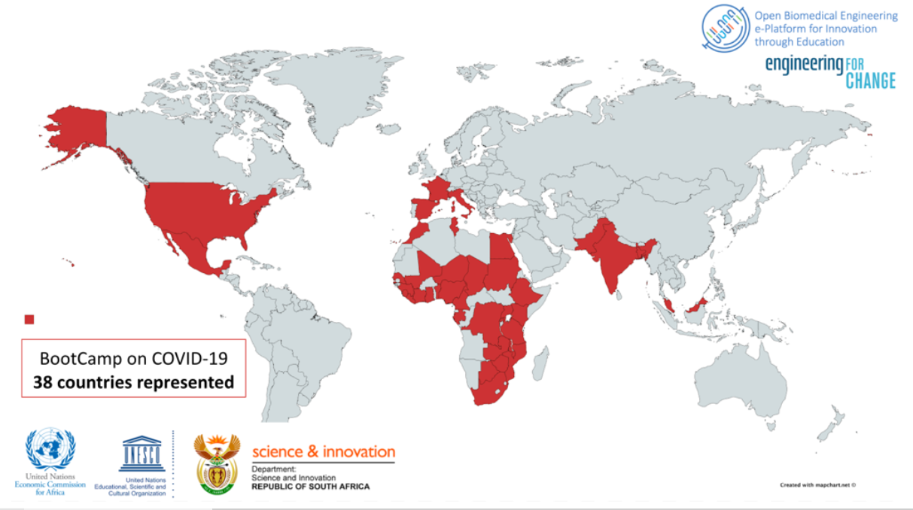
2020 Progress on achievements (all budget sources: 18, 23, 11, 35)
Progress made to achieving the result area: continued..
Convening Preparations for ARFSD 2020 inputs to the HLPF and for the 7th ARFSD in Brazzaville 2021. Africa Regional WSIS Outcomes 2020 (Virtual) whose outcomes informed the WSIS COVID-19 Innovation and Investment Forum 2020 (15-19 June) [testing, devices, PPEs, track & trace, Govt, pharma prodn] -164 investment-ready innovations submitted, 29 pitched, 4 showcasing -38 countries and 8 investors served as lion(ness) BDS needs of selected innovations COVID-19 Innovation Competition and Design Bootcamp 2020 (15-26 June) -264 applied, 105 in mentorship, 10 groups; 34 mentors/lecturers &11 key speakers – on design& fabrication of (1) medical devices and PPEs; 2) contact tracing and isolation; 3) new testing approaches; and 4) devices for therapy.

Slide 4
2020 Progress on achievements (all budget sources: 18, 23, 11, 35)
Progress made to achieving the remaining result area:
Think Tank (Research and reports): Emerging technologies for sustainable transportation in Africa (ACPC & RITD) New Approaches for Funding Research and Innovation (Q3) Report on impact of cyber Security in Africa Digital economy Transition (Q4) Unleashing the potential of the private sector to drive green growth and job creation (ACPC/SROs) Fostering sustainable transformation of agriculture in Africa through inclusive green economy (SRO/SA) Operational Follow on green growth, digital transition and harness technology and innovation to advance resource efficient economic diversification and sustainable development (NRM, ACPC and SROs) Convening Organization of side events and inputs into the HLPF and for 7th ARFSD in Brazaville 2021. Consultative meeting on STI Policy Design and Scoreboard in support of STISA 2024 and SDGs BME Youth Innovators and Design School Malawi (Dec ’20) Africa Internet Governance Forum (Q3).

Slide 5
HOW? Delivery modalities – RA1
Alignment with ECA’s strategic directions
Target countries
Joint delivery in Countries of Focus
(pick the relevant ECA SD icon)
Burundi, Cameroon with SRO-CA, Cote d’Ivoire, Ethiopia, Guinea, Kenya ACS, Niger, Rwanda, Senegal, Togo, Uganda, South Africa, Zambia and Zimbabwe
Digital strategies (Ethiopia, Cameroon with AUC, UNCTAD, ITU, AUC, SRO-CA)
NVRs/VLRs (Uganda, Cameroon, Zimbabwe with MGD, DESA, OSAA, UNDP, AUC),
Digital Platform for Transparency (Kenya with ACS),
IDEP on Entrepreneurial Universities, Intellectual Property and Green Economy (All African countries)
STI Policy Training (SADC -IATT WS6)
Response to COVID-19
Africa Innovation and Investment Forum 2020 on COVID-19
Youth Innovation and Design Competition Bootcamp on COVID-19
Digital platform for COVID-19 information (ACS)

Slide 6
HOW? Delivery modalities - RA1
Contribution to the SDGs
Follow-up on ARFSD res.
Partnerships (external)
Voluntary National Reviews
Voluntary Local Reviews
Youth Innovation Bootcamp
In ECA: MGD, GPSD, RITD, ACS, PSDFD, IDEP and SROs
Other UN: UNCTAD, ITU, WIPO, UNESCO, UN Environment, UNDP, FAO, DESA, OSAA, Other UN Regional Commissions, Secretariats of CBD, UNCCD and
UNFCCC, and other UN entities
Non-UN: AUC, ABEC, Fintech Associations, ATU, AUDA-NEPAD, RECs, AfDB,
Other UN and Non-UN: ABEC, Engineers for Change, Universities
2.a
3.b-d
4.3-6
5.b
8.2-3
9.a-e
12.2
12.5-6
13.1
13.2
14.1
14.2
15.1-3
15.5
17.6-8; 17.16
OIBCs (if applicable)
Gender Mainstreaming
2 = Economic transformation and diversification;
4 = Leveraging new technologies and enabling digital transitions
5 = Fostering action on climate change and enabling energy transitions
GEITS’ focus on building a critical mass of female researchers and STI experts (e.g. engineering)
Gender parity was highly encouraged during all panels at ARFSD

Slide 7
Status update: Risks and mitigations
Risks
Mitigation strategies
Limited human resources in the section
Increased demand in a difficult working environment (connectivity, digital platform limitations, low staffing of the section, slow recruitment process etc)
Delay of deliverables as result of the lockdowns associated with COVID-19 Pandemic
Requesting an increase in number of fellowships (1) and interns (three onboard)
Empowering partners to undertake activities that complement Section’s efforts
Prioritize research and preparatory activities and outputs that can realistically be delivered within resources or networks
Strengthen intra-and inter-divisional collaborations
Strengthen capacity for and adopting virtual delivery of outputs where possible

Slide 8
Status update on implementing partners
UNESCO:
Indirectly $30,000 for the first Bootcamp in Victoria Fall (Feb)
$12,000 contract for the Virtual Bootcamp on COVID-19 (June)
Travel and DSA for experts to the STI Forum 2020 (Feb)
DSI-South Africa
Travel and DSA for experts to STI Forum 2020 (Feb)
Sponsors of selected youth for IP training @ WIPO Academy (June)
Mobilization of Mentors, speakers and investors AIIF 2020 and Bootcamp
UNDESA:
Funding for ARFSD 2020 – US$25,000 (Feb)

Slide 9
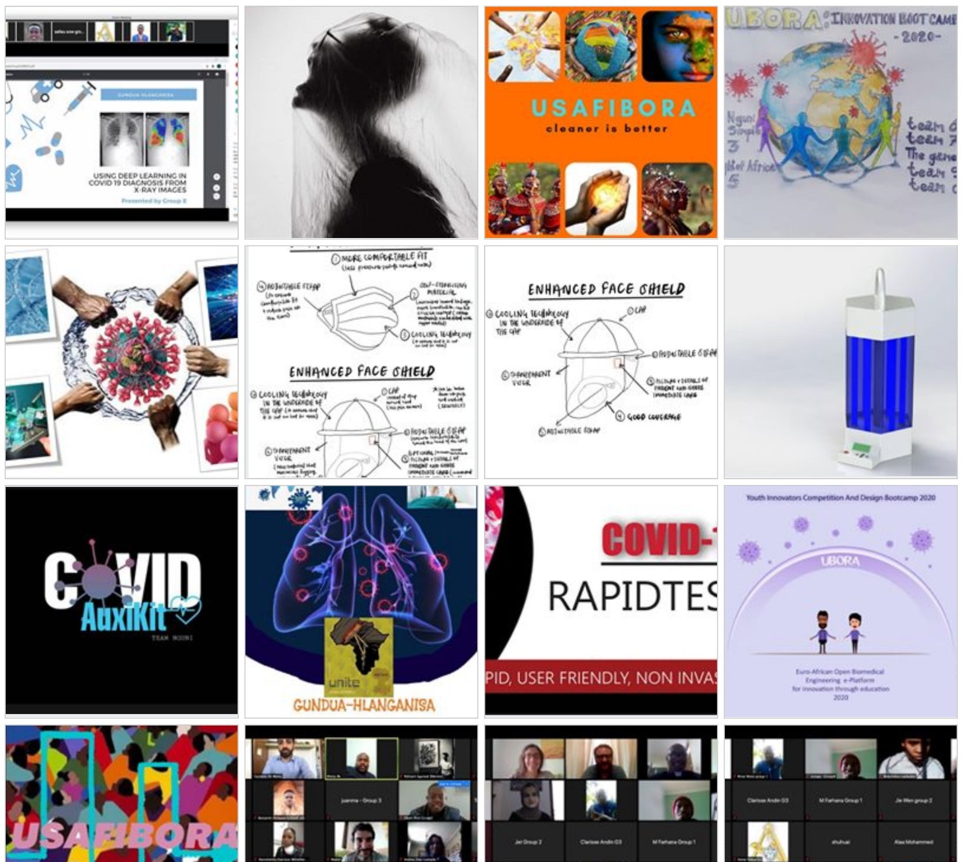
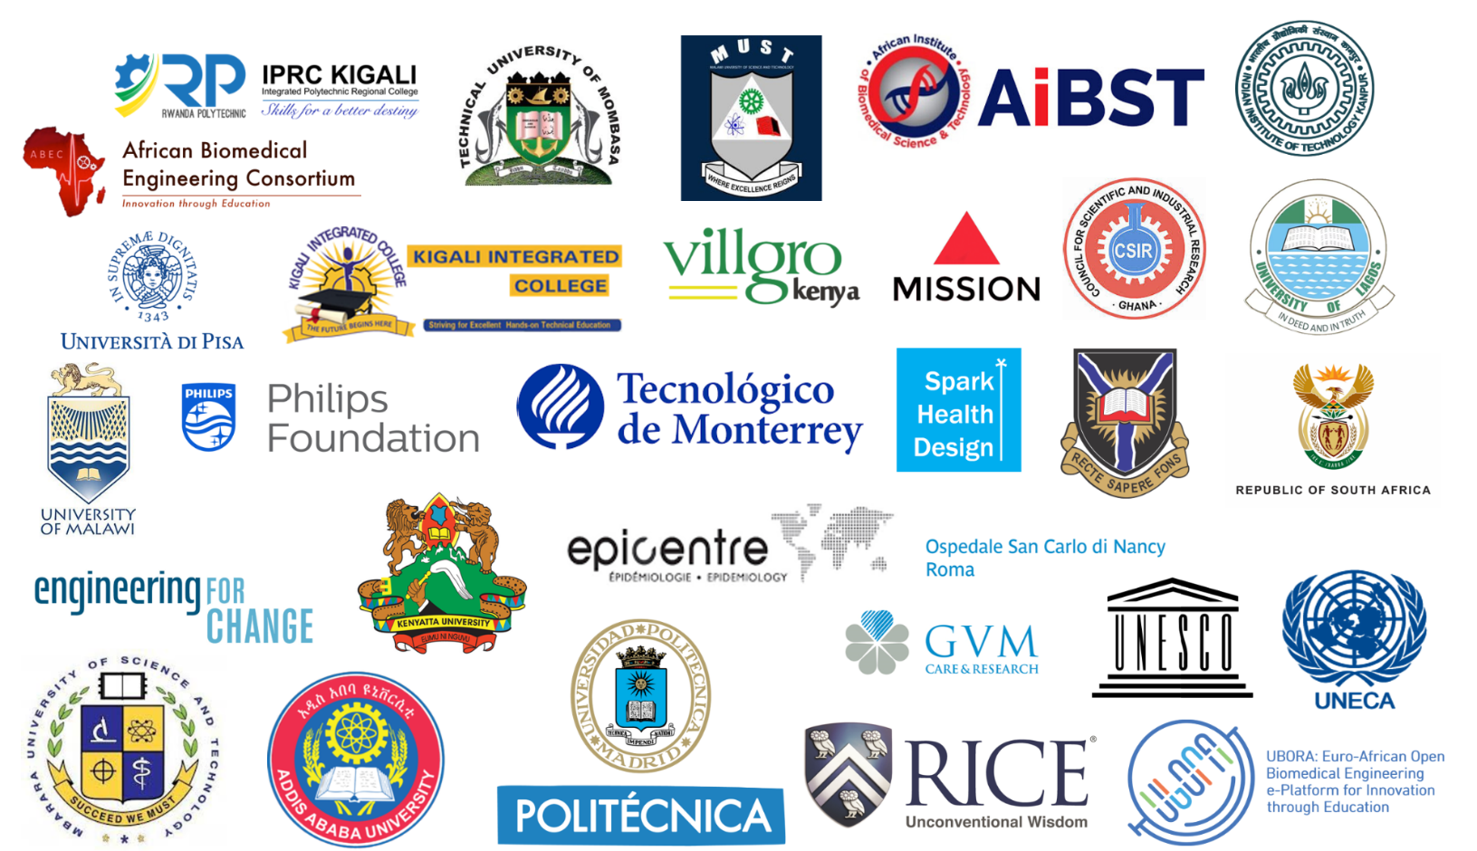
Highlights of Q2 2020
Two background research briefs in COVID-19:
1. Rapid testing for COVID-19 in resource constrained areas
2. Medical Devices and PPES Design in Emergence Use Authorization
Several contributions to the HLPF 2020

Slide 10
THANK YOU!

