Slide 1


Implementing the 2030 Agenda for Sustainable Development
NSOs Meeting on the Data Revolution in Africa
Addis Ababa
20-22 January 2016

Slide 2
The New 2030 Agenda
Adopted 25 September 2015; January 2016 – December 2030
“a plan of action for people, planet and prosperity”, “leave no one behind”
Consists of
  Declaration
  17 Sustainable Development Goals (SDGs), 169 targets
  means of implementation and renewed global partnership
  framework for review and follow-up (possibly 229 indicators)
Notes:
At a UN Summit (25-27 September 2015), 193 Member States of the United Nations adopted the new sustainable development agenda entitled “Transforming Our World: 2030 Agenda for Sustainable Development.” It officially comes into effect upon expiry of the Millennium Development Goals on 1 January 2016, and will run through 2030.
The 2030 Agenda sets forth “a plan of action for people, planet and prosperity”. It seeks to strengthen universal peace in larger freedom. And it herald’s a universal pledge that no one will be left behind. It envisages a world of universal respect for human rights, equality and nondiscrimination. And, commits stakeholders to work together to eradicate poverty in all its forms, promote sustained and inclusive economic growth, social development and environmental protection.
The 2030 Agenda consists of a Declaration, 17 Sustainable Development Goals (SDGs) and 169 targets, a section on means of implementation and renewed global partnership, and a framework for review and follow-up.

Slide 3
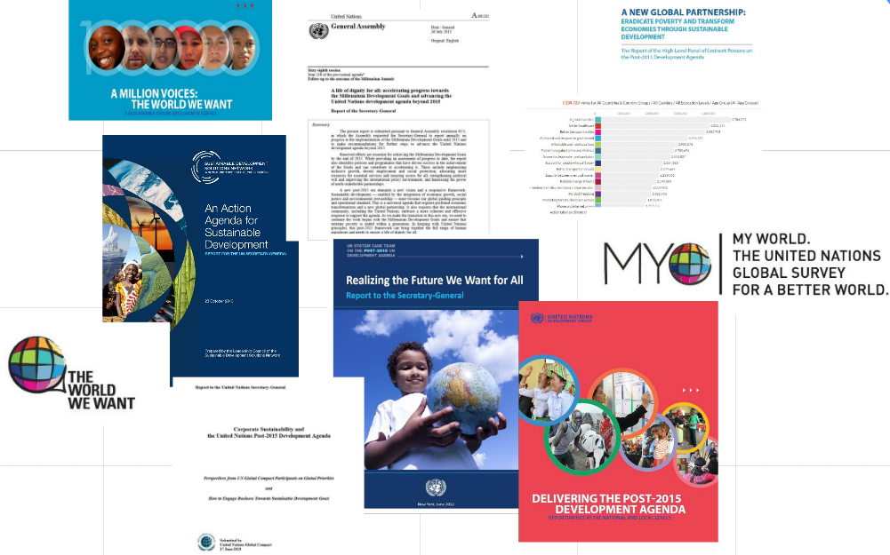
Result of a Participatory Process
Notes:
One of the potential lasting legacies of the SDGs is the inclusive nature of the process, people’s engagement and how this is the beginning of a fundamental shift in the way “we do business” in development. The process to design the 2030 Agenda for Sustainable Development was informed by a public consultation at a scope unprecedented in UN history. It is the result of a three–year–long transparent, participatory process inclusive of all stakeholders and people’s voices.
The UN system facilitated 88 national consultations starting in 2012 on the future that people want; 11 thematic consultations on a wide range of issues related to sustainable development; 6 dialogues on implementation; the worldwewant2015 platform; and the MY World survey.
The consultation process shaped deliberations of the High-Level Panel of Eminent Persons, the Member States Open Working Group charged with proposing a set of Sustainable Development Goals, contributed to the regular reports from the Secretary General, and ultimately informed the official negotiations that culminated in the adoption of the 2030 Agenda.

Slide 4

Sustainable Development Goals
Notes:
The SDGs are integrated and indivisible and balance the three dimensions of sustainable development: the economic, social and environmental.

Slide 5

From MDGs to SDGs
A much wider scope, beyond predominantly ‘social’ goals of MDGs, incorporating more fully aspects of economic and environmental sustainability, aspiration for peaceful and inclusive societies.
A more ambitious agenda, to eliminate rather than reduce poverty, with more demanding targets on health, education, gender equality
A universal agenda, applying to all countries and all people, with explicit recognition that international collective action is required
Notes:
The SDGs have built on the lessons learned from the MDGs and seek to complete the unfinished business. They are, however, more ambitious and broader in scope than the MDGs.
The Agenda calls for integration beyond silos and sectors and prioritizing actions that move us forward more quickly across a broad range of inter-linked goals
It requires us to support countries to “go the last mile” to reach the unreached, addressing the economic, social, and political factors underpinning exclusion.
It will be essential to manage risk, strengthen risk informed programming and resilience across all areas of the agenda
The SDGs are universally applicable, everywhere, both North and South, taking into account different national realities, capacities and levels of development and respecting national policies and priorities. Embracing universality means that national choices need to be informed by the policies and actions of others, with a much stronger understanding of policy coherence and the role of global public goods.

Slide 6

Implementing the SDGs
Now that this historic agenda has been adopted, how do we translate these goals into practical action?
Notes:
For the UN, the response needs to be at two levels:
As a system - the UN needs to step up efforts for coordinated and coherent support to Member States (-> e.g. see MAPS)
Within individual entities - strategies, programmes and operating procedures have to be adapted to the new era of development planning and assistance

Slide 7
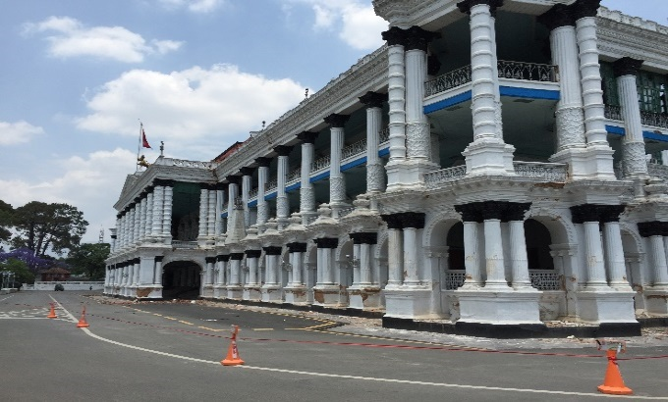

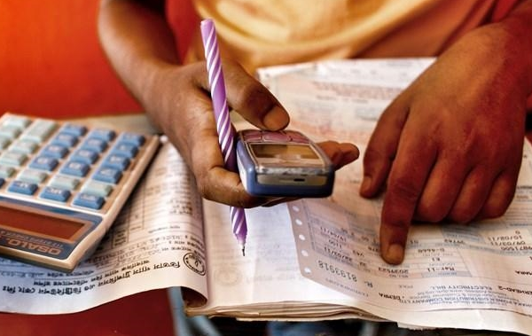
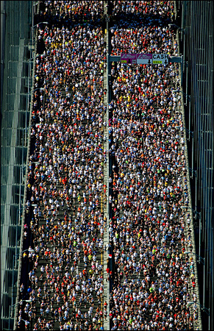
What is MAPS?
MAINSTREAMING
ACCELERATION
POLICY SUPPORT
Land the SDG agenda at national and local levels: integration into national and sub-national plans for development; and into budget allocations
Focus on priority areas defined by countries
Support integrated approach, considering synergies & trade-offs
Target resources at bottlenecks and gaps - financing, partnerships, measurement
Support – skills and experience - from UN agencies to countries, which should be made available at a low cost in a timely manner
Notes:
Responding to requests from Member States for coordinated support from the UN development system in implementing the 2030 Agenda, the United Nations Development Group (UNDG), under its Sustainable Development Working Group, is elaborating a common approach for effective and coherent implementation support, under the acronym ‘MAPS”.
MAPS stands for Mainstreaming, Acceleration, and Policy Support.
Mainstreaming: Helping governments to land and contextualize the agenda at national and local levels; ultimately reflecting the agenda in national plans, strategies and budgets. This means mapping what a country is already doing, and where it may need to change direction. It is also about continuing to sensitize national stakeholders about the new agenda.
Acceleration: Supporting governments and national stakeholders to target resources at root bottlenecks to sustainable development, paying special attention to synergies and trade-offs across sectors.
Policy Support: Providing coordinated and pooled policy support to countries that demand it, drawing on the expertise and programmatic experience of each part of the UN.

Slide 8



MAPS
Pay attention to cross-cutting issues:
  Partnerships
  Accountability
  Data
MAPS components will not follow a sequential order, but can frame a coherent approach to policy guidance by the UN development system. The UNDAF remains the strategic framework for the UNCT.
Deliverables 2015/2016:
  Mapping of agency / joint policy support tools
  Guidance for support to mainstreaming SDGs
  Guidance for national reporting on SDGs
  Toolkit for SDG-based acceleration framework
Notes:
MAPS can be tailored to development context and challenges faced, including in countries in transition or recovering from crises. Supporting partnerships, the availability of quality disaggregated data and analysis, and accountability are themes which cut across all three components of our approach to implementation.
MAPS components will not follow a sequential order, but can frame a coherent approach to policy guidance by the UN development system. It is applied through a set of tools, guidance and expertise for the UN Country Team’s substantive engagement with governments and partners on the SDGs. This informs the UN Development Assistance Framework or UNDAF, which remains the strategic framework that describes the collective response of the UN system to national development priorities.
MAPS Deliverables 2015/2016:
Mapping of agency/joint policy support tools (first iteration available on UNDG website)
Guidance for support to mainstreaming SDGs (co-led by UNDP; first iteration released 9 October 2015, see next slides)
Guidance for national reporting on SDGs (co-led by UNDP; expected end Q1 2016)
Toolkit for SDG-based acceleration framework (co-led by UNDP; expected by Q2 2016)

Slide 9

Mainstreaming Reference Guide
Array of approaches and tools that UNCTs can discuss with Member States to adapt the Agenda to national, sub-national and local conditions and realities.
A menu of options, with case studies providing examples of how some countries have begun to develop and use relevant tools.
It might also be of direct use to a broader audience of government officials and development practitioners.
Notes:
In October 2015, the UNDG endorsed the first deliverables of MAPS: the “Reference Guide to UN Country Teams on Mainstreaming the 2030 Agenda for Sustainable Development”. It is designed in support of initiative to adapt The 2030 Agenda for Sustainable Development to national contexts while protecting its integrity. As such, the guide does not seek to be either prescriptive or exclusive, but rather to spark on how to proceed.
It features a menu of approaches and tools to adapt the 2030 Agenda to national, sub-national and local conditions and realities, incorporating regional perspectives where appropriate. These approaches and tools should be treated by UNCTs as a menu of options, with the case studies providing examples of how some countries have begun to develop and use relevant tools.
While this reference guide was primarily prepared for UNCTs, the steps it describes, the case studies it highlights, and the publicly available tools that it refers to, might also be of direct use to a broader audience of government officials and development practitioners.

Slide 10
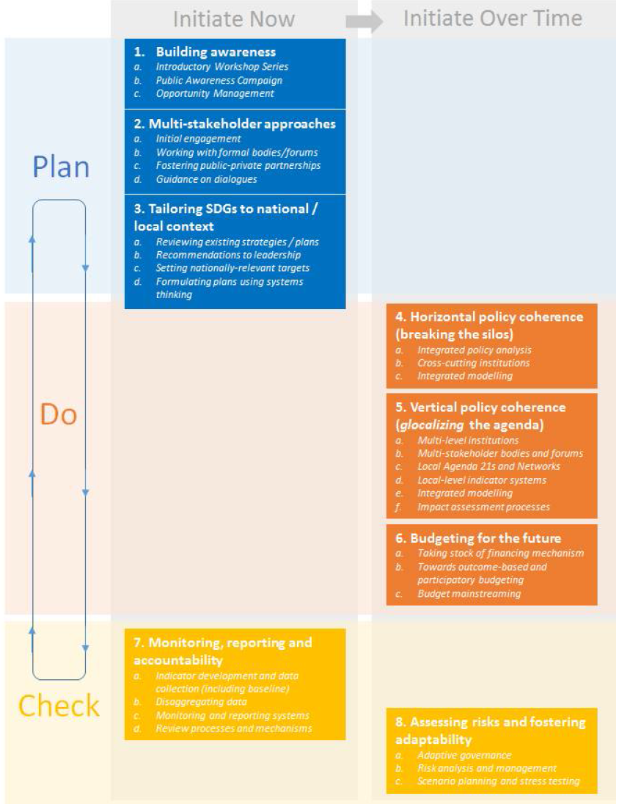
Notes:
The UNDG Reference Guide describes eight areas for mainstreaming the 2030 Agenda and adapting the SDGs to national contexts:
Raising public awareness
Applying multi-stakeholder approaches
Adapting SDGs to national, sub-national, and local contexts
Creating horizontal policy coherence (breaking the silos)
Creating vertical policy coherence (“glocalizing” the agenda—reflecting both local & global considerations)
Budgeting for the future
Monitoring, reporting and accountability
Assessing risks and fostering adaptability
Initial Roll-out of Mainstreaming Activities in 21 Countries:
21 UNCTs are piloting the use of this reference guide with policy and programmatic support by UNDP, as well as some seed funding. This group of 21 UNCTs covers all developing country typologies.
UNDP convened on 24-25 November 2015 in New York UNRCs and their government counterparts from pilot countries to draw initial lessons and identify additional needs for support. Representation was at the ministerial level in some cases and counterparts mainly came from Ministries of Finance and Planning. The meeting reinforced the usefulness of the reference guide and confirmed the appreciation for timely support and expectations for continued support over the next years.

Slide 11
Early Implementation Efforts
Algeria is undertaking a study on the current capacities of the national statistics systems and their readiness to contribute to the SDGs.
Cabo Verde and Rwanda undertook a gap analysis to ascertain alignment of national development targets with SDGs.
Botswana is conducting dialogues to map potential shocks that might impact SDG achievement, to inform long-term vision & medium-term plan.
DRC is convening a multi-stakeholders discussions on the prioritization and integration of the SDGs in the upcoming national development plan.
Morocco is using the ongoing United Nations Development Assistance Framework process as an opportunity to raise awareness about the SDGs.
Somalia is localizing and prioritizing the SDGs in the special context of fragility, and is establishing a statistics database for key indicators.
To popularise the goals, Uganda has appointed SDG Ambassadors (President on Goal 16) and mapped SDGs onto text of national anthem.
Notes:
Algeria is a study on the current capacities of the national statistics systems and their readiness to contribute to the Sustainable Development Goals indicators. Algeria is elaborating a detailed work plan for each of the 8 guidance areas of the MAPS Reference Guide.
Building resilience against economic, natural and other risks: Botswana is undertaking national dialogues and training workshops in all rural districts and urban centres to map potential shocks that might impact the achievement of the SDGs. These range from climate change impacts to global economic trends, including prices of diamonds, Botswana’s economic mainstay. The findings are to inform the formulation of its long term Vision (Vision 2036) and medium term National Development Plan (NDP11).
To help transpose the 2030 Agenda into national plans, UNDP has developed the “Rapid Integrated Assessment Tool ”. Cabo Verde has already used this gap analysis tool to inform national discussions on SDGs prioritization and mainstreaming into its next Growth and Poverty Reduction Strategy, which will be developed in 2016. Namibia is undertaking a similar exercice using the Rapid Integrated Assessment tool.
Rwanda is also a gap assessment through a review of national development plans. The UN Country Team has established an interagency Task Team on SDG domestication, which has supported the Government in piloting SDG 16 institutional Development and monitoring. Outputs include citizen report card, the CSOs barometer and the justice sector gender audit.
DRC convened initial workshops in December 2015, led by the Ministry of Planning and Revolution of the Modernity, to discuss the country prioritization of SDGs in view to their integration in the next 2017-2021 national strategic development plan, the elaboration of which is in progress. The Government plans to establish a national SDG working group and develop a roadmap to support implementation of the SDGs.
Morocco is using the ongoing United Nations Development Assistance Framework process as an opportunity to raise awareness about the SDGs, through various events such as a Youth Caravan on MDGs and a radio communication campaign based on Project Everyone.
In addition to a SDG launch conference with federal government, state governments, civil society and academia, Somalia has started the process of localizing and prioritizing SDGs in the Somali context, aiming to collate all relevant policies related to the SDGs, to identify a first set-up of indicators in line with the National Development Plan and to establish an initial statistics database for the key indicators.
To popularize the goals, Uganda has appointed SDG Ambassadors. The President of Uganda is the Ambassador on Goal 16. It is also using its national anthem to popularize the SDGs – by having mapped the issues contained in them onto its text.

Slide 12


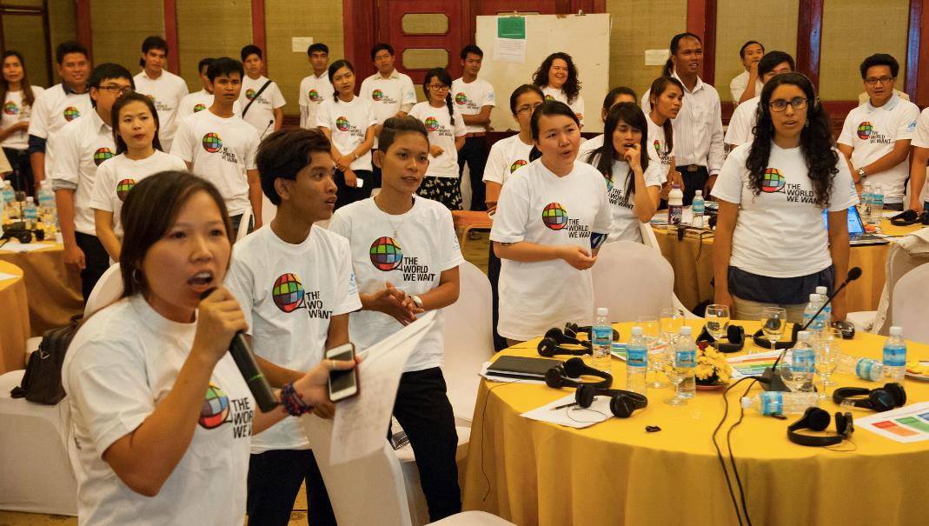

SDG Action Campaign
UN Millennium Campaign:
  Build and maintain political will for achieving the MDGs
  Build multi-stakeholder partnerships
  Citizen & stakeholder outreach for post-2015 Global Conversation
UN Millennium Campaign:
  Build and maintain political will for achieving the MDGs
  Build multi-stakeholder partnerships
  Citizen & stakeholder outreach for post-2015 Global Conversation
New UN SDG Action Campaign:
  Popularize SDGs in every country
  Engage stakeholders in implementation
  Sponsor citizen-driven processes to monitor progress
Notes:
UNDP will also play a strong role on national SDG advocacy and campaigning, continuing to administer the successor of the UN Millennium Campaign, an inter-agency initiative of the Secretary-General.
In October 2015, the UN Secretary-General requested that the UN Millennium Campaign mandate be extended to support the new Agenda, and that it coordinate closely with DPI.
The successor of the UNMC, "The SDG Action Campaign”, is to ensure that action-oriented mobilization - the core identity of the legacy campaign, and of the Post2015 global conversation process - is carried into the SDG implementation and monitoring processes.
The SDG Action Campaign will concentrate its efforts at the country level, working over the long-term and in a sustained way to:
Popularize the goals in every country through action-oriented engagement activities and training for key groups such as Parliamentarians, municipal leaders, and civil society.
Bringing stakeholders together to support implementation efforts led by governments, particularly from civil society.
Sponsoring citizen-driven processes to track progress on the agenda through crowdsourcing and grass-roots mobilization, including through an evolution of the MY World platform.

Slide 13

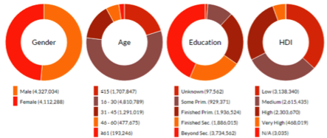
MY WORLD RESULTS
OVER 9.7 MILLION VOTES
194 COUNTRIES
1000+ PARTNERS
82% OFFLINE VOTES
77% VOTERS 30 YEARS OLD & YOUNGER
OPEN SOURCE PLATFORM
LIVE DATA VISUALIZATIONS
COUNTRY LEVEL MULTI-STAKEHOLDER GROUPS
 |  | A good education
 |  | Better healthcare
 |  | Better job opportunities
 |  | An honest and responsive government
 |  | Affordable and nutritious food
 |  | Protection against crime and violence
 |  | Access to clean water and sanitation
 |  | Support for people who can’t work
 |  | Equality between men and women
 |  | Better transport and roads
 |  | Reliable energy at home
 |  | Freedom from discrimination and persecution
 |  | Political freedoms
 |  | Protecting forests, rivers and oceans
 |  | Phone and internet access
 |  | Action taken on climate change
data.myworld2050.org
Notes:
SDG Action Campaign for the Sustainable Development Goals​
Continue the work of the UN Millennium Campaign​
Popularize the SDGs​
Localize the SDGs​
Get feedback from citizens​
Partner and innovate

Slide 14

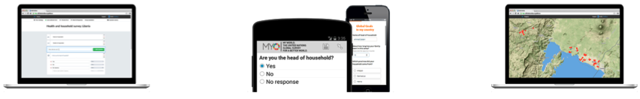
MY WORLD 2030
Beta version available now at myworld2030.org
Respondents asked asked to select the SDGs they are most passionate about and rate progress
Customized survey development options
Tool for localization, monitoring and accountability
Participating in data revolution
BUILD CUSTOM SURVEYS
COLLECT DATA
ANALYZE AND MANAGE DATA
Notes:
MY World 2030:​
Build on MY World 2015 - http://data.myworld2015.org/​
People's perception of progress on SDGs implementation - How are their lives changing?​
Globally comparable data - scaled up, nationally representative​
Feed into official monitoring efforts at national and global levels​
Build dialogue between decision-makers and citizens, to contribute a "people's perspective" on how to implement the SDGs.​

Slide 15
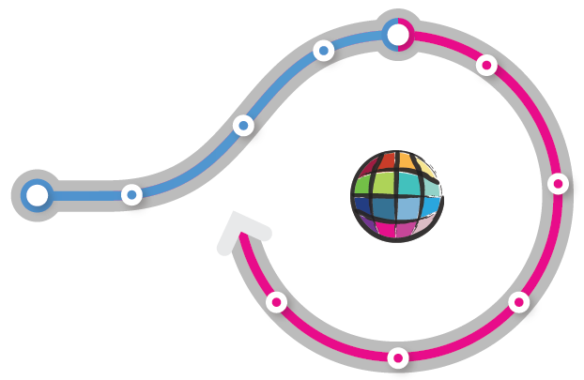
1000+ PARTNER ECOSYSTEM
TODAY
LOCALIZATION, IMPLEMENTATION AND ACCOUNTABILITY
MASS CITIZEN ENGAGEMENT
PRIORITIZATION VEHICLE FOR SDGS
SCALE AND REPRESENTATIVENESS
MY WORLD 2015
MY WORLD
2030
EMBEDDED INTO POLITICAL PROCESS
GLOBAL , REGIONAL, NATIONAL, SUB-NATIONAL
NATIONAL STAKEHOLDER GROUPS FOR DESIGN AND ADVOCACY

Slide 16

Implementing the SDGs
SDG Implementation in Fragile
and Conflict-Affected States

Slide 17
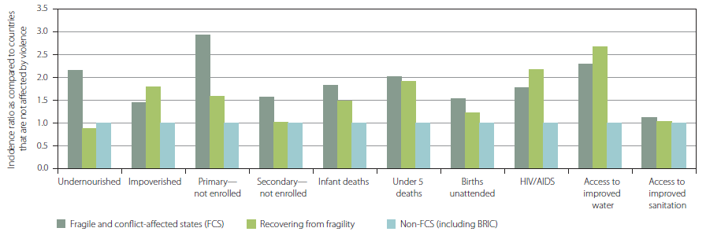
Conflict-affected countries were famously
‘left behind’ by the MDGs
Fragile and conflict-affected states have been among the lowest performing countries with regards to the MDGs

Slide 18
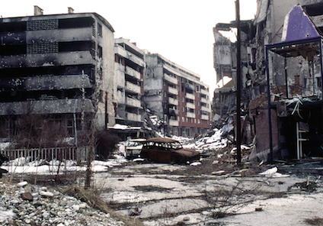
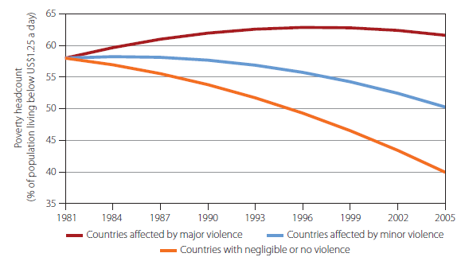
Conflict destroying development gains
Conflict and disaster often destroys hard gained development gains
Notes:
Syria, refugee influx Lebanon got worse with regards to development indicators

Slide 19
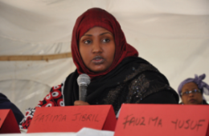
Special approach needed
“Leave no one behind”
There was criticism that their special circumstances were not taken enough into consideration in the MDG process
For the SDGs, fragile and conflict-affected countries need targeted support to address bottlenecks

Slide 20

SDG Readiness in Fragile States
Study
UNDP Strategic Policy Unit is planning a research study to support the readiness of states affected by conflict and fragility to implement the 2030 Agenda, in short “The SDG Readiness in Fragile States Study”
The study will draw on a range of countries as case studies and publish recommendations for SDG implementation in fragile and conflict-affected states
Notes:
Bottlenecks fall in the area of capacity (e.g. availability and ability to collect national statistics), peace and inclusivity (addressing conflict legacy, social cohesion, political settlements), risk and resilience (risk management, preparedness and prevention)

Slide 21
SDG Indicators
UN Statistical Commission Roadmap
  Inter-Agency and Experts Group on SDG Indicators established by UN Statistical Commission in March 2015
  Two work streams: indicator framework, interlinkages across goals and targets
  Process is highly political and contentious​. Strong oversight, or political guidance by member states.
  SDG Indicators Framework to be presented at 47th Session of UN Statistical Commission expected in March 2016: 149 agreed indicators, 80 for further discussions
Mandate/Criteria
  Limited number of indicators, but no target left behind
  Data disaggregation by age, gender and other criteria to address vulnerability and exclusion
  Respect national policy space: each country can decide own indicators
Notes:
26

Slide 22
How did we support MDG Monitoring?
Scorekeeper of the MDGs
  500+ national MDG reports in 140+ countries
  Promotion of MDGs
  Assessment of progress
  Contribute to national debate on development
  Highlight challenges and insufficiently monitored issues
Country Report Guidelines in 2001, 2003, 2009, 2013
Support statistical capacity for measuring development progress
  Data collection and analysis to produce MDG reports
  Fill data gaps
  Improvement in data quality
  Help create data-friendly environment

Slide 23
National SDG Reports
United Nations Development Group - Sustainable Development Working Group
Inter-agency task team on Data and National SDG Reports
Objectives:
  Strengthen data systems, capacities, methodologies and mechanisms to track progress
  Effective and efficient monitoring and reporting through coordination, facilitation, knowledge sharing
  Guidance for producing national SDG reports
  Pooled expertise from UN System to support for 144 low and middle income countries
Notes:
28

Slide 24
Data Ecosystem Mapping
Opportunities and constraints for stakeholders engagement in data revolution for sustainable development
7 countries: Bangladesh, Colombia, Moldova, Mongolia, Senegal, Swaziland, Trinidad and Tobago
Stakeholders
Data producers
Data users
Data funders
Infomediaries
Capacities
Statistical capacity
Analytical capacity
Data literacy
Leadership
Processes
Monitoring, Accountability, Transparency
Development planning
Policy-making
Knowledge sharing
Policies
Laws: FoI, A2I, Privacy, Security
Enabling regulations
E-commerce, Copyrights
International obligations
Infrastructure
Telecoms, Data centers
Data analytics, visualization
Data standards
Inter-operability
Notes:
29

Slide 25
Why Data Matters for the SDGs?
Inform policies
  AAAA: High-quality data is essential for smart and transparent decision-making, can improve policymaking at all levels
  The complexity and inter-connectedness of the SDGs will require significant research and analysis to ensure the coherence of implementation efforts and manage trade-offs.
Monitor progress
  With 169 targets, and potentially as many indicators, measuring the SDGs will require significant improvements in quality, reliability, availability and timeliness of development data
  Data from non-official, third-party sources can complement official statistics where gaps exist
Leave no one behind
  Data can help achieve the transformative impact of the SDGs, by providing information on who benefits or not from the SDGs, through data disaggregation according to international human rights framework
Accountability, participation and empowerment
  Data is necessary but not sufficient for accountability. People must have a say on which data about them is used and how. They must have access to data and be empowered to take action within their communities.

Slide 26
Key Dates 2016
8-11 Mar: 47th Session of the Statistical Commission to agree on SDG indicators
30 Mar-1 Apr: 3rd Meeting of the Inter-Agency and Experts Group on SDG Indicators
11-12 Apr: UNGA High-Level Thematic Debate: Implementing Commitments on Sustainable Development, Climate Change and Financing
22 Apr: Signing of Paris Climate Agreement
11-20 Jul: High Level Political Forum on Sustainable Development
18-22 Jul: ECOSOC High-level segment: The Theme “Implementing the post-2015 development agenda: moving from commitments to results”

Slide 27
Thank You!

