Slide 1
Delivering on Data Revolution in Africa:
Country Compacts as the Next Step
Alex Ezeh, PhD
Executive Director
African Population and Health Research Center

Slide 2
Moving from ADC to a Country-led DR in Africa
ADC Principles:
  Countries MUST OWN the prioritization, financing & leadership of this revolution
  The data community should EMBRACE the Fundamental Principles of Official Statistics as a starting point
  Information MUST BE timely, accurate, relevant & accessible
Key Actions
  Create an inclusive data ecosystem
  Government should take the lead …

Slide 3
How do we catalyze a data revolution at country level in Africa?
Data for Africa Development (DfAD) Working Group
  Explored root causes of slow data progress in Africa with a focus on political economy challenges
Final report available at http://www.aphrc.org
  Identifies challenges and strategies to address limitations
  Provides specific, actionable recommendations for strengthening national statistical systems in Africa
    National government
    Donors and international technical agencies
    Civil society and research organizations and academic institutions

Slide 4
Summary of DfAD WG Recommendations
Build Institutions that can produce accurate, unbiased Data
  Enhance functional autonomy
  Fund National Statistical Systems differently
Improve data access, accuracy and coordination
  Build quality-control mechanisms, inter-sectoral coordination, norms & standards
  Encourage open data
Leverage regional/multilaterals to build NSS capacity
  Develop formalized partnerships for capacity building

Slide 5
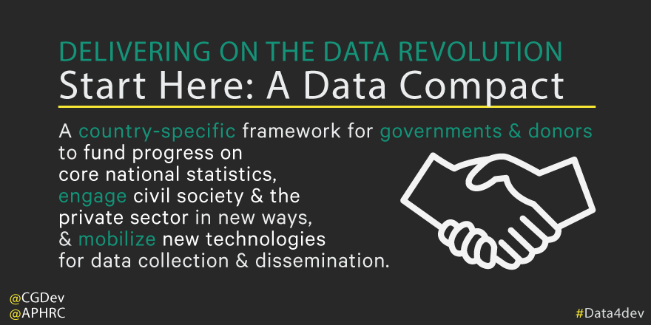
Putting the Recommendations into Action: Call for Country Compacts

Slide 6
Achieving a Country Compact: Steps & Activities 1
Convene a National Data Forum
  Lead: Government (NSO + line ministries and sub-national govts)
  Output: A profile of key actors, their focus, capacity, plans & commitments
  Outcome: A Reference group or National Data Steering Committee formed + key Technical Working Groups
Conduct reviews – legal/regulatory, other actors, financial flows, gaps and data priorities, etc.
  Lead: technical agencies with capacity in each area + oversight from NSO & National Forum (Steering Committee).
  Output: Series of reports documenting results of each review and a summary report + dashboard
  Outcome: An up-to-date assessment of the country’s data ecosystem, current status, gaps, opportunities, national roadmap, etc.

Slide 7
Achieving a Country Compact: Steps & Activities 2
Develop action plan with thematic working groups
  Lead: National Forum – through technical working groups
  Outputs: defined technical working groups formed with joint institutional leadership – regulatory reforms, inter-sectoral coordination/norms/standards, CRVS, financing, capacity building, etc.
  Outcome: A working data community poised to deliver on the DR
Sustaining the revolution
  Lead: National Forum through its management organs
  Outputs: Resources mobilized through the NF to support TWGs; Peer-reviews used to track performance and progress of TWGs; TWGs meet at least monthly and NF at least twice each year
  Outcome: A working data community delivering on the DR with strong common voice to influence continental and global agendas around DR.
Notes:
Should we say something about the duration of a compact? funding for its implementation?

Slide 8
APHRC Consultation on Country Compact 1
Meeting: February 10-11 in Nairobi
  Institutions involved in delivering on data revolution in Africa
    Continental bodies – ECA
    DGs of selected NSOs already leading national processes on DR – SA, KE, TZ, etc.
    CSOs active in the region – Development Initiatives, PASGR, Ushahidi
    Others

Slide 9
APHRC Consultation on Country Compact 2
Objectives
  Brainstorm on creating a space for Africa-led strategy & activity harmonization
  Define and clarify strategies and steps to advance CCs
  Identify each partner’s area of focus and planned activities
  Discuss possibilities and modalities of collaboration for accelerated actions
  Identify collaborative opportunities that if taken separately would have less impact and be less efficient

Slide 10
APHRC Consultation on Country Compact 3
Expected outcomes
Joint work plan for 2016
  Outline partners’ roles and responsibilities
Strategy for resource mobilization to support further partnership and engagement
  Distill lessons learned and bring together wider network of interested and invested stakeholders.

Slide 11
