Slide 1
Africa and the Data Revolution
Dozie Ezigbalike
African Centre for Statistics, UNECA
Special EGM for DGs of NSOs
20 – 22 January 2016
Addis Ababa, Ethiopia

Slide 2
Central Messages
Definition of data revolution that is not based on exists
Priority to implementation
Principle 5 of Fundamental Principles
Re-interpreting the definition

Slide 3
An explosion in the volume of data, the speed with which data are produced, the number of producers of data, the dissemination of data, and the range of things on which there is data, coming from new technologies such as mobile phones and the “internet of things”, and from other sources, such as qualitative data, citizen-generated data and perceptions data...
A Definition of Data Revolution
[SG’s Data Revolution Group in “A World that Counts”]

Slide 4
Concern for Africa
With this definition, we are going to be left behind by the data revolution
These things are not necessarily true in Africa

Slide 5
Interpretation
Re-interpret “data revolution”
NOT in terms of what exists – which doesn’t exist in Africa
BUT in terms of what we need to do

Slide 6
Data Revolution: A Working Definition for Africa
A Data Revolution in Africa is defined as the process of bringing together diverse data communities to embrace a diverse range of data sources, tools, and innovative technologies, to provide disaggregated data for decision-making, service delivery and citizen engagement; and information for Africa to own its narrative.

Slide 7
What is a Data Community?
A data community refers to a group of people who share a social, economic or professional interest across the entire data value chain – spanning production, management, dissemination, archiving and use

Slide 8
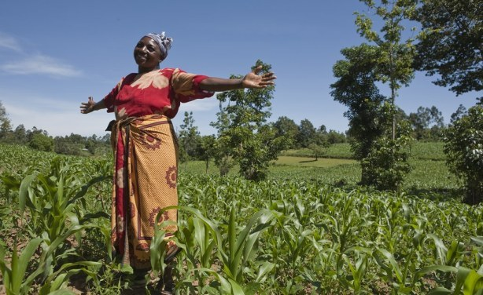
SDG Goal 2
Example to explain the data community concept
End hunger, achieve food security and improved nutrition and promote sustainable agriculture

Slide 9
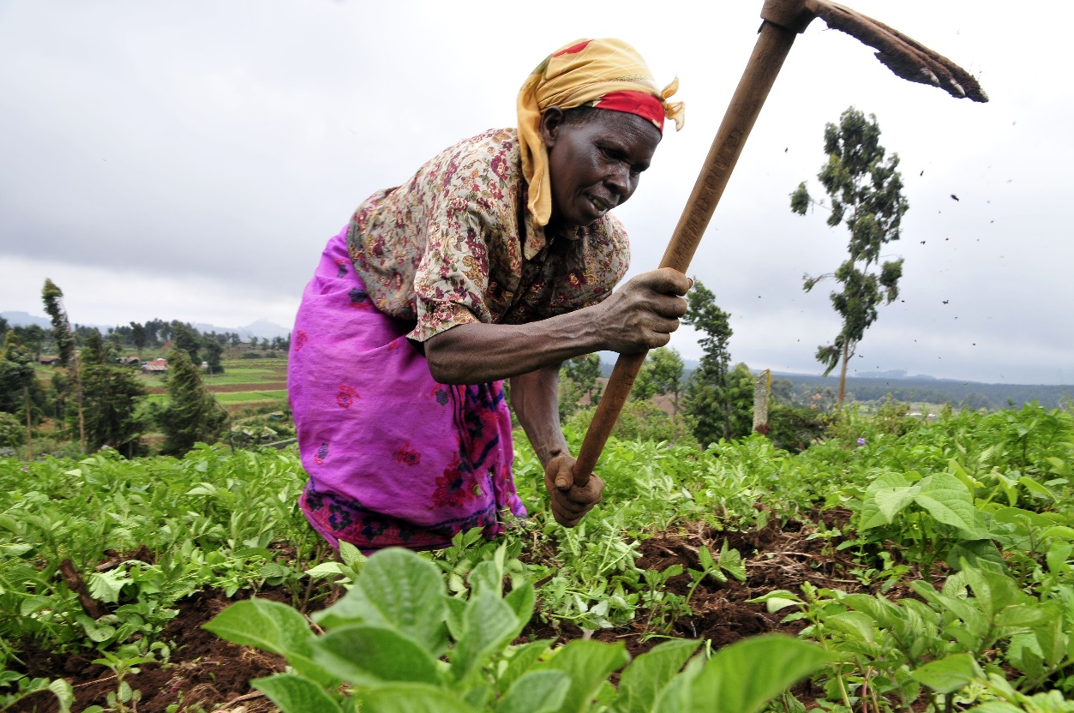
“By 2030, double the agricultural productivity and incomes of small-scale food producers, in particular women, indigenous peoples, family farmers, pastoralists and fishers, including through secure and equal access to land, other productive resources and inputs, knowledge, financial services, markets and opportunities for value addition and non-farm employment”
Explaining the data community concept (cont’d)
Target 2.3

Slide 10
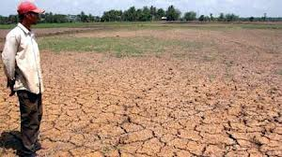
“… ensure sustainable food production systems and implement resilient agricultural practices that increase productivity and production, that help maintain ecosystems, that strengthen capacity for adaptation to climate change, extreme weather, drought, flooding and other disasters and that progressively improve land and soil quality”
Explaining the data community concept (cont’d)
Target 2.4

Slide 11
Explaining the data community concept (cont’d)
Emphasis on “Implementation”
Common misconception that “development goals” are about only “monitoring” and reporting
Therefore, a tendency to collect data on agreed indicators to report on situation
After the fact. Land has degraded, people may have died from floods, etc.
Focus on Implementation
Properly defined, should include documenting baseline situation, planning interventions, delivering services and monitoring progress to refine plans and actions
The data will then be available to generate the indicators for reporting

Slide 12
Explaining the data community concept (cont’d)
Proposed indicator for 2.3
Volume of production per labour unit (measured in constant USD), by classes of farming/pastoral/ forestry enterprise size
Deconstruct the target:
Did we double productivity? | √
… of small-scale producers? | √
… particularly women? | ⊗
… secure and equal access to land? | ⊗
… financial services? | ⊗
High volume does not necessarily meet the target
… because emphasis was on reporting on the indicator

Slide 13
Explaining the data community concept (cont’d)
Secure and Equal Access
Refocus on implementation data
Identification of land parcels or units of holding and/or use
Interests and rights recognized in land
Ownership interests, grazing rights, access rights, group rights, management rights, etc.
Current holders of the interests
Including stakeholders
Land capability and potential
Suitability analysis
Current uses
Taxes and charges assessed; amount paid
… etc

Slide 14
Explaining the data community concept (cont’d)
Not really new
Land records and cadastres have been around
Initially with emphasis on conveyancing and taxation
Became multi-purpose in the 1980s, applying modern information technologies
Countries have varying degrees of restrictions to access
From complete public access – conditions apply of course
To near-complete secrecy – except for owner
Modern economic models recommend openness to the management of land information
Country specific decisions on degree of openness

Slide 15
Explaining the data community concept (cont’d)
Managing Land Record: The land Data Community
There are experts, practitioners, officials, who:
Understand the concepts associated with this type of data, including best way to curate them and disseminate to wider society
Are in a position to collect the data in the course of normal work
Need them more than others in the course of their work, therefore have the strongest incentives to keep them updated
Constitute them into a data community and give it mandate/credential to collect, curate and disseminate these datasets for everybody
Define other data communities in similar fashion

Slide 16
Principle 5. Data for statistical purposes may be drawn from all types of sources, be they statistical surveys or administrative records. Statistical agencies are to choose the source with regard to quality, timeliness, costs and the burden on respondents.

Slide 17
Just Formalize it!
How? …

Slide 18
Develop a Data Revolution Implementation Strategy
Start with high level political commitments to support key initiatives related to data revolution and statistical development
Designate a coordinating government entity and secretariat
Natural choice should be National Statistical Institute/Office
Develop engagement and communication strategy
Don’t forget: governance arrangements
Publicize the strategy and call for expression of interest
Specific outreach to key data communities: include geospatial data community, government departments, CSOs, private, academic and research sectors
Convene consultative meeting of stakeholders
Endorse the governance arrangement
Endorse the strategy
Agree on priorities, actors and timeline for activities
Proceed with the planned activities

Slide 19
Expanding the Data Ecosystem
NOT all new data sources CAN fit into traditional/official statistical systems
New sources constantly being discovered
New uses evolving
Some decisions do not need data to be stamped as “official” before using them

Slide 20
Data Ecosystem (contd.)
The outcome document from the SDG negotiation process, submitted to the GA, emphasized that the follow-up and review of the implementation of the goals will be based on national official data sources
The new development paradigm’s “leave no one behind” and emphasis on accountability imply involving private citizens and other non-government actors in data production and curation.

Slide 21
So Expand the Ecosystem!
How? …
Formalized data communities coordinated by NSOs

Slide 22
Key Issues and Challenges
Not yet in the policy radar
Must be underpinned by national policy with explicit provisions for open licensing, governance, partnership and capacity development
Legal framework/environment
Laws dealing with data and statistics need to be aligned to each other and to new data revolution concepts
Competence of new data communities
Data quality and curation principles
Interfaces with each other and with the national statistical systems
Competence of citizens
To participate in data generation
To consume information and get involved in accountability

Slide 23
Thanks

