Slide 1
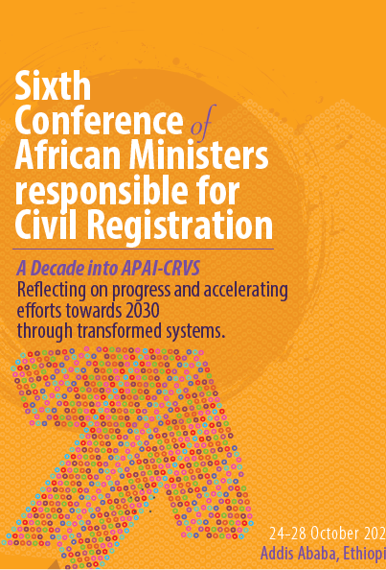

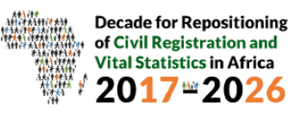

Assessing progress in the development of civil registration and vital statistics systems in the region: How can Africa accelerate progress in meeting regional and international commitments? Your presentation will be on “Status of birth registration in Africa: status, success stories, proven best practices, opportunities and strategies for progress: 24th October 2022
Name of presenter: Andrew Brooks, Child Protection Regional Advisor
Institution: UNICEF-ESARO
Country: Nairobi-Kenya

Slide 2
Outline of the presentation
Status of birth registration in Africa
Success stories, proven best practices
Opportunities and strategies for progress

Slide 3

Status of Birth registration in Africa
The right of every child to birth registration is enshrined in various international instruments such as the UN CRC (articles 7 & 8) & African Charter on the Rights and Welfare of the Child (article 6)
However, many children in Africa are still deprived of birth registration for different reasons among them, barriers to services or information, costs, discriminatory laws, among others.
Of the 164 million unregistered children worldwide, more than half (around 91 million) live in Africa) which is 56% of the unregistered U5 children globally (32% South Asia and 12% the rest of the world).
Without birth registration and a certificate, children are invisible to their Government’s and may miss out on essential programmes and rights such as education, health, social protection, child justice/ECM.
To support member countries to accelerate birth registration and legal identity, the UN has a dedicated SDG target 16.9- legal identity for all by 2030 including birth registration.

Slide 4
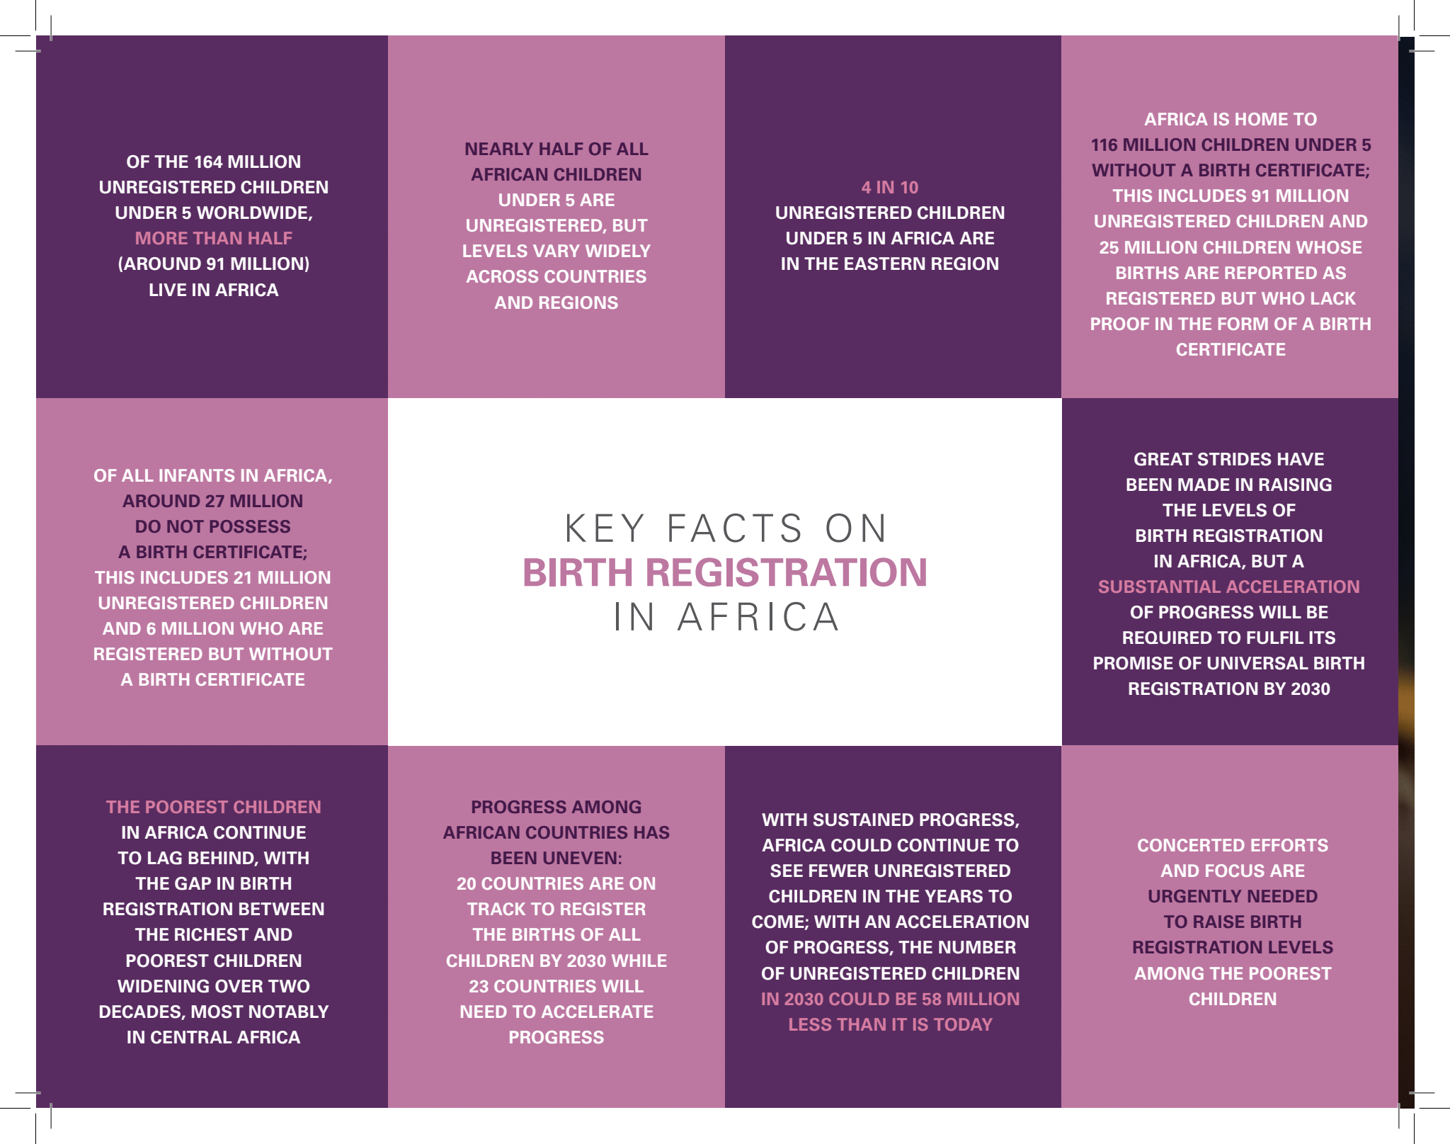
Statistics on the status of birth registration in Africa (2022 BR Statistical brochure)

Slide 5
Success stories and best practices
In Cameroon, Côte d’Ivoire and Mali, the law allows delegation of authority from civil registration to the health system for the declaration of births, removing the need for parents to travel to the civil registration office.
In the Democratic Republic of the Congo, parents can sign a power of attorney form to allow health agents to declare the births on their behalf.
In Rwanda, the law has given the health sector, through the director of midwifery and nursing in health facilities where births occur, the same powers as the civil registrar’s office to register births and deaths and to issue certificates

Slide 6
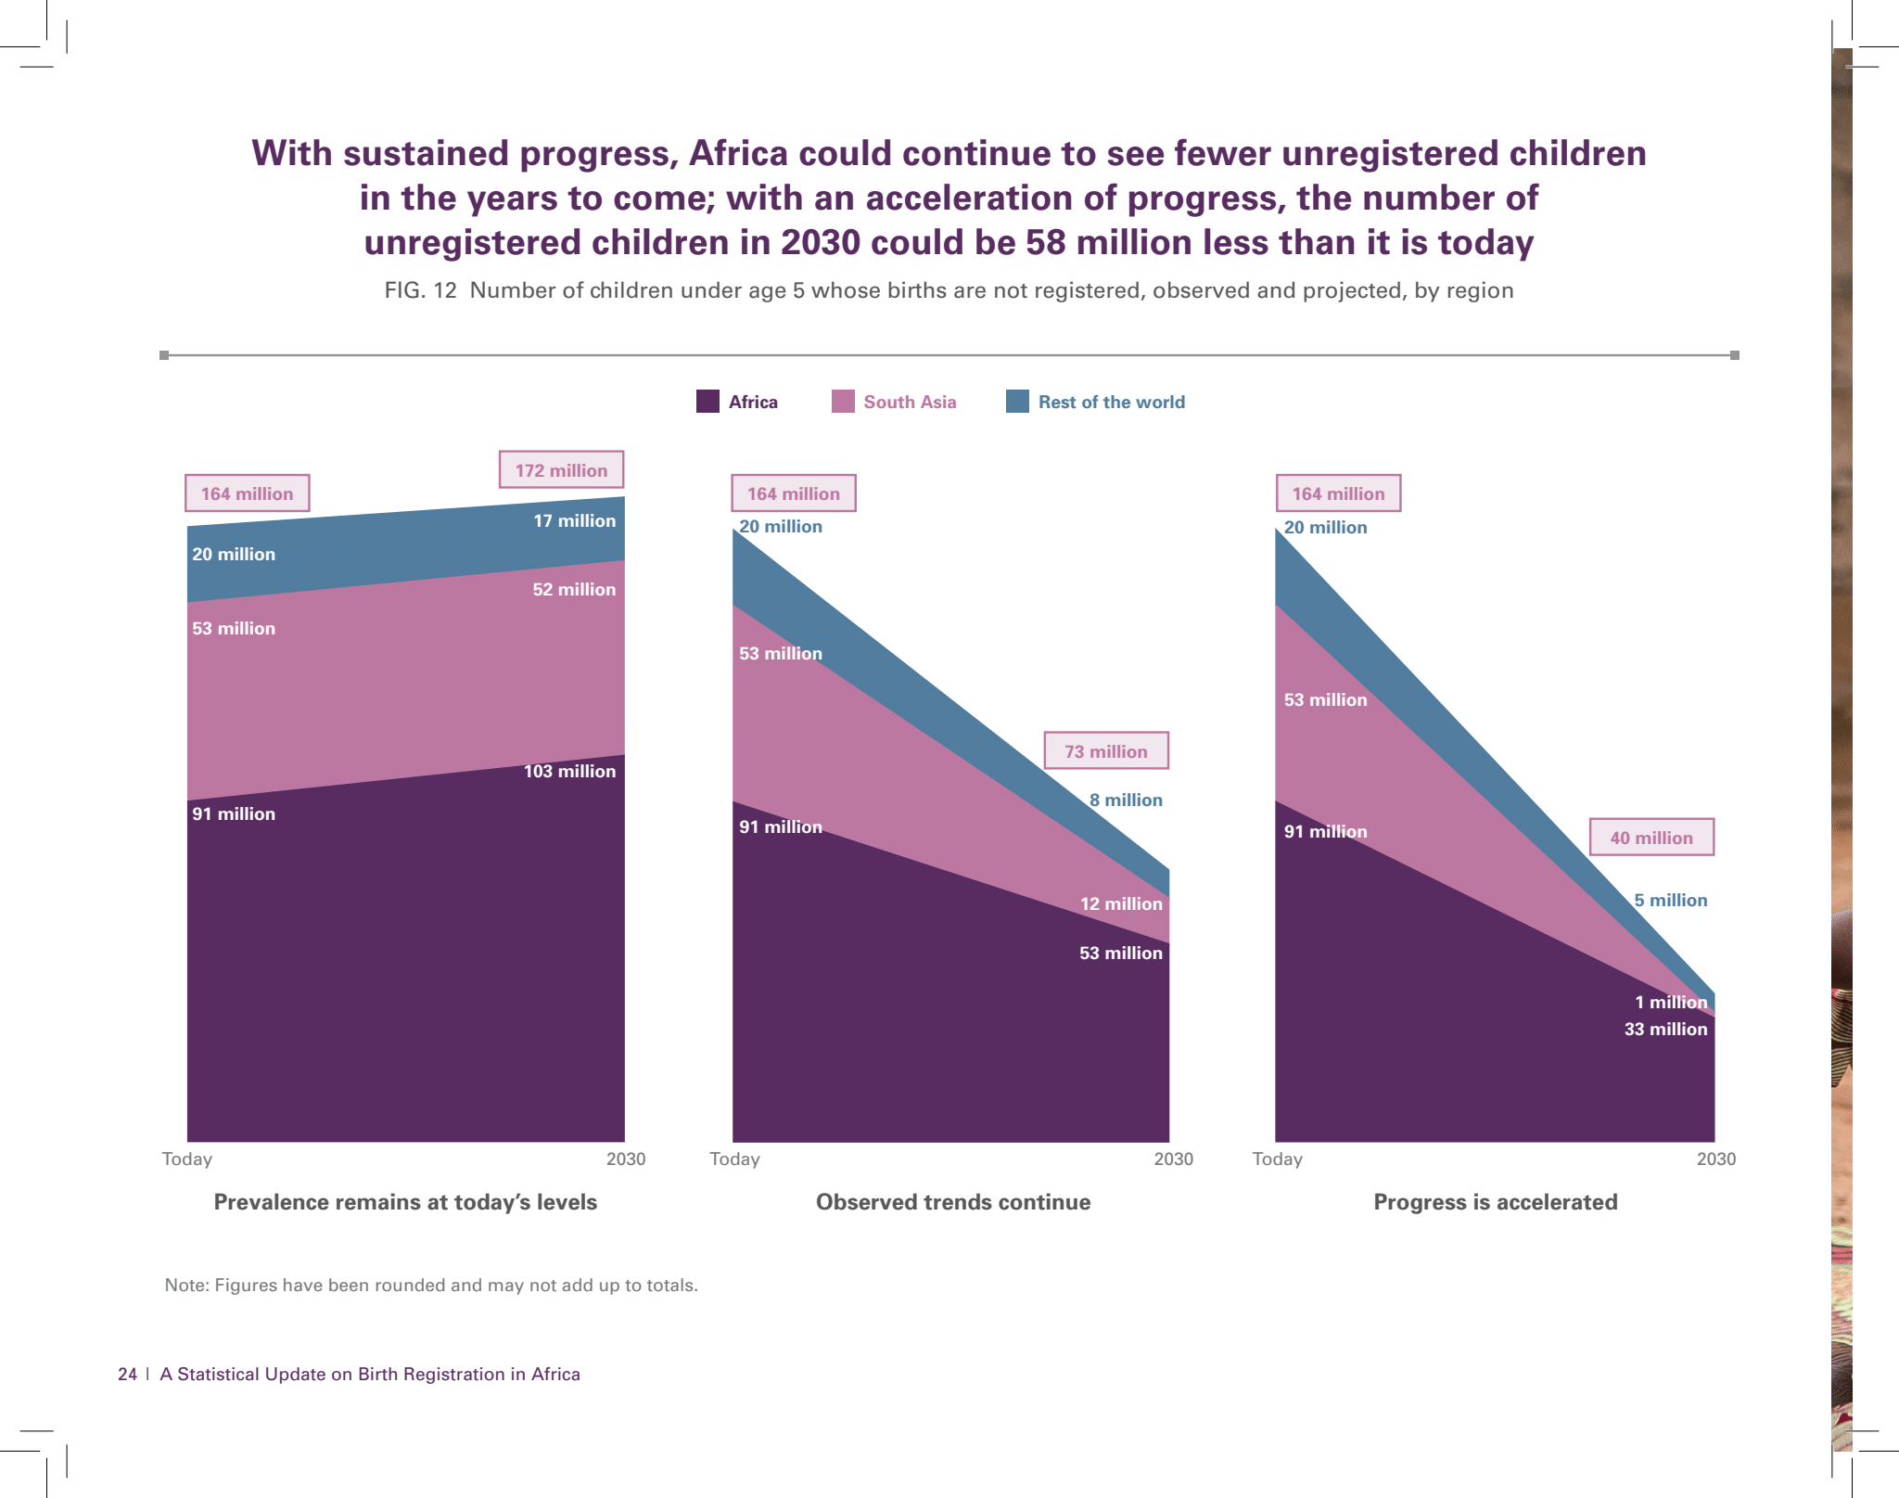

Success stories and best practices (Graph)

Slide 7
Key opportunities and strategies
Adoption of a one-stop approach for newborn registration and certification that is entirely interoperable with health and immunization systems, including in humanitarian contexts
Countries should make a gradual shift towards digitization through a combination of paper-based and digitalized systems adhering to safe and innovative practices.
Revision of laws and policies to remove all discriminatory provisions and making registration and certification free within the legally permissible time period and beyond.

Slide 8
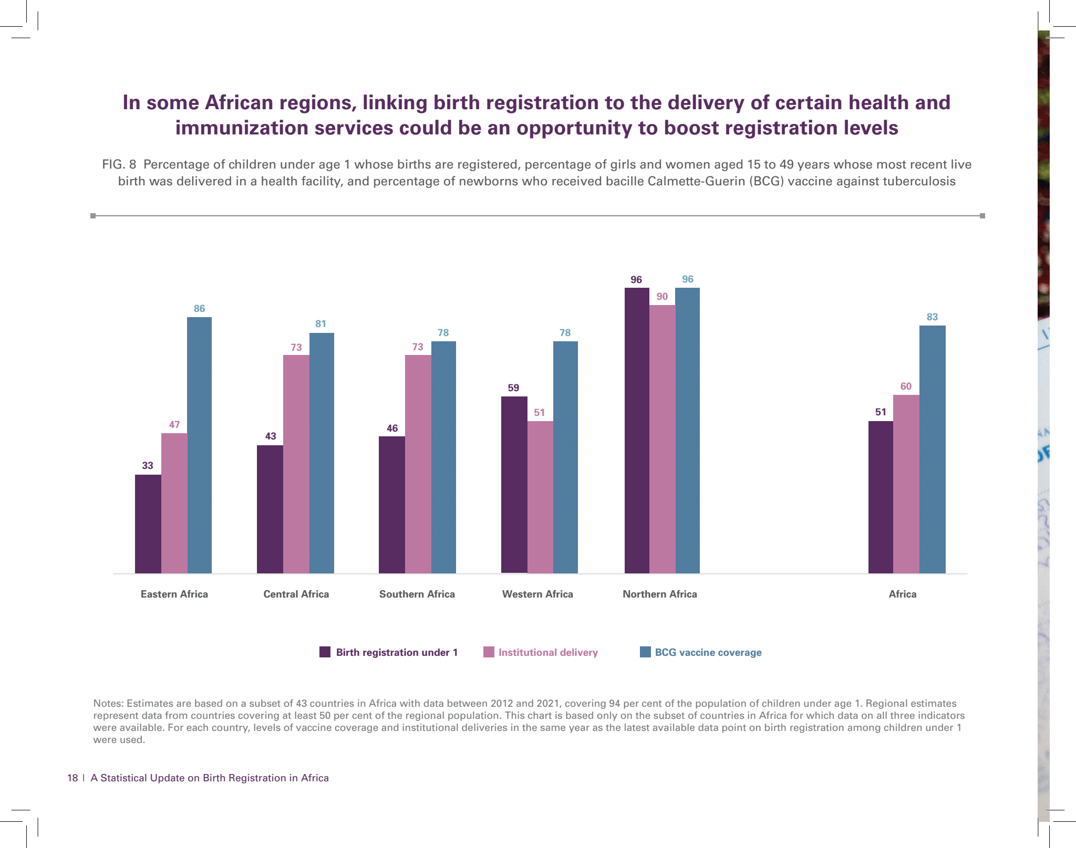
Key opportunities & strategies: leveraging on the health sectors’ reach (Graph)

Slide 9
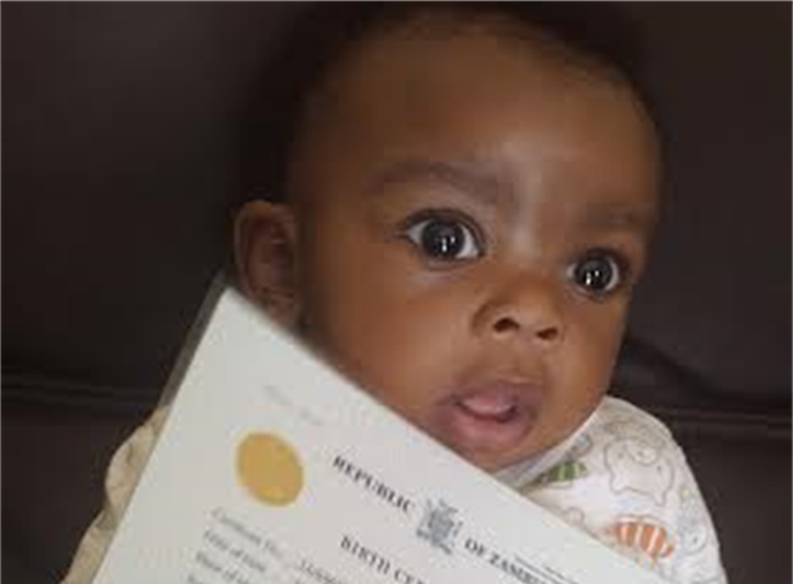



Slide 10














