Slide 1
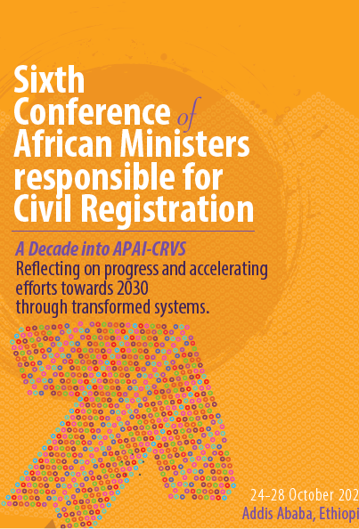

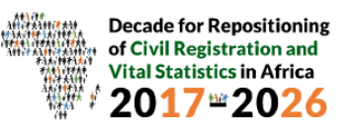
The South Africa National Population Register
Mosidi Nhlapo
Statistics South Africa
South Africa

Slide 2
Outline
  Context on population registers
  Historical development
  Purpose
  Legal Instruments
  South African NPR as a live system
  Who is in the NPR
  How has NPR been used
  Challenges

Slide 3
Population Registers
  National Population Registers (NPR) - mechanisms for continuous recording of selected information pertaining to each member of the resident population of a country;
  Organisation and operations should have a legal basis;
  Population registers start with a base consisting of an inventory of the inhabitants of a country and their characteristics;
  To assist in locating a record for a particular person, household or family in a population register, an identification number is provided for each entity.

Slide 4
South African Population Register- Legislative arrangement
First implemented through the Population Registration Act of 1950.
Identification Act, 1986 (Act No. 72 of 1986) – inclusion of Black Africans.
Population Registration Act Repeal Act, (Act No. 114 of 1991) - abolished the distinction between population groups.
South African Citizenship Act (Act No. 88 of 1995)
Identification Act (Act No. 68 of 1997).

Slide 5
Historical development
Operationalised in 1972 for the white, coloured & Indian population groups
Black Africans only included in the NPR from 1986,
The register is a product of the civil registration system; it is updated every time a person’s status changes through birth, marriage, alteration of sex status, or through death.

Slide 6
Purpose development
The South African National Population Register (NPR) is a register of the population of South Africa, held by the Department of Home Affairs (DHA).
The purpose is: “To provide for the compilation and maintenance of a population register in respect of the population of the Republic; for the issue of identity cards and certain certificates to persons whose particulars are included in the population register; and for matters connected therewith

Slide 7
NPR - register of registers
National Population Register
Births Register
Deaths register (Stillbirths)
Marriage
Divorce Register
Immigration

Slide 8




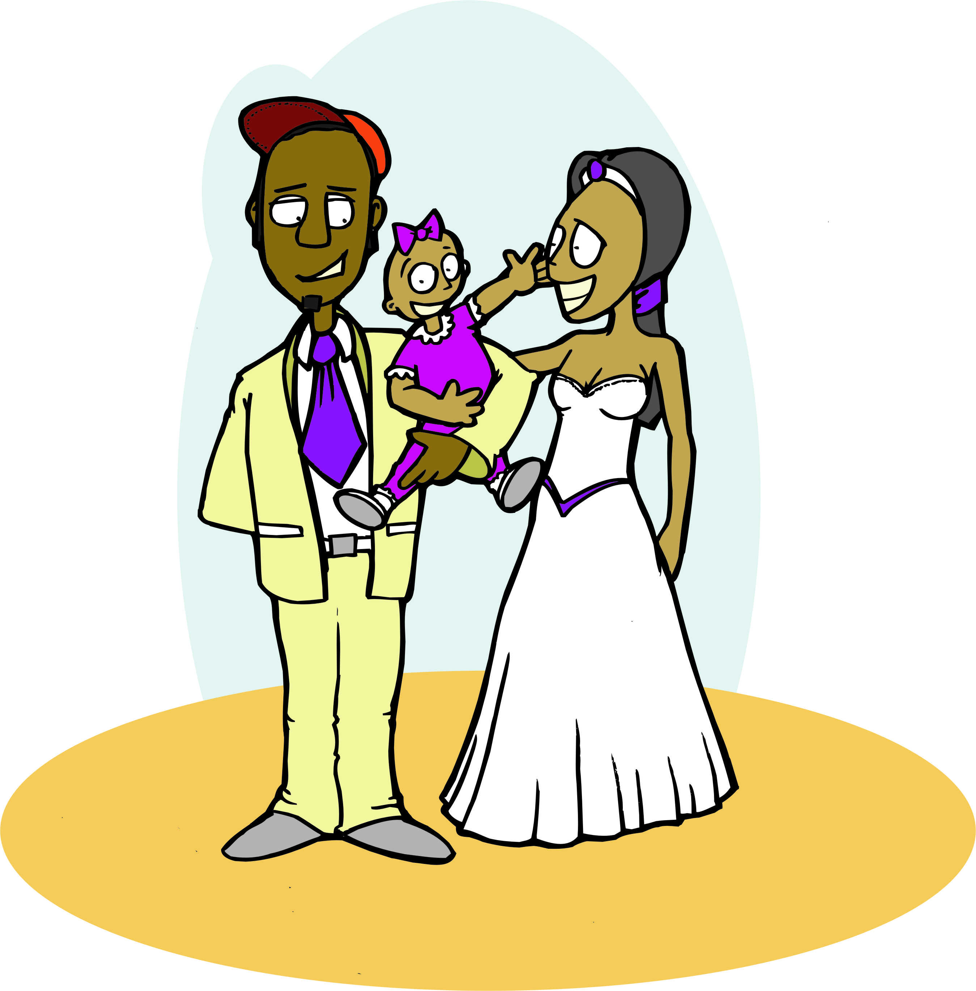





SA NPR as a live system
16
Issue ID document
0+
Births
Links mother & child/children
Issue Passport
NPR database
Naturalisation
Marriage register
Entry into the NPR
Death
60
Triggers pension payment
Recognition
Divorce

Slide 9
South African NPR
Inclusions
All children born of South African citizens and permanent residents when the notice of the birth is given.
Upon attainment of the age of 16, applied for & granted identification cards.
Individuals naturalised SA citizens
Exclusions:
Non-South African citizens who sojourn temporarily in the country, refugees and asylum seekers.
All South African citizens and permanent residents who died before notice of their birth had been given.
Characteristics
Data is continuous and covers the majority of the South African population
Each person has a unique identification number (ID)- details on date of birth, sex and citizenship.
A person’s status is updated through marriage and divorce

Slide 10
Census 2011 & NPR

Slide 11
Observations: Census 2011
Census missing persons ages 7 to 21 years, cohort of persons born between
1990 and 2004.
NPR data corresponding to the same population as enumerated during census 2011 ( Census day).
Assessment:
    Convergence between the population register and census 2011 is observable in some ages.
    Below age 5 few cases in NPR (under registration)
    At ages five to seven, the population register shows a slightly higher population, assumed to be requirement of a birth certificate for schooling.

Slide 12
Observations: Community Survey 2016

Slide 13
Observations: Community Survey 2016
    An assessment undertaken to compare NPR & CS 2016 age structure:
    The average time it took for a birth to be registered was seven years.
    Under registration of children a challenge
    NPR dataset had a total of 69 116 223 persons of this total:
      10 million individual assumed to be dead – removed.
      Additional 2,3 million had no Identity Numbers (IDs) were also removed.
      94% of those without ID’s, were aged 70 years and above. Majority of these average age - 93 years.

Slide 14
Challenges of the NPR
  Lack of geographic layers
  No metadata
  Coverage issues
  Internal migration and Emigration
  DHA codes:
Country | DHA Code | Stats SA codes | ISO Country codes
Australia | 028 | 501 | AU
Mexico | 064 | 236 | MX
Angola | 025 | 121 | AO
Kenya | 080 | 151 | KE

Slide 15


Slide 16














