Slide 1


PREPARATION TO THE PRINCIPAL SECRETARY STATE DEPARTMENT FOR CITIZEN SERVICES
-
Notes:
1

Slide 2
Presentation Layout
Over-view of Huduma Namba
Huduma Card Distribution
NIIMS Business Process

Slide 3
PART A: OVER- VIEW OF HUDUMA NAMBA/ NIIMS BACKGROUND
In 2005, the Government of Kenya (GoK) initiated the registration of persons using a harmonized approach to address the many challenges encountered during registration of persons.
To solve these shortcomings, the Integrated Population Register System (IPRS) was established to serve as the single source of truth for the population data in the country. IPRS was a good step towards integration of population data, but is limited in capacity since it only consolidated data from primary population registration agencies. IPRS failed to constitute a master register which could be regarded as “a single source of truth”. Kenyans were then compelled to obtain, keep and move around with multiple identification documents such as Identity Cards, Passports, Driving Licenses, NSSF and NHIF cards, inconveniencing them. The question has been, why not have only one card? Or should one even have a card, where just a number can suffice?
To build on IPRS and resolve the shortcomings of IPRS, the Government initiated the National Integrated Identity Management System (NIIMS) in 2018
Its a National Programme for the establishment of an integrated biometric population database that will be the “single source of truth” on persons’ identity data
It was established through Executive Order No. 1 of 2018 and No.1 of 2022.
Draws legal mandate from The Statute law (Miscellaneous Amendments) Act, 2018, Sec. 9A- CAP 107
Has been code-named Huduma Namba.

Slide 4

Challenges Facing Registration and Identity management System in Kenya
Weak Policy and Legal Framework
The biggest challenge with undocumented policies is the fluidity and unpredictability that come with it. This makes it difficult for the government to implement an ideal civil registration system. The legislation governing civil registration and identity management system is contained in various statutes which are outdated. Specifically, the legislation on registration of births, registration of persons and registration of deaths has been operational for since colonial times and have undergone piecemeal amendments that are not reflective of the changes in society particularly technological advancements.
Multiple Disintegrated Institutional Framework
Kenya has several disintegrated agencies created under different statutes that undertake civil registration and identity management functions. These include: the CRS which registers births and deaths, the NRB which registers persons at the age of eighteen, the Department of Immigration with a mandate to issues passports and registers stateless persons and foreigners, the Refugee Affairs Secretariat which registers asylum seekers and refugees and the IPRS which manages the digital population register.
This arrangement has created an inherent weakness in the civil registration regime, leading to unreliable data in multiple registers, lack of end-to-end civil registration processes, duplication of efforts and increased operational costs. The capturing of different data parameters of the same individual by different government agencies increases overall cost of delivery of services and heightens bureaucratic processes, in addition to proving to be a disincentive to seek such registration.
The national Identity card, despite having all the personal data details, including biometrics, although in analog system, has very little utility in functional areas. The failure to have linkage between foundational and functional systems has led to duplication in registrations of persons, wastage of resources and diminution of trust in the identity ecosystem.

Slide 5
..Challenges Facing Registration and Identity management System in Kenya
Inaccurate Foundational Entry Point into The Identity Management System
Against the best practices in the world, Kenya has not fully utilized birth registration as a foundational entry point into the identity management system from which all the registration of vital events should be based. Additionally, registration of births is undertaken without use of biometric data leading to low coverage rates that fail to provide a solid foundation for the national registration system.
Lack of a unique Identity Code
The number indicated in the birth certificate is different from the one in the ID or passport and therefore the need to have a unique identification number from birth to death is critical civil registration purposes and for vital statistics.
Semi-Automated Systems and Slow Uptake of Technology
The various registries use different systems in their operations. Some are manual, others are partially automated while others are fully digitized. Civil registration is majorly carried out manually. Due to the manual recording of vital events, processing of registration data is inaccurate and takes a considerably long time. The manual civil registration systems hinder integration and linkages that impact on overall service delivery to the individual. Further, it limits the establishment of robust civil registration and identity management systems, including a digital population register.
Lack of data integration among government agencies.
Due to lack of digital identity system, there is no mechanisms of data integration which links government agencies to an integrated database for needed secure access of population data. It follows that there is no real time transmission of data on registration of vital events to the other agencies leading to delay in updating the civil register. This makes it impossible for Kenya to have real-time and an accurate population count and also increases the potential for ID fraud as the efficient functioning of the identity management database depends on the interoperability of civil registries.

Slide 6
..Challenges Facing Registration and Identity management System in Kenya
Inadequate Data protection Mechanism
The data collected from an individual during civil registration is sensitive personal data. There is need to ensure civil registration and identity management systems protect the integrity of the data and safeguard it from unlawful access. While the IPRS implements business rules that restricts the range of data that can be shared with each authorized user, it has not formulated clear polices on the privacy of individual data including in response to potential queries driven by commercial interests as well as queries from individuals seeking to access the database.
Some systems have been infiltrated and abused by criminals, most of them posing as Kenyans or using Kenyan documents to commit crime, fraud, and massive forgery. In addition, the Kenyan travel documents have become a subject of debate in many countries across the globe. Kenyans travelling abroad have often been submitted to unwarranted scrutiny in comparison to people from other nationalities.
The national Identity card, despite having all the personal data details, including biometrics, although in analog system, has very little utility in functional areas. The failure to have linkage between foundational and functional systems has led to duplication in registrations of persons, wastage of resources and diminution of trust in the identity ecosystem.

Slide 7
FUNCTIONS OF NIIMS
National Integrated Identity Management System (NIIMS) is established under section 9A of the Act to —
To create, manage, maintain and operate a national population register as a single source of personal information of all citizens and foreign nationals resident in Kenya
To harmonize, incorporate and collate into the register, information from other databases in Government agencies related to registration of persons
To assign a unique national identification number to every person in the register
To verify and authenticate information relating to the registration and identification of persons
To ensure the preservation, protection and security of any information or data collected, obtained, maintained or stored in the register
To prescribe, a format of an identification document to capture the various forms of information contained in the identification documents for purposes of issuance of a single document where applicable
To correct errors in registration details, if so required by a person or on its own initiative to ensure that the information is accurate, complete, up to date and not misleading
To support the preparation and distribution of identification cards, certificates, licenses, permits, passports and foreign travel documentation

Slide 8
Huduma Namba Legal Framework
There are Legal instruments that have been developed since the projects inception borrowing heavily from the following existing pieces of legislation
The Constitution of Kenya 2010, of which Article 12 enshrines a right to identification document.
The Registration of Persons Act, Cap.107,
Births and Deaths Registration Act (Cap 149);
Basic Education Act (No. 14 of 2013;
Kenya Citizenship and Immigration Act (No. 12 of 2011)
Refugees Act (No. 13 of 2006).
Kenya Information Communication Act,1998, provides in Part VIA that the Cabinet Secretary can gazette protected systems, of which NIIMS is one of them.
The Registration of Persons (NIIMS) Regulations, 2020
The Data Protection Act, 2019
The Children Act;
The Data Protection (Civil Registration Regulations) 2020
National Civil Registration and Identity Management Policy 2021
Presidential Executive Order No 1 of 2018

Slide 9
.. Huduma Namba Legal Framework
United Nations (UN) Sustainable Development Goal 16
Promote peaceful and inclusive societies for sustainable development, provide access to justice for all and build effective, accountable and inclusive institutions at all levels
16.9- By 2030, provide legal identity for all, including birth registration
2030 Agenda for Sustainable Development and its guiding principle “Leave no one behind”, specific reference to refugees, stateless and other displaced persons.
Universal Declaration of Human Rights (UDHR),
Article ,2 (against discrimination ),5(protection from torture or to cruel, inhuman or degrading treatment or punishment),6(Everyone has the right to recognition everywhere as a person before the law),7(equal protection of the law) and14(1) (the right to seek and to enjoy in other countries asylum from persecution)
Constitution of Kenya 2010,
by dint of Article 2(5) and 2(6) of the Constitution of Kenya 2010, all International Conventions that have been ratified by Kenya now form part of Kenyan law. The Constitution of Kenya 2010 also offers a number of protections to refugees vide Chapter IV which guarantees the fundamental rights and freedoms of the individual.

Slide 10
..Huduma Namba Legal Framework
Subsequently two acts of Parliament and two regulations were developed as follows
Registration of Persons Act Cap 107
This set up the National Integrated Identity Management System (NIIMS) as a department and defined its mandate in section 9A of the act.
Data Protection Act 2019
This Act seeks to ;
Regulate the processing of personal data; ensure that the processing of personal data of a subject is guided by the principles of Data protection set out in Section 25.
Protect the privacy of individuals
Establish the legal and institutional mechanism to protect personal data
Provide data subjects with rights and remedies to protect their personal data from processing that is not in accordance with this Act.
Registration of Persons(NIIMS) Regulations, 202
Operationalizes the Statute Law(Miscellaneous Amendments), 2018
Sec. 9A
Provide mechanisms for operation and maintenance of the NIIMS; and
Facilitate the assigning of the Huduma Namba and issuance of a Huduma card to a resident individual.

Slide 11
…Huduma Namba Legal Framework
Data Protection(Civil Registration) Regulations, 2020
The Regulations are made under the Data Protection Act, 2019 to provide for the administration of personal data processed by the civil registration entities.
  Huduma Bill, 2021
  Consolidate the law on registration of persons; Establish a digital national population database to be the primary source of foundational data for resident individuals; Provide mechanisms for registration of births and deaths; Facilitate the assigning of the Huduma Namba and issuance of identity and travel documents, Maintain integrity, confidentiality and security of personal data under NIIMS database and enable usability of the Huduma card by effectively making it to be the 3rd generation identity card.
  National Civil Registration And Identity Management Policy, 2021
  Two DPIA’s have been developed as a requirement of the Data Protection Act, 2019.
  Overarching guide on civil registration, recognition of vital events and identity management in Kenya. It applies to Kenyan citizens, foreign residents, refugees, asylum seekers and stateless individuals and foreign nationals recognized in Kenya.
Data Impact Assessment (DPIA) Reports
This was conducted in full appreciation and adherence to the implementation of appropriate safeguards to ensure adequate protection of personal data and compliance with section 31 of DPA.
It covers the entire project since commencement in compliance with court decisions.
They are ; DPIA for phase II/ continuous registration submitted to the data commissioner dated 15th march,2021. The second one was filed on 17th december,2021.

Slide 12
Benefits of National Integrated Identity Management System (NIIMS)
The processing of personal data under the Huduma Namba project enables the creation of the country’s identity system which is done through the registration of persons and the consequent issuance of identity cards.
Further, it facilitates other registration events including the processing of personal data relating to—
Registration of births;
Registration of adoptions;
Registration of persons;
Issuance of passport;
Registration of marriages;
Registration of deaths; or issuance of any document of identity
The proposed enrolment would enable the creation of a credible population database. The current manual registers have compromised service delivery and left the country vulnerable to the emerging security threats.
The NIIMS population database will save the country significant amount of money associated with different MDAs conducting their own biometric registration and maintaining different sets of databases that are not interlinked / integrated.
Easy convenient, effective service delivery through use of one identity to access different services.

Slide 13
..Benefits of National Integrated Identity Management System (NIIMS)
NIIMS is aimed to ensure availability of accurate, reliable, and comprehensive population registration database. The harmonized nature of NIIMS will make it easier for security agencies to quickly access relevant information about potential threats without having to approach numerous and independent databases for full identification thereof. This will help in solving crimes such as terrorism, murders, robberies, rape and theft. NIIMS provides mechanism to government agencies for convenient and timely access to information held by primary registration agencies by computer linkages to enable informed decision making. It ensures standardization and streamlining of relevant government processes.

Slide 14
PART B: HUDUMA CARD ISSUANCE
Huduma Card mass production began towards end of January, 2021
The cards are produced at the state of the art card personalization and printing Centre located at government press store that was setup by the project.
Over 11,554,626 Huduma cards have been printed and distributed through all the National Registration Bureau (NRB) offices in the country and 52 Huduma Centers using our casual staff and NRB personnel.
Over 9,221,681 Huduma cards collected by citizens
This is out of the 17,935,856 adults data collected from a total of 37 Million data collected(including minors) during the first mass registration held between 2nd April and 25th May 2019.
A total 2,332,945 cards remain uncollected as at 30th October, 2022.
Gazettement of Huduma Card
Once the Huduma bill is passed by government, Huduma card will become operational as the 3rd generation digital identity card upon its gazettement and subsequent degazettement of the current 2nd generation identity card by the cabinet secretary, ministry of interior & national administration.

Slide 15
Huduma Card Sms Broadcasting
Process Of Huduma Card Issuance and Collection
A total of over 10 million SMS’ have been sent out, either notifying the recipient to:
Select the preferred Huduma Card collection point or
Proceed to a Huduma Card collection Centre for issuance of the Card
NB: For those who fail to choose another delivery destination, the card is printed and delivered to the earlier indicated delivery destination.
For those who did not provide phone numbers during registration, or have since changed their phone numbers, a portal has been developed to enable them to check the status of their Huduma Cards.

Slide 16
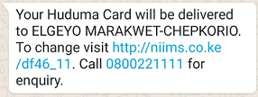
Notification Of Huduma Card Collection Point
An SMS with a personalized URL is sent informing the recipient that the Huduma card is ready and will be delivered to a certain delivery destination (NRB/ID office).
If one has not received the SMS and they registered, they can check the progress/status of their Huduma Card by visiting the public portal Confirmation.hudumanamba.go.ke

Slide 17
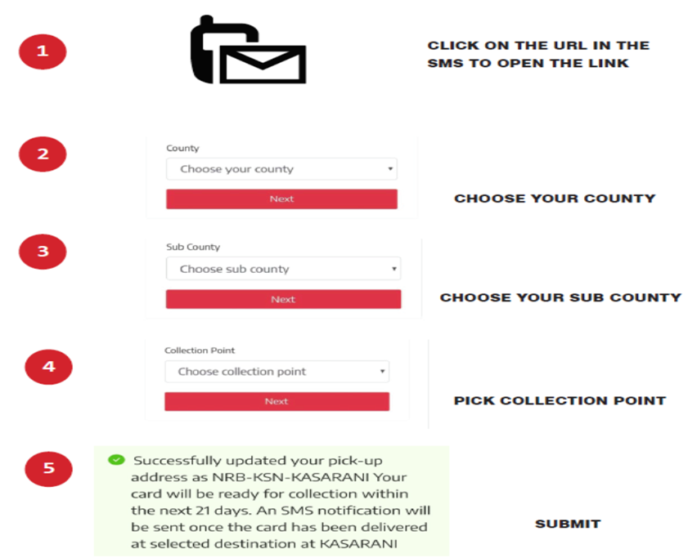
Change Of The Pre-selected Huduma Card Collection Point
If the choice made for delivery destination is not convenient, the recipient uses the URL to access the portal and select a preferred delivery destination, as illustrated below:
Upon submitting of the preferred Huduma Card collection point, an on-screen confirmation is displayed.
The recipient can also call the Huduma Namba Call Centre toll free number 0800 221111 for assistance with the selection.

Slide 18
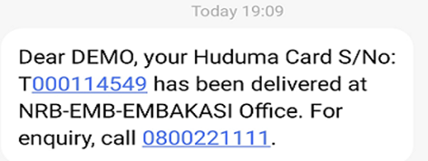
Collection Of Huduma Card
Once a card had been delivered at a designated delivery point, a SMS notification will be sent to the Huduma Card Holder indicating the Collection point as illustrated below:

Slide 19

PART C: NIIMS BUSINESS PROCESS
The National Integrated Identity Management System (“NIIMS”), consists of;
NIIMS Database
Huduma Namba
Huduma Card

Slide 20
NIIMS Database
The Huduma Namba project seeks to create and manage a central master population database, which serve as the primary source of resident individuals person’s identity and contains information of Kenyan citizens and foreign nationals residing in Kenya.
The NIIMS database will be the primary source of foundational data about a person and all government agencies will tap into it.
The processing of personal data cycle is expounded in the Registration of Persons (NIIMS) Regulations, 2020.
Personal data is collected with consent of data subject by authorized officers in a prescribed form through specially configured devices.
The enrolment into NIIMS involves registration of all Kenyans both locally and abroad and also all foreign nationals who live in Kenya.
The first enrolment is on mass registration of stock population. The other is the continuous enrolment of newborns to be done immediately after registration of a birth. Upon death, the Huduma Namba of a deceased person is retired and Huduma card revoked.
Personal data is stored by the State Department in secure locations governed by national security protocols.

Slide 21
Huduma Namba
Upon enrolment into the NIIMS, a person is assigned a Huduma Namba, this being a unique identification number that would be used to identify all persons in the country and facilitate the access of public services and identification by government and private sector.
Types of Huduma Card
Adults’ Huduma card, issued to a citizen who has attained the age of eighteen years
Foreign Nationals’ Huduma card, issued to a foreign national
Refugees’ Huduma card, issued to a refugee
Huduma card will contain the integrated personal and foundational data of the card holder.

Slide 22
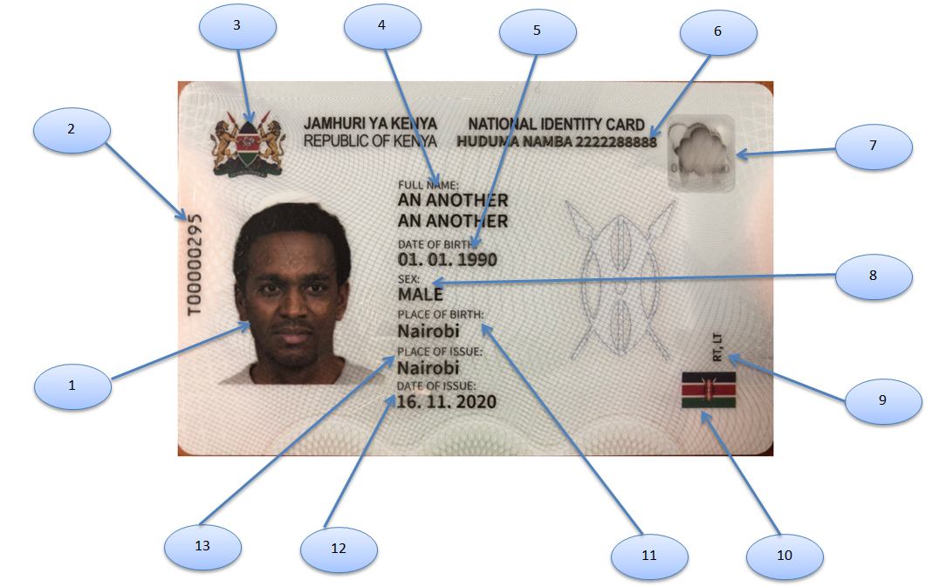
Huduma Card Front
3-Levels anti-forgery security features:- Visual, Portable device and forensic detection
CARD FEATURES AT THE FRONT:
1. Passport photo: A passport photo will help to identify the owner of the card.
2. Unique serial number: This uniquely identifies the Card.
3. Coat of Arms: Coat of Arms signifies patriotism.
4. Full name: Card will contain the name of the card holder.
5. Date of birth: It will indicate the day, month and the year when the card holder was born.
6. Huduma Namba:
7. Transparent window: Contains Card Holder ghost image and date of Birth visible when the card is tilted at an angle.
8. Sex: Gender of the Card Holder.
9. Kenyan Flag: This shows the card belongs to the Republic of Kenya
10. Place of Birth: This will show where the card holder was born
11. Date of Issue: When was this card produced
12. Place of Issue: It will show where the card holder will collect his/her Huduma card.

Slide 23
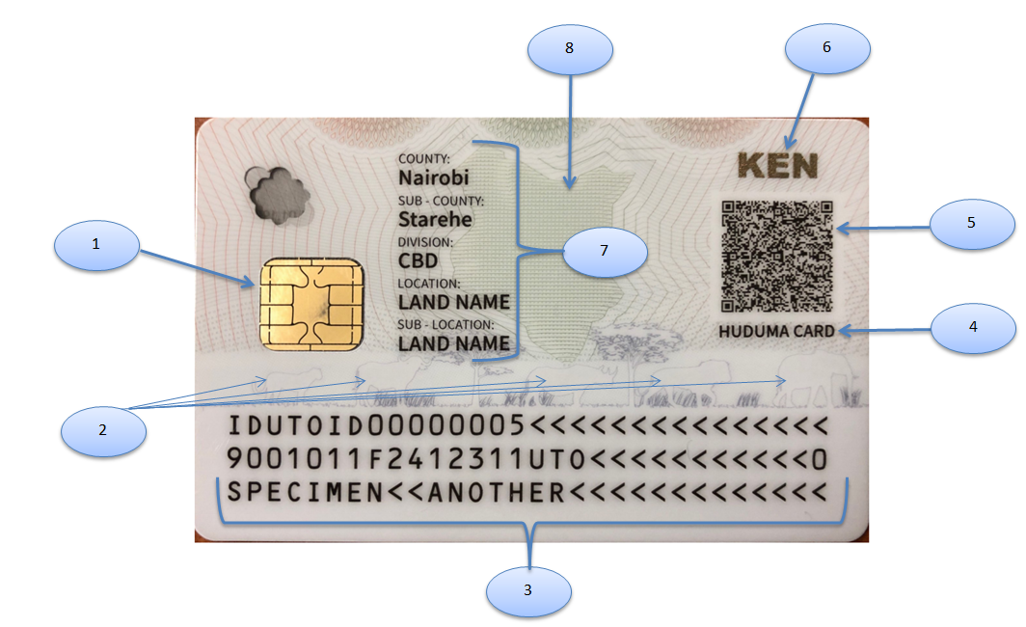
HUDUMA CARD BACK
1. Contact Chip: It contains securely stored biodata and biometrics (fingerprints and facial image) of the card holder. It is used in conjunction with card and fingerprints readers for match on chip biometric verification.
2. The Big Five: This is a representation of Kenya’s flora and fauna.
3. MRZ (Machine Readable Zone): This Part contains the card data as per the ICAO Standards.
4. Huduma Card Title: This is located at the back since it is where the various E-Government Services are.
5. QR Code: Stores the card holder’s information in a secure form. A special application can be used to read the information for verification and validation.
6. KEN: Abbreviation of the name Kenya in optical variable inks.
7. Administrative Units: This will show where the card holder has come from i.e. County, Sub-County, Division, Location and Sub-County
8. Kenyan Map – A drawing of the map of Kenya with infrared absorbent inks

Slide 24
HUDUMA NAMBA REGISTRATION PROCESS
Enrolment at Birth
Generation of Huduma Namba
Capture of Biometrics
(6 years and above)
Retirement of Huduma Namba upon Death
Update of Details & Issuance of Huduma Card (18 years)

Slide 25
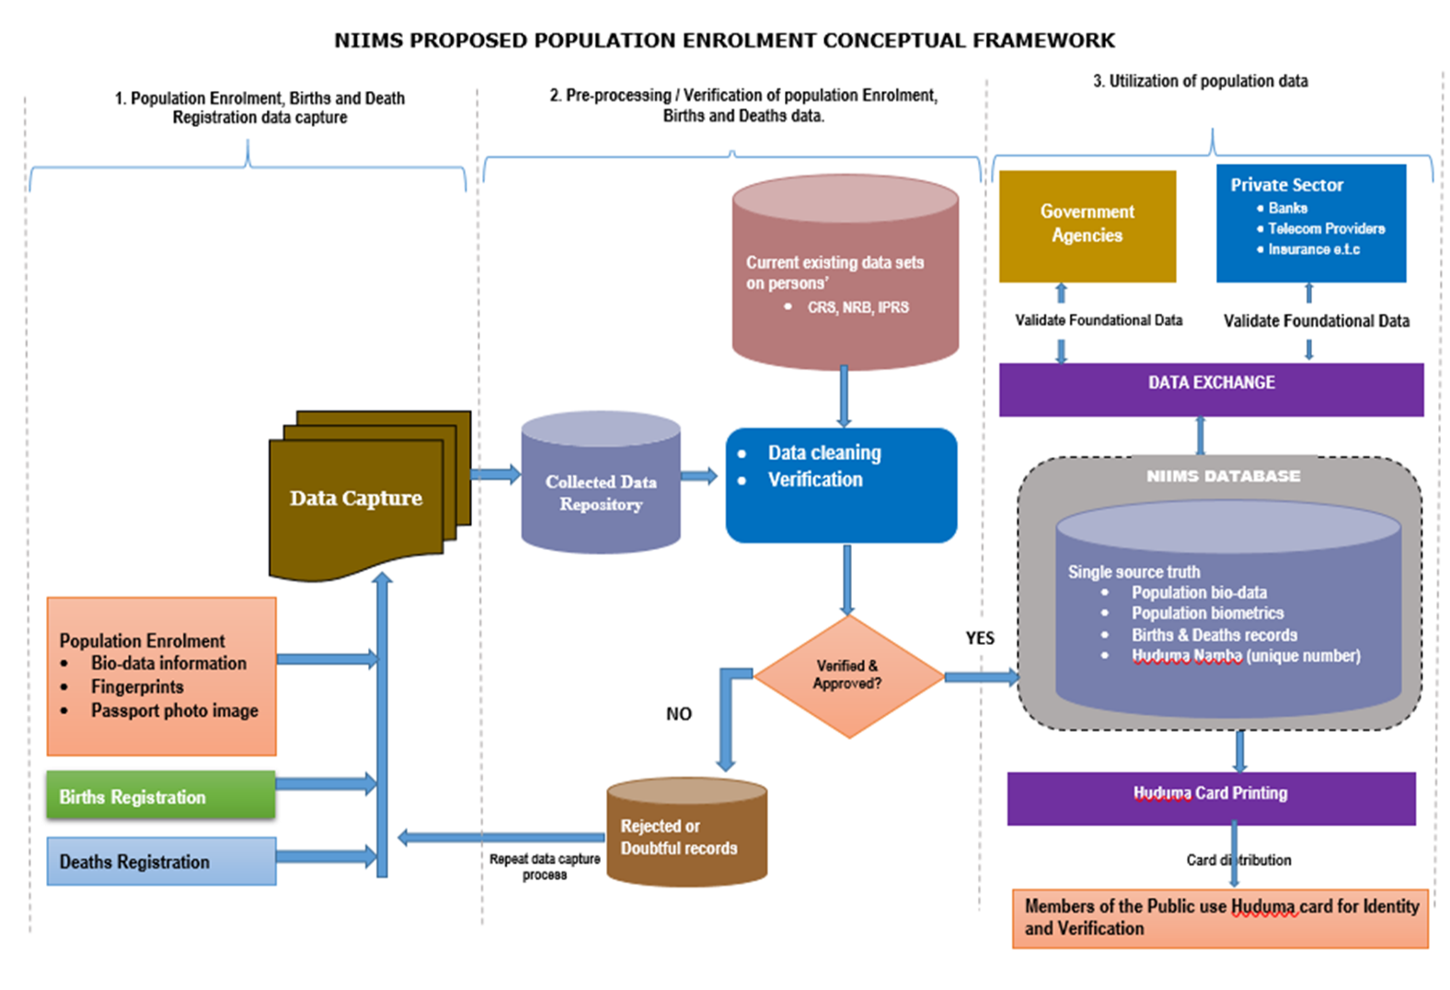
Identity registration enrolment involves capturing and recording in the identity management system key identity attributes of a person who claims a certain identity. This may include biographical data (e.g., name, date of birth, sex, address) and biometrics as well as other attributes and forms of digital credentialing. Once the person has claimed an identity during enrollment, this identity is then validated by checking the attributes presented against existing data, such as information in the civil register and other databases.

Slide 26
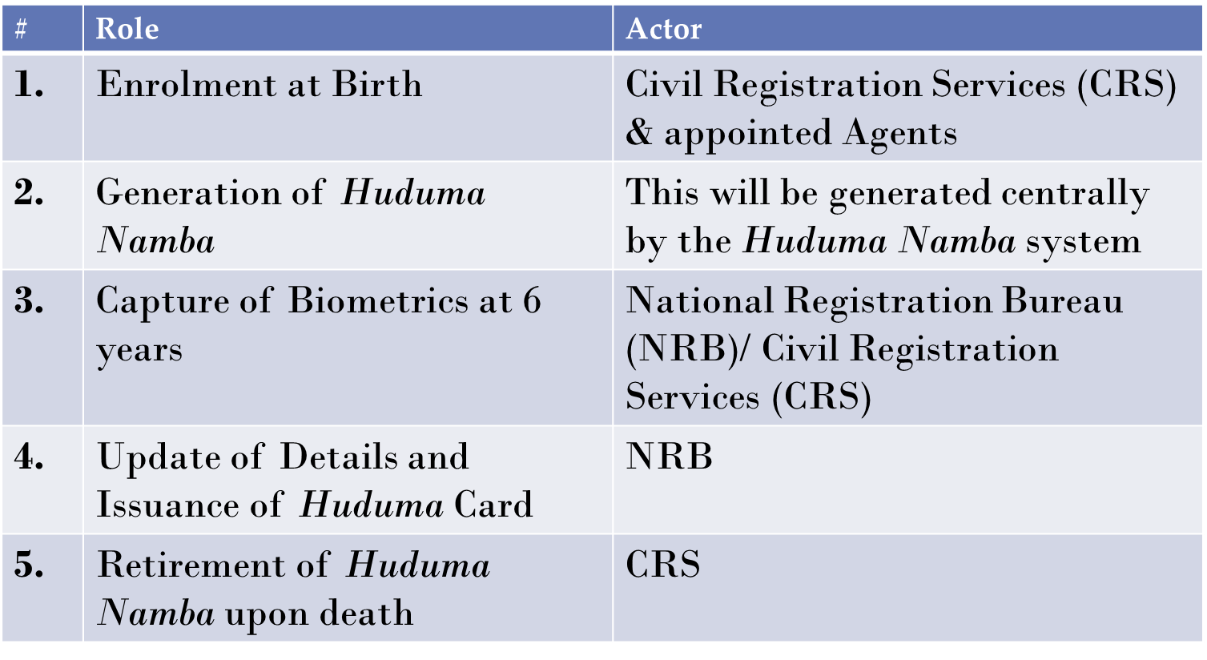
HUDUMA NAMBA REGISTRATION ACTORS

Slide 27
TRAININGS
Training done to 5357 personnel from NRB, NGAO ,county ICT authority ,covering all field offices.
Training and capacity building of all 14 254 National Government Administrative Officers (NGAO) on efficient government service provision using the Huduma cards is ongoing
The training of all the 1,010 CRS personnel in all the 130 CRS registration Sub county offices.
Registration of 37,724,521 million Kenyans and foreign nationals resident in the country (2nd April- 25th may, 2019) and registration of 96,571 Kenyans in the diaspora through the 51 Kenyan missions abroad.
Personalization and Printing Centre that is equipped with three machines that have a capacity of producing 70,000 cards per day and that is fully owned and managed by the government of Kenya and operated our own local Kenyan experts, has been set up at the 2nd floor of government press security building purposely to personalize persons’ data after adjudication and subsequently print the digital Huduma card.
The facility is able to produce quality cards that are compliant to; the international civil aviation organization (icao) 9303 standard for machine readable documents that enables the card to be used across the east African region,
The physical characteristics of the card complies with iso/iec 7810:2019,the microchip on the e-id card complies with iso/iec 7816 standard
In future the facility will be able to produce from one central point all Kenyan security related identity documents like passports, driving licenses, log books, title deeds and secure government departmental identity passes thus saving the country the huge cost of contracting external venders.
Notable achievements

Slide 28
Development of a modernized and secure facility for storage of Huduma card production consumables, packaging areas and card dispatch points with modern fire detection system at government printers basement security building.
31,500 biometric kits are available for use in our integration with ministries/departments/agencies (MDAs) and part of it is currently being used ;
I. For automated registration of persons
II. By NRB officers countrywide in Huduma card distribution and registration activities.
III. By the respective government agencies dealing with personal identity in the enhanced effective and efficient service provision once the Huduma system is fully integrated.
Digitization at civil registration services of 32,745,803 million birth/ death certificate records was done between 26th August to 30th September 2019 and 26th May to 20th June 2020.
Provided logistical and technical support to the national transport and safety authority (NTSA) team on the countrywide boda boda (motorcycle) registration that started on 28th march, 2022 where a targeted 2.5 million riders were expected to be registered by the end of the exercise.
Notable software’s developed by the secretariat
-Mass enrolment software (used for the initial enrolment)
- Huduma card distribution , issuance and tracking software
- Software for the continuous registration
- Application to enable update and correction of persons particulars
- Huduma Namba public portal
….Notable achievements

Slide 29
Civil Registration Services Vital Statistics End To End System For Registration Of Births And Deaths
This is being developed by our team of ICT experts located at our state of the art Personalization and printing center in conjunction with the civil registration personnel who are very experienced in the birth, death registration and vital statistics.
Once complete it will greatly assist remove exclusion that is currently evidenced by the punitive requirement of vetting of all border communities
This will also assist the stateless persons get registered once they are approved by the taskforce on stateless persons
The system will also help develop vital statistics on births, deaths, marriages, adoption, divorce, recognition, legitimation real-time that are very critical for planning.
It will also greatly improve birth and death registration rates to the SDG 16.9 desired levels
Reduces cost of numerous parallel biometric registrations done on registration of persons by different Government agencies
The system will work with all the birth and deaths registration agents who are the assistant chiefs for events happening outsides hospitals and hospital personnel for events happening in a hospital set up.
We have a pool of 10,000 hand held Ipads’ and 30,000 biometric kits which will be distributed for use by the agents once the system is ready for use.
Birth and death certificates will be printed from the system as and when required and will have all the relevant details including the unique identifier number of the child issued at birth.
So far the system is 40% developed and Civil registration Personnel are being trained to enable usability.
The rollout of the system modular.

Slide 30
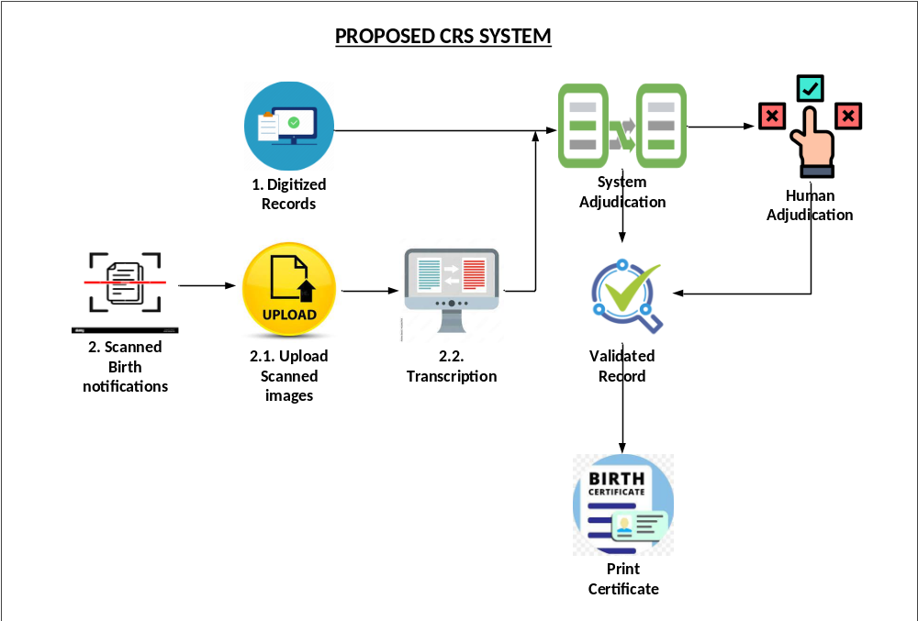
Civil Registration Services Vital Statistics End To End System For Registration Of Births And Deaths (Development Ongoing).

Slide 31
Digitized Records- These are records that were digitized during the Mass digitization exercise conducted by the department in 2019.
Scanned Birth Notifications – These are birth notifications that have been scanned by the various registration offices that are yet to be transcribed.
Upload scanned Images – This is the process of uploading scanned images into central system to be transcribed
Transcription – The process of converting the scanned images into searchable text
System Validation – This entails checking for completeness of a record, duplicates and validation of parents details.
Human Adjudication – This process human intervention in adjudicating civil data, duplicates, change approval, parents details verification, Quality assurance and Regularization of problematic records.
Validated Record - These are records that have been successfully validated and are approved.

Slide 32
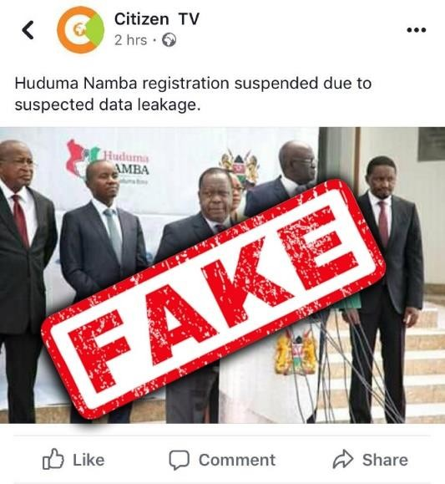

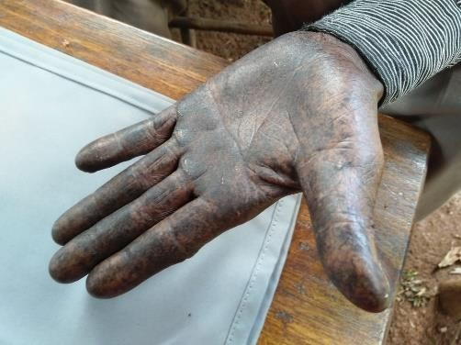

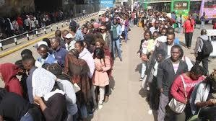
Challenges
Several court cases
Lack of political goodwill from some sections/ negative political propaganda
Inadequate funding
Fear/ resistance to change from some sections of staff of government departments that will integrate with the system
Misinformation on data required (DNA, GPS)
Link to 666 in the bible
Fake news
Lack of Registration documents
Biometric capture challenges ex. manual laborers
Network challenges
Long queues (Last days of registration)
Low turnout after extension of Registration by H.E The President.
Distribution challenges such as poor road network
Insecurity-Remote areas
System challenges
No previous experience/ benchmarking
Fake news
Network challenges
Biometric capture challenges ex. manual laborers
Long queues (Last days of registration)

Slide 33
- Urgent roll out of the phase II Huduma Namba registrations to get more data records of the approximately 12 million Kenyans who missed the first mass registration.
- Automation of all 130 civil registration services field offices to enable end to end registration is ongoing.
- Training on the usage of the end to end system being developed to all the 1,010 CRS personnel in all the 130 CRS registration sub county offices, all the 8,437 assistant chiefs and health personnel in all the 9,997 health facilities across the country which have maternity services.
- Enactment of Huduma Bill.
- Development of Huduma regulations.
- Increased interaction with civil society for ownership and advocacy
- Provision for correction/updating of persons particulars for those who already registered and also allow data recapture for those who registered but their cards could not be printed.
- Engagement with political leadership for necessary legal/ policy approvals.
- Integration of marriages and divorce registry through digitization and automation
- Provision of a coordinated technical and policy framework on integrated identity management
- Development of integration protocols to enable all government departments to effectively integrate with the Huduma Namba system.
Government Of Kenya And United Nations Collaboration Through Un LIA on establishment of the national integrated civil registration and identity management system scope of work which is awaiting cabinet secretary approval Government Of Kenya And United Nations Collaboration Through Un LIA on establishment of the national integrated civil registration and identity management system scope of work which is awaiting cabinet secretary approval. This will enable UN/Government collaboration in the rollout of the project in line with the UN SDG 16.9 on legal secure identity for all humanity
Upcoming/Ongoing Activities

Slide 34
Integration (NIIMS)/ Huduma Namba is actively engaging 4 MDAs in piloting the usage of Huduma Namba/card as we await passage of the bill into an act of parliament after which the full usage of the card will commence.
The Agencies Currently Include:
…Upcoming/Ongoing Activities
National Health Insurance Fund (NHIF)/ Ministry Of Health Under The Universal Healthcare Project
The Pensions Department, The National Treasury On Records Verification
The Kenya Post Office Savings Bank (Postbank) On The Inua Jamii Social Benefits Project
National Transport Safety Authority (NTSA)

Slide 35
ID4AFRICA 2023 CONFERENCE
Kenya has been offered the opportunity to host the conference in the year 2023 from 24th to 25th may, 2023.
This conference will bring numerous economic benefits and exposure; the country will gain through hosting the conference.
The conference will also help Kenya in compliance with the un 2030 agenda for sustainable development goal sub-article 16.9 that talk about legal identity for all humanity.
…Upcoming/Ongoing Activities

Slide 36

END
THANK YOU!

