Slide 1
The Case for population registers, key requirements for building them and their status of implementation across the continent
Gloria W. Mathenge
Statistician, Demographic and Social Statistics
African Centre for Statistics
Economic Commission for Africa

Slide 2

Outline
Population registers in the current development context
Definition and conceptual framework for population registers
Key requirements for establishing functional population registers
The state of implementation of population registers across the continent
Conclusion and recommendations

Slide 3
Population registers and their relevance in the current development context
The current data era calls for more robust, timely, frequent and disaggregated population data that can enable rigorous measurement and monitoring of human development. Population registers provide one of the best source of population data
Many African governments are implementing e-government platforms aimed to streamline public administration and service delivery. These require unique identification of individuals within a population through a single verifiable identity record and/or credential. Population registers facilitate identification of all residents within a population
The Covid-19 pandemic had a critical impact on traditional population data collection methods including censuses in many countries underlining the importance of Administrative data sources. 53% (158) of countries had to post pone their Census due to the Pandemic (UNSD global survey)

Slide 4
What are population registers?
The United Nations defines population registers as:
“records all residents in the country, together with their basic demographic information, and updates for births, deaths, changes of marital status, international migration (both into and out of the country), and internal migration (by recording changes of address within the country).” United Nations handbook on Registers-Based Population and Housing Censuses (2022).
Population registers are accounts of residents within a country maintained via the legal requirement that both nationals and foreigners residing in the country must register with the local authorities

Slide 5
Two types and functions of population registers?
The term “population register” is often used in reference to an administrative information system used primarily by public agencies for administrative purposes. However, population registers exist in two distinct forms:
  As administrative population data systems (administrative population registers) that can also be used for statistical purposes;
  Statistical population data systems (statistical population registers) commonly built on the basis of existing administrative population records. Even where statistical registers are constructed on the basis of a census database, an administrative register is needed to enable updating

Slide 6
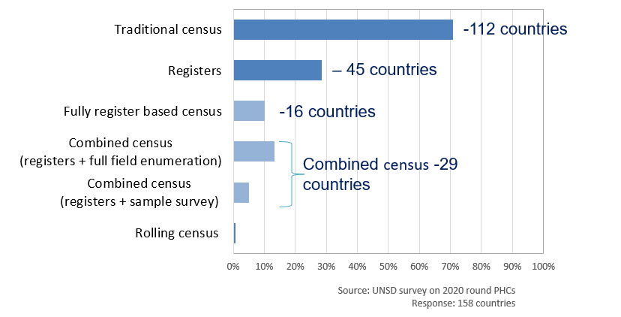
Population registers and their relevance in the current development context
Population registers are a major foundational register for successful implementation of register-based censuses
Global surveys conducted by UNSD in 2009 and 2019 show gradual increase in the number of countries moving from traditional to fully register or combined methods approaches between the 2010 and 2020 census rounds.
Though mainly in the Asia and Europe, these changes paint a picture of evolution of census methods around the world and highlight the rewards that countries (including those in Africa) can reap from implementing population registers

Slide 7
Population registers a key pre-conditions for a register based census
Existence of a national law providing for the creation of a population register and authority to access and use the data contained in it for statistical purposes;
An established central population register;
High-quality data in the population register with comprehensive geographical coverage;
An effective system of continuous updating of the population register;
Harmonized concepts and definitions adopted in the various registers used;
A universal personal identification (unique identity) system to facilitate the effective linking of data;
Quality and consistency checks to verify the suitability of the data contained in various registers, including the presence of a timestamp to ensure that the location and characteristics of enumerated units relate to the same reference point in time.
Notes:
Rev 3, UN Principles and Recommendations for Population and Housing Censuses, , outlines eight preconditions for conducting a register-based census, namely:

Slide 8
Pros and Cons of a register- based census

Slide 9
Some Advantages of a register-based census
Reduced operating costs if registers/admin databases already exist & funded.
Reduced/no response burden for citizens
Processing of results faster than for a traditional census
May include citizens who are hard to reach in traditional censuses e.g., Highly mobile or have multiple residences and those that don’t engage with censuses, but are in administrative systems
More frequent outputs – annual outputs on pop count, employment

Slide 10
Some Disadvantages of a register-based census
Initial costs may be high (setting up systems, assessing and improving quality of registers/admin data sources)
Dependency on the operators of the registers to maintain them to quality needed for statistical purposes. Influence of the NS0 over the admin source may be limited
Admin systems may change over time which may undermine comparability of data internationally and over time
Register characteristics collected primarily for administrative purposes rather than a statistical purpose e.g., Population base may not match that needed for the census

Slide 11
Creating and maintaining an administrative population registers

Slide 12
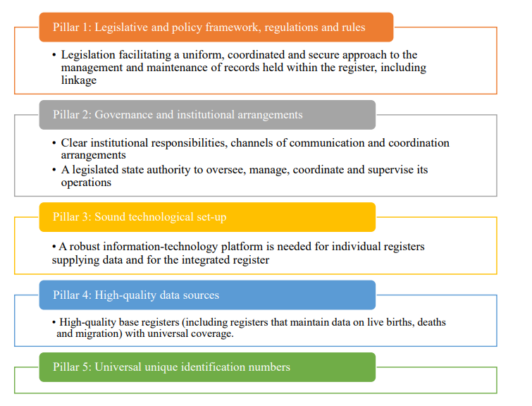
Functional requirements for the establishment of a population register

Slide 13
Establishment of population register
53rd session of the United Nations Statistical Commission: Implementation of the 2020 World Population and Housing Census Programme
  Recommendation: (c) To encourage national statistical authorities to consider the establishment of national statistical population registers on the basis of the census master file produced in the 2020 round of censuses in full compliance with the provisions of the Fundamental Principles of Official Statistics; https://unstats.un.org/unsd/statcom/53rd-session/documents/2022-8-Censuses-E.pdf

Slide 14
Status of population registers in Africa
In Africa, the status of implementation of administrative population registers ( in alignment to the UN definition- especially linking births and deaths collected through civil registration and international migration data) remains unclear. An assessment is currently ongoing to collect this information among countries.
African countries that might be in a position to have and maintain an administrative population register include: South Africa, Cote d’Ivoire Eritrea, Namibia, Kenya. In some of these countries, though named so, the registers do not capture migration data
African countries known to use their administrative population register for statistical production include Eritrea. In Eritrea, the register is used to derive: Population size by region, sub-region, urban, and rural areas, according to sex, age, marital status, ethnic groups, religion, level of education, and other background characteristics

Slide 15
Opportunities and challenges for the registers in Africa
Opportunities:
  Significant investments in CRVS systems have been made by many countries. A few countries are now reporting levels of registration completeness of above 90% for birth and death
  A significant number of countries are now implementing national ID systems.
  Advocacy for the UN Legal identity agenda has encouraged implementation of population registers among many countries
Challenges
  Lack of universal vital event registration in many countries
  Challenges in collection of migration data

Slide 16
CRVS completeness levels in selected countries
UNECA, 2022 Report on implementation of resolutions of the 5th Conference of African Ministers responsible for Civil registration
  Botswana –100% (birth) and 80%(death)
  Congo –95% (birth) and 80%(death), 2021
  Mauritius –100% (birth) and 100%(death), 2021
  South Africa –89% (birth) and 96%(adult death), 2020
  Seychelles–90% (birth) and 90% (death), 2018
  Sao Tome & Principe –95% (birth) and 100% (death), 2021
  Tunisia –100% (birth) and 100% (death), 2021

Slide 17
Conclusion, recommendations areas of discussion
We have two sets of countries:
    Countries without population registers but with highly complete Civil registration (90% birth and death registration)—encourage their implementation
    Countries with population registers—encourage their use and begin testing how feasible they are for use in supplementing the census
Are register-based censuses a possibility for the continent in the 2030 census round?
    Are there countries that may be in a position to experiment on use of the registers in this round?
    If not, what can be done to prepare for possible implementation in the 2030 or 2040 rounds?

Slide 18
References
United Nations, 2014. Principles and Recommendations for a Vital Statistics System. Department of Economic and Social Affairs. https://unstats.un.org/unsd/demographic/standmeth/principles/m19rev3en.pdf
World Bank. 2019. ID4D Practitioner’s guide: Version 1.0 (October2019). Washington, DC: World Bank. Page 221.
The Organisation for Economic Co-operation and Development. OECD Glossary of Statistical Terms - Population registers Definition. https://stats.oecd.org/glossary/detail.asp?ID=2089
United Nations, 2020. Implementation of the United Nations Legal Identity Agenda: United Nations Country Team Operational Guidelines. https://unstats.un.org/legal-identityagenda/documents/UNCT_Guidelines.pdf
Gloria Mathenge, Petra Nahmias, Tanja Sejersen, Statistician, and Afsaneh Yazdani, Statistician, 2020. Population Registers: A Key Resource for Producing Vital Statistics. ESCAP Stats brief. Stats Brief, issue no. 26 (October 2020) (unescap.org). https://www.unescap.org/sites/default/d8files/knowledgeproducts/Stats_Brief_Issue26_Oct2020_A_Key_Resource_for_Producing_Statistics.pdf
United Nations, 2018. United Nations Legal Identity Agenda Fulfil the promise to Leave No One Behind. https://unstats.un.org/legal-identityagenda/documents/Conference%20in%20Prep%20for%20HLPF2019%201%20pager_final.pdf

