Slide 1
EXPERIENCE ACROSS AFRICA IN THE USE OF DIGITILSATION FOR ROAD SAFETY
(EXPERIENCE FOR UGANDA)
BY
EDWARD KIZITO
MINISTRY OF WORKS AND TRNSPORT , UGANDA
AT
Technical Workshop: Digital Transformations and Innovation for safer Roads
Marrakech, Morocco, September 25th – 26th 2023

Slide 2
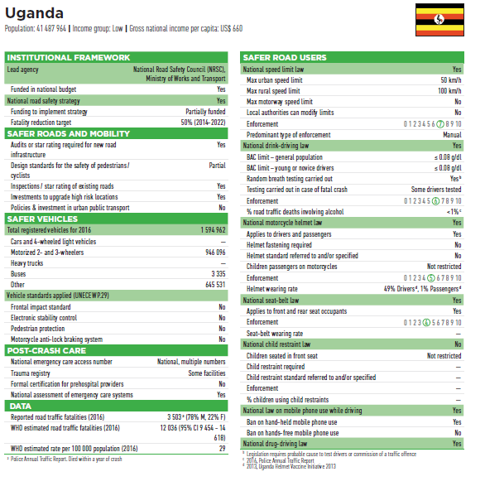
WHO GLOBAL ROAD SAFETY STATUS REPORT

Slide 3
REPORTED ROAD CRASH STATISTICS

Slide 4
REPORTED ROAD CRASH STATISTICS
  Source: Uganda Police Force
Year | Fatalities | Serious Injuries
2017 | 3,500 | 10,420
2018 | 3,689 | 9,541
2019 | 3,880 | 9,635
2020 | 3,663 | 8,370
2021 | 4,159 | 12,589
2022 | 4,534 | 15,227

Slide 5
ATTEMPTS TO DIGITISE CRASH DATA MANAGEMENT
Support from World Bank, UNRSF (UNECA)
Developing a Web based Application
    Log in credentials
    Supportive IT infrastructure
    Training the Police on data collection tools and data entry
    Equipping with tools for data collection
    Availability of connectivity

Slide 6
ATTEMPTS TO DIGITISE CRASH DATA MANAGEMENT

Slide 7
Constraints and CHALLENGES
  INADEQUATE APPRECIATION INTO THE IMPORTANCE OF ROAD CRASH DATA/ ROAD SAFETY MANAGEMENT
  INADEQUATE FINANCING/ INVESTMENT IN DATA MANAGEMENT
  INADEQUATE CAPACITY BUILDING
  UNDER REPORTING
  INCENTIVES TO REPORTING OF CRASH DATA
  DATA INTEGRATION AND INTERFACING
  LACK OF VITAL RECORDS DATA
  LACK OF COLLABORATION OF STAKEHOLDER AGENCIES IN DATA MANAGEMENT
  HOW DETAILED SHOULD A CRASH DATA FORM BE/ NON STANDARDISATION OF REPORTING
  LOW LEVELS OF RESEARCH, ANALYSIS AND CRASH INVESTIGATIONS

Slide 8
RECOMMENDATIONS
  RECOMMENDATIONS SHOULD STRIVE TO ADDRESS THE CHALLENGES OUTLINED

Slide 9
  THANK YOU

