Slide 1



Use of drone’s technologies and other features for accident prevention
Luca Persia
2nd Kofi Annan Road Safety Award Ceremony
www.ctl.uniroma1.it
info@ctl.uniroma1.it

Slide 2
Structure of the presentation
Digitalization of road safety
Innovative approaches to road safety analysis and planning
Comparison of approaches
The situation in African countries

Slide 3
Digitalization in road safety
A real revolution (7th) is changing the transport systems paradigms: decarbonisation, autonomous driving, digitalisation
Road safety research mainly focussed on innovative digital methodologies and technologies
A huge amount of concepts: Big Data, ITS, AI, IoT, Machine Learning, FCD, Telephone Data, Drones, Satellite Images, LIDAR, ADAS, CCAM, etc.
What is the potential and timeschedule for implementation of such concepts?

Slide 4
Different scenarios
Current: long-term off-line data used for off-line road safety management and planning

Slide 5
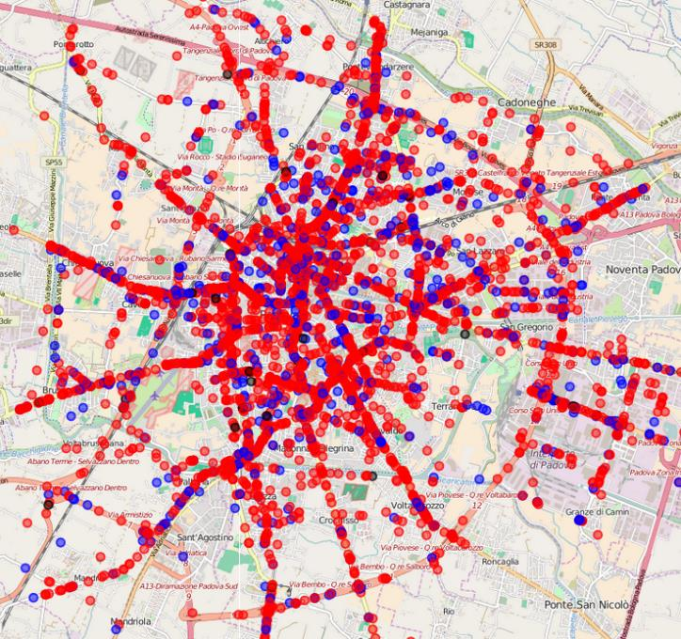
Road accident-based approach
Data:
Road accident police reports (3-5 years)
Traffic monitoring and simulation (AADT)
Infrastructure databases

Slide 6
Main drawbacks
Accidents are rare events, so it takes some time to collect sufficient data for reliable analysis (ethical concerns)
For longer period, it is difficult to correlate the crash number with a factor, since it might also change during the same period
Not all crashes are reported and the quality of reporting sometime depends on the level of severity
Availability of traffic and infrastructure data
Accident data are collected by Police forces to identify responsibilities, not causes

Slide 7
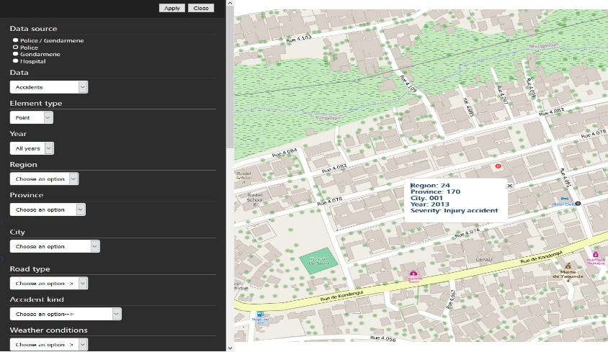

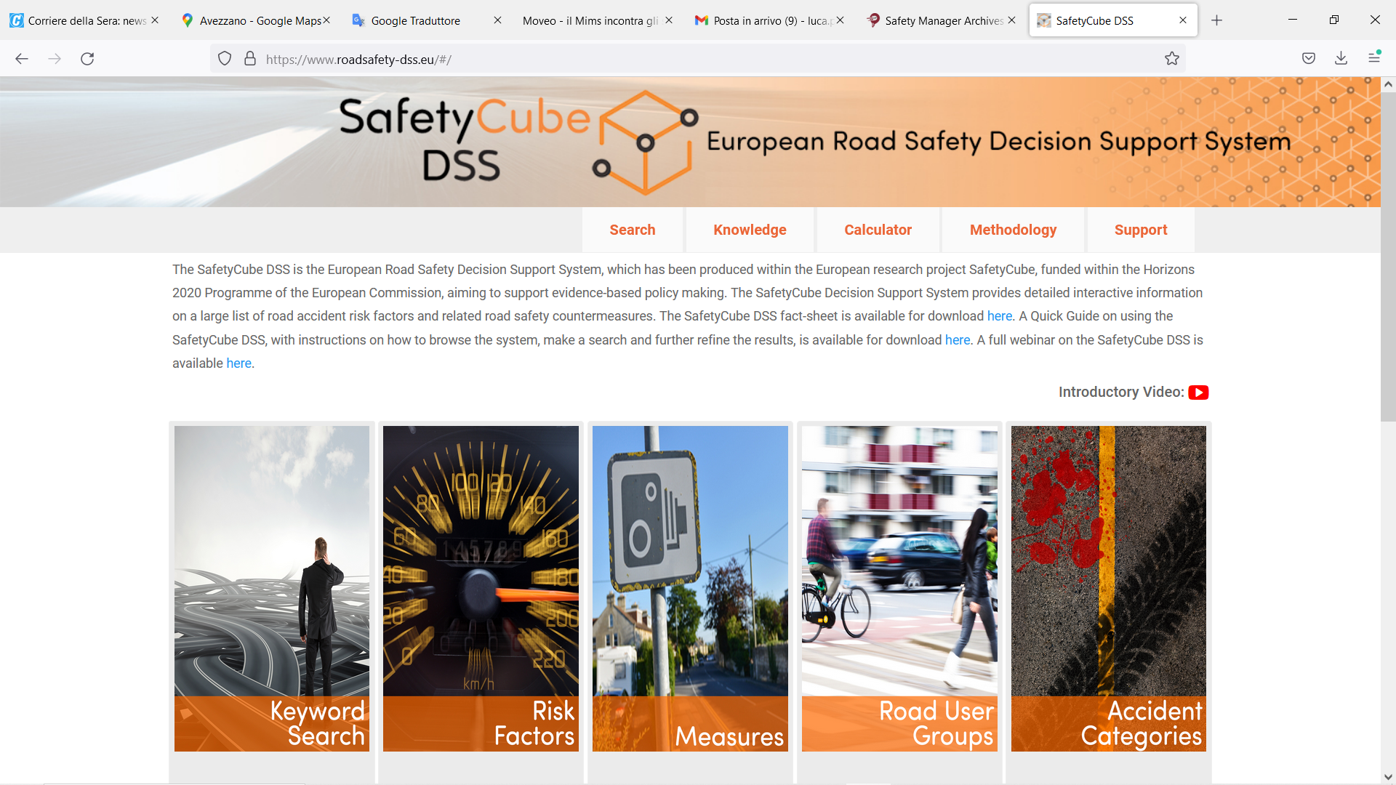
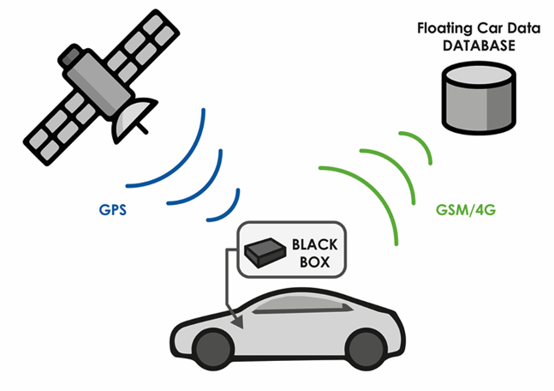
Innovations in traditional approach ₍₁₎
Digitalization of road accident data collection and analysis
Traffic data collection through FCD

Slide 8
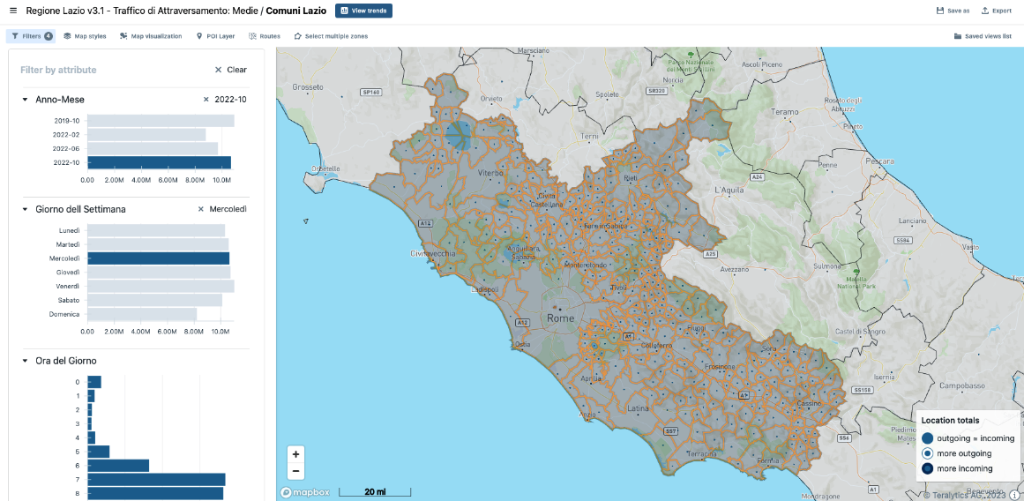
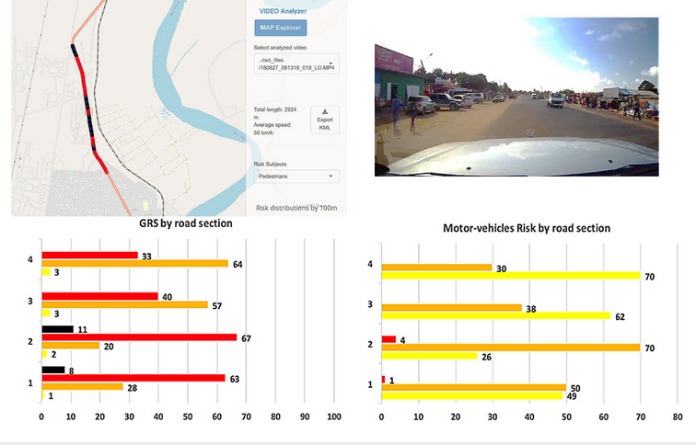
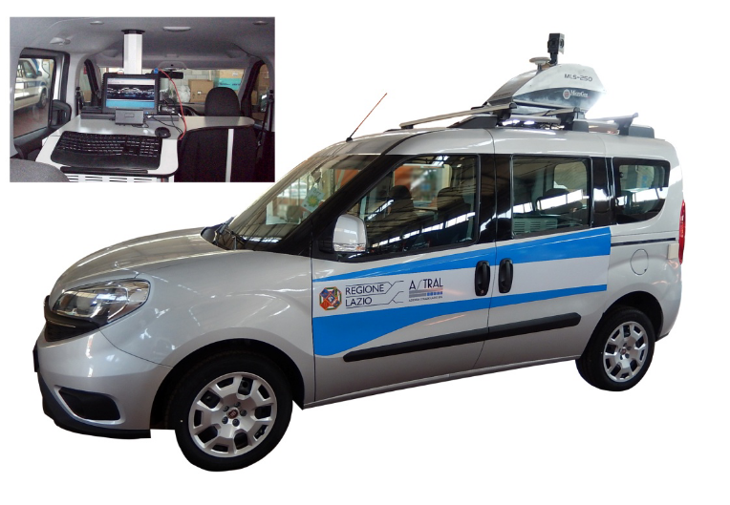
Innovations in traditional approach ₍₂₎
Traffic data collection through smartphones
Infrastructure data collection through video-inspection (Road Assessment)

Slide 9
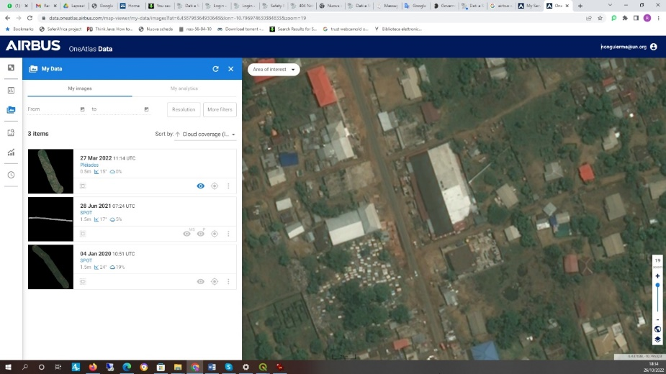
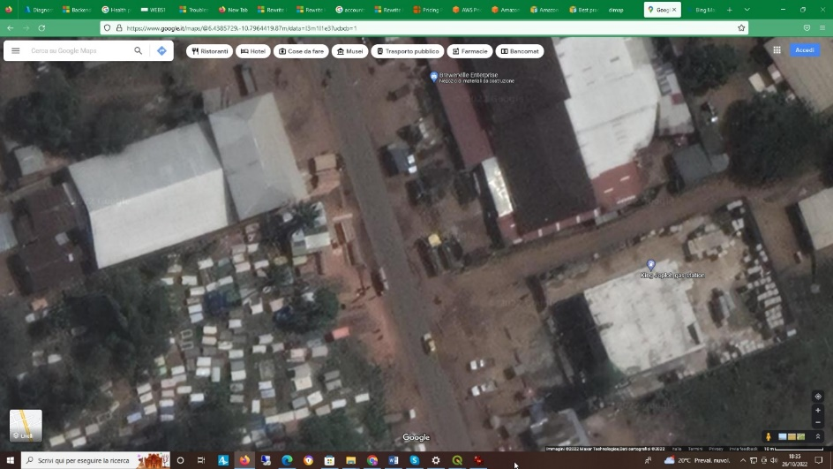
Innovations in traditional approach ₍₃₎
Infrastructure data collection through satellite imagery and AI (TAHN Project)

Slide 10
Different scenarios
Current: long-term off-line data used for off-line road safety management and planning
Current/short term: short-term off-line data used for off-line road safety management and planning

Slide 11
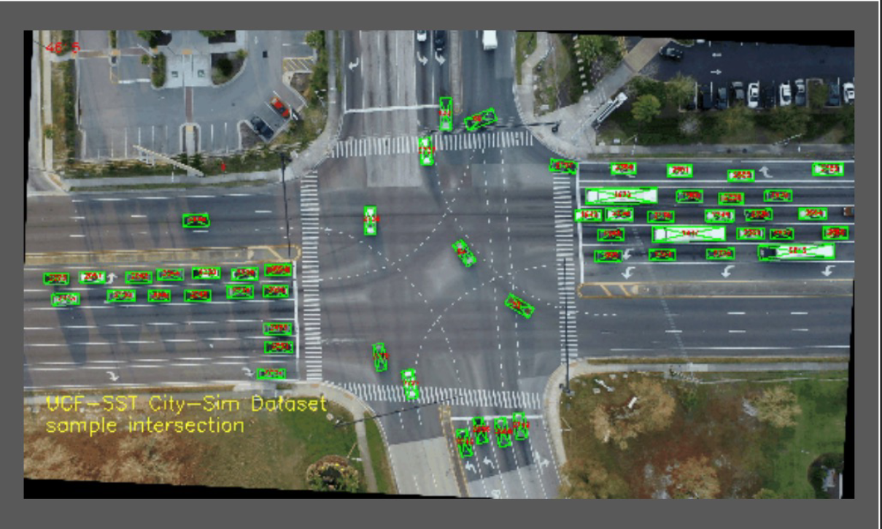
Video-based risk level analysis of critical road sections
Data:
Traffic conflicts (near misses): surrogate safety measures
Cameras/ drones (traffic/ trajectories)
Floating car data
Source: A.R.C.I.S. – UCF SST
Use of AI for video processing and insights extraction
Difference with naturalistic driving

Slide 12
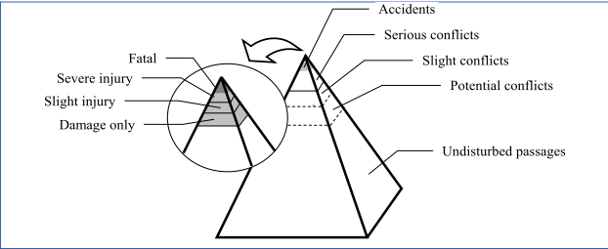
The concept
Accidents: Most severe and exceptional events in traffic (fatal, injury and property-damage-only)
Traffic conflicts : Events characterized by small margins in both time and space that almost end in accidents.
The 'safety-pyramid’. Hydén, 1987
Normal traffic events: Majority of the events that characterize the normal traffic process

Slide 13
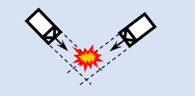
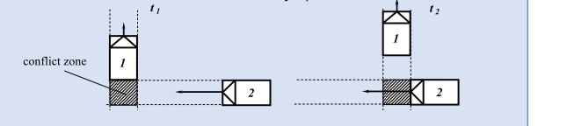
The parameters
TTC is the time until a collision would occur between road users if each continued their present course at their present rate.
Time to Collision (TTC). Source : InDeV, 2018.
PET is the time between the moment that the first road user leaves the path of the second and the moment that the second reaches the path of the first. It is the extent to which they have missed each other.
Post Encroachment Time (PET). Source : InDeV, 2018.

Slide 14
The models
Potential application
- Site safety assessment
- Before/After analysis
- Real time safety prediction
Crash based modelling
Develop a relationship between the traffic conflict frequency and the crash frequency.
- Crash frequency or probability is the dependant variable and conflict frequency is the independent variables with or without other variables ( traffic, road, weather, etc..)
- Crash severity estimation
Conflict frequency modelling
- Develop a relationship between the number of traffic conflicts on the junction during a specified period and contributing factors [ traffic (volume, speed), weather , road geometry, signal data]
Some general challenges
- Sample size of conflicts and observation period
- Validation of crash conflict relationship
- Include road user characteristics and behaviour in conflict studies
- Conflict thresholds selection and validation
- Conflicts measures for VRU
- Conflicts studies at Unsignalized intersection
- Conflicts studies in less organized environment like in developing countries
Non-crashes-based modelling
- Causal model: Probability of crash is the product of the probability of initiating conditions (conflicts), the conditional probability of evasive actions given the initiating conditions, and the conditional probability of crashes given the evasive actions.
Conflict severity modelling
- Develop a relationship between the severity of traffic conflicts and contributing factors [ traffic (volume, speed), weather , road geometry, signal data]

Slide 15
Different scenarios
Current: long-term off-line data used for off-line road safety management and planning
Current/short term: short-term off-line data used for off-line road safety management and planning
Short/medium term: off-line and on-line data used for on-line traffic management and accident risk reduction

Slide 16
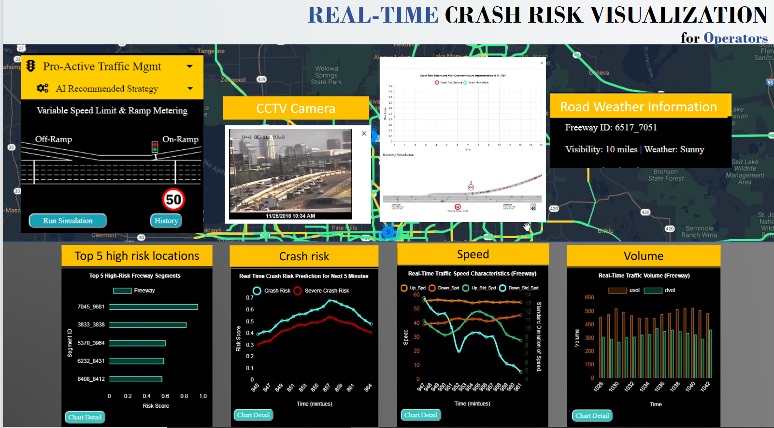
Real time risk-based traffic mgnt
Data:
Traffic volumes
Traffic speed
Traffic density
Weather conditions
FCD
Source: Real time crash risk – UCF SST
Different kinds of sensors installed on infrastructures and vehciles
Crowdsourcing

Slide 17
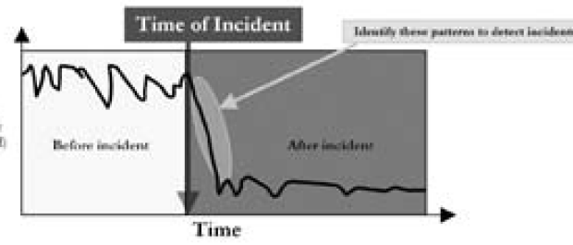
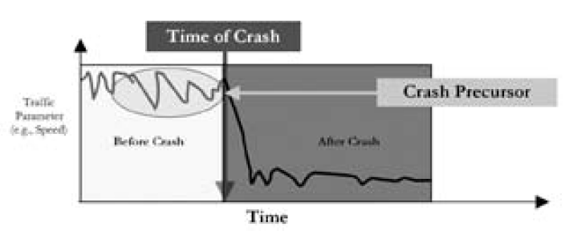
The concept
In the reactive approach, measures triggered by a specific incident or event, which may still result in traffic delay
The premise of the proactive method is that there are certain traffic patterns that are associated with a high likelihood of crash occurrence called ‘’crash precursor’’
The cornerstone of the proactive approach is the development of a real time crash prediction model able to identify and estimate the risk (likelihood*severity) of crash occurrence in the next minutes
Reactive approach
Proactive approach. Source : Abdel aty et al. 2010.

Slide 18
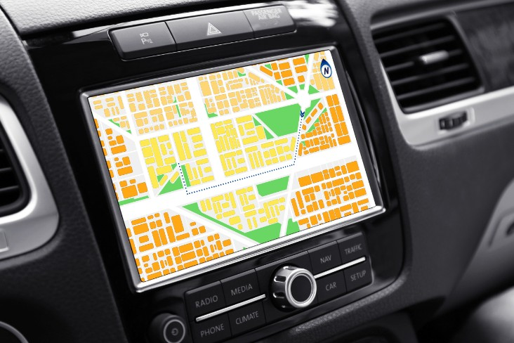
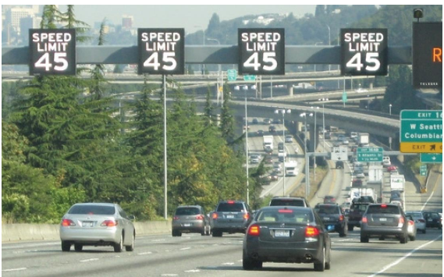
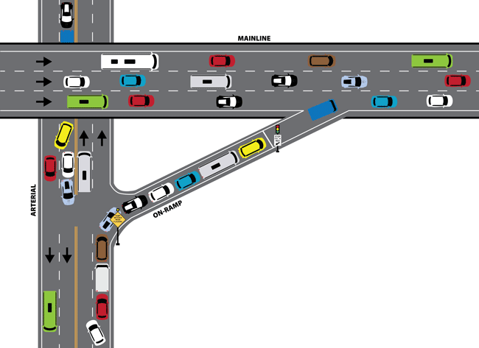
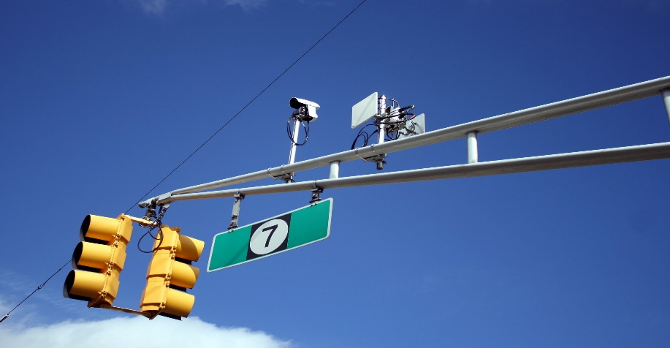
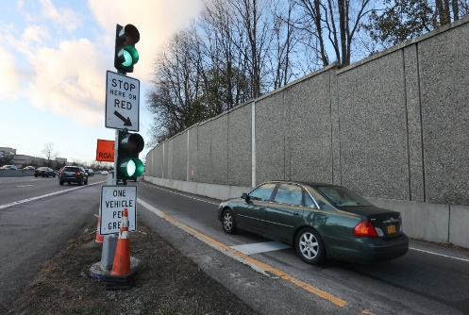
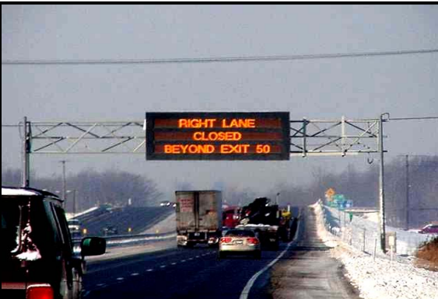
The applications
On-board information
Variable speed limits
Ramp metering
Adaptive Traffic Signal Control
Dynamic message signs
Notes:
Adjustment of speed limits based on real-time traffic, roadway, and/or weather conditions
Traffic signals installed on freeway on-ramps to control the frequency at which vehicles enter the flow of traffic on the freeway
Inform traveller about traffic related updates, current and anticipated roadway conditions, access to specific lanes, sections of the roadway or the network.
traditional signals running on pre-set timers, adaptive monitor each cycle with camera, and use a central server to make the adjustment on all signals.

Slide 19
Different scenarios
Current: long-term off-line data used for off-line road safety management and planning
Current/short term: short-term off-line data used for off-line road safety management and planning
Medium term: off-line and on-line data used for on-line traffic management and accident risk reduction
Long-term: on-line data used for full traffic automation and accident risk minimization

Slide 20
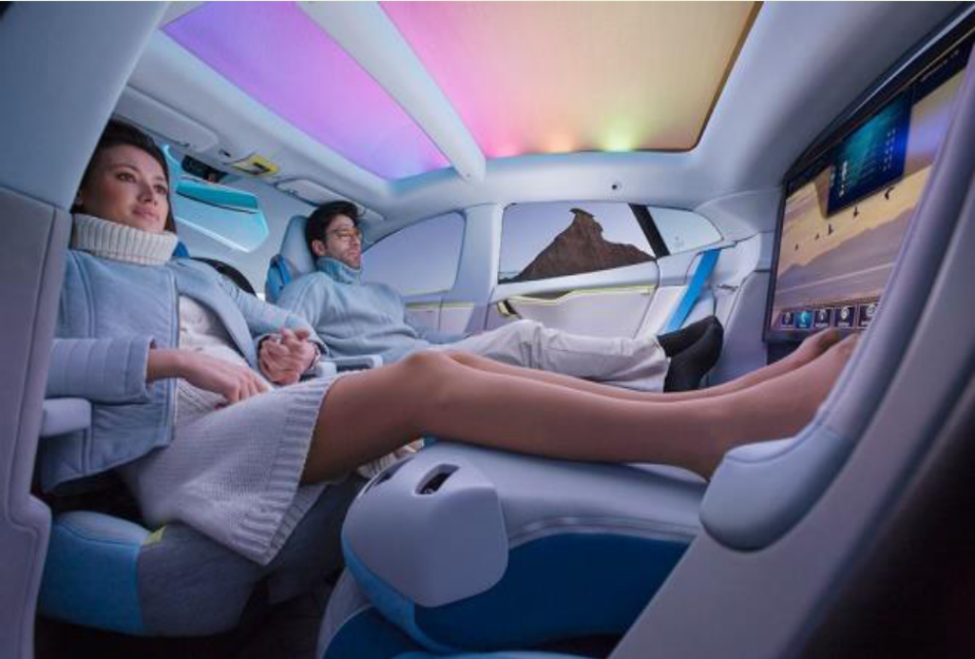
Autonomous vehicles

Slide 21
But …
Community vs User objectives (speed, risks for whom)
Higher anxiety for users
Slow and unreliable in mixed traffic, with different accident risks
Hardware and Software failures/hacking can lead to fatal results. Reliability to be assessed
Increased risk-taking (risk compensation theory). More aggressive and distracted driving for automation levels 1-3, less cautions (eg safety belts) for levels 4-5

Slide 22
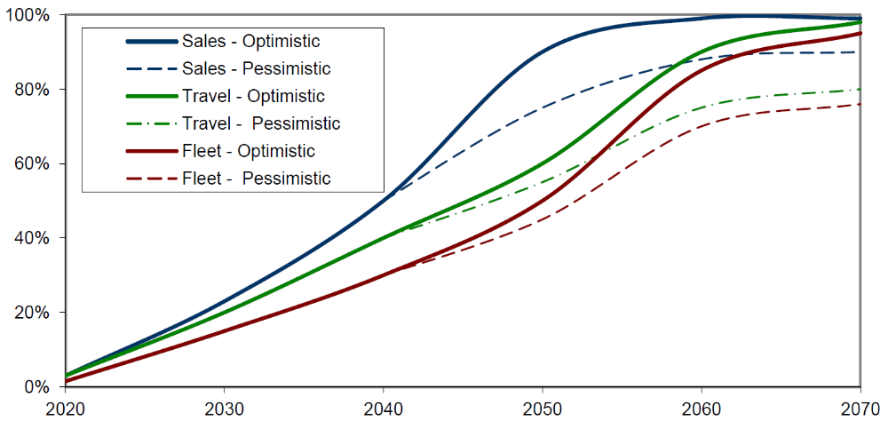
When?
Source: Victoria Transport Policy Institute

Slide 23
Comparison of approaches
 | Timing | Data availability | Extent | Regulations | Acceptability
Accident-based | 0 | + | +++ | ++ | ++
Road Assessment | ++ | ++ | ++ | ++ | ++
Image-based | ++ | + | + | 0 | ++
On-line traffic management | +++ | + | ++ | + | 0
Do they lead to similar results??

Slide 24
The framework in African countries
Applicability of innovative methodologies to the African countries:
  Data availability
  Needed resources
  High potential to overcome problems of road accident databases quality
  Applicability of models developed in other continents (difference in traffic contexts)
  Local research
What is CTL doing (two Cameroonian PhD Students): comparison between approaches and Europa/Africa

Slide 25
Conclusions
New methodologies with very high potential, but the traditional approach still needed
Need for digitalization of the traditional accident data-based approach
Actual results of new methodologies still to be demonstrated
New methodologies represent a great opportunity for African countries
Need to increase research activities on African context, but mainly in African contexts:
  Capacity building
  Need for networking (ex. FERSI)

Slide 26
Research Centre for Transport and Logistics
Via Eudossiana 18
00184 – Rome
More information:
Prof. Luca Persia
+39 342 7191763 luca.persia@uniroma1.it www.ctlup.com

