Slide 1


Domestic and International private business and finance – FDI, remittances, domestic financial markets
Sonia Essobmadje, CFA
Chief of Section, Finance and Domestic Resource Mobilization
Macroeconomics, Finance and Governance Division
UNECA

Slide 2
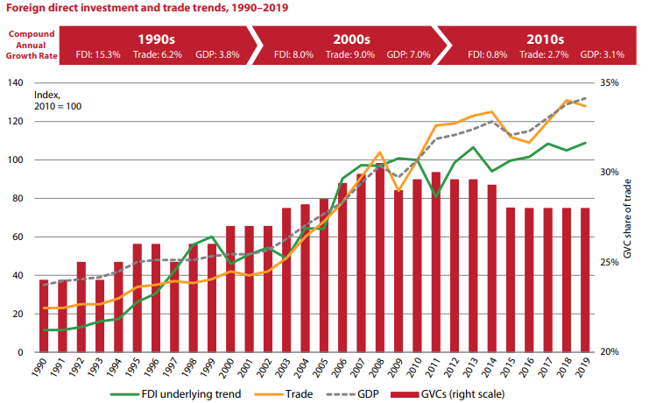
Africa's mixed FDI performance reflects the continent's diverse investment climate
Rising protectionism and political uncertainty, as well as recent crises, have contributed to this slowdown.
Africa received 4% of the global FDI flows.
Several factors contribute to this persistent trend of low FDI in the region:
  Macroeconomic and political risks
  Infrastructure deficits and shortage of skilled labour
  Information shortages and negative perceptions about the investment climate
Note: Graph 1 Source: UN, Financing for Sustainable Development Report 2024. Graph 2: data from UNCTAD

Slide 3
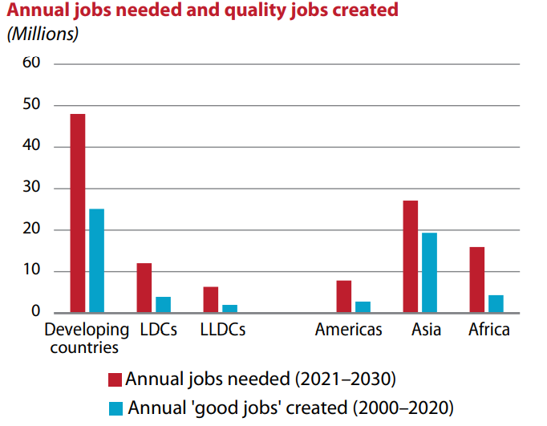
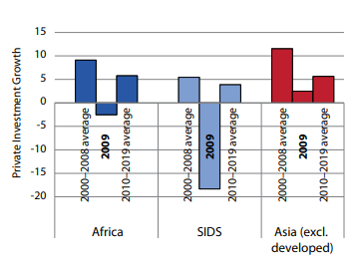
A slow dynamism in private sector’s contribution to sustainable growth and development
Source: UN, Financing for Sustainable Development Report 2024
Limited industrialization and economic diversification
Volatile growth prospects
Low labor productivity
Limited access to finance

Slide 4
Infrastructure development remains constrained by limited access to long-term finance
Note: Data from LSEG Deals Intelligence, 2023
* EMEA: Europe, Middle East, Africa
Africa received roughly 1% of project finance loans
Rising global interest rates have increased borrowing costs, making it more expensive to finance large-scale projects.

Slide 5
Access to finance remains a major constraint for businesses
The percentage of African companies benefiting from a bank loan remained relatively low compared to other regions.
On average, the region also has the highest proportion of loans requiring a collateral (81%).
Note: Data from the latest World Bank Enterprise Surveys on 48 African countries

Slide 6
The potential for leveraging capital markets to mobilize resources remains untapped
Note: Data from WFE Statistics Portal based on the reporting of 17 African exchanges
Markets are dominated by government securities issuances, crowding out private sector

Slide 7
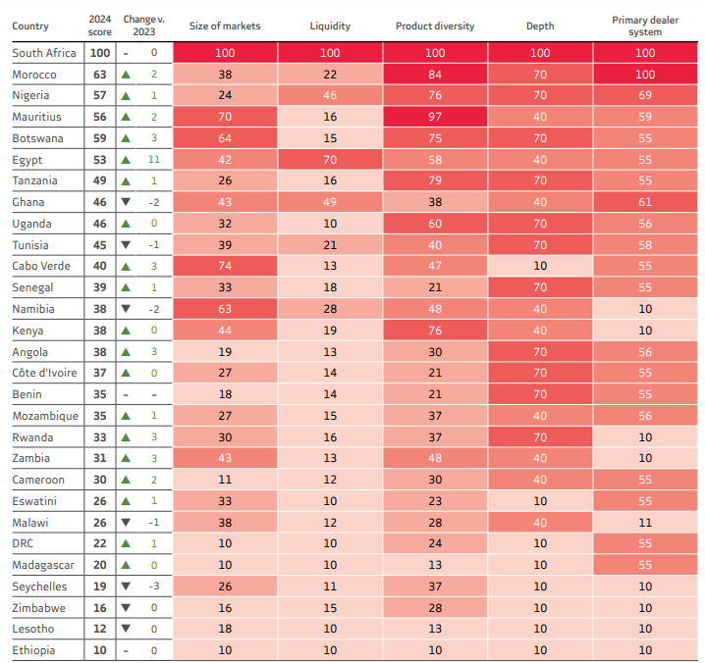
Liquidity across the continent remains a major concern
Markets remain small overall
Limited secondary market activity
Opportunity to diversify financial instruments with green/sustainable finance and Islamic finance products remains.
Source: AFMI report 2024

Slide 8
Capitalizing on remittances for development
Note: Data from World Bank-KNOMAD, June 2024 and from UNCTAD
Remittance flows are less volatile than FDI flows

Slide 9
Leverage remittances for development
Note: Data from World Bank-KNOMAD, June 2024
Remittance has become Africa's largest source of external financial flows

Slide 10
3 key action-oriented recommendations
Don’t just focus on finance, tackle the underlying issues that make critical sectors inefficient.
Anchor your industrialization strategy on an efficient industrial fabric.
Leverage the development of the capital market to accelerate resource mobilization.

Slide 11
Thank you
THANK YOU

