Slide 1

Action Plan to Improve Statistics for Food Security, Sustainable Agriculture & Rural Development in Africa (2011-2017)
StatCom-Africa 5, 08-11 December 2014, Tunis, Tunisia
Implementation status of the Governance Mechanism and Technical Assistance component of the Action Plan
Statistical Capacity Building Division
Statistics Department
Economic Complex
African Development Bank
Progress Report on the Implementation of the Action Plan

Slide 2
Table of Contents
Achievements under the Governance Mechanism
Achievements under the Technical Assistance component
Some of GM and TA key activities proposed for 2015
Achievements under the Training component

Slide 3
I. Recent Governance Mechanism achievements
Completed staffing of the Regional Secretariat within the AfDB
Held the 3rd Regional Steering Committee meeting, April 2014 - Some of the important decisions: approval of 2014 workplan/budget, co-chairs by countries, endorsement of CA results, etc.
Participation to GSC and GEB meetings: 9th GSC and 5th GEB meetings
Participation to global Coordination meeting: 1st meeting (Sept 2014, Rome)
Resource mobilization efforts to support the AP for Africa is underway between EU and AfDB – Agreement expected to be signed by the end of the year

Slide 4
I. Recent Governance Mechanism achievements (Cont’d)
M&E framework meeting held in Tunis, June 2014 for, among others: (i) Reviewing the existing M&E framework, (ii) Identifying the regional needs to feed into the GO framework review, and (iii) Fine tuning the Global Logical framework
The national governance structures being strengthened in the framework of SPARS development - Agric Stat Coord. Committees, Sub-Sectors TWGs, etc.
Regional Workshop on the implementation of the AP: Maputo for English and Portuguese speaking countries

Slide 5
II. Recent Technical Assistance achievements
  The 1st Stage of CA completed successfully
  Reporting Status - A record of 52 countries
  Methodology and preliminary results discussed, approved and owned by countries, and endorsed by:
    23rd session of AFCAS in Rabat
    Meeting of Heads of NSOs at the 9th African Symposium on Statistical Development in Botswana
    Third face-to-face Regional Steering Committee meeting in Kenya
  Final Report of ASCI – Yet published widely (November 2014)

Slide 6
II. Technical Assistance (Cont’d)
  Main findings of the 1st Stage of CA
  The capacity for African countries to produce timely and reliable agricultural statistics measured objectively and in a standard way by indicators (ASCI) on explaining elements and their aggregation by four dimensions:
    Institutional infrastructure
    Resources
    Statistical methods and practices
    Availability of statistical information
  A composite/aggregated indicator calculated to measure the development level of national agricultural system
  Country ranked according to their ASCI levels and grouped by ASCI and GDP/Agric VA levels
  ASCI to be used as key M&E indicators (1st results=Baseline informational)
  Country profiles being established

Slide 7
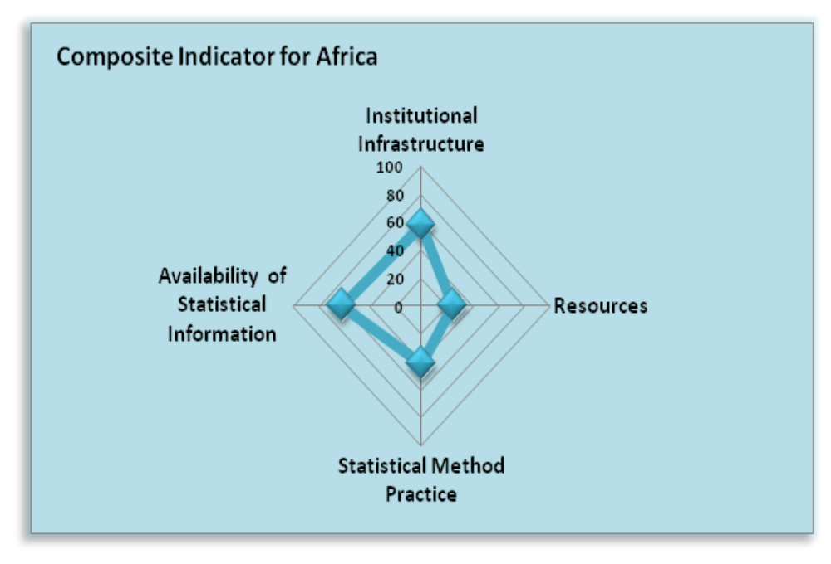
State of NASS? Weak capacity for Africa to produce Agric Stat
Notes:
1

Slide 8
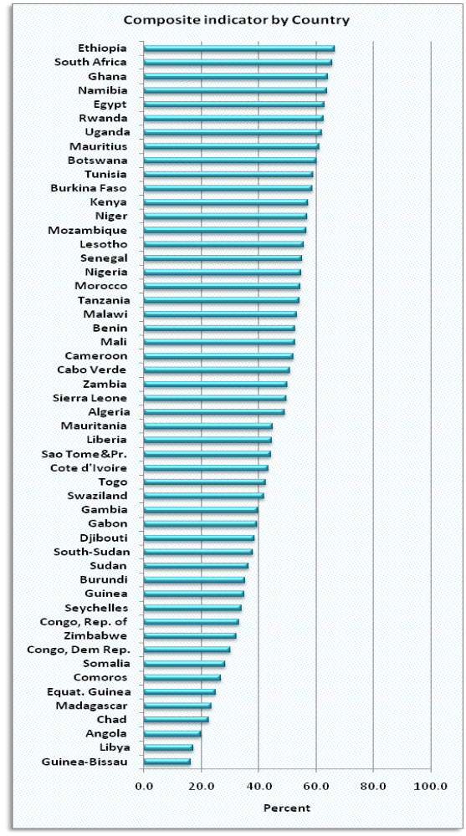
State of NASS? Weak capacity for Africa to produce Agric Stat
Notes:
1

Slide 9
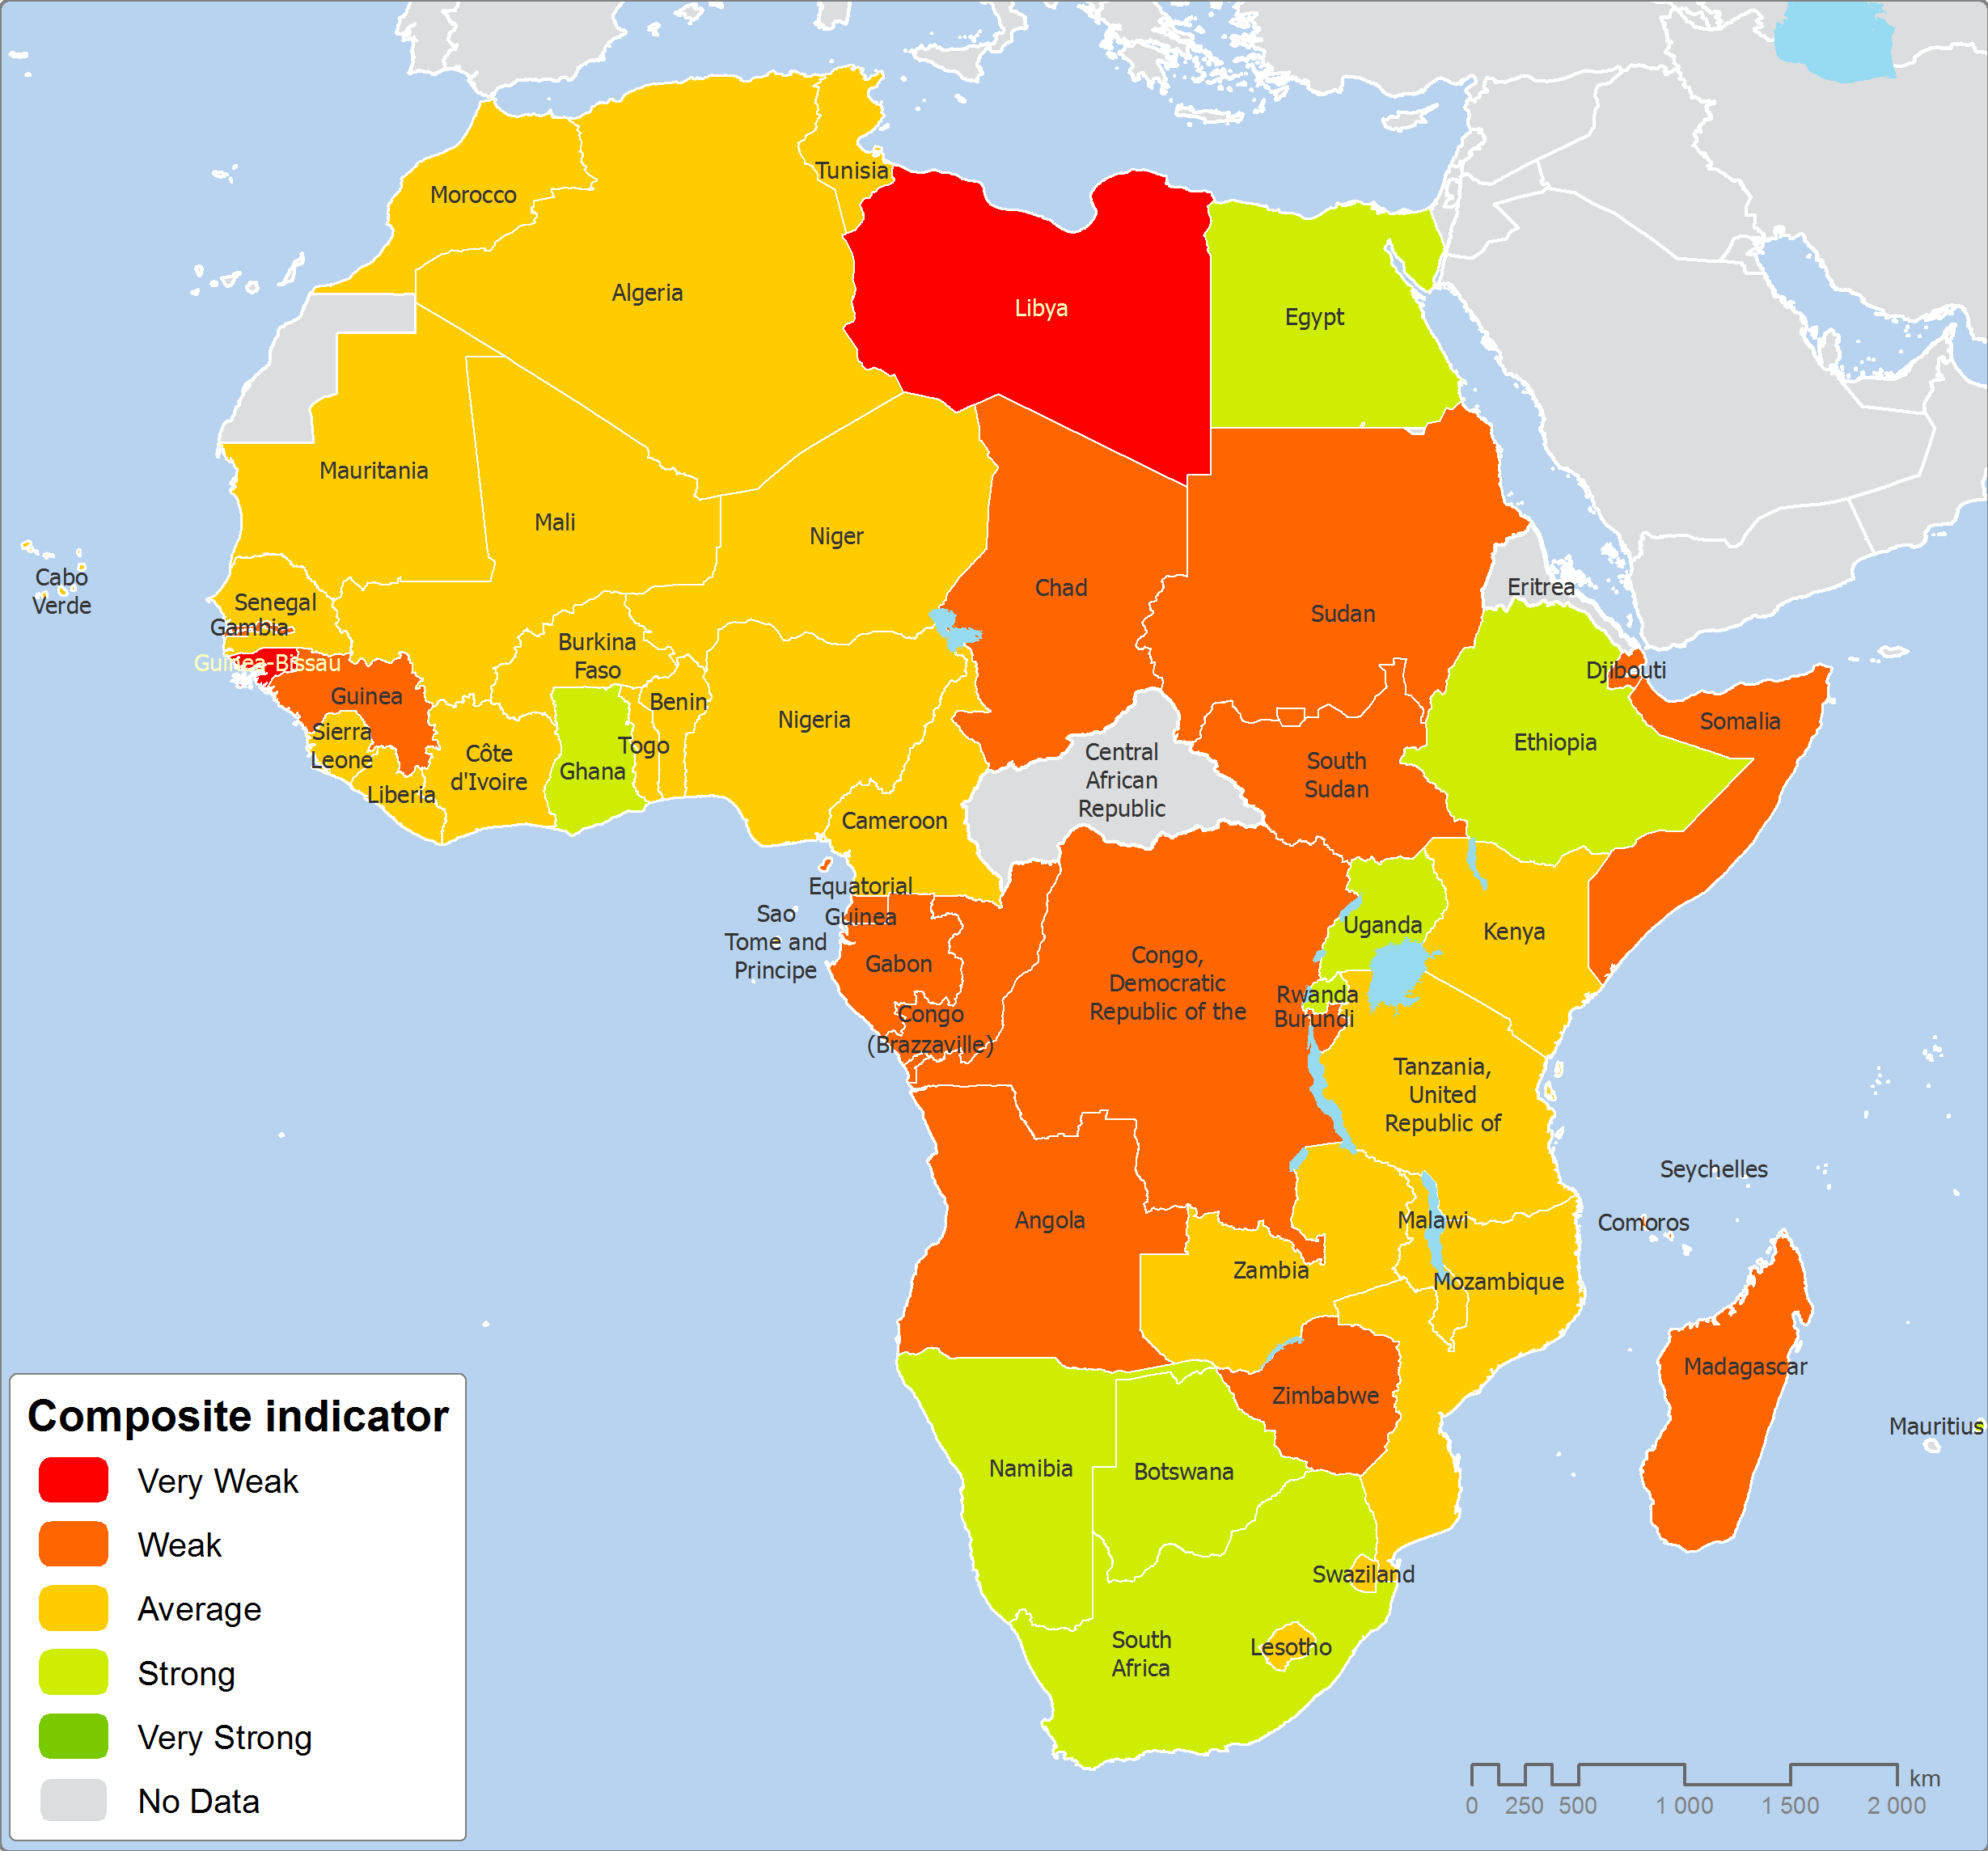
Composite Capacity Indicator – High spatial variation
Notes:
1

Slide 10
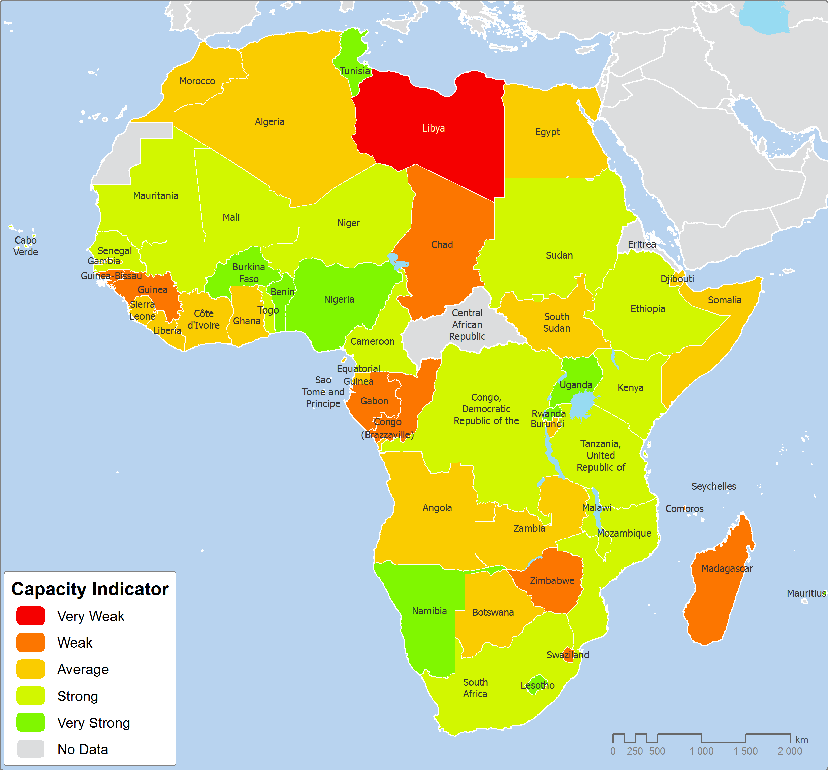
Indicator on Institutional Infrastructure – High spatial variation
Notes:
1

Slide 11
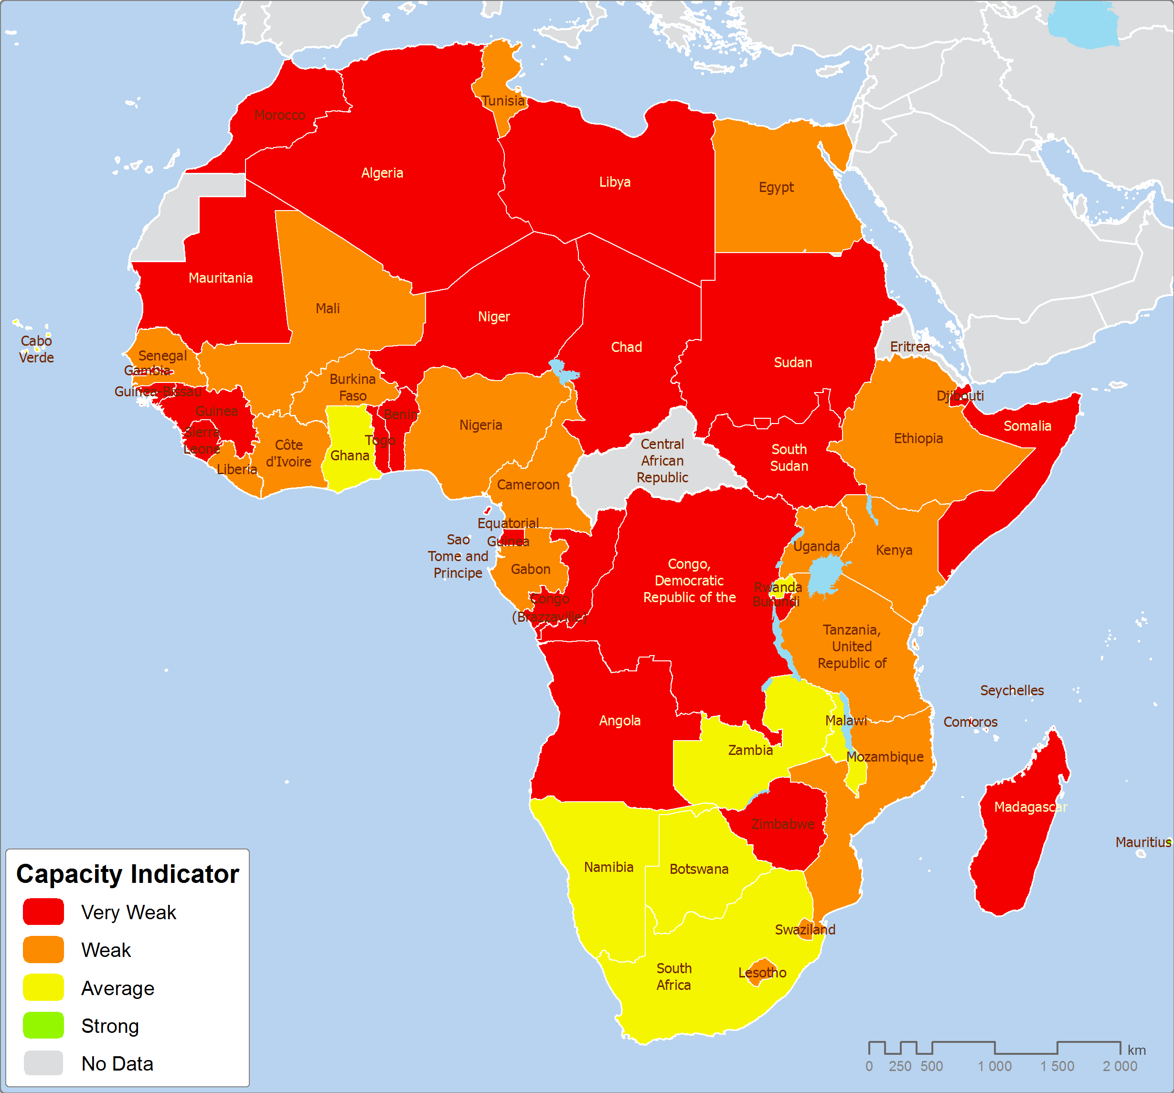
Capacity indicator on Resources – Highly weak in almost countries
Notes:
1

Slide 12
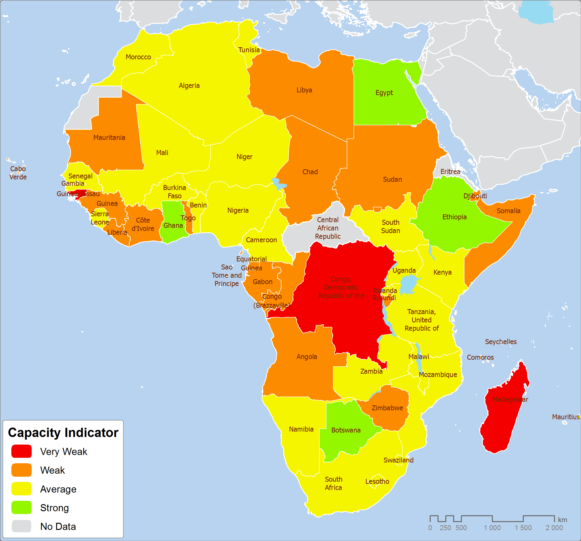
Statistical methods and practices - High spatial variation
Notes:
1

Slide 13
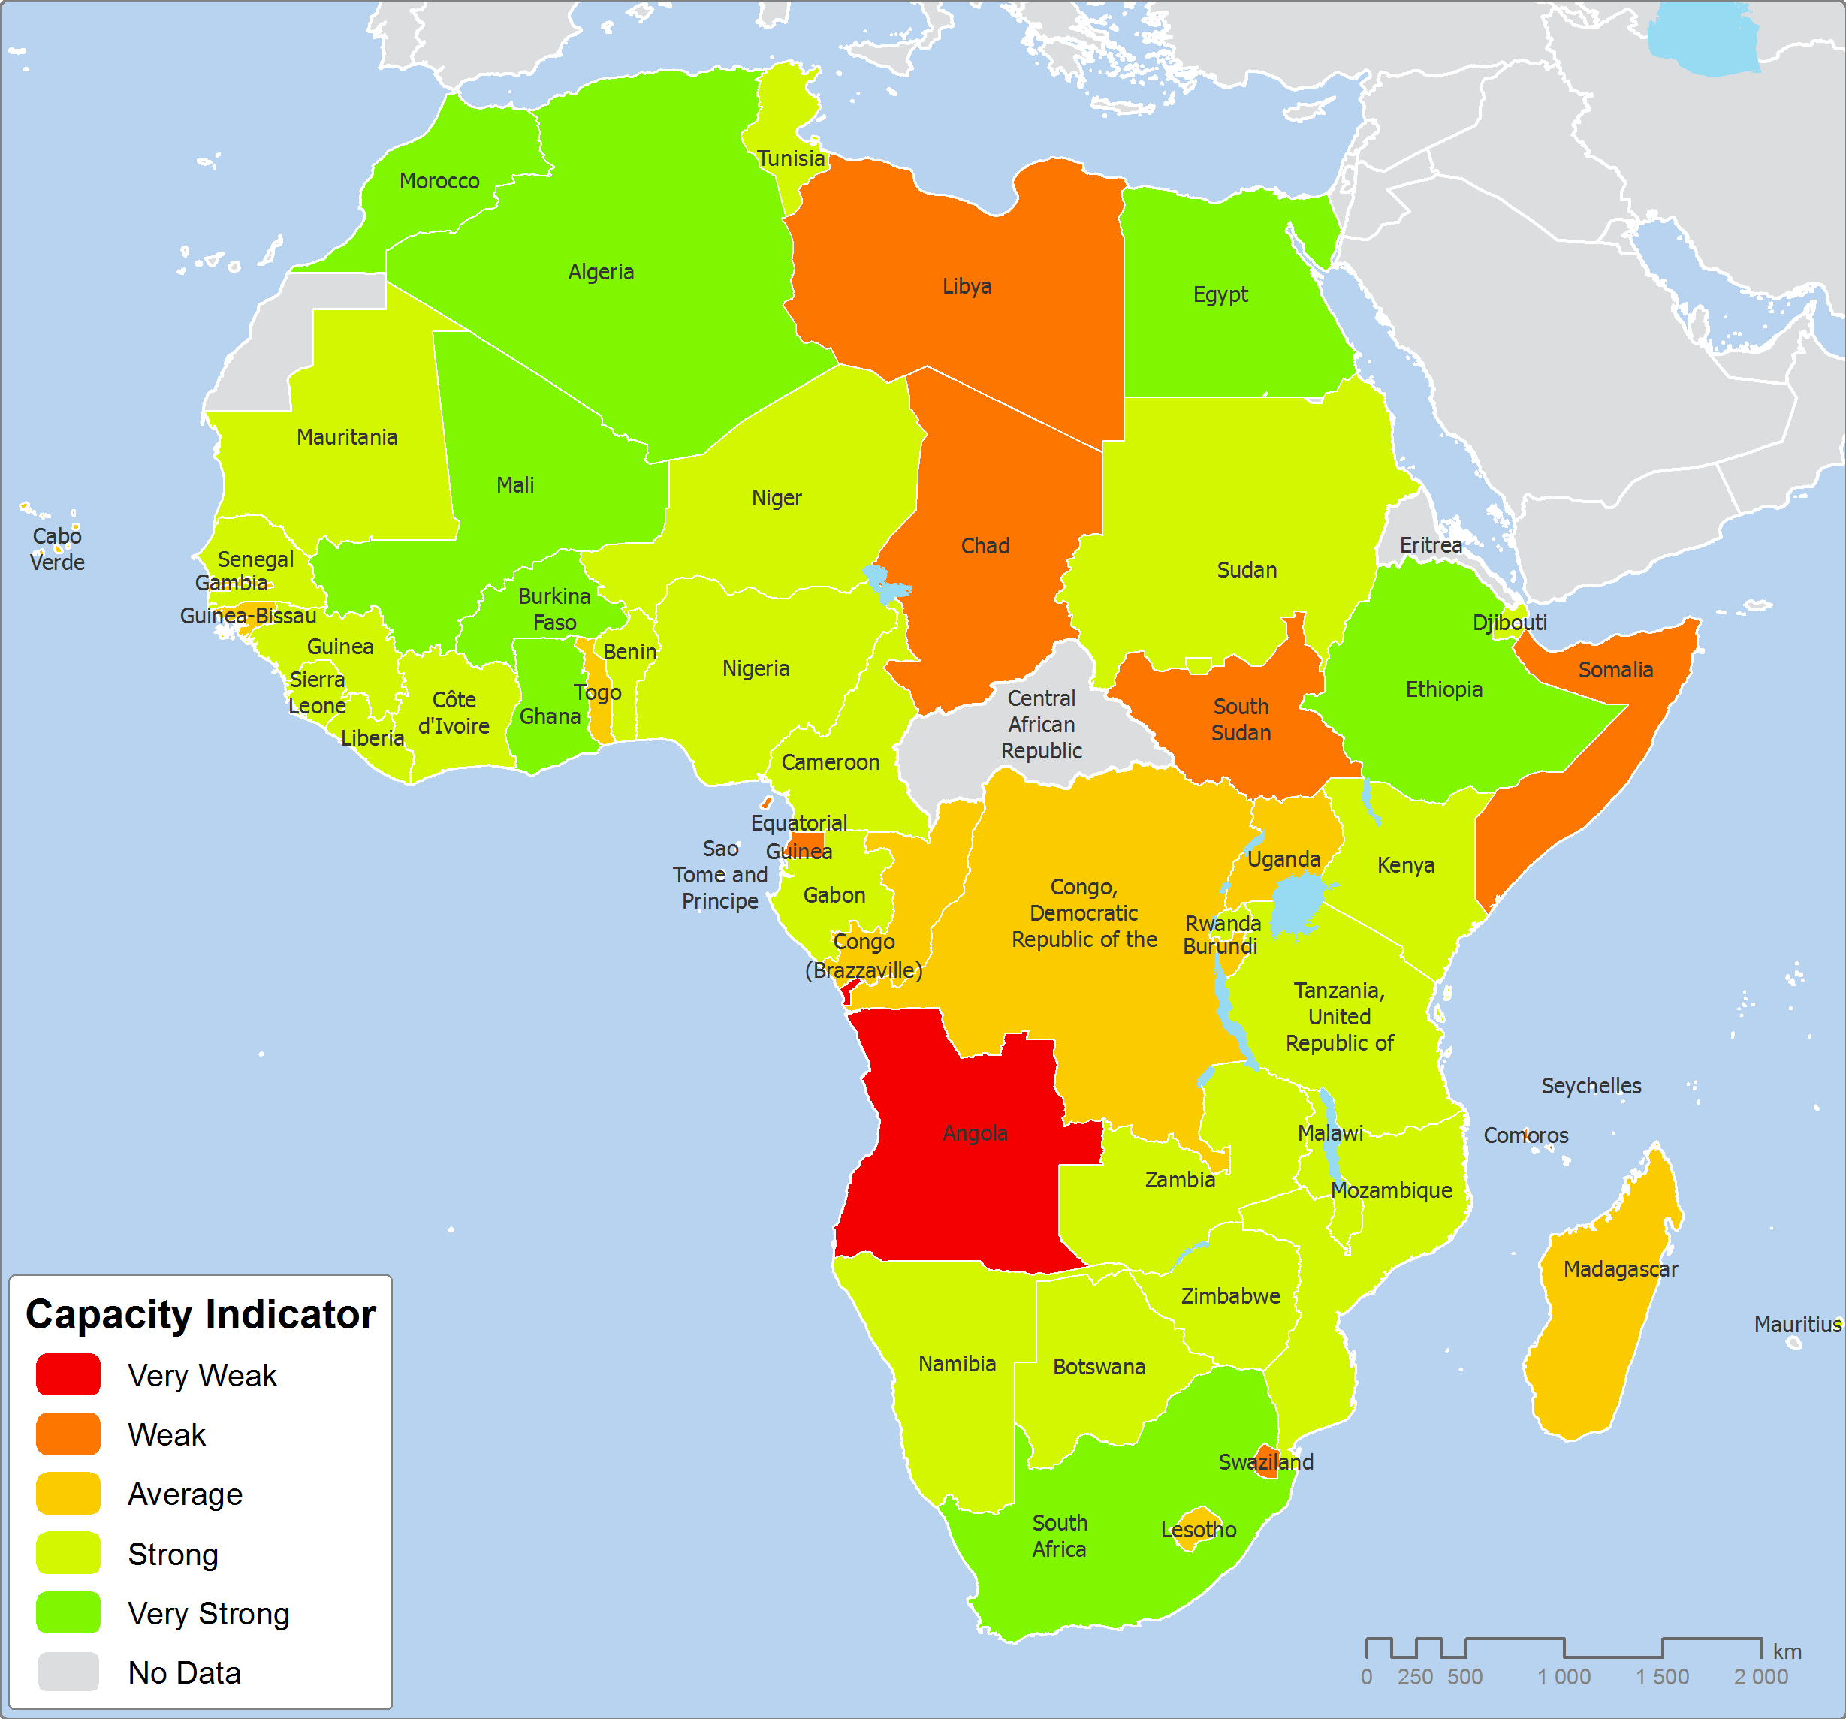
Capacity indicator on data availability - High spatial variation
Notes:
1

Slide 14
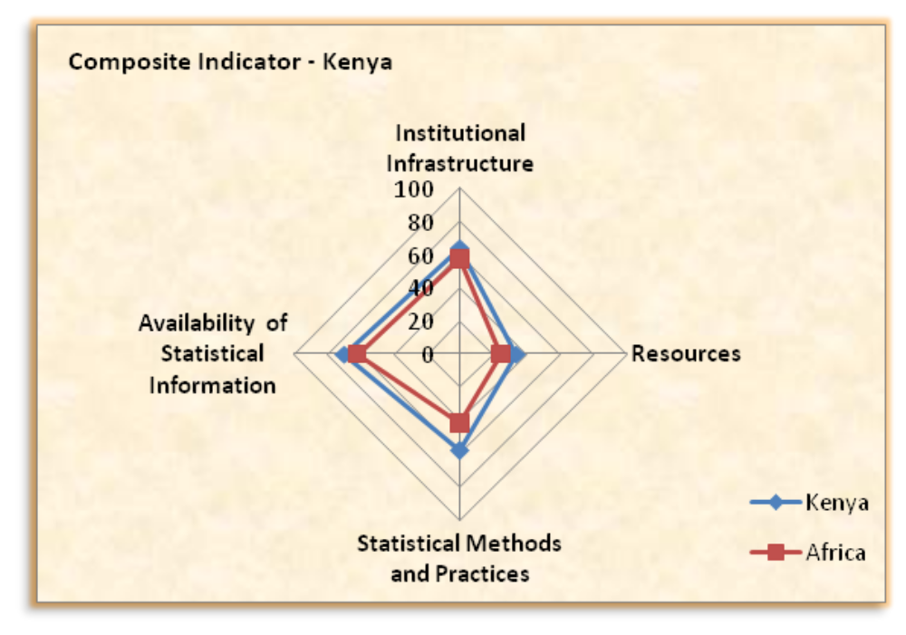
Country profile in terms of ASCI – Case of Kenya
Notes:
1

Slide 15
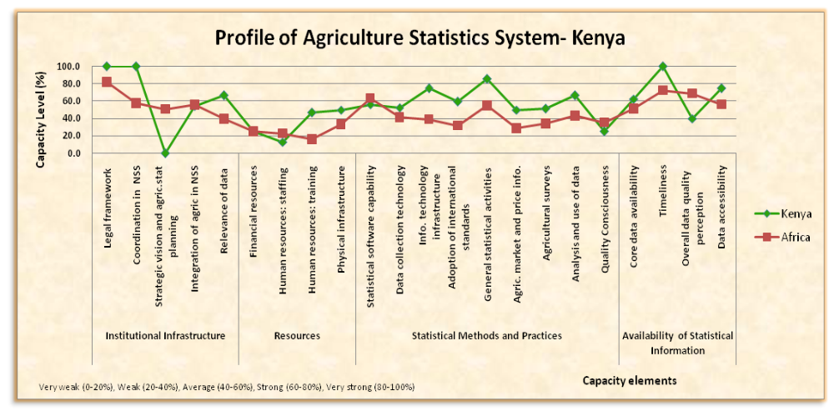
Capacity for Kenya to produce Agric Stat Agric
Notes:
1

Slide 16
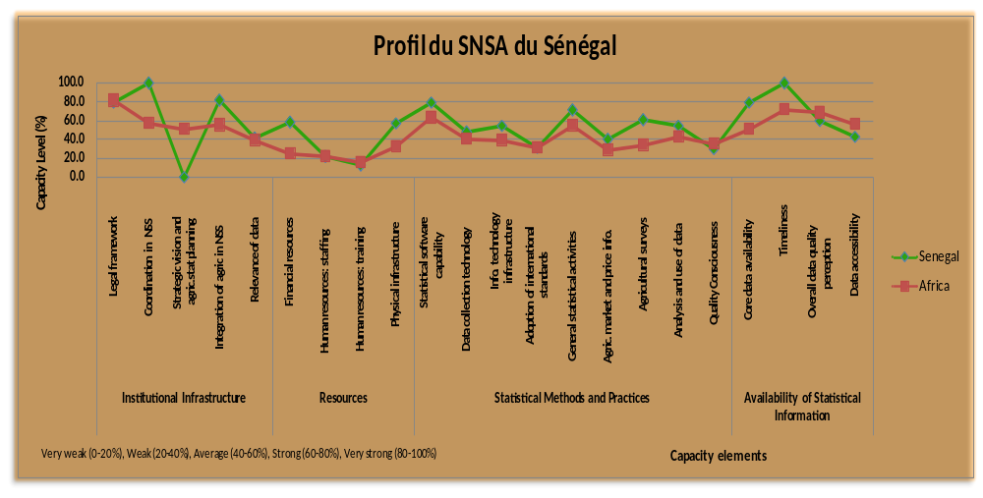
Capacity for Senegal to produce Agric Stat Agric
Notes:
1

Slide 17
II. Technical Assistance (Cont’d) – SPARS development in progress
Field testing of SPARS guidelines – Jointly by FAO/AfDB
  Carried out in Burundi in March 2014 and also a country request to develop their SPARS
Technical Assistance being provided to countries on SPARS
    Roadmaps developed/approved and Launching made for Benin, Burundi, Cabo Verde, Cote d’Ivoire, Senegal and Kenya – SPARS for Benin, Burundi and Cabo Verde be completed by Jan 2015, Senegal and Kenya by March 2015, Cote d’Ivoire -TBD
    SPARS development at the Launching stage: Soudan – To be completed by June 2015
    Formal Country requests for TA on SPARS development: Burkina Faso, Congo Democratic Rep., Gambia, Madagascar, Niger, Nigeria, Rwanda, and South Africa – List extended to 24 countries (TA needs identification)
    Supported Tanzania for preparing Agriculture Statistics Strategic Plan – USDA/FAO/AFDB joint missions

Slide 18
II. Technical Assistance (Cont’d) – Others
Validation of IdCA reports for BMGF focus countries - To feed SPARS (Plan for Nigeria and Burkina Faso)
  Regional IdCA validation workshop was organized by FAO and AfDB in May 2014 in Accra
  Update on implementation of IdCA in BMGF focus countries was discussed and validated
Cabo Verde - Reviewed and finalized technical documents for Agricultural census, AfDB MIC funds document
Finalized and published Rwanda 2013 agricultural survey results – TA to design a Multiple Frame Survey methodology (Area and list) and preparation of the survey report, Training staff, Identifying areas for improvement of the survey methodology and advice on how to implement it
IdCA for Senegal jointly with USDA/NASS – To feed SPARS
Extending TA provision based on the results of the current initiative on identification of country TA specific/priority needs – Part of the 2015 Workplan/Budget

Slide 19
Number of Countries by TA needs

Slide 20
III. Key GM and TA activities to be planned for 2015
Discussions to ensure that the regional executive board of the AP is in place and chaired by a country;
Continuous resource mobilization to cover the current funding gap, beyond EU additional funds;
Continued establishment of implementation structures of the Action Plan at national level (Quid Setting up National Coordination Committees and making NSC/TWG functioning actually);
Hold a RSTC meeting early next year – For among others Approving the 2015 workplan/budget;
Regional training workshops on IdCA, SPARS, Newly developed methods, Minimum core data sets and urgent standalone TA – To be organized in Tunisia for French speaking countries (January 2015);

Slide 21
III. Key GM and TA activities to be planned for 2015 (Cont’d)
Backstopping missions on SPARS - Benin, Cabo Verde, Cote d’Ivoire, Senegal, Kenya, Senegal, and Sudan;
Launch SPARS development in Burkina Faso, Congo Democratic Rep., Gambia, Madagascar, Niger, Nigeria, Rwanda, and South Africa, etc;
Based on country identified specific/priority TA needs:
  Provision of TA to countries on the use of newly developed methods (training workshops and/or backstopping missions)
  Provision of TA to countries on data harmonisation and dissemination
  Other standalone TA’s as need may be
Support to CAADP, including mapping CAADP M&E indicators and Minimum Core Data Sets of GS;
Undertaking a light CA.

Slide 22
Implementation Status of the Training component
Covering period 2012/13 -14

Slide 23
Implementation Status
Two manuals (in English and French versions) developed and to be disseminated soon
Agricultural statistics training needs assessment framework
To help agricultural statistics agencies assess training needs and devise a capacity-building strategy as they increase their human capital.
Human resources policy guidelines
To give agricultural statistics agencies a structured and coordinated human resources development strategy that would coordinate the training of agricultural statistics professionals with the training of professional in national statistical systems.

Slide 24
Implementation Status
Development of agricultural statistics training curriculum
  Curriculum at the senior technician, bachelor’s and master’s levels has been developed
  Expert Group Meeting for the finalization of the curricula held on 26-30 May 2014, Rabat , Morocco
  Next step is to disseminate this curriculum to the respective statistical training institutions across Africa

Slide 25
Implementation Status
Short-term and in-service training in agricultural statistics
  Four syllabuses translated into English and French and will soon be available to selected Statistical Training Centers:
    Agricultural Census and Survey
    Agricultural Data Processing
    Economic Accounts for Agriculture
    Sampling design for Agricultural Surveys

Slide 26
Implementation Status
Training of human resources managers in agricultural statistics agencies
Organized with the United Nations Institute for Economic Development and Planning, took place in Dakar, Senegal, February 3 to 7, 2014.
Forty-five human resources managers and officers responsible for the development of agricultural statisticians from 23 countries have attended the training.

Slide 27
Implementation Status
Expert Group Meeting for Review and Validation of Agricultural Statistics Training Needs Assessment Framework, Human Resources Policy Guidelines, and Agricultural Statistics Training Syllabuses, Maputo Mozambique, 2013, Nov. 8 to 12
The meeting was organized in collaboration with the Insituto Nacional De Estatistica and Escola Nacional de Estatistica of Mozambique
discussed the design and recommended improvements to the above documents.

Slide 28
Implementation Status
African Group on Statistical Training and Human resources development (AGROST) Annual Review Meeting on training component of the Action Plan, Maputo, Mozambique, November 13 to 15, 2013
  After the improvements recommended at the Expert Group Meeting were made, participants at this meeting reviewed, discussed and validated the training packages for agricultural statistics.

Slide 29
Implementation Status
Scholarship for master’s qualifications in agricultural statistics
The first group of 12 countries has been covered by the program in 2013: Burkina Faso, Ethiopia, Ghana, Nigeria, Mali, Tanzania, Uganda, Cape Verde, Morocco, Mozambique, Rwanda, and Zambia.
The countries that submitted their official lists of the beneficiaries of this 2013 scholarship fund are: Burkina Faso, Burundi, Comoros, Ethiopia, Ghana, Madagascar, Mali, Niger, Nigeria and Tanzania.

Slide 30
Implementation Status
The students attend their studies at the following 4 STCs which have signed a memorandum of understanding (MoU) :
ENSEA- Abidjan,
ENSAE- Dakar,
EASTC Dar Es Salaam, and
ISSEA-Yaounde
Each country has a memorandum of understanding with the students
that they will return and serve their institutions upon completion
of their studies.
The first scholarships have been awarded, and the financial transfers
have been made to the statistical training centre.

Slide 31
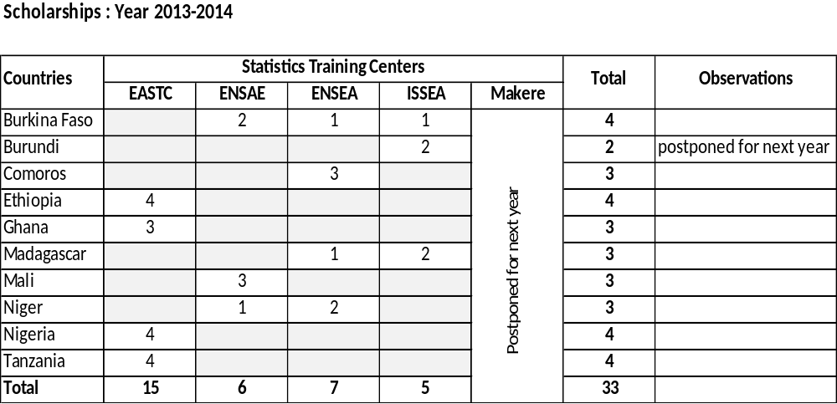
Implementation Status

Slide 32
Challenges
Late arrival of funds has created some delays on the implementation process.
The student allowance seems insufficient in some countries in terms of cost of living. It would therefore be useful to review the situation.
STC administering the scholarship funds are quite late in reporting financial and also and technical . ISSEA , Yaounde has not yet submitted.

Slide 33
Thank you

