Slide 1

Financing Civil Registration & Vital Statistics
Africa region
3rd Conference of African Ministers responsible for Civil Registration
Samuel Mills, MD DrPH
World Bank Group
February 11, 2015

Slide 2
CRVS is prominent in the post-2015 Sustainable Development Goals
Target 17.18
By 2020, enhance capacity building support to developing countries including for LDCs and SIDs, to increase significantly the availability of high quality, timely and reliable data disaggregated by income, gender, age, race, ethnicity, migration status, disability, geographic location and other characteristics relevant in national context.
CRVS is the most reliable source of disaggregated data
Target 16.9
By 2030, provide legal identity for all including birth registration
Linking CRVS with national identification management systems provides the foundation for good governance and has benefits in all sectors
It is time to change the definition of birth coverage rates from under-5 years to under-1
Source: Open Working Group proposal for SDGs. http://sustainabledevelopment.un.org/sdgsproposal

Slide 3
WBG Identification for Development (ID4D) support to countries
Strengthening CRVS systems
Modernizing identification management systems through integrated solutions
Promoting universal financial access
Enhancing performance of social payments systems
Fostering social inclusion of marginalized groups
Improving governance and public sector performance
Fostering private sector involvement
Fostering transparency and accountability

Slide 4
Global CRVS Investment Plan
Consultative stakeholder workshop on civil registration and vital statistics (CRVS), Addis Ababa, April 28-29, 2014
http://www.who.int/healthinfo/civil_registration/TechnicalConsultation_April2014/en/
Released on May 28, 2014
http://www.worldbank.org/en/topic/health/publication/global-civil-registration-vital-statistics-scaling-up-investment
Maternal, Newborn and Child Health Summit, Toronto, May 28-30, 2014 hosted by Canadian Prime Minister
http://mnch.international.gc.ca/index-en.html

Slide 5
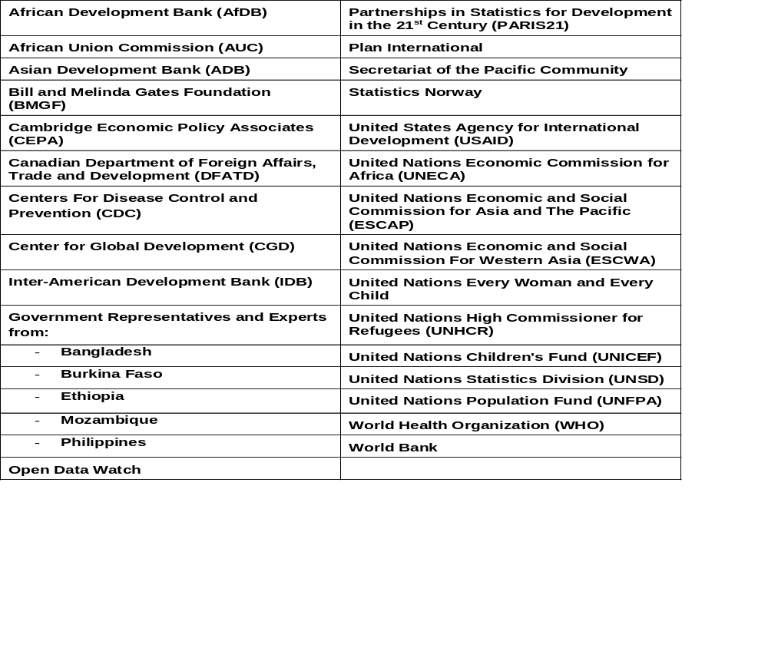
Acknowledgements

Slide 6
Objective of Global CRVS Plan
To develop a Global Scaling-up Investment Plan 2015-2024 to inform the mobilization of additional resources for strengthening CRVS (including improved birth and death registration coverage, and vital statistics for continuous monitoring of development programs) in low and middle income countries

Slide 7
Goal and Targets of Global CRVS Plan
Goal: Achieve universal civil registration of births, deaths and other vital events and legal proof of registration by 2030
Targets | 2020 | 2025 | 2030
Births in given year are registered | 80% | 90% | 100%
Children whose births are registered have been issued certificates | 70% | 85% | 90%
Deaths in given year reported, registered, and certified with key characteristics | 60% | 70% | 80%
Maternal and newborn deaths reported, registered, and investigated | 80% | 90% | 100%
Deaths in children under 5 reported, disaggregated by age and sex | 60% | 70% | 80%
Cause of deaths in hospitals reliably determined and officially certified | 80% | 90% | 100%
Countries have community assessments of probable cause of death determined by verbal autopsies using international standards | 50% | 65% | 80%

Slide 8

ID4D
Civil Registration and Identification
Certification
Notification
Live birth
Health service
Certifier of cause of death
Civil Registration
Population Registry
Compulsory
Universal
Continuous
Confidential
Vital
Statistics
Compilation
Processing
Validation
Dissemination
Additional administrative sources:
Police
Registries
Health info
Death
Fetal death
Authorized institutions
Marriage
Complimentary/
interim sources:
Population census
Surveys
Sample registration areas
Divorce
Courts
Judicial institutions
Stats DB
Annulments
CR DB
Judicial
separation
Adoption
National & sub-national statistics
Legitimation
National ID
e-ID / Voter ID
Capture (enrollment)
Identification (de-duplication)
Authentication (verification)
Functional Registries
e-Passport + Taxpayer + Beneficiary + Civil Serv. + Healthcare + Finance + Transport + Mobile ID
Recognition
e-ID enabled e-Services
Online Verif. + API + Mobile Apps
e-ID DB

Slide 9
Strengthening CRVS requires multisectoral approach
Health sector
  Birth registration, death registration, and causes of death
Other sectors
  Strengthening and integrating civil registry, vital statistics, identity management systems etc

Slide 10
Role of the Health Sector

Slide 11
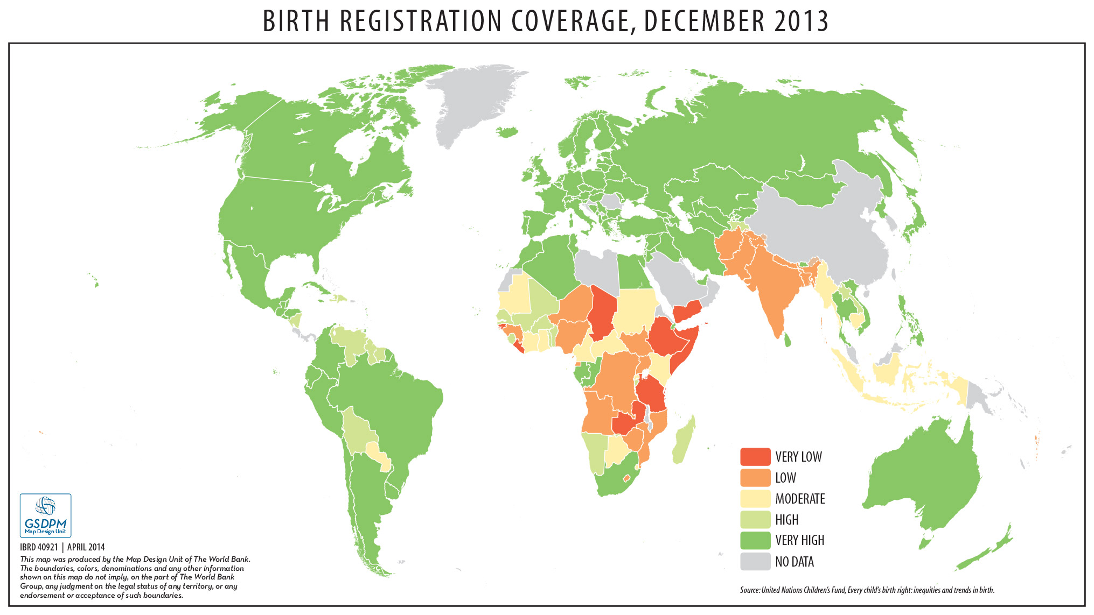
Current Status of Birth Registration

Slide 12
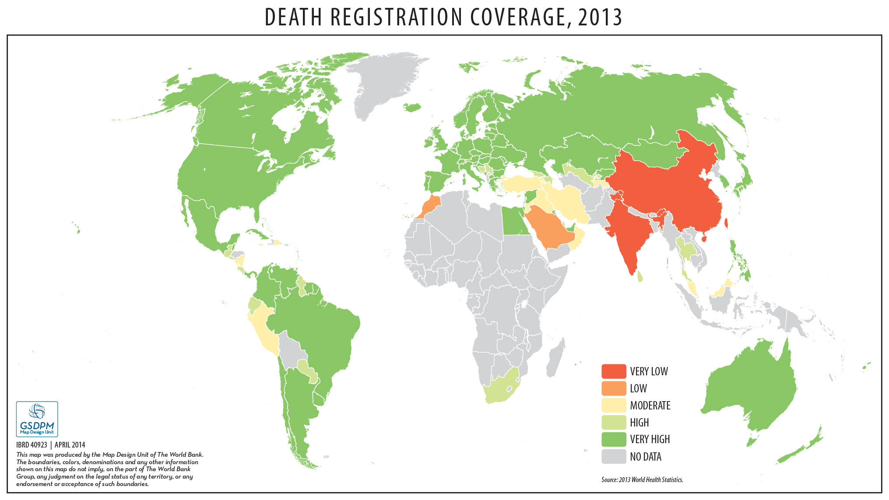
Current Status of Death Registration

Slide 13
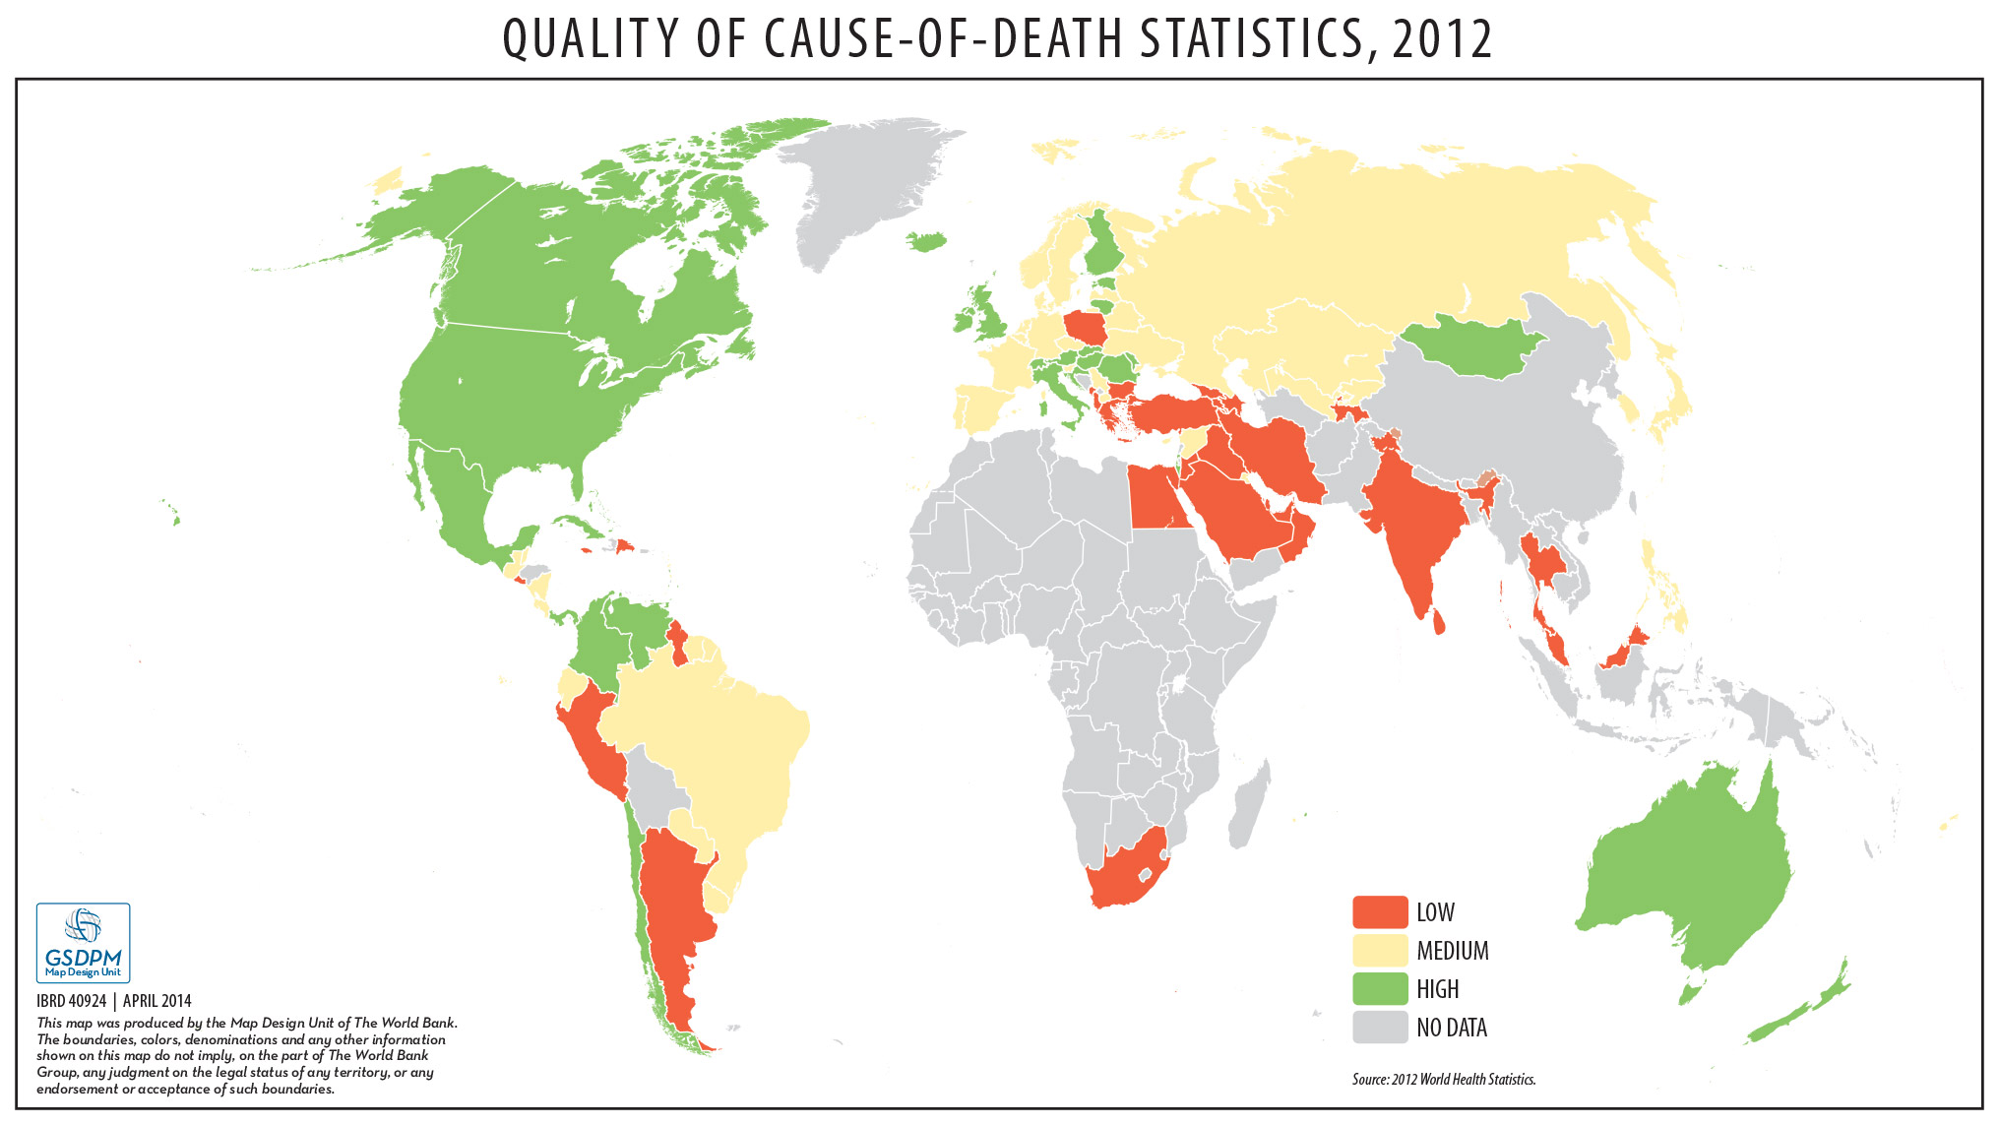
Current Status of Cause of Death

Slide 14
Birth registration lags behind antenatal care and DPT1 immunization
Source: DHS data

Slide 15
Birth certification lags behind birth registration
Source: DHS data

Slide 16
Some missed opportunities
  Antenatal care visits and maternal care tracking systems
  Unregistered births at health facilities
  Multiple immunization visits
  Community health outreaches
  Limited and fragmented maternal and perinatal death information
  Not using the health information system to identify child marriages as an event
  Other opportunities from broader health sector contact points such as use of birth and death notifications

Slide 17
Some thoughts on what can be done in health
  Creating awareness during antenatal care
  Instant birth registration of all institutional births
  Provide unique ID number in birth certificate, if possible
  At 6 weeks for DTP1 vaccination, cross-check and register
  Community outreaches for birth registration
  Strengthening maternal death surveillance and response system (MDSR) for death registration and causes of death

Slide 18
Role of Other Sectors

Slide 19
Some cross-sectoral entry points
Boost birth registration eg religious (eg baptism) or traditional naming ceremonies, schools, RBF schemes,
Community outreaches from civil registries
Referral during household surveys, censuses etc
Outreach to the poor and marginalized groups
National identity systems
Police records, courts, child protection and other social services
Engaging CSOs

Slide 20
Improving National CRVS Systems
Strengthen national institutions
Amend and enforce legislation, policies and regulations in line with international standards
Introduce safeguards to protect confidentiality, to secure registration information and record, and to avoid fraud/corrupt use
Improve infrastructure
Build capacity (registration and statistical agencies; health personnel for ICD coding including automated techniques)
Embed civil registration within institutions such as hospitals, health centers, religious institutions and schools
Link CRVS with other national systems eg national identity systems, population registers, electoral rolls, national pension systems, electronic medical records systems etc
Modernize and automate CRVS through ICT solutions
Set up a system for monitoring & evaluation
Promoting the demand side through IEC

Slide 21
Role of Regional/International Agencies
Establish/update international standards and tools
Tools and devices for birth registration, death registration, cause of death, data collection, analysis, and dissemination
Models for legislation, policies & regulations on the collection, management & use of information, promoting effectiveness & protecting individuals
Legislative protections and technical safeguards to protect individual privacy, to secure registration information and records, and to prevent improper use
Standards for linking CRVS with other national systems eg national identity systems, population registers, electoral rolls, national pension systems, electronic medical records systems etc
Standards for interoperability of CRVS database and other management information systems (eg health, education, social protection)
Standards for use of mobile technology and other emerging technologies
Updated the rules and definitions of birth registration (shorter age reference)
Standards for monitoring and evaluation of CVRS systems

Slide 22
Role of Regional/International Agencies
Build the evidence base with implementation research
Increasing mobile registration of vital events through services such as child health days, immunization campaigns, and post-natal and neonatal care
Improving cause of death registration & quality of cause of death data
Using birth certificate unique identifiers for CRVS databases and other national systems (health, child protection, national identity, education, elections, humanitarian, judiciary and statistics)
Engaging community workers, TBAs, and pharmacists through mobile SMS technologies
Establishing programs of south-south cooperation
Establishing public-private partnerships
Use of biometrics
Using RBF programs for birth registration
M&E of programs and innovations and sharing lessons learned and best practice examples

Slide 23
Costs and financing of CRVS systems

Slide 24
Estimated Global Financing Gap for 73 countries for 2015-2024 (US$ million)
 | 2015-2019 | 2020-2024 | 2015-2024 | Financing Gap
Startup costs¹ | 1,140 | 1,140 | 2,281 | 1,604
Recurrent costs² | 408 | 793 | 1,201 | 49
International support to CRVS including sharing knowledge and strengthening the evidence base | 114 | 114 | 228 | 228
Monitoring and evaluation | 57 | 57 | 114 | 114
TOTALs | 1,720 | 2,104 | 3,824 | 1,995
¹Startup costs: development of legal/ regulatory framework , comprehensive assessment, infrastructure and equipment, ICT (technology costs), digitization of existing registration records, development of operational guidelines and procedures
² Recurrent costs: capacity building, IEC (advocacy and communication campaigns), maintenance of technology and other infrastructure, data management, outreach activities to improve coverage, system monitoring and enforcement costs

Slide 25
Assumptions on domestic financing
For low-income countries: (i) Governments will finance 20 percent, 40 percent, 60 percent, and 80 percent of the variable/operating costs in years 2015, 2016, 2017, and 2018 and bear full costs from 2019 onward; and (ii) Governments will finance 10 percent of fixed/start-up/capital costs from 2015 to 2019 and 20 percent from 2020 to 2024.
For lower-middle-income countries: (i) Governments will finance 20 percent, 40 percent, 60 percent, and 80 percent of the variable/operating costs in years 2015, 2016, 2017, and 2018 and bear full costs from 2019 onward; and (ii) Governments will finance 25 percent of fixed/start-up/capital costs from 2015 to 2019 and 50 percent from 2020 to 2024.
For upper-middle-income countries: Governments will bear the full variable/operating costs from 2015 to 2024, 50 percent of fixed/start-up/capital costs from 2015 to 2019 and 75 percent of fixed/start-up/capital costs from 2020 to 2024.

Slide 26
Funding sources for CRVS
Domestic financing (national budgets) – should be major source
Bilateral donors
Private Foundations
UN Agencies
International Agencies/NGOs
Multilateral Development Banks such as the AfDB, WBG
Global Financing Facility (GFF) for Reproductive, Maternal, Newborn, Child, and Adolescent Health (RMNCAH) in support of Every Woman Every Child

Slide 27
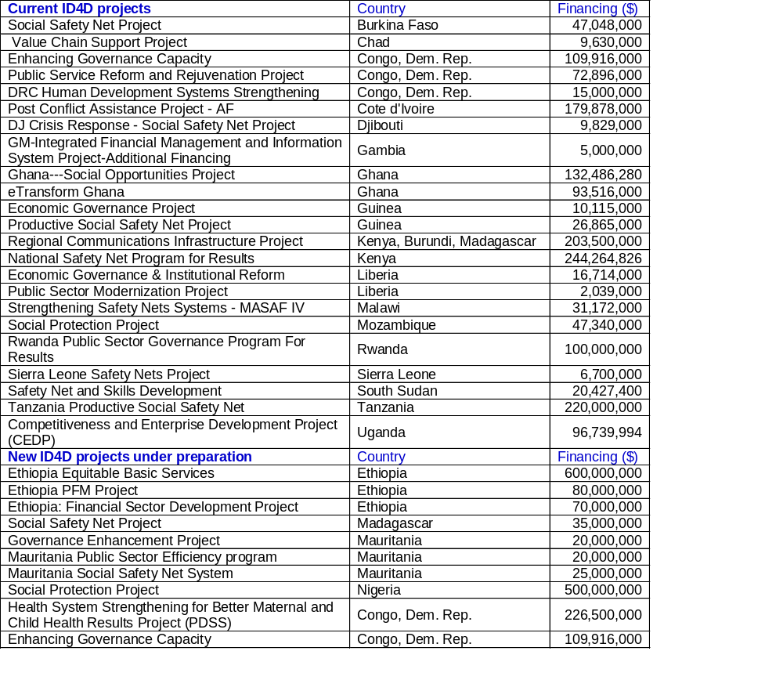
World Bank Projects with ID4D components

Slide 28
Global Financing Facility
Announced on September 25, 2014 during the 69th UN General Assembly
To contribute to the global efforts to end preventable maternal, newborn, child and adolescent deaths and improve the health and quality of life of women, adolescents and children
It will also finance the strengthening of CRVS systems
GFF Business Plan is being developed by a team of about 50 reps of several organizations and countries
It will be launched at the 3rd International Conference on Financing for Development, Addis Ababa, Ethiopia, 13-16 July 2015

Slide 29
Commitments to the GFF to date
CANADA
$200 million contribution is part of Canada’s $3.5 billion commitment (2015-2020) to maternal and child health, announced in May 2014
NORWAY
$600 million
UNITED STATES
Up to $400 million in leveraged resources through financing mechanisms and public-private partnerships
IDA International Development Association (WBG)
Low-interest loans and grants, leveraging up to $3.2 billion

Slide 30
Three mutually reinforcing characteristics of the GFF approach
Focus on high impact, cost effective interventions and results
Smart
Financing RMNCAH at scale through significantly increased domestic and international financing
Scaled
Sustainable
Support transition to long-term sustainable domestic financing for RMNCAH
Notes:
WHAT: CHALLENGES ON THE ROAD TO 2030 (DETAILED)

Slide 31
Focus on Results
Results-Based Financing
Any program that rewards the delivery of one or more outputs or outcomes through financial incentives, upon verification that the agreed-upon result has actually been delivered
Subsets of RBF
Supply side: Performance-Based Financing (PBF) - Payments to service providers upon verification of delivery of agreed services (quantity and quality)
eg for increasing birth registration coverage from 20% to 30%
Demand side: Conditional Cash Transfer (CCT) - Incentives only to program beneficiaries
eg parents receive cash payments when they show a copy of a birth certificate (which verifies birth registration).

Slide 32
Criteria for prioritizing countries for CRVS investment linked to RMNCAH plans
a) RMNCAH plans with incentivized indicators for birth registration, birth certificates, maternal death registration, newborn death registration, maternal death investigation, newborn death investigation
b) RMNCAH plans incorporating some of the missed opportunities including immunizations, antenatal care, the strengthening of maternal death surveillance and response system (MDSR) and other relevant mortality collections
c) RMNCAH plans incorporating innovative approaches such as linking birth registration and MNCH tracking and immunization)
Added advantage
d) Linked to national CRVS multisectoral plan

Slide 33
Criteria for prioritizing countries for multisectoral CRVS strengthening – GFF or stand alone IDA
a) Completed a comprehensive assessment of its CRVS systems as a first step in addressing weaknesses, reviewing current status, identifying areas requiring improvement and prioritizing actions;
b) Has in place one cross-sectoral national coordinating mechanism (including ministries and DPs) with an anchor ministry/agency to oversee the development and implementation of a CRVS investment plan;
c) Demonstrated national financial and legal commitment to strengthening CRVS systems as reflected by increasing share of public expenditure to strengthening components of the CRVS,
Added advantage
d) Draft legislation to support the proper functioning of national CRVS institutions
e) National plan with RMNCAH entry points

Slide 34
Final thoughts
Domestic resources should be the mainstay of CRVS financing
Establish effective national coordinating mechanism and have a national investment CRVS plan
Countries should be in the driver’s seat and ensure that all external sources of financing for CRVS contribute to the implementation of the national investment CRVS plan

Slide 35
  Thank you

