Slide 1
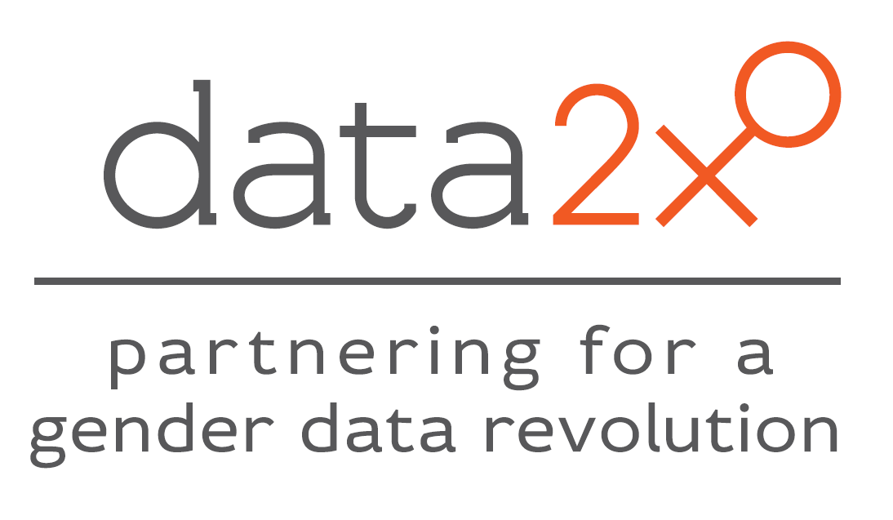
Misha Belkindas, Open Data Watch
Rebecca Furst-Nichols, Data2X, United Nations Foundation
February 11, 2015

Slide 2
Data2X
About Data2X:
Goal: Improved gender data collection and use to guide policy and inform global development agendas
Named for the power women have to multiply progress in their societies
Coordinated by the UN Foundation with support from the Hewlett and Gates Foundations, and collaboration with the Office of Hillary Clinton
Launched in 2012 by Secretary of State Hillary Clinton
Better data for women, better data for all
Data2X is a platform, technical assistance resource, and coordinating body; does not collect data
@Data2X

Slide 3
Gender Data
Sex disaggregation
  Affects men and women, but need to disaggregate at individual level to know status of girls/women – both in absolute levels and relative to boys/men
    e.g. enrollment rates for boys and girls
Gender data
  May apply just to women (sex), or to both women and men, in areas where differences are a function of social choices or constraints (gender)
    Sex (women only): Uterine cancer rates, maternal mortality rates
    Gender (women and men): Wages
@Data2X

Slide 4
Reasons for Problems with Gender Data
Standard data issues: Data in many countries is limited and of poor quality
  Coverage and quality
  Openness
  Data use and literacy
But gender data poses a particular challenge:
  No data
  Bad data
  Disaggregating by sex (and age) costs more
@Data2X
Notes:
We all know about traditional issues with data across domains and across countries.
Gender data has particular challenges:
No data: data not collected on issues that are not highly valued by society, such as home-based production, time spent fetching fuel/water, and intimate partner violence
Bad data: biased portrayal of women based on traditional stereotypes, such as man as provider and head of household – which influences how surveys are designed and who responds on behalf of household

Slide 5
Data2X – Work to Date
Global Expert Group
Identified and mapped gender data gaps (28)
  Report available at www.data2x.org
Building partnerships to fill actionable gaps at the global level
Six partnerships announced in December 2014
  Momentum event with Secretary Hillary Clinton, NYC Mayor Michael Bloomberg, and Data2X partnership representatives
  Included partnership on CRVS in Africa (UNECA & APAI-CRVS) and Asia (UN ESCAP)
@Data2X
Notes:
Expert group: 2013
Mapping: 2013-2014
Building partnerships and executing them: 2015-2020

Slide 6
Data2X – Partnerships
CRVS in Africa and Asia:
  UNECA & APAI-CRVS in Africa, UN ESCAP in Asia
Women’s work and employment:
  ILO, FAO, World Bank
Financial services:
  Global Banking Alliance for Women, Inter-American Development Bank
Women’s subjective well-being and poverty:
  Government of Mexico
Big data and gender:
  UN Global Pulse, UN Women, individual academic researchers
Improving gender data in US foreign aid reporting:
  US government
Work ahead in 2015 and beyond: ‘Nuts and bolts’ of partnerships.
@Data2X

Slide 7
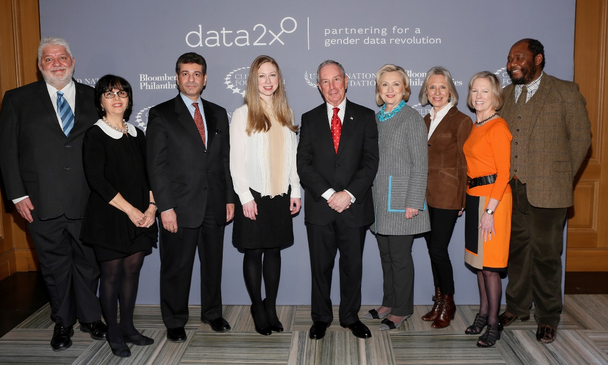
@Data2X

Slide 8
Why CRVS? CRVS & Gender (1/3)
Not often considered a gender issue (boys & girls registered fairly equally), but significant, less obvious, gender implications exist
At its best, VS data is gender data; individual-level data that covers men and women, boys and girls
But, we need small adjustments to existing plans to ensure CRVS systems reach everyone they are intended for, and have:
  Huge potential impacts on the lives of women and girls
  Huge potential contributions to generating high quality gender data; the ‘denominator’ of a society that must include both genders
@Data2X
Notes:
According to a recent UNICEF report, boys and girls are registered about equally across countries (UNICEF 2013). For this reason, the lack of reliable vital event data from a non-functioning or poorly functioning civil registration system could be perceived as a gender neutral gap.
CRVS is a basic building block that cuts across many of the other issues we care about. Production of vital statistics is a core data function at the country level; if this is a gap, we have no denominator. And there are important gendered elements of CRVS systems that are often ignored.

Slide 9
Why CRVS? CRVS & Gender (2/3)
What are the gender issues?
  In many countries single or unmarried women are unable to register their children without the signature of the father
  Bias toward father’s nationality
  Poor, less educated women register their children less
  Women with restricted mobility for social reasons are less likely to access registration centers
  Marriage and divorce information is not emphasized
@Data2X
Notes:
→Strong link to intergenerational transmission of poverty
Women’s disadvantage
In many countries single mothers and women in consensual unions who are not legally married are unable to register their children without the signature of the father.
Poor, less educated women register their children significantly less.
Marriage and divorce information is often left out of a complete CRVS system
CRVS can have disproportionate benefits for girls and women
Having good marriage and divorce documents can contribute to women’s ability to inherit property, among other benefits.
Registering girls at birth and recording their marriages provides a legal backing against early and forced marriage.
Strengthened CRVS allows for actual rather than estimated health statistics, including on maternal mortality and death due to diseases for which women bear a disproportionate disease burden.
Having an ID provides access to programs, services, rights and responsibilities.

Slide 10
Why CRVS? CRVS & Gender (3/3)
Benefits of addressing them
  Marriage and divorce documents →
    Women’s ability to inherit property and register their children
  Registering girls at birth and recording their marriages →
    Legal backing against early and forced marriage
  Death registration →
    Actual rather than estimated health statistics, including MMRs
  Access to identity →
    Access to programs, services, rights and responsibilities
@Data2X
Notes:
Benefits of addressing them
Marriage and divorce documents →
Women’s ability to inherit property and register their children
Registering girls at birth and recording their marriages →
Legal backing against early and forced marriage
Death registration →
Actual rather than estimated health statistics, including on maternal mortality and death due to diseases for which women bear a disproportionate disease burden
Access to identity →
Access to programs, services, rights and responsibilities, precisely some of the areas where women and girls are likely to be excluded
Women’s disadvantage
In many countries single mothers and women in consensual unions who are not legally married are unable to register their children without the signature of the father.
Poor, less educated women register their children significantly less.
Marriage and divorce information is often left out of a complete CRVS system
CRVS can have disproportionate benefits for girls and women
Having good marriage and divorce documents can contribute to women’s ability to inherit property, among other benefits.
Registering girls at birth and recording their marriages provides a legal backing against early and forced marriage.
Strengthened CRVS allows for actual rather than estimated health statistics, including on maternal mortality and death due to diseases for which women bear a disproportionate disease burden.
Having an ID provides access to programs, services, rights and responsibilities.

Slide 11
What Can Be Done? Data2X and APAI-CRVS Partnership
  Research and cross-regional collaboration: Analyzing the gender constraints and opportunities for CRVS strengthening
  Pilots and guidelines: Develop regional guidelines based on select country-level pilots, including identifying lead agencies and costing
  Exploring innovative approaches: New technologies and information systems, to improve the reliability and access to hard-to-reach populations
  Technical assistance: Identifying ways to incorporate marriage and divorce information as an essential part of CRVS
  Advocacy: Highlighting gender issues, including legal and social obstacles, at the regional and country levels, and through women’s organizations
  Convening: Bringing together key partners to a common platform, facilitating collaboration
@Data2X
Notes:
Analyzing the gender constraints and opportunities for CRVS strengthening
May include analysis of legal, institutional and customary frameworks that impede women from registering their children and exercising individual rights, assessment of women’s awareness of and demand for individual identity, and mapping of women’s organizations and other entry points to advocate for expanding CRVS coverage to women and children.

Slide 12
CRVS & Gender – Seeking Feedback
Additional CRVS & gender issues not outlined?
Potential challenges?
Other ways Data2X can be helpful to ongoing CRVS efforts?
Good practice examples?
@Data2X

Slide 13
Data2X Briefing Paper on Gender & CRVS
www.data2x.org/resources/
@Data2X

Slide 14
www.data2x.org

