Slide 1
A Valuable Resource:
Health Sector as a Beneficiary and Contributor to CRVS Systems

Slide 2


Health
health planning and resourcing; fertility;
Immunization; mortality; Life expectancy; disease burden; population….
Economic
Planning data; population and growth; population structure; health and ageing profile….
Social
Social planning and resourcing; Education; child protection; rights; ageing…..
Statistics
fertility; mortality; life expectancy; inter-censal population estimates; planning data; denominator….
Legal Identity
Individual identity; access to services; citizenship; access to legal institutions such as marriage…
Governance
Confirmation of identity in population; access to services, election-eligibility….
Civil Registration and Vital Statistics Systems
Legal identity, data

Slide 3

Importance of CRVS to Health
Country policy and planning, especially mortality data, but also population data
Setting health policies and priorities
Establishing health implementation needs
Understanding routine delivery needs and progress
Monitoring and evaluation.

Slide 4
CRVS data is important to the whole Health Policy Cycle
Issue identification
Population health issues: eg population growth, ageing, leading causes of death, avoidable deaths, MNCH deaths, communicable / non communicable…
Set Strategic Agenda
CRVS data supports the initiation or alteration of existing policy program… eg prevention programs, new forms of service delivery. CRVS data critically underpins planning – especially with population and health specific information.
Formulate Policy and Programmes
CRVS data can be used to support the identification of policy or delivery options and the most appropriate policy response
Monitor and evaluate
Create baseline using national mortality data and measure progress.

Slide 5
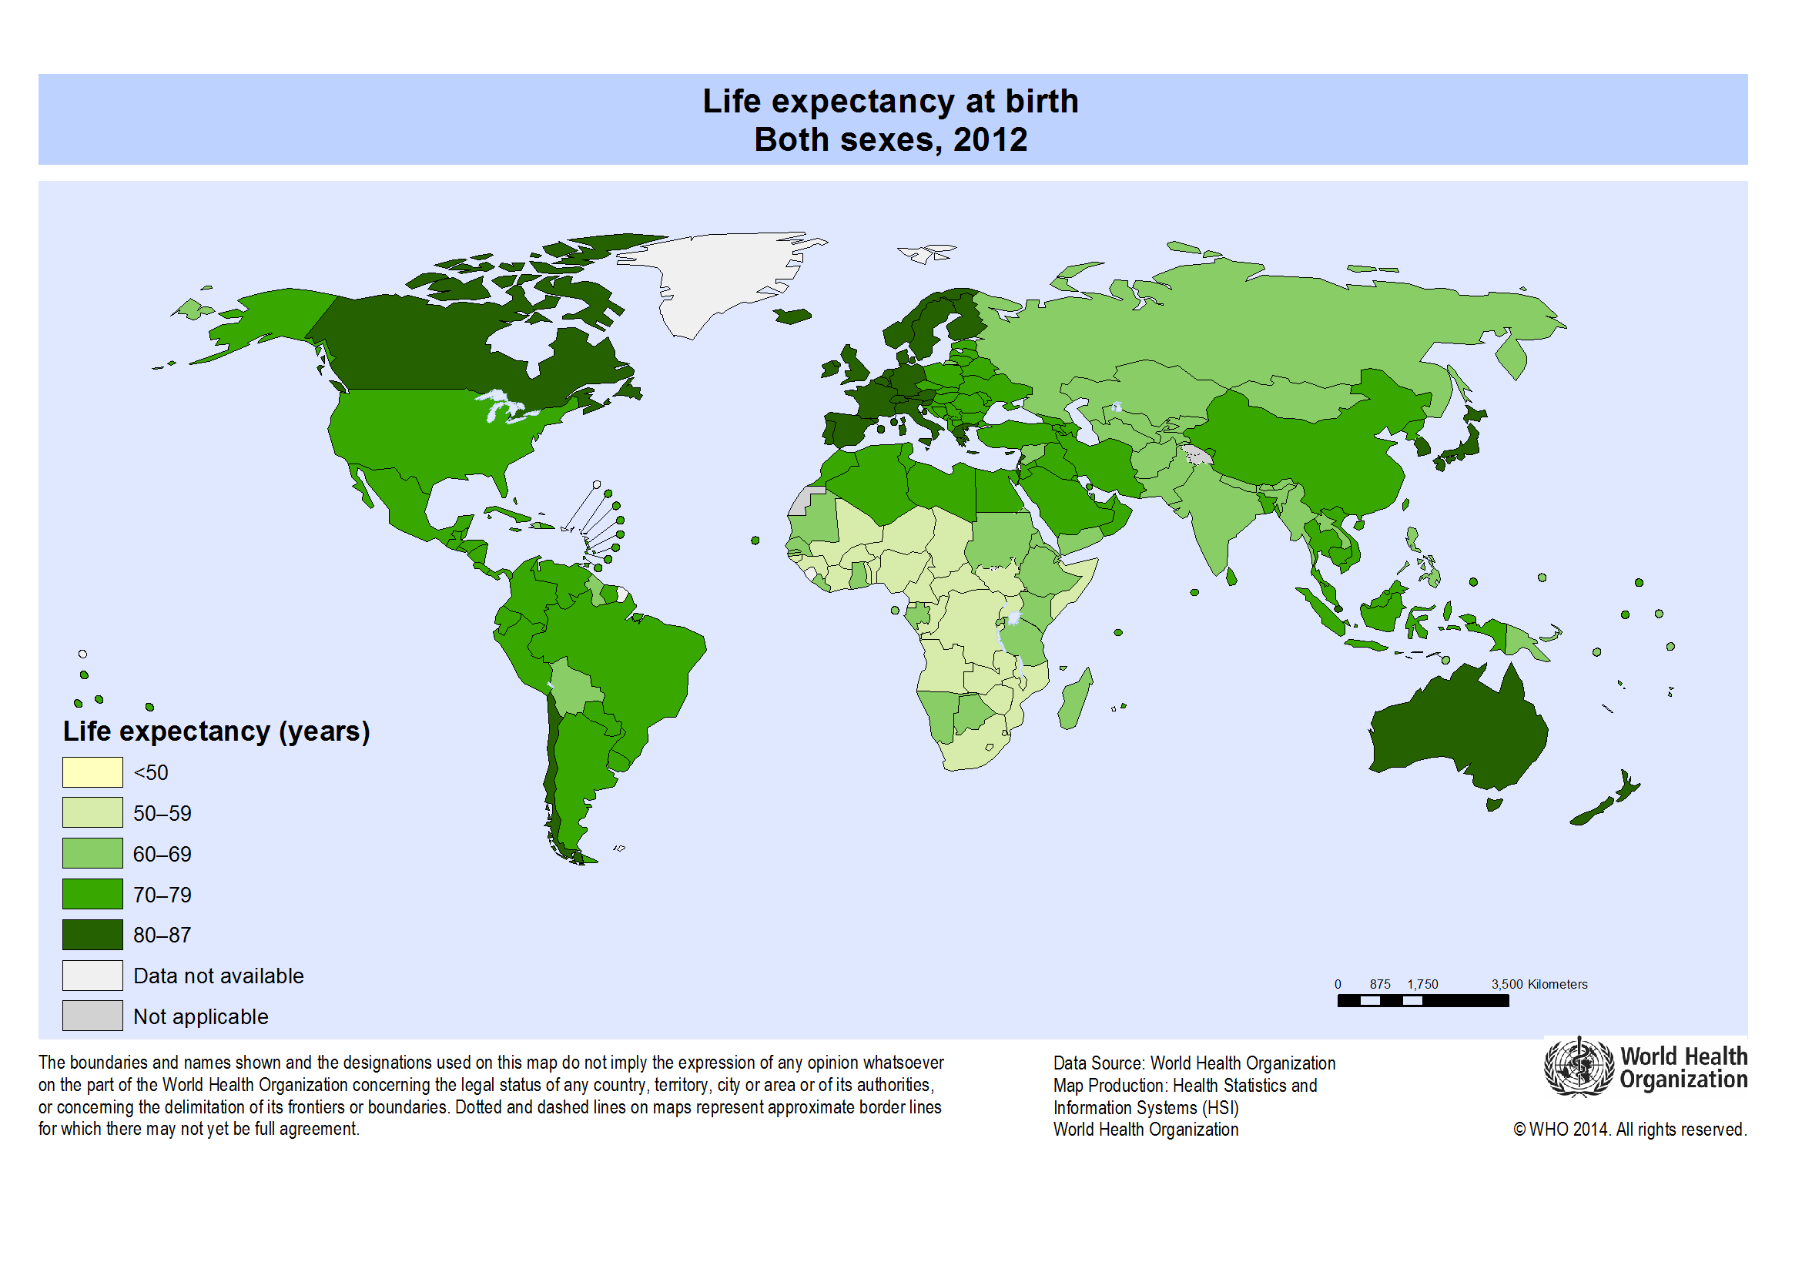

Slide 6
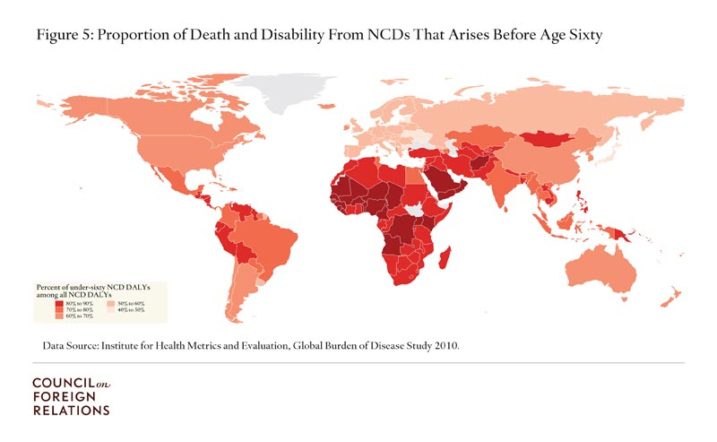
Africa’s peoples are vulnerable to non-communicable diseases

Slide 7
Post 2015 – Health-related SDGs
Overall goal :Ensure healthy lives and promote wellbeing for all at all ages
1 Reduce the global maternal mortality ratio to less than 70 per 100,000 live births
2 End preventable newborn and under-5 child deaths
3 End the epidemics of AIDS, TB, malaria and NTD
3 And Combat hepatitis, water-borne diseases and other communicable diseases
4 Reduce premature mortality from NCDs through prevention and treatment and promote mental health and wellbeing
5 Strengthen prevention and treatment of substance abuse, including narcotic drug use and harmful use of alcohol
6 Reduce deaths and injuries due to road traffic accidents
7 Ensure universal access to sexual and reproductive health-care services
8 Achieve Universal Health Coverage

Slide 8
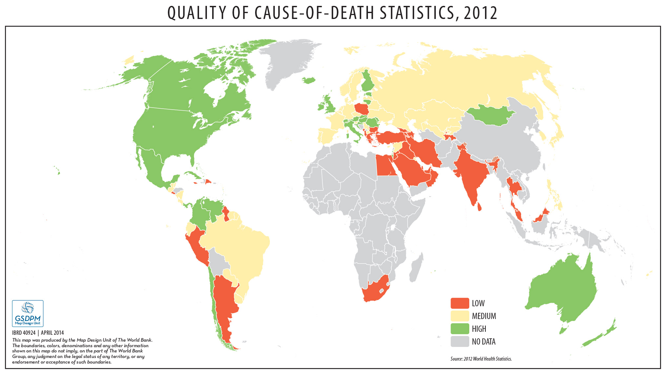
Quality of CRVS data is an issue for countries and for global health

Slide 9







02 Legal Identity and Governance
06 Social
Education planning, families, ageing, vulnerable groups
01 CRVS System
Identity, rights, access
All births, all deaths, all causes of death
03 Data
Population, mortality, fertility, life expectancy
05 Economics
Economic planning, growth, population change
04 Health
Health policy, health planning, health delivery, health coverage, financial protection.

Slide 10

Targets | 2020 | 2025 | 2030
Births in given year are registered | 80% | 90% | 100%
Children whose births are registered have been issued certificates | 70% | 85% | 90%
Deaths in given year reported, registered, and certified with key characteristics | 60% | 70% | 80%
Maternal and newborn deaths reported, registered, and investigated | 80% | 90% | 100%
Deaths in children under 5 reported, disaggregated by age and sex | 60% | 70% | 80%
Cause of deaths in hospitals reliably determined and officially certified | 80% | 90% | 100%
Countries have community assessments of probable cause of death determined by verbal autopsies using international standards | 50% | 65% | 80%

Slide 11
Opportunity: CRVS Systems and Health Innovation
Better Data for Health…. And many other things…
Civil Registration and Vital Statistics Systems
(centralised or decentralised)
Outreach:
in hospitals
At health related ‘one stop shops’
immunization points
Routine Linkage:
Hospital Notifications
Mortuary data
Death records - Police
Other health data
Active Collection:
Integrating:
verbal autopsy collections
MNCH tracking systems
MDSR processes
Survey / census collections

Slide 12

Building a National CRVS System:
Civil Registration
Civil Registration
Civil Registration
Civil Registration
Civil Registration
Civil Registration
Civil Registration
Civil Registration
LINK: Health Information
LINK: Health Information
LINK: Health Information
LINK: Health Information
LINK: Health Information
LINK: Health Information
Develop birth registration strategy
LINK Systematic Community Births
LINK Systematic Community Births
LINK Systematic Community Births
LINK Systematic Community Births
LINK Systematic Community Births
ADD and LINK Systematic Community Mortality Collection
ADD and LINK Systematic Community Mortality Collection
ADD and LINK Systematic Community Mortality Collection
ADD and LINK Systematic Community Mortality Collection
ADD and LINK Systematic Community Mortality Collection
Develop mortality strategy
Vital Statistics Estimates
Vital Statistics Estimates
Vital Statistics Estimates
Vital Statistics Estimates
Vital Statistics Estimates
Vital Statistics Estimates
Using Census and / or National Surveys for national CRVS data

Slide 13
Mortality Systems - Why?
Information on causes of death is indicative of the overall health status or quality of life of a population.
Countries should have the capacity to report leading causes of death that account for large numbers of deaths within a specified population group and time period.
Hospitals are important sources of mortality data because they are generally the only source of medically certified deaths.

Slide 14
Health and Vital Statistics
Common statistics derived from aggregate hospital records include total institutional deaths by sex and age group and by major causes.
Important facility-based indicators that can be derived from such data include:
  All cause hospital mortality rates by age group and sex per 1,000 admissions;
  Distribution of causes of death by sex and age group;
  Cause-specific case fatality rates per 1,000 admissions for major causes by sex and age group;
  Institutional maternal mortality ratio (facility maternal deaths per 100,000 facility deliveries).

Slide 15
6 Steps to Build a Health Facility
Mortality Statistics System
Step 1:
Governance
Step 2:
International Medical Certificate form
Step 3:
Medical certification
Step 4:
Code to ICD
Step 5:
Compile and Analyse the Data
Health Facility
Mortality Statistics System
Step 6:
Use the Data….

Slide 16
Community Deaths
Develop a baseline report from all available information about community deaths – available data from surveillance, sample surveys, administrative data sources such as community health, mortuaries, police records. NOT REPRESENTATIVE – but it tells you what is there
Work to integrate these sources into a mortality system.
INTEGRATION OF SOURCES IS THE KEY

Slide 17
Example: Main hospital mortality collection in Laos
CRVS system is being established. Only main hospital codes causes of death to an ICD shortlist.
We learned:
Mortality is a critical source of monthly data for this health facility, in managing its core business.
There is clearly value in these data for policy and planning within the hospital, and that is why it continues to be collected.
IT DOES NOT YET LINK TO THE CRVS SYSTEM – BUT IT CAN
Death Notification
Medical Certification
Medical records system
Coded and counted into Main Hospital Statistics – reported monthly
Hospital statistics and reporting
Health priorities.
Planning and service delivery. Financing including required hospital resources. Monitoring.

Slide 18
Example: Australian Mortality Collection
Major points:
Health is a critical source of data to the national system, especially data from health facilities.
More than one health data source has to be used and collection is drawn together to produce national statistics.
Health sector extensively uses its own data, as well as national data. Health data acts also as a ‘check’ for national data system.
There is exponential value of these data for policy and planning
Death Notification
Medical Certification
Coroner
Police
Funeral Director
Registrar
NCIS
Autopsy and other data eg Toxicology
Coded and counted into National Statistics
Global Data
National statistics and reporting priorities and progress:
economic planning; government financing arrangements; social policy and programs eg indigenous programs
State / Local statistics. for planning and delivery:
Economic planning; government financing. Arrangements; social policy and programs eg indigenous programs
Health: statistics for planning and delivery
Health priorities, inequities, regions.
Health planning and service delivery. Health Financing including insurance. Health monitoring and progress.

Slide 19
Example: Systemic Thinking from Mozambique / Many other countries
Death Notification
Medical Certification
Emerging thinking:
Focus on strengthening hospital data as a core of hospital information and the strengthening of the CRVS system.
Accommodate Multiple Mortality Collections
Actions:
Assess the quality of mortality data from different sources
Create a centralized database. (Built upon the SIS-ROH database)
Generate annual reports
SISROH
Ward data
MNCH
Centralised National Health Data Base (based on SIS ROH)
Fatal injuries
Surveillance
HIV / TB
Other Mortality
Annual Reporting
Global Data?

Slide 20

Better mortality statistics from CRVS systems today will help improve her health tomorrow

