Slide 1
Welcome
An Urban Lens in National Development Planning
Training Workshop

Slide 2
Please introduce yourself…
Name
Department and role
Something you hope to discuss here
If you won a 1-week trip to any city in the world, where would you go?

Slide 3
Training goal
To enhance the transformative power of urbanization for inclusive growth and development.
Training (concepts, data, co-created knowledge, action plans)
Improved common understanding and skills; collaborative relationships built
Better urban narrative; integration in economic policy; broader urban scope within NDP
Transformative power of urbanization leveraged for inclusive growth and development

Slide 4
Training approach
Interactive
Contextualized
Action-oriented
Supported
Notes:
Refer to Part 1 of the Trainer’s Guide for an explanation of these

Slide 5
Training framework: Four themes; Four stages
Themes:
A: Sector Targeting
B: Productive Cities
C: National Spatial System
D: Coordination & Finance
These are entry points for urban issues in national development planning.
Notes:
This is the framework for the Guidebook & training as a whole.

Slide 6
Training framework: Four themes; Four stages
Stages:
Diagnostics & analysis
Vision, goals & targets
Implementation strategies
Monitoring & evaluation
These are generalized stages. Urban issues should be integrated into each.
Notes:
This is the framework for the Guidebook & training as a whole.

Slide 7
Three-day training structure
Day 1: Intros, conceptual framework and themes
  Welcome
  Opening remarks
  Intro to topic & discussion
  Intro to four themes & discussions
  Focus theme selection
Day 2: Deep dive into the focus theme
  Small groups work through the four stages of NDP & discuss in plenary
Day 3: Action planning
  Action planning: small group work, plenary discussion & synthesis
  Action planning final presentations
  Evaluation
  Closing
Four themes
Four stages
Notes:
Additional days can be added to bring in the other themes (i.e. repeat Day 2 for other themes)
High-level officials will not have time for the full 3-day training, but are invited to opening sessions and final presentations.
Today and tomorrow we will be demoing some sessions from each training day.

Slide 8
Focus theme selection
Where are the biggest gaps in the current NDP framework? (Issues not addressed or prioritized)?
Where in the NDP are opportunities for improvement (in scope, depth, narrative)?
Which issues are the most important for economic development?
What area can be feasibly improved in the short-medium term?

Slide 9
Action Planning
Actions needed to integrate urban issues into national development planning
Action What will be done? | Responsibilities Who will do it? | Timeline By when? | Resources Resources available, needed, opportunities | Risks & Mitigation Why the action may fail & how to overcome the risk | Coordination Plan Who is involved; what coordination method?
1.
2.
3.
Etc…
+ Evidence of success (benchmarks)
+ Monitoring or follow up plan
Notes:
Let participants know that they should be keeping their own running list of action items. This will come in handy during Action Planning on Day 3.
The point is to list actions that the country would need to take to better integrate urban issues into national development planning.

Slide 10
Ground Rules
Respect each other.
Keep comments concise.
Participate in discussions; Make space for others to participate.
Arrive on time; Finish on time
Others?
Notes:
Or, start with a blank slide (title only) and write rules as participants suggest them.

Slide 11
Sample Slides:
Day 1 Substantive Presentations

Slide 12
Why integrate urban issues in national development planning?
Introduction to the workshop topic
Day 1

Slide 13
Why national development planning?
Commission of Growth and Development Report success factors:
  Strong leadership
  Commitment to stable economy & investment climate
  Implementation of long-term economic policy
Lessons from East Asia:
  Long-term vision with 5-year development plans
  Economic growth plus present challenges
  Administrative process to link economic, sectoral, spatial and budgetary planning
  More interventionist early on, more market-driven later in development
  Target labour-intensive industry early, then to heavy industry, then to knowledge and technology-intensive industries

Slide 14
The resurgence of national development planning in Africa
Initial attempts at national development planning in Africa fell by the wayside during the structural adjustment era.
Since the late 1990s, there has been a recognition of the importance of planning, especially reflecting on successes in Asia.
Planning can direct resources to strategically important sectors and align public and private investments.
African countries are moving away from externally determined priorities to a self-led economic development focus and domesticating global commitments (SDGs) within national development framework.

Slide 15
National Development Planning in [country]
Add bullet point on longer term vision (ex: Vision 2030: Become a middle income country… etc.)
Add bullet point on main themes of current NDP
Add bullet point on NDP’s approach to urbanization (if included in the NDP)

Slide 16
The urban narrative in Africa is incomplete
Space missing from national economic discourse
Economy missing from urban development discourse
Urban narrowly equated to housing sector
Not enough focus on quality of urbanization
However, there are steps in the right direction
Agenda 2063, the Common African Position on the Post-2015 Development Agenda and the Common African Position on Habitat III all recognize cities as economic drives.
New momentum by African policy makers to address urban issues

Slide 17
Urbanization in [Country]
**insert chart showing projected urbanization using data from UNDESA (see sample slide)
**note how much the urban population is expected to grow (see sample slide)

Slide 18
Sample Slide: Urbanization in Zambia
Between 2015 and 2050, the urban population will increase 3-fold, by nearly 20 million people.
(Like adding 8.5 new Lusakas.)
Data from UNDESA
Notes:
Data from UNDESA (https://esa.un.org/unpd/wup/CD-ROM/).
Customize this slide using data for the training country.
Representing forecasting growth in terms of largest cities (“8.5 new Lusakas”) can help participants conceptualize it.

Slide 19
Why an urban lens? Why now?
The scale and speed of urbanization demands proportional attention
The way cities are designed and managed impacts economic growth and structural transformation
Spatial implications of macroeconomic and sector policies are substantive
Opportunities are transitory, and today’s policy actions define the future of national economies in the long-term (hard choices)
Coordination failure is costly: public, firm and household investments have to be aligned in space
Urbanization is multi-sector and complex, should be coordinated
Notes:
Check against guidebook

Slide 20
Urbanization and economic development are inextricably linked.
[Country name]
*adjust to point to country
Data: WDI
Notes:
Label the country on this graph. Find the country by looking up its 2015 GDP per capita and level or urbanization in the WDI database: http://databank.worldbank.org/data/reports.aspx?source=world-development-indicators#

Slide 21
The Urbanization → Economic Structural Change
Theory of Change
Factors contributing to urbanization:
- Natural increase
- Economic growth (with or without jobs)
- Rural push factors
Urbanization
We are familiar with factors contributing to urbanization.
Notes:
Check against guidebook

Slide 22
The Urbanization → Economic Structural Change
Theory of Change
Factors contributing to urbanization:
- Natural increase
- Economic growth (with or without jobs)
- Rural push factors
Urbanization:
- Thick markets for inputs, goods, labour
- Increase in urban labour
Structural change
& broad-based economic growth
What may be less familiar is how urbanization can contribute to structural transformation.
This link is not automatic.
Notes:
Check against guidebook

Slide 23
The Urbanization → Economic Structural Change
Theory of Change
Factors contributing to urbanization:
- Natural increase
- Economic growth (with or without jobs)
- Rural push factors
Urbanization:
- Thick markets for inputs, goods, labour
- Increase in urban labour
Structural change
& broad-based economic growth
Another central question:
What policy elements can influence this relationship?
Policy Framework
Moderating Factors
One central question:
What factors moderate this relationship?
Notes:
Check against guidebook

Slide 24
The Urbanization → Economic Structural Change
Theory of Change
Factors contributing to urbanization:
- Natural increase
- Economic growth (with or without jobs)
- Rural push factors
Urbanization:
- Thick markets for inputs, goods, labour
- Increase in urban labour
Structural change
& broad-based economic growth
Policy Framework:
- Economic targets
- Spatial targets
- Institutional factors
- Investment
Moderating Factors:
- Productive urban jobs
- Urban links to rural productivity
- Quality of cities
These are the subjects of this training.
Notes:
Check against guidebook

Slide 25
The Urbanization → Economic Structural Change
Theory of Change
Factors contributing to urbanization:
- Natural increase
- Economic growth (with or without jobs)
- Rural push factors
Urbanization:
- Thick markets for inputs, goods, labour
- Increase in urban labour
Structural change
& broad-based economic growth
Policy Framework:
- Economic targets
- Spatial targets
- Institutional factors
- Investment
Moderating Factors:
- Productive urban jobs
- Urban links to rural productivity
- Quality of cities
Theme A
Theme C
Theme D
All themes
Theme A
Themes A, C
Theme B
Notes:
Check against guidebook

Slide 26




Urbanization and economic development are inextricably linked.
Structural transformation requires the movement of labour from lower productivity sectors to high productivity sectors.
This entails agricultural modernization (labour shedding), entry of labour into urban sectors (manufacturing and services).
National development planning can help create the required urban jobs for this transition.
productive
sector
expansion
productivity
increase
labour

Slide 27
Urbanization and economic development are inextricably linked.
Cities host proven productive benefits to firms (agglomeration economies)
Urban productivity arises from the proximity and interaction of economic actors.
  Lowering transaction costs
  Fostering economies of scale
  Facilitating sharing and matching (labour, inputs, markets)
  Facilitating knowledge transfer and resulting in innovation
Econometric studies indicate as a city grows by 25%, worker productivity rises 1-2%. This elasticity is higher for specialized cities. (Turok & McGranahan. (2013) ‘Urbanisation and economic growth: the arguments and evidence for Africa and Asia’)
Notes:
Full citation: Turok, I. and McGranahan, G. (2013) ‘Urbanisation and economic growth: the arguments and evidence for Africa and Asia’, Environment and Urbanisation, 25(2), pp. 465-482. Available at http://journals.sagepub.com/doi/pdf/10.1177/0956247813490908

Slide 28
Characteristics of Productive Cities
 | Well-functioning cities bolster productivity | Poorly-functioning cities reduce the urban productive advantage
Institutions | - Property markets work -> location choice - Clear regulations & taxes - Goods markets work - Labour markets work (pooling, skills) | - Hard to get land, permits - High transactions costs - Constrained supply -> high cost of living - Jobs-workforce mismatch (skills, location)
Infrastructure | - Easy access to electricity, utilities - Easy commutes, multimodal options - Efficient freight | - Outages & unreliable utilities - Long, unpredictable, costly commutes - Slow, inefficient freight
Spatial layout /urban form | - Density & clustering - Knowledge spillovers - Dense markets - Social mix -> economic mobility - Connectivity -> market access | - Sprawl -> long, costly travel - Separation reduces knowledge spillovers - Segregation -> poverty traps - Poor connectivity reduces market size & access
Takeaway: Cities -> costs to firms -> productivity & competitiveness
Notes:
Key point: all these factors add to either direct or indirect costs to firms. The ways cities function impacts the bottom line for African firms. This relates to income and competitiveness.
See full table 1.1 in Guidebook

Slide 29
Urbanization challenges
Urban population growth can occur without economic growth and without productive job growth.
This breakdown can be the result of several factors.
  Natural resources and agriculture exports without value added creates “consumption cities” without productive jobs.
  Natural demographic growth of urban populations without commensurate productive job growth.
  Cities underperforming due to underinvestment, inadequate infrastructure and services, congestion, crime, segregation, etc.
National development planning will shape whether urbanization achieves its economic potential.
Notes:
“Productive” job growth distinguishes between low-wage and often informal jobs vs. tradeable higher wage formal sector jobs.
Background information on “consumption cities” can be found in ERA 2017 p. 101 and Gollin, D., R. Jedwab and D. Vollrath. (2014). “Urbanization with and without Industrialization.” Journal of Economic Growth 21 (1): 35–70.

Slide 30
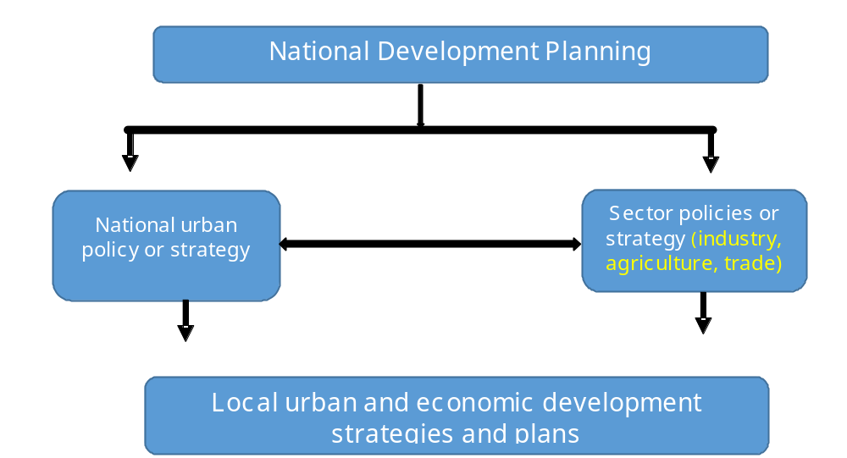
NDP is required to coordinate sector strategies and subnational strategies.
Notes:
Revise

Slide 31
Four substantive themes
A: Economic Sector Targeting
B: Productive Cities
C: National Spatial System
D: Coordination & Finance
These are entry points linking cities and national economic development.
Notes:
This introduces the subsequent discussions.

Slide 32
Discussion
Quick reactions?
Clarifications?
Gaps in the current NDP process in [country]?
Possible action items?
Notes:
Gather people’s thoughts, questions & reactions. At some point ask for a few people to share any action items they wrote down in their action planning worksheet.

Slide 33
Economic Sector Targeting
to leverage the potential of cities and urbanization
(Introduction to Theme A)

Slide 34
Key questions for policymakers
Which economic sectors will create urban jobs and generate structural transformation?
Which economic sectors will leverage and harness urban demand for domestic sector growth?
How can cities add value to rural products through forward and backward linkages?
Notes:
We will be exploring these issues here.

Slide 35
Economic sector targeting in _[country name]_’s current NDP
Notes:
Customize this slide to reflect which economic sectors are prioritized in the training country’s national development plan.

Slide 36
In Africa, growth is increasingly coming from urban sectors.
Data: WDI
Notes:
We can assume that a significant proportion of industry and services sector growth is occurring in cities and towns.

Slide 37
However, not all growth is job-rich.
Data: WDI; Most recent year between 2005 and 2015 with poverty data
Notes:
Key takeaway is that poverty is not necessarily tied to GDP growth. Some sectors do not create broad-based jobs (for example, shown here, natural resources extraction).

Slide 38
Key points on urban jobs
Urban populations are growing, with or without jobs (often due to natural increase)
Productivity is key
  Structural transformation requires urban population is working in productive employment
  Wages (and poverty) depend on productivity
  Manufacturing and tradable services are productive. However, nontradable and informal service sectors are currently dominating urban job options.
Youth budge needs productive urban jobs to become demographic dividend
Urban wages are critical for slum amelioration

Slide 39
Productive urban job creation is the primary condition determining whether urbanization will contribute to economic development.

Slide 40
One role of NDPs is to marshal support behind strategic economic sectors.
These sectors must create productive urban jobs to leverage the power of urbanization.

Slide 41
Where are urban job creation opportunities in [country name]?
Notes:
What economic sectors hold untapped potential?
Have people say only the name of the economic sector in one word (ex: construction, textiles, ICT). Do not pass the microphone for discussion.
Refer to Table 2.2 in the Guidebook
Key point: important to support some sectors that create urban jobs through the NDP’s economic sector prioritization

Slide 42
Urbanization creates demand
Urban infrastructure
Urban housing
Urban middle class consumption
Urban preferences for manufactured & processed goods
Traded, processed, packaged foods
FDI is already drawn to African urban consumption
Notes:
Key point: this demand can be harnessed to create jobs in construction, manufacturing & agri-business

Slide 43
The construction value chain presents job-creation opportunities
Notes:
However, many housing value chains in African cities are highly constrained. This is due to dysfunctional land markets, an untrained workforce, inefficiencies in the building materials value chain, and low access to mortgages. Intervention to make this market work better can create jobs.
Subsidized and social housing programmes can also create urban jobs.

Slide 44
Urban food consumption also presents opportunities
Notes:
Opportunities for rural suppliers as well as jobs in transport, logistics, processing, packaging, marketing, wholesale, retail.

Slide 45
Case Example: Malaysia’s early development strategy
Post-independence (1960s & ’70s) economic strategy designed to move labour to productive sectors. Focus areas:
Reducing commodity reliance (rubber & tin)
Investment in primary processing industries linked to agriculture, mining, forestry.
Products for domestic market (food products, beverages, textiles, printed materials, furniture, rubber products, and building supplies)
Intermediate goods (chemicals & transport equipment)
Spatial integration and urban livability
After success in labour-intensive industries, industrial restructuring (’70s & ‘80s), then toward ICT & skill-intensive sectors.
Notes:
See Box 2.6 in the Guidebook and reference: Yusof, Z.A. & Bhattasali, D. (2008). Economic Growth and Development in Malaysia: Policymaking and leadership. Washington, DC: World Bank

Slide 46
Possible indicators to inform economic sector targeting
Labour intensity of priority economic sectors
Urban youth unemployment and trend
Share of imports in food supply
Ratio of raw to processed agriculture exports
Manufacturing value added and employment share in GDP
Ratio of tradable to nontradable sectors by output, value added and employment

Slide 47
Urbanization vs. employment in industry
Ratio of urbanization : employment in industry
Data: WDI
Notes:
What can we say with this data?
Countries falling in the middle of the chart likely have the highest need for industrial employment because they are going through the urban transition and need productive off-farm jobs to trigger structural transformation.
High ratios of urbanization : employment in industry indicate that industrial jobs are not readily available to urban populations (area for possible improvement)
Low ratios indicate that industrial jobs are more widely available, critical for larger urban populations.
Consider forecasts: is industrial employment growing fast enough to keep pace with urbanization?
Customize this slide or a similar one by finding relevant data for the training country and comparators.

Slide 48
Urbanization vs. manufacturing value added
Ratio of urbanization : manufacturing value added
Data: WDI
Notes:
What can we say with this data?
Countries falling in the middle of the chart likely have the highest need for manufacturing because they are going through the urban transition and need productive off-farm jobs to trigger structural transformation.
High ratios of urbanization : manufacturing value added indicate that manufacturing jobs are not readily available to urban populations (area for possible improvement)
Low ratios indicate that manufacturing proceeding more closely with urbanization.
Consider forecasts: is manufacturing growing fast enough to keep pace with urbanization? (see next slide)
Customize this slide or a similar one by finding relevant data for the training country and comparators.

Slide 49
Urban growth vs. manufacturing growth
Ratio of urban growth to manufacturing growth
Data: WDI
Notes:
What can we say with this data?
Countries with fastest growing urban populations are to the left.
Ratios higher than 1 (blue bar is higher) = urban populations are growing faster than manufacturing value added.
Ratios lower than 1 (orange bar is higher) = manufacturing is growing faster than urban populations.
Negative ratio = manufacturing output is shrinking
Customize this slide or a similar one by finding relevant data for the training country and comparators.

Slide 50
Ratio of raw to processed food exports
Ratio raw: processed:
7:1
0.7:1
1:1
3:1
4:1
Data: UN Comtrade, Observatory of economic complexity
Notes:
What can we say with this data?
Countries where the ratio is high (Cameroon, Uganda, Zambia) could better develop their agricultural value chains. This can create urban jobs.
Countries where imports are high compared to exports (Chad) could consider boosting production for rising urban consumption as geography allows.
Countries where this is a large percentage of exports indicating comparative advantage (Cameroon & Uganda) should give special attention to agricultural-urban linkages during sector targeting, whereas the others may choose to focus on other areas.
Note that these points are generally along the lines of what these countries are already doing.
Customize a slide similar to this by finding relevant data for the training country and comparators.

Slide 51
Benchmarking against international comparators at 200% current GDP per capita
*No data available for Cameroon and Chad
* Country comparisons slightly over 200% GDP due to data availability
Data: WDI
Notes:
The point is that comparator countries matter for benchmarking and target-setting.
Customize this slide or a similar one by finding relevant data for the training country and comparators.

Slide 52
Benchmarking against international comparators at 200% current GDP per capita
Data: WDI
Notes:
The point is that comparator countries matter for benchmarking and target-setting.
Customize this slide or a similar one by finding relevant data for the training country and comparators.

Slide 53
Discussion
Quick reactions?
Clarifications?
Gaps in the current NDP process in [country]?
Possible action items?
Notes:
Gather people’s thoughts, questions & reactions. At some point ask for a few people to share any action items they wrote down in their action planning worksheet.

Slide 54
Urban Productivity
Cities that convey competitive advantages to national economies.
(Introduction to Theme B)

Slide 55
Key questions for policymakers
What are the biggest barriers to the productivity and competitiveness of urban firms?
What level of investment in urban infrastructure is needed to make cities drivers of structural transformation?
How can urban investments and programmes be prioritized to best leverage urban economic advantages and aligned with national development priorities?
What components of urban management require national-level support and/or coordination?
Notes:
We will be exploring these issues here.

Slide 56
Urban productivity as conceptualized in _[country name]_’s current NDP
Notes:
Customize this slide to summarize the way cities and urban productivity are incorporated into (or missing from) the NDP’s strategy for structural transformation

Slide 57
Cities are required for structural transformation.
“No countries have achieved sustained economic growth without the growth of cities”
- UN-Habitat (2011). The Economic Role of Cities.
Data: WDI

Slide 58
Agglomeration economies
“Workers are more productive on average in large cities than in small cities and in small cities than in rural areas.”
Duranton, G. (2014). Growing through Cities in Developing Countries.
Mechanisms of agglomeration economies:
Sharing intermediate inputs, especially when inputs are highly specialized or need to respond to rapidly changing demand.
Sharing a labour pool, allowing individual firms to expand or reduce their labour force as needed in the context of a large, stable labour market.
Labour matching, i.e. better matches between worker skills and firm requirements and reduced training costs.
Knowledge spillovers, i.e. the conscious or unconscious transfer of ideas and techniques first described by Marshall (1920).

Slide 59
Diseconomies of agglomeration
With size also comes costs arising from congestion and crowding.
African cities are disproportionately expensive: Cost of consumer goods 31% higher than in comparable cities (Nakamura et al., 2016).
Firms in African cities pay 19% higher costs per unit of production than firms in East Asia (Iarossi, 2009).
In spite of inefficiencies, African cities still have a productive advantage and contribute a disproportionate percent of GDP.
Well-managed cities can maximize the benefits of agglomeration while mitigating the costs.

Slide 60
Three ways to maximize urban productivity through urban form
Density
Mobility
Integration
The point is to maximize accessibility and interactions.
Notes:
Explain each of these using the Guidebook section on Urban Form as a reference.
Urban planning is the tool to achieve this, but implementation is not easy. National standards and support (financial, institutional, regulatory) for planning implementation is necessary.

Slide 61
Real estate development shapes cities.
Most of the city is built by the private sector.
Institutions shape the real estate development process.
Supply side:
  The land market should work efficiently.
  The construction value chain can be improved (including workforce & building materials)
  Access to finance should be expanded
Demand side:
  Subsidies can help the poor take part in formal urban development
  Informality can be managed to be efficiently laid out and upgradable
  Private investment can be encouraged through transparent regulations and crowded in with public investments.
The goal: dense, connected, mixed urban land uses

Slide 62
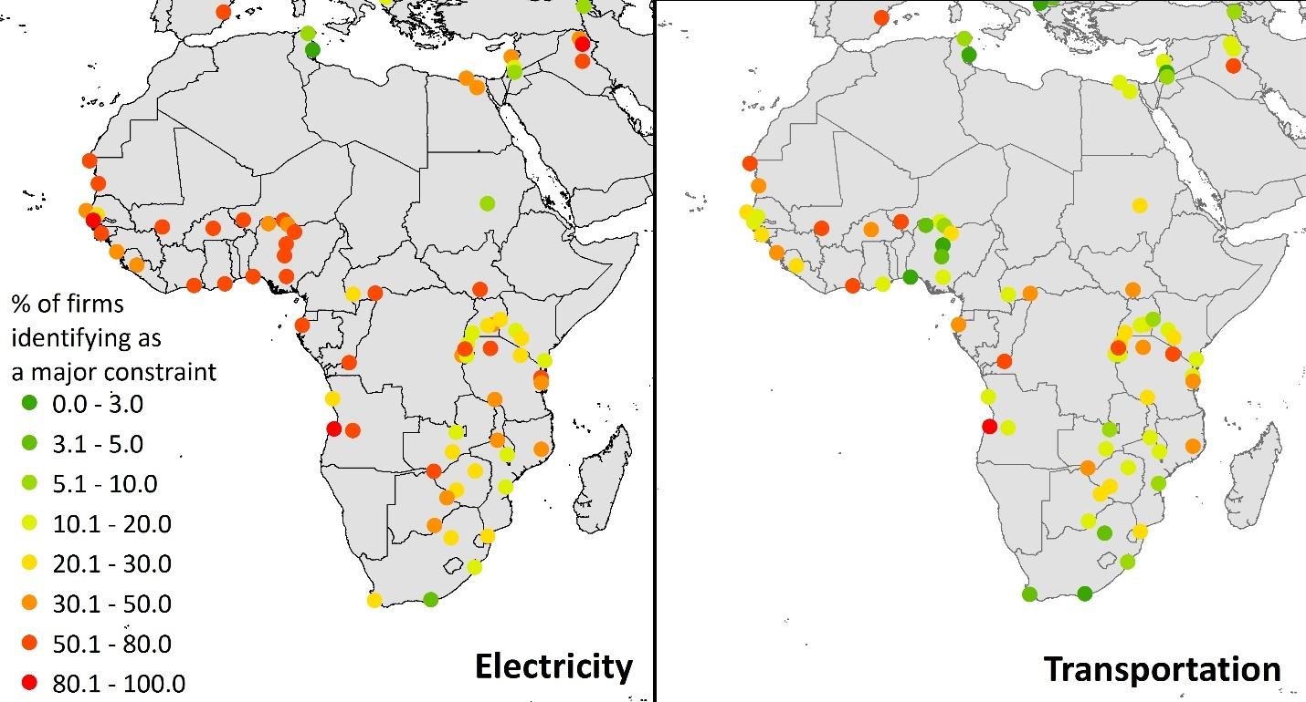
Urban infrastructure
Inadequate infrastructure poses direct and indirect costs to firms.
Transport and electricity are two of the biggest constraints.
Underinvestment in cities has long-term economic consequences.
Electricity and transport ranked as constraints to firms by city
Data: Enterprise Surveys, most recent year available
Notes:
Public investments are the bones that the city is built upon.

Slide 63
Considering the return on well-planned urban investments
Benefits calculations should consider:
Lower costs per capita due to density
Increase in population served due to urbanization
Effect on economy via productive economic sectors
Domestic & foreign private investments leveraged
Spillover benefits to rural economies
Facilitation of agglomeration economies
Resulting public revenues generated
Cost savings calculations should consider:
Well-planned infrastructure avoids costly replotting & retrofitting
Social costs of urban poverty include less private investment, insecurity from young hopeless population and risk of political upheaval
Preventing sprawl prevents its costs in travel times, pollution, congestion & foregone agglomeration economies

Slide 64
Case example: Singapore’s multimodal planning in the 1970s
Singapore’s forward-thinking approach to transport:
Encouraged dense development, reducing commute times
Linked land use planning and transit planning: higher density at transit hubs and along lines
World Bank consultants advised busses were more cost effective than rail; however government pursued major investments in rail as an attractive alternative to driving for the middle class
Regulated single occupancy vehicles: 40% import duty; 25% registration fee
Density and connectivity are the foundation of agglomeration economies: tied to productivity, knowledge sharing and innovation.
Notes:
From the Guidebook box 2.8.

Slide 65
Possible indicators on urban productivity
City or metro area GDP per capita;
The ratio of a city’s GDP contribution to population share
Productivity of firms within the city vs. other locations
Share of employment in informal and/or nontradable sectors
Cost of living and indirect costs to firms (electricity, transport, waste management, urban regulations)
Traffic congestion
Issue: How much of this data is available for your country and its comparators?
Notes:
Highlight the lack of city-level economic data. How can we track the effectiveness of policies to bolster urban productivity if we cannot measure it?

Slide 66
Possible indicators on factors influencing urban productivity
Land administration index
Cadastral coverage and accuracy
Share of land taxes in local revenues
Measures of sprawl, including density, leapfrog development and unbuilt urban space (satellite data)
Land allocated to streets, and walkability ratio
Percentage of households living in slums/informal settlements
Access to electricity, water, sanitation
Cost of power interruption to firms
Average commute time and congestion
House price to income ratio

Slide 67
Subnational indicators: constraints on urban productivity
Cameroon
Chad
Morocco
Uganda
Zambia
Data: Enterprise Surveys, most recent year available
Notes:
Customize with data from enterprise surveys using training country cities and comparators.

Slide 68
Subnational indicators: constraints on urban productivity
Cameroon
Chad
Morocco
Uganda
Zambia
Data: Enterprise Surveys, most recent year available
Notes:
Customize with data from enterprise surveys using training country cities and comparators.

Slide 69
Discussion
Quick reactions?
Clarifications?
Gaps in the current NDP process in [country]?
Possible action items?
Notes:
Gather people’s thoughts, questions & reactions. At some point ask for a few people to share any action items they wrote down in their action planning worksheet.

Slide 70


THANK YOU!
more info: [trainer/organizer contact info]
UNECA.ORG

Slide 71

LUNCH!

Slide 72
Ice Breaker
[Title of icebreaker]

Slide 73
National Spatial System
and its role in national economic development
(Intro to Theme C)

Slide 74





The national spatial system is the arrangement and distribution of cities towns and rural areas, including their functional roles and the connections between them.
Notes:
We care about this because spatial targeting of policies and investments should align with the national economic strategy.

Slide 75
Key questions for policymakers
Where within the national spatial system can investments most cost-effectively achieve economic growth?
Where within the national spatial system will target economic sectors generate growth?
Which cities and towns require which types of investments in order to support target economic sectors?
How can industrial parks and special economic zones leverage existing geographic advantages for competitiveness and to facilitate spillover benefits to the rest of the economy?
How can connective linkages best bolster value chains and a productive system of complementary cities and towns?
Notes:
We will be exploring these issues here.

Slide 76
The current NDP’s vision for the spatial-economic system
Notes:
Customize this slide to summarize how spatial targeting is linked to economic goals. Which cities/rural areas/ growth poles are prioritized? Consider also mentioning the role of corridors, African regional connections and special economic zones.

Slide 77
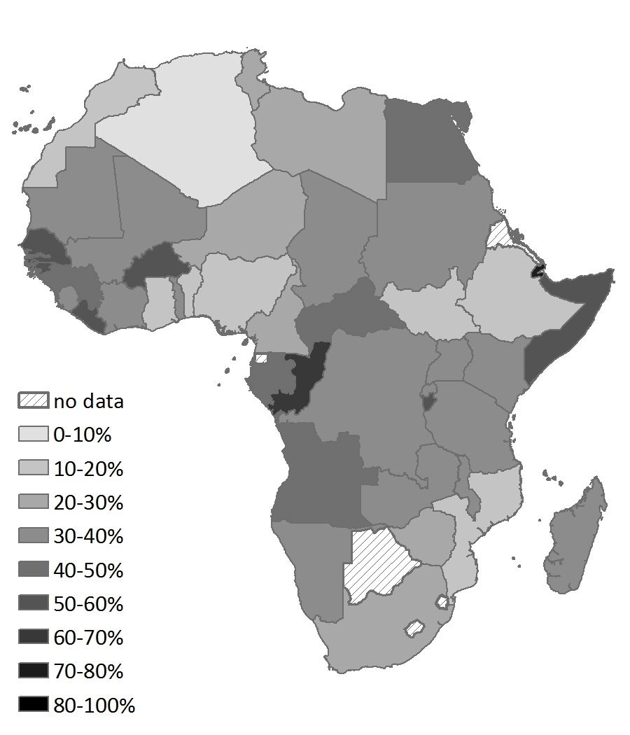
City size distribution
Many countries suffer from high urban primacy:
Large city too large – burdened by diseconomies
Small cities too small – not attractive or competitive locations for business
Lack of good location options for the variety of firm types
Percentage of the urban population in the largest city, 2015
Notes:
Remove this slide if this is not a problem for the training country

Slide 78
Cities and spatial targeting tradeoffs
Large cities
  Highest productivity, most attractive to knowledge-intensive sectors
  Play central role in creative destruction, churning process of firm births and deaths
  Underinvestment can undercut the entire economy’s competitiveness and growth
Secondary cities
  Specialized cities can maximize benefits of same-sector clustering while avoiding costs of very large cities
  Often attractive to labour-intensive industries
  Underinvestment can contribute to problems of primacy
Rural growth poles
  Often important in initial commodities/agriculture processing
  Important for spatial equity
  Underinvestment can undercut the rural economy

Slide 79
Spatial targeting: city considerations
Cities with higher ROI | Cities with lower ROI
Preferred location for strategic industries Dense enough for urban amenities Have basic infrastructure and human capital Close to a size threshold to become productive/competitive Well-connected to transport networks | Lagging in basic infrastructure Isolated from national, regional and international networks Lacking subnational management capacity Unappealing to targeted industries
How many growth poles are feasible given resource limitations?
Notes:
Based on table 2.5 in the Guidebook

Slide 80
Economic sector preferences differ.
Sector type | Common location preferences
Knowledge-intensive; skill-intensive; R&D; innovation-intensive | Large, diverse city
New firms, startups | Large, diverse city
Land-intensive industry | Urban periphery or secondary city with low land cost
Labour-intensive industry | Mid-sized cities with low cost of living
Input-intensive industry; Initial processing of raw commodities | Close to source of inputs
*Caveat: generalizations are not universal;
sector stakeholders can provide more specific insight.
Notes:
Based on table 2.5 in the Guidebook

Slide 81
Special economic zones
“Location and market size matter. Zones with proximate access to large consumer markets, suppliers, and labor tend to be more successful.”
– Farole’s (2011) review of special economic zones in Africa
SEZs can provide pockets of advantages for key industries
Linking them to cities gives SEZ firms access to components of agglomeration economies
Urban linkages are also important for knowledge spillovers and multipliers to uplift the larger economy.
Isolated SEZs tend to fail to achieve competitiveness.
Notes:
Quote from Farole is from a comprehensive review of the performance of SEZs in Africa. One major finding is that SEZs as isolated enclaves, especially in lagging regions face steep barriers, and those located in better connected areas and near cities do better.

Slide 82
Regional linkages
Manufactured goods are more prevalent in African regional trade (41.9% of intra-African exports; 14.8% of Africa’s exports outside the continent).
The power of African cities is greater when they are connected to larger and more diverse regional markets.
Regional economic communities are making progress and can better link urban economies.
Firms in South America and East Asia pay 50% and 70% less, respectively, for inland transport to and from ports, compared to firms in Africa (Iarossi, 2009. Benchmarking Africa’s Costs and Competitiveness. World Bank.)
Africa is constrained by small size of countries and cities. Integration is essential. (Collier & Venables. 2008. “Trade Performance: Does Africa’s Fragmentation Matter?”)
Notes:
Source for first stat is 2017 ERA.
If Africa was one country, it would be 4th in GDP and 3rd in population (stat from The Economist)

Slide 83




Urban-rural linkages
Food and other rural products
Labour
Financial services, ICT, marketing, logistics, processing, wholesale & retail
Knowledge and innovation
Migrant remittances
Notes:
One important point is to get out of the disparities mindset during economic planning since it results in investments in the most lagging areas with the worst ROI. There should be an economic rationale for spatial targeting that seeks to uplift urban and rural together to achieve the overall goal of structural transformation.

Slide 84
Economic policies often have more powerful spatial impacts than spatial policies.
Spatial impacts should be anticipated and planned for.

Slide 85
Spatial impacts of economic policies
Consider how the following policies may impact human geography
Macroeconomic
Trade
Finance and credit
Investment
Labour
Notes:
If time, have participants share their ideas of how economic policies impact human geography. Refer to the subsection on this topic within the Guidebook.

Slide 86
Matching spatial and economic policies
Poorly matched policies:
Fail to expand public services where there is job growth and resulting population growth
Provide public investments in areas without economic growth, resulting in low ROI
Fail to provide the type of infrastructure and services required by expanding economic sectors
Well matched policies:
Anticipate private investment and crowd it in with public investment
Plan for spatial matching of jobs and housing, enterprises and infrastructure.
Invest in cities and urban linkages in accordance with their role in economic growth

Slide 87
Case example: Indonesia’s spatial targeting with an economic lens
Where is productive advantage, economic opportunity & high return on investment? Subnational data sheds light.
Population vs. income growth by city size, Indonesia
Agglomeration Economies
Disagglomeration Economies
Source: World Bank (2012). Indonesia The Rise of Metropolitan Regions: Towards Inclusive and Sustainable Regional Development.
Notes:
Where is productivity rising and declining? Medium cities are doing well, but diseconomies are setting in in megacities in spite of their continued prominent role. This has policy implications. Also note the importance of subnational data.
Findings from this data:
Large metropolitan cities of 5-10 million population were found to be stagnating; Jakarta in particular is constrained by congestion and availability of land
Midsized cities of 500,000-5 million performed well, growing their economies equal to or faster than their populations; financial services and construction sectors increased in share of GDP.
Largest increase in trade, restaurant and hotel sectors was in cities of 0.5-1 million
Recommendation: continue investing in metro and medium cities instead of establishing new cities; work to reduce diseconomies in megacities and capitalize on existing agglomeration economies.
Note also that Indonesia’s Master Economic Transformation Plan (MP3EI) 2010-2025 pairs economic sector targeting with spatial planning for specialized economic corridors (see Guidebook Box 3.8). Important to get good subnational data for this type of planning.

Slide 88
Possible Indicators on the economic functionality of the national spatial system
Urban primacy
Presence of specialized cities
Industrial concentration
Inter-regional transport connectivity
Domestic and regional trade

Slide 89
Rank-size distribution of the top-10 cities
Notes:
The more quickly the curve decreases and becomes flat, the higher the degree of primacy. Cameroon stands out as strongly bi-polar. Chad has the highest primacy, followed by Uganda and Zambia. Morocco has the most even distribution of cities, with the top nine cities after Casablanca (the largest) all exceeding 10% of Casablanca’s population.

Slide 90
Primacy & comparators at 200% GDP
Notes:
Note that none of these countries (perhaps with the exception of Chad) have a major primacy problem. That information can help to inform economic planning and spatial targeting.

Slide 91
Regional integration index, 2016
 | Overall |  | Infrastructure |  | Trade
 | score | rank/total | score | rank/total | score | rank/total
Cameroon (ECCAS) | 0.664 | 1/11 | 0.482 | 4/11 | 0.980 | 1/11
Chad (CEN-SAD) | 0.329 | 19/27 | 0.141 | 21/28 | 0.036 | 24/28
Chad (ECCAS) | 0.512 | 4/11 | 0.196 | 11/11 | 0.747 | 4/11
Morocco (CEN-SAD) | 0.445 | 9/27 | 0.544 | 2/28 | 0.318 | 17/28
Morocco (UMA) | 0.577 | 1/5 | 0.669 | 1/5 | 0.795 | 2/5
Uganda (COMESA) | 0.52 | 3/19 | 0.310 | 18/19 | 0.749 | 5/19
Uganda (EAC) | 0.577 | 2/5 | 0.476 | 2/5 | 0.940 | 2/5
Uganda (IGAD) | 0.701 | 2/6 | 0.378 | 8/8 | 0.998 | 1/7
Zambia (COMESA) | 0.565 | 2/19 | 0.437 | 10/19 | 1.00 | 1/19
Zambia (SADC) | 0.523 | 4/15 | 0.444 | 10/15 | 0.628 | 2/15
 | Above average |  | Average |  | Below average
Notes:
Customize with the training country and comparators if useful
Reference: https://www.integrate-africa.org/fileadmin/uploads/afdb/Documents/ARII-Report2016_EN_web.pdf

Slide 92
Discussion
Quick reactions?
Clarifications?
Gaps in the current NDP process in [country]?
Possible action items?
Notes:
Gather people’s thoughts, questions & reactions. At some point ask for a few people to share any action items they wrote down in their action planning worksheet.

Slide 93
Coordination and Finance
Making implementation real
(Intro to Theme D)
Notes:
This section draws upon both Theme D and Stage 3 in the Guidebook.

Slide 94
“What makes planning is not the targets, which merely express what we would like to see happen, but the action that is taken to achieve these targets.” – Arthur Lewis
Notes:
Two major barriers for implementation of urban issues within national development planning are coordination and finance.

Slide 95
Key questions for policymakers
What mechanisms can be established through the NDP process to allow for coordination between the many public and private actors engaging in the development of cities?
How can subnational authorities be better supported to manage cities in ways that align with the NDP?
Within cities and the national spatial system, how well are public and private investments currently coordinated and how can they be better aligned?
How can investments in cities better leverage private sector contributions?
How can the potential public revenues arising from cities be better harnessed for public investments?
Notes:
We will be exploring these issues here.

Slide 96
Types of coordination
INSTITUTIONAL
Horizontal between national entities
Vertical with subnational entities
Jurisdictional between subnational entities
Public-private
PLANNING
Alignment between entities’ plans
Alignment of plans with resources
Alignment of implementation strategies
IMPLEMENTATION
Coordination in timing
Alignment in space
Coordination of resources
Coordination of roles
What are the mechanisms for coordination on cities and urbanization?
Where are the gaps?

Slide 97

Coordination in planning: Avoiding the “box-ticking” mentality
National Development Planning
National Development Planning
Economic analysis
Integrated analysis:
Economic
Other sectors
Urban
Economic goals and targets
Economic strategies
Vs.
Urban sector targets
Economic goals and targets
Other sector targets
Economic strategies
Urban strategies
Other strategies
Other sector targets
Notes:
- Goal is to move from siloed to integrated
- Can pose the question: which one does your NDP process look like? Can discuss or show of hands only.
- Note that it’s not necessarily different stakeholders but engaging existing stakeholders differently.

Slide 98
Urban components exist within a wide range of plans.
Macroeconomic framework
Economic sector plans
National spatial plan
Local development plans
National infrastructure plan
How do these plans relate to an economic vision for cities and urbanization?
How are urban activities coordinated between plans?
Notes:
Discuss this. Refer to Table 3.8 in the Guidebook.

Slide 99
Subnational authorities have a key role to play
Local economic development plans should function to implement the national economic vision.
Local authorities should have the skills, staffing and equipment to effectively implement the national economic vision.
Local authorities should have a collaborative relationship with national entities.
There should be an effective mechanism to coordinate national and subnational projects.
Are these conditions in place in __[country]__?
Notes:
Can discuss or have a show of hands for each bullet point.

Slide 100
Coordinating urban development: examples of coordination failures
Municipal street investments occur in one location while a national housing agency places affordable units in a separate location.
Arterials and highways are constructed; private land owners build up all land before local streets and connectors can be planned.
Roads, housing and electricity is extended to an area without proper drainage investment, resulting in flooding.
Workforce housing is constructed by one agency while the industrial park is constructed by another; they are on opposite sides of the city.
A gated community limits access to street used by lower income commuters, cutting them off from employment.
High-rise housing is built along a major freight route without additional transport investment, tripling freight transport times due to congestion.
Notes:
Possible points of discussion: Are these type of urban development coordination failures common in the training country? What can be done to overcome them?

Slide 101
Bridging the finance gap is necessary to leverage urbanization for development.
Two problems:
Not enough resources
Poorly allocated resources
Notes:
The following two slides speak to these two points.

Slide 102
Finding enough resources to leverage cities: Options to consider
Improving basic financial management among subnational entities
Private financing and PPP
Grants and loans
Land value capture
Incentives and regulations to guide private development
Cost savings from spatial efficiency
Notes:
Speak to these points drawing from the list in Section 3, Stage 3 of the Guidebook.

Slide 103
Benefit / cost analysis for strategic prioritization of urban projects
Economic assessment can support decision-making related to
  The type of urban projects funded
  The location of projects, both within and between cities
  The vision for the national spatial system (ex: location and number of growth poles)
Economic assessment should factor
  Impacted economic sectors and their role in structural transformation
  Minimum investment, services or density thresholds required to reach economic competitiveness
  Spatial strategies to increase impacts of investments via density or connectivity
  The bidirectional links between land use and transportation
  Potential of public investments to leverage private investments
  The long-term costs of urban retrofitting in the event of unplanned or poorly planned infrastructure
Notes:
The result of this analysis will likely prioritize smart urbanization over disconnected, sprawling, unplanned urbanization. This assessment can help direct resources to smart and sustainable projects. For example, endless highway and ring road expansion will always be overwhelmed by cars, but investments in mass transit and nonmotorized modes can boost urban competitiveness in the long term.

Slide 104
Case example: Spatial, sector and national economic coordination in South Africa
South Africa has established mechanisms to coordinate via the National Planning Commission and Economic Development Department (EDD).
EDD coordinates between national entities on economic planning and reports to the NPC. This includes creation of Spatial Economic Development Action Plans.
EDD also works with provinces to
  “identify corridor opportunities across provinces;
  identify economic clusters across sectors and regions;
  identify competitive advantages in each province and the linkages between them;
  build strategic relationships with SALGA and the metropolitan councils;
  build coherence and links between national and provincial development agencies; and
  identify social partnership opportunities to promote economic development.”
EDD works with target sectors (esp. labour absorbing industries) to meet competitiveness requirements
Source: EDD website
Notes:
See Guidebook Box 3.13 and http://www.economic.gov.za/about-us/programmes/planning-and-coordination/national-economic-planning

Slide 105
Case example: Land-based finance in China
Subnational governments own land classified as “urban” and have responsibility to provide infrastructure and long-term leases.
Industrial land leases kept low to stimulate economic development.
Non-industrial leases competitively auctioned.
Land leases account for 46.7% of public revenue.
Majority of land lease revenue is spent on infrastructure.
China has spent approx. 10% of GDP on infrastructure over the last two decades, fueling growth.
Over 30 years, 500 million people lifted out of poverty due to urbanization and economic growth.
Notes:
See Guidebook Box 2.20. Mention some of the problems China has experienced as well.

Slide 106
Possible indicators for coordination and finance – implementing the urban vision
Qualitative assessments of coordination drawing upon insider knowledge
Stock and quality of public capital (infrastructure)
Public investment in urban infrastructure as % of GDP
Per capita subnational budget
Domestic firms share in public procurements
Share of own source revenues vs. transfers in subnational budgets of major cities
Revenue from property tax as % of GDP
Private sector share of public projects investment

Slide 107
Select scores on the Public Expenditure and Financial Accountability (PEFA) framework
Multi-year perspective in fiscal planning, expenditure policy and budgeting | D | D |  | D | D | C | D | D | B | D+ | D | D+ | D+ | B+ | B | A | B+ | D | D | D | D+
Effectiveness in collection of tax payments | D+ | D | D+ |  | D+ | D+ |  | D+ | D | D+ |  |  | D+ |  |  | B+ |  |  |  | D+ | D
Predictability of transfers from higher level of government | D+ | D+ | D | D |  |  |  |  | D+ | D+ | D+ | D+ | D+ | C+ | B+ | A | D+ | D+
Municipalities unless otherwise specified
Ouagadougou
Tshwane
Antananarivo
Ekurhuleni
Addis Ababa
Lagos State
Douala
Kaduna State
Anambra State
Yobe State
Kenema
Johannesburg
Makeni
Karogwe
Freetown
Mwanza
Bo
Mtwara Mikindani
Kicukiro District
Gauteng Province
Kigoma Ujiji
Burkina Faso Cameroon Ethiopia Madagascar Nigeria Rwanda Sierra Leone South Africa Tanzania
Notes:
D is the lowest score; A is the highest score. Those without scores were not rated.
To assist with presenting this slide, review the ways these scores are calculated: https://pefa.org/content/pefa-framework

Slide 108
Discussion
Quick reactions?
Clarifications?
Gaps in the current NDP process in [country]?
Possible action items?
Notes:
Gather people’s thoughts, questions & reactions. At some point ask for a few people to share any action items they wrote down in their action planning worksheet.

Slide 109
Theme Focus Selection
Primary and secondary focus for days 2 & 3

Slide 110
Priority issue identification
Out of all the issues discussed so far, which is the most important for [country]?
Which theme does it fall under?
A: Economic Sector Targeting
B: Productive Cities
C: National Spatial System
D: Coordination & Finance
Notes:
Help participants categorize their priority issues before they choose a focus theme.

Slide 111
Focus theme selection
Where are the biggest gaps in the current NDP framework? (Issues not addressed or prioritized)?
Where in the NDP are opportunities for improvement (in scope, depth, narrative)?
Which issues are the most important for economic development?
What area can be feasibly improved in the short-medium term?

Slide 112
Day 2 Theme selection
A: Economic Sector Targeting
B: Productive Cities
C: National Spatial System
Which themes are most relevant for better leveraging cities and urban areas for structural transformation in [country name] ?
Notes:
Select a theme using a combination of voting and discussion. Do not select Theme D since it will be part of the discussion of any of the other three.
Selection will guide Day 2

Slide 113
Homework to prepare for tomorrow’s discussion
Review your notes about the selected theme. Refer to the Guidebook as needed.
Write down at least one action item per theme. We will be sharing these in the morning.
Notes:
Action items are the steps the country needs to take in order to integrate each theme related to cities and urbanization into national development planning.

Slide 114
THANK YOU!
more info: [trainer/organizer contact info]
UNECA.ORG

Slide 115
Sample slides: Day 1 Extra Slides
(Use if needed)

Slide 116
NDP vs. NUP: Why include urban issues in the NDP if there is an NUP?
  The NUP Ministry does not typically have the authority or instruments to coordinate all urban issues.
  The NDP provides guidance for making hard choices in NUP implementation.
  The NDP can consider the entire national spatial system whereas the NUP focusses on cities.
  The NDP can align economic sector targeting policies with urban interventions.
  The NDP and NUP can provide complementary inputs to each other.
Notes:
Use Box 1.3 in the Guidebook as a reference.

Slide 117
Anti-urban myths
Myth: Agriculture should be the driver of development.
  Agriculture is one piece; structural transformation requires productive jobs in industry and services
  Increasing agricultural productivity depends on industrializing it and connecting it to value chain activities (industry & services)
  Increasing agricultural productivity sheds jobs. Cities must provide high productivity jobs or these workers will be stuck in poverty and not contribute to economic development.
  Agricultural development & urban economic development must go hand-in-hand.
Notes:
Use Box 1.4 in the Guidebook as a reference.

Slide 118
Anti-urban myths
Myth: Polices should focus on rural development to slow migration to cities and avoid overcrowding.
  Urbanization is driven more by natural growth than migration.
  Policies to slow rural-urban migration in Africa and Asia have failed or resulted in lost productivity.
  Urban-rural economic linkages mean urbanization can be good for rural areas (way out of poverty, many send remittances)
  Under-investment in cities will be detrimental to long-term economic growth
Notes:
Use Box 1.4 in the Guidebook as a reference.

Slide 119
Anti-urban myths
Myth: Poor countries cannot afford to invest in cities.
  Urbanizing countries cannot afford NOT to invest in cities.
  Cities are the location of the future economy and will pay a role in long-term growth and productivity.
  Urban investment are costly but have high rate of return if they generate urban jobs in formal manufacturing & services.
  Cities can generate massive public revenues.
  Investments in urban services leverage economies of scale to reduce costs per person
  Urban investments must be prioritized for effectiveness (role for NDP).
Notes:
Use Box 1.4 in the Guidebook as a reference.

Slide 120
Anti-urban myths
Myth: Cities evolve organically, without national policy action.
  Cities are built around infrastructure and public space. Sets the stage for compactness, connectivity or sprawl.
  Long-term planning framework signals government commitment and crowds-in private investment.
  Local planning requires national government standards and institutions.
  Failures in public investment and planning lead to dysfunctional cities.
Notes:
Use Box 1.4 in the Guidebook as a reference.

Slide 121
Sample slides: Day 2

Slide 122

An Urban Lens in National Development Planning
ECA
Training for Policymakers
**Location**
**Trainers’ Names**
**DATE**

Slide 123
Welcome
An Urban Lens in National Development Planning
Training Workshop

Slide 124
Ice Breaker
[Title of icebreaker]

Slide 125
Discussion: Action items by theme
  [Theme name]
  [Theme name]
  Theme D: Coordination & Finance
  General action items (no specific theme)
Notes:
After participants select a focus theme, list the other two in this slide, plus Theme D and general action items. The selected theme will be the topic of discussion after this.
The point is to discuss the actions that the country would need to take to better integrate urban issues into national development planning.

Slide 126
Review: [Focus theme name]
  What were the key points from yesterday?
Notes:
Customize slide title to reflect the focus theme. Get participants to weigh in so that they refresh their memories.

Slide 127
Four general stages of national development planning
  Diagnostics & Analysis
  Vision, Goals & Targets
  Implementation Strategies
  Monitoring & Evaluation
  We will discuss they ways [Focus Theme] can be integrated into the NDP process in each of these stages.
Notes:
Customize slide title to reflect the focus theme.

Slide 128
Small Group Roles
  Facilitator
  Animates and motivates the group;
  Keeps the group on task;
  Makes sure everyone is heard;
  Asks for consensus;
  Recorder:
  Keeps notes of the group’s work
  Reporter:
  Shares the group’s work and ideas with the larger group
  Timekeeper:
  Makes sure group completes the task within the time provided
  Observer:
  Pays special attention to how the group is working together
  Shares observations with the group
  Please assign your roles now.
  You can switch roles for the next small group discussion.
Notes:
Before assigning roles, it may be necessary to have people move tables to get into assigned small groups. The trainer can help participants form interdisciplinary groups.

Slide 129
Small Group Assignment (60 minutes)
  1. Diagnostics & Analysis:
  Develop 4-6 key statements relating [theme name] to the realities of economic development in [country name].
  Draw upon any data you may have available.
  Keep track of questions that cannot be answered due to insufficient data and the type of data you would need.
  (30 minutes)
  2. Vision, Goals & Targets
  Set 1-2 major goals or targets related to [theme name].
  These goals/targets should contribute to the overall development vision of [country name].
  (30 minutes)
Notes:
Customize slide title to reflect the focus theme and training country.
Make sure participants have any questions answered before starting the group work.
Leave this slide up for groups to refer to.
Hand out copies of any slides from Day 1 with data related to the focus theme.
Let the groups know when the first 30 minutes has passed.

Slide 130
LUNCH!

Slide 131
Ice Breaker
[Title of icebreaker]

Slide 132
Small Group Reporting
  1. Diagnostics & Analysis: 4-6 key statements relating this [theme name] to the realities of economic development in your [country name].
  2. Vision, Goals & Targets: 1-2 major goals or targets related to [theme name].
Notes:
Have groups report as briefly as possible. If there is additional time, open it up for discussion, comments, questions, etc.

Slide 133
Small Group Roles
  Facilitator
  Animates and motivates the group;
  Keeps the group on task;
  Makes sure everyone is heard;
  Asks for consensus;
  Recorder:
  Keeps notes of the group’s work
  Reporter:
  Shares the group’s work and ideas with the larger group
  Timekeeper:
  Makes sure group completes the task within the time provided
  Observer:
  Pays special attention to how the group is working together
  Shares observations with the group
  Please assign your roles now.
  You can switch roles for the next small group discussion.

Slide 134
Small Group Assignment (50 minutes)
  3. Implementation Strategies:
  Develop a list of 2-4 key projects or programmes needed to achieve the goals/targets you set.
  Which entity should lead each project or programme? Which entities should coordinate their work with the lead entity?
  Describe mechanisms that would help achieve coordination?
  How could these programmes/projects be funded?
  (30 minutes)
  4. Monitoring & Evaluation
  Select 1-2 indicators for each goal/target you set.
  Where will the data for these indicators come from and how will it be reported?
  (20 minutes)
Notes:
Customize slide title to reflect the focus theme and training country.
Make sure participants have any questions answered before starting the group work.
Leave this slide up for groups to refer to.
Let the groups know when the first 30 minutes has passed.

Slide 135
Small Group Reporting
  3. Implementation Strategies:
  What is your coordination mechanism?
  What financing options did you discuss?
  4. Monitoring & Evaluation:
  What are your indicators?
  What agency is in charge of collecting and reporting the data?
Notes:
Have groups report as briefly as possible. If there is additional time, open it up for discussion, comments, questions, etc.
Note that this slide doesn’t actually have groups report on their projects or programmes. These will come back into focus during action planning.

Slide 136
THANK YOU!
more info: [trainer/organizer contact info]
UNECA.ORG

Slide 137
Sample slides: Day 3

Slide 138
An Urban Lens in National Development Planning
ECA
Training for Policymakers
**Location**
**Trainers’ Names**
**DATE**

Slide 139
Welcome
An Urban Lens in National Development Planning
Training Workshop

Slide 140
Ice Breaker
[Title of icebreaker]

Slide 141
Action Planning
Actions needed to integrate urban issues into national development planning
Action What will be done? | Responsibilities Who will do it? | Timeline By when? | Resources Resources available, needed, opportunities | Risks & Mitigation Why the action may fail & how to overcome the risk | Coordination Plan Who is involved; what coordination method?
1.
2.
3.
Etc…
+ Evidence of success (benchmarks)
+ Monitoring or follow up plan
Notes:
The point is to list actions that the country would need to take to better integrate urban issues into national development planning.
Participants can consider action items from their own running list, the list created at the beginning of Day 2 (multiple themes), and the focus theme discussions during Day 2.
Make sure participants also are aware of the need to create a monitoring and follow up plan.

Slide 142
Small Group Roles
  Facilitator
  Animates and motivates the group;
  Keeps the group on task;
  Makes sure everyone is heard;
  Asks for consensus;
  Recorder:
  Keeps notes of the group’s work
  Reporter:
  Shares the group’s work and ideas with the larger group
  Timekeeper:
  Makes sure group completes the task within the time provided
  Observer:
  Pays special attention to how the group is working together
  Shares observations with the group
  Please assign your roles now.
  You can switch roles for the next small group discussion.

Slide 143
Action Planning Instructions (90 minutes)
  Brainstorm a list of specific near-term action items to help [country name] better integrate urban issues into national development planning.
  Fill out the action planning worksheet with those items that are both impactful and feasible.
  The goal of these action plans is to practical, not theoretical.
  Consider:
    What is the first action you will take after the training?
    Who is the first person you will get to help you?
    Who in this room should you connect with to collaborate?
    How will ECA be involved in supporting the plan?
  Consider what political and organizational support is needed and make sure that is included in the worksheet.
Notes:
At some point during this 90 minutes, participants may choose to take a tea break (if tea is available). Encourage them to do that as desired.

Slide 144
Small Group Reporting
  Briefly list your action items.
  Give an brief overview of the overall timeline.
  List the agencies involved in your plan.
  Describe one idea about action item resources from your list.
  Describe one risk and mitigation strategy from your list.
  Describe one coordination mechanism from your list.
Notes:
Have groups report as briefly as possible. Discuss further if time allows

Slide 145
LUNCH!

Slide 146
Action Planning Synthesis
Notes:
Facilitate the creation of a single action plan with key points from individual group action plans. Make sure to include a plan for monitoring and follow up.

Slide 147
Final Action Plan Presentation
Notes:
Ideally this will be presented to high level attendees who return for the final afternoon session. Have one of the participants present if possible.

Slide 148
Training Workshop Evaluation
  Please take time to provide your feedback.
  Your input is important.
  Your feedback will be used to improve future trainings.

Slide 149
Closing Sessions

Slide 150
THANK YOU!
more info: [trainer/organizer contact info]
UNECA.ORG

