Slide 1
International migration and development in Africa: Past, present, future
Bela Hovy
Chief, Migration Section
Population Division, Department of Economic and
Social Affairs (UN DESA)
Regional Consultation on International Migration in Africa
UN/ECA, Addis Ababa, 26-27 October 2017

Slide 2
Components of population change -
Africa and Europe compared
Africa
Migration is reducing population growth (but little impact)
Europe
Migration is slowing population decline (but not halting)
Natural change
Total net population change
Net international migration
Notes:
2

Slide 3
The demographic window of opportunity
Total dependency ratio, by region, 1950-2100,
(ratio of population 0-14 and 65+ per 100 population 15-64)
Latin America and
the Caribbean
Europe
Northern America
Oceania
Asia
Africa
Source: World Population Prospects: The 2017 Revision

Slide 4
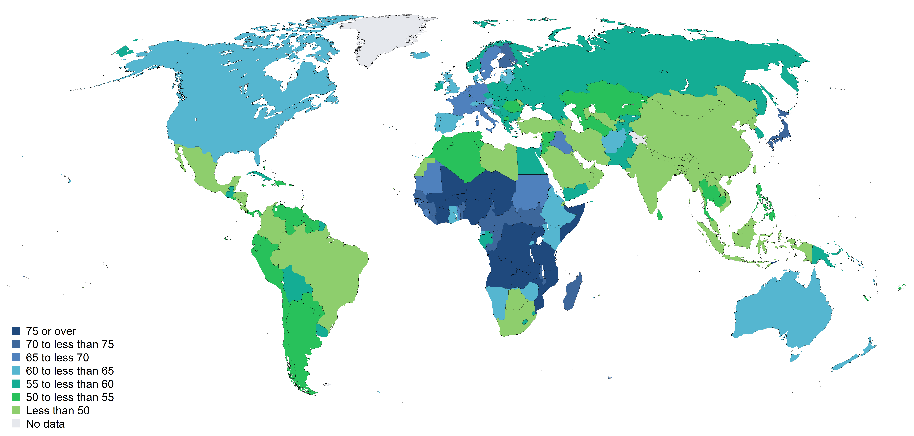
2030

Slide 5
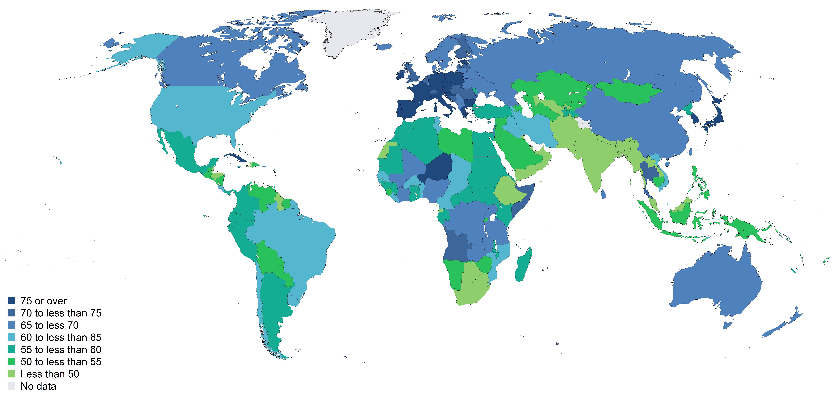
2050

Slide 6
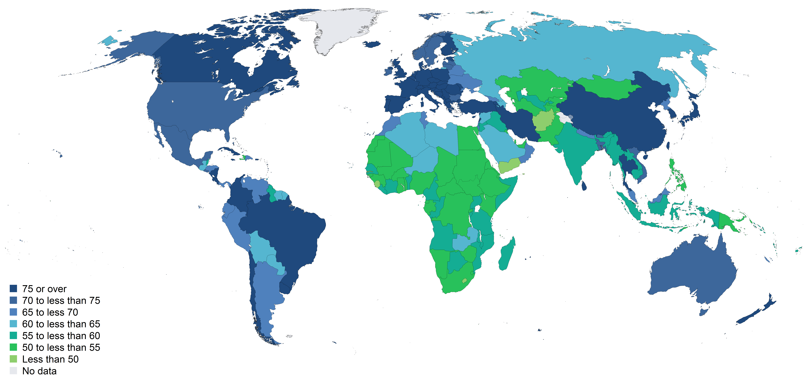
2075

Slide 7
Total fertility rate, Africa, 2015-2020

Slide 8
Who is an international migrant?
(UNDESA, 1998. Recommendation on statistics of international migration)
Anyone who changes her/his country of residence
  Part of this definition:
    A physical move
    Minimum duration of stay (1 year or more)
  Not part of this definition:
    Reason (work, family, study, asylum, etc.)
    Legal status
How to measure?
  Foreign-born population and foreign citizens in census

Slide 9
International migrants are highly concentrated

Slide 10
Total number of international migrants
2000 and 2017
 | 2000 | 2017 | Change
Africa | 14.8 | 24.7 | 67%
Eastern Africa | 4.8 | 7.6 | 57%
Middle Africa | 1.8 | 3.5 | 101%
Northern Africa | 1.9 | 2.4 | 28%
Southern Africa | 1.2 | 4.3 | 255%
Western Africa | 5.1 | 6.8 | 33%
Asia | 49.2 | 79.6 | 62%
Europe | 56.3 | 77.9 | 38%
Latin America and the Caribbean | 6.6 | 9.5 | 45%
Northern America | 40.4 | 57.7 | 43%
Oceania | 5.4 | 8.4 | 57%
World | 172.6 | 257.7 | 49%

Slide 11
Top-20 countries of destination of international migrants, Africa, 2017 (thousands)

Slide 12
Regional expatriation rates

Slide 13
Who is a refugee?
(1951 United Nations Convention relating to the Status of Refugees)
Refugee definition (art. 1)
  well-founded fear of being persecuted
  for reasons related to race, religion, nationality, membership of a particular social group or political opinion
  outside country of nationality and unable to return
How to measure
  Administrative records (registers of refugees and asylum-seekers)
  [Population census (reasons for migration)]

Slide 14
In Africa and Western Asia, refugees constitute an high percentage of all international migrants
Refugees as a percentage of all international migrants

Slide 15
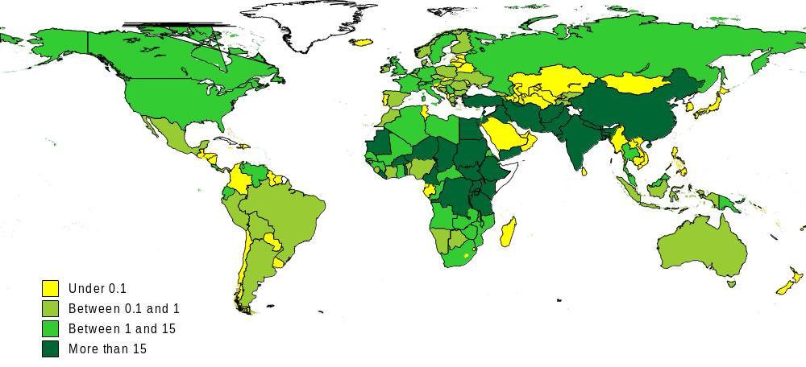
Uneven sharing of responsibilities for refugees
Ratio of refugee population to gross domestic product per capita (PPPs)

Slide 16
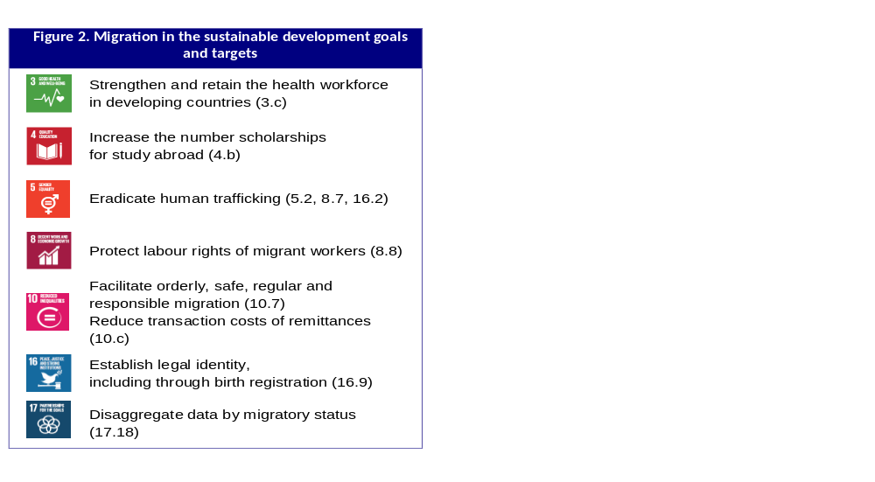
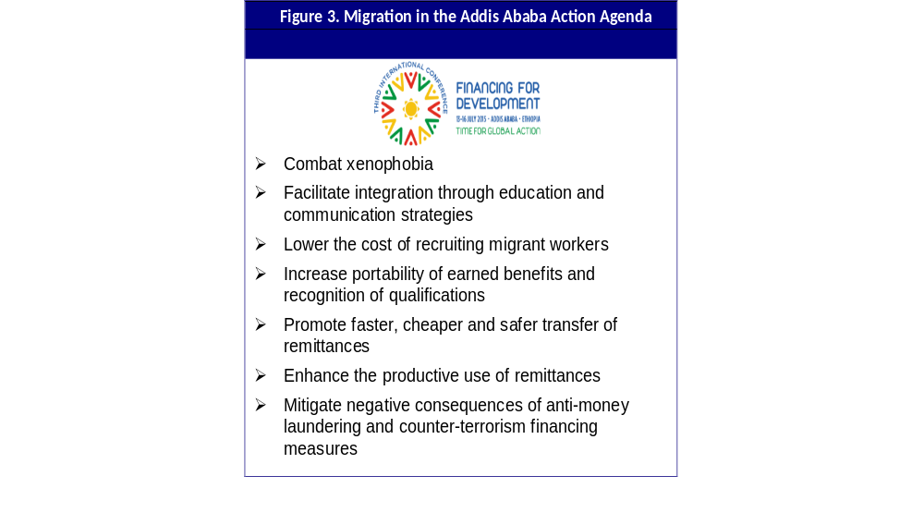
Migration in the 2030 Agenda
(10 out of 169 targets are “migration-related”)

Slide 17
While remittance flows to Africa vary and are relatively small …

Slide 18
… they form an important part of the gross domestic product in some countries
Remittance inflows as a percentage of GDP, 2016

Slide 19
Ratification of relevant conventions reflects policy priorities of Member States
2000 Human Trafficking Protocol
2000 Migrant Smuggling Protocol
1951 Refugee Convention
1967 Refugee Protocol
1949 ILO Migration for Employment Convention (No. 97)
1990 UN Migrant Workers Convention
1975 ILO Migrant Workers Convention (No. 143)
2011 ILO Domestic Workers Convention (No. 189)

Slide 20
The global compact for safe, orderly and regular migration: A comprehensive and ambitious agenda (Source: New York Declaration for Refugees and Migrants, Annex II)
24 elements (indicative, non-exhaustive)
  Interrelationships with development, opportunities, drivers, contributions, safe, orderly and regular migration, well-managed migration policies, international cooperation, impacts on human capital, remittances, human rights of migrants, migrants in vulnerable situations, border control, human trafficking and migrant smuggling, irregular migration, migrants in countries in crisis, inclusion and access to basic services, regularization, labour rights and working conditions, migrant responsibilities, return and readmission, diasporas, racism and xenophobia, data disaggregation, portability

Slide 21
Preparing for the global migration compact at the national level: Next steps
Develop coherent national position (inter-ministerial taskforce)
Mobilize stakeholders (NGOs, private sector, academia, diaspora groups, migrants, etc.)
Consider implementation and follow-up
  How to integrate migration in national development planning?
  How to strengthen national institutions?
  How to improve data, research and training?
  What role can the international community play?

