Slide 1
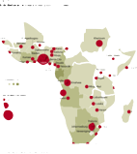
Situational Analysis of African Migration
Presented by:
Prof. Caroline Wanjiku Kihato (PhD)
24 October, 2017
Addis Ababa

Slide 2
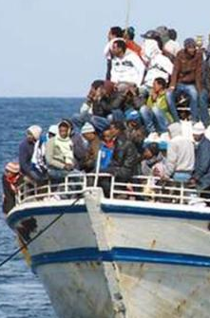
The Global ‘Migration crisis’
African migration portrayed as an uncontrollable crisis
Leads to skewed narratives focussing on African’s heading north
The African migration policy agenda is driven largely by Europeans
The result is little is attention given to intra-African movements
The global discourse pathologises and criminalises mobility
Notes:
Stereotypes of Africa conflict despearation
European refugee crisis – 2015 Valetta Summit
Significant regional migration policy activity
Key features of managed migration
Contain – through local development initiatives
Advocacy campaigns to prevent people from moving
Deportation
Focus on irregular migration
Concerns agenda is driven by external agendas in ways that drown out Africa’s own challenges and needs

Slide 3
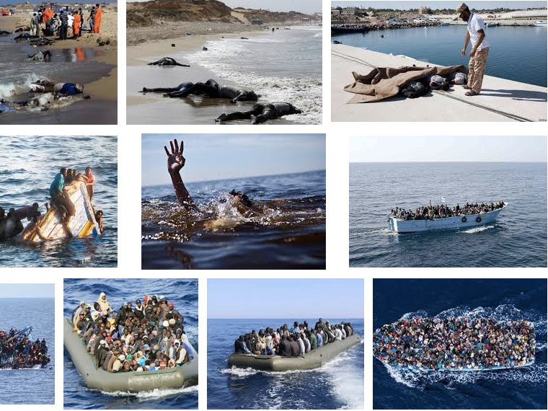

Slide 4
The ‘hidden’ story of Africa’s migration
Majority of Africans move within the continent (79%)
At least 90% of Africans to OECD countries enter legally
Africa is also host to migrant populations from Asia (5%), Europe (4%), North America (0.3%), Latin America and the Carribean
Notes:
According to the best available data -- So the boat images are just a small % of people moving to Europe.
The nature and causes of African migration are not essentially different and exceptional compared to migration elsewhere. Dominant discourse on migration which tend to pathologise African migration talk about our movements as abnormal and needing to be stemmed.

Slide 5
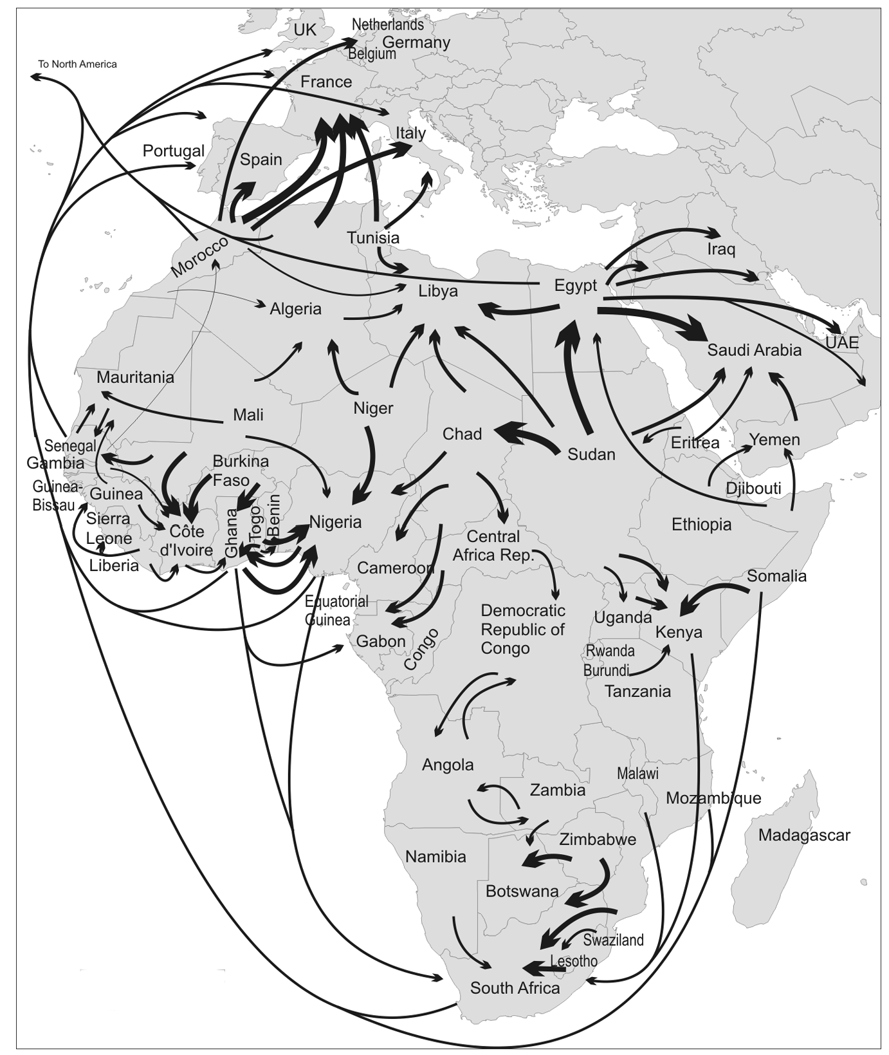
The ‘hidden’ story cont…
Mixed migration flows, with 90% being normal migration
Largely young and economically active – ages 20-64 66%, 0-19 29% and 65+ 5%
Slightly more men than women (46% women)
African Migration is not unique, and has a similar character to migrations elsewhere
De Haas, 2017
Notes:
Image shows the flows Migration within and outside of the continent. The arrow dimensions give an approximate indication of the volume of flows based on available migrant stock data and studies. Exact figures are generally unavailable
Generally most of the migration occurs within the RECS – western, southern and Eastern africa.
Except North Africa – generally Maghreb to Europe and Egypt to the Middle East, ECOWAS largely within the REC
Defies misery migration

Slide 6
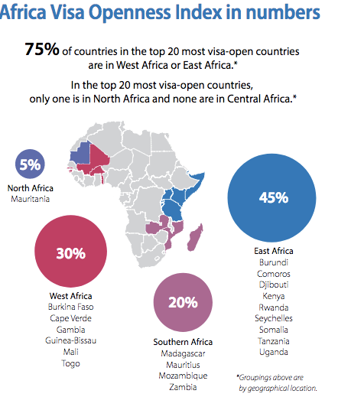
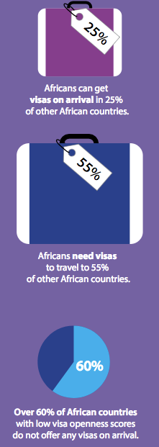
Notes:
A study by the ADB and the AU shows Africa as one of the most restrictive continents towards its own citizens. There are of course regional variations ECOWAS very open towards its member states but quite restrictive towards other countries. North Africa is the most visa restrictive, and East Africa most visa open.
55% of Africans need visas to travel.
Over 60% of African countries score low on the visa openness.
It encourages irregular migration, and it also presents the business opportunities for smuglling and traficking businesses

Slide 7
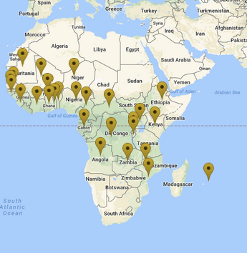
Why should we care?
The danger of the ‘single’ story
Current policies are based on a skewed understanding of migration
Key policy focus is on
  Containment and border control
  Deportation
  Conditional development aid
  Concerns that the agenda is driven by external interests in ways that obsccure Africa’s own challenges and needs
Countries where MIEUX works
Source: MIEUX website
Notes:
Why should we care that there are different migration stories we can tell?
Because current policies are based on a one-sided story of a migration crisis.
Securitisation
Encampment
Ambiguous urban refugee/migration policies
EU migration crisis
Containment and border management
Restriction of movement
Aid and weapons providing perverse incentives to states
Result: Weakening democracy and human rights regime

Slide 8
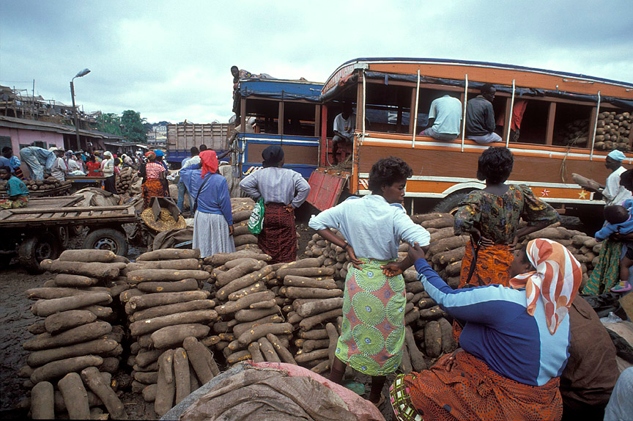
Reframing the African migration debate
Migration is a historical fact and has a net benefit for the continent
Increasing border restrictions only drive migration underground and provide fertile ground for opportunistic smuggler enterprises
Align migration policies to meet Africa’s development prioritise
African states need to invest in understanding the dynamics of African migration
Notes:
Data collection has been skewed towards a European agenda.
Critics of the Global Slavery Index argue that the index is based on weak empirical foundations, questionable scientific methodologies, limited data and a poorly defined concept of -- ‘modern slavery’ . Indeed some argue it is difficult to know when to draw the line between modern slavery, and labour exploitation Anne Gallagher, “The Global Slavery Index Is Based on Flawed Data – Why Does No One Say so? | Anne Gallagher,” The Guardian, November 28, 2014, sec. Global development, http://www.theguardian.com/global-development/poverty-matters/2014/nov/28/global-slavery-index-walk-free-human-trafficking-anne-gallagher; Daniel Mugge, “40.3 Million Slaves? Four Reasons to Question the New Global Estimates of Modern Slavery,” openDemocracy, October 17, 2017, https://www.opendemocracy.net/beyondslavery/daniel-m-gge/403-million-slaves-four-reasons-to-question-new-global-estimates-of-moder.
What cannot be denied is are the forms of labour exploitation and some incidences of trafficking, there seems to be no evidence that it is endemic

Slide 9
Thank You

