Slide 1



ECA-OECD Development Centre-ECLAC Policy Dialogue on ‘Africa and Latin America at a Crossroads: Addressing Structural Transformation in the New Global Landscape’
The recent return of Industrial Policy to Latin American Countries: some lessons from Argentina
Pablo José Lavarello
CEUR-CONICET (ARGENTINA)

Slide 2
Index
Stylized Facts: structural Change in Argentina during the 2000s?
Industrial Policy: some general traits
Design and Implementation issues
Conclusions and policy lessons

Slide 3
I. Structural Change in Argentina during the 2000s?

Slide 4
Latin America Countries early de-industrialization
% Manufacturing Value Added / Total Value Added. Constant Prices 2005
Source: UNCTAD.

Slide 5
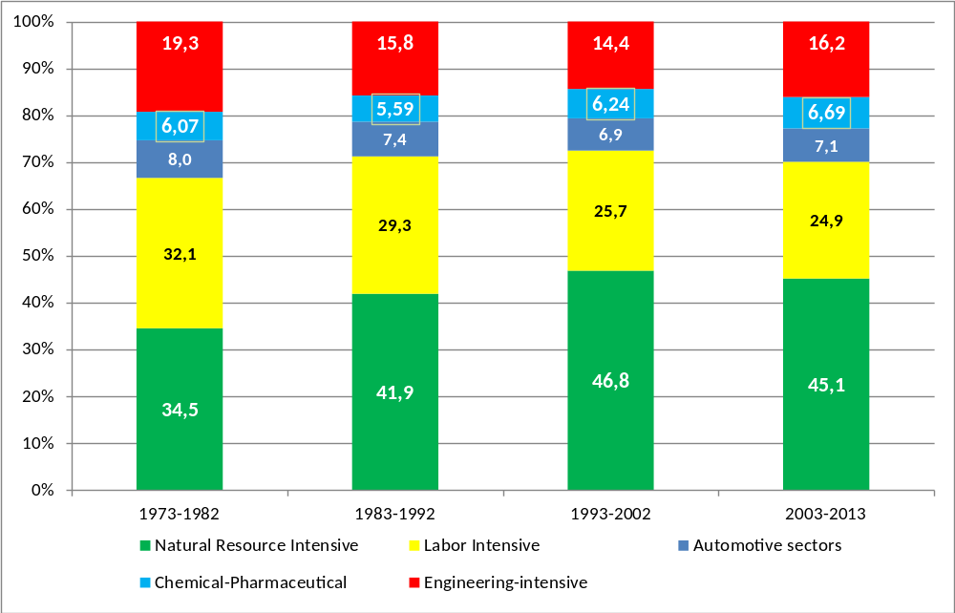
Structural Change in Argentine Manufacture. 1970-2013
Employment share by Argentine tipology
Source: Based on PADI-CEPAL

Slide 6
Argentina Manufacture Trade Balance : the external constraint
Millions USS Dollars
Source: Based on UN-COMTRADE

Slide 7
Broadening Technology Gap in Argentine: sectoral diferencies
Argentina’s Labor productivity as a percentage of US Labor productivity (US= 100)
Source: Based on PADI-CEPAL

Slide 8
«Frontier» productivity growth: US Labor Productivity
1970=100
Source: Based on PADI-CEPAL

Slide 9
II. On the recent return of Industrial Policy in Argentine: some stylized facts

Slide 10
Industrial Policy: budgetary and financial effort
2010-2013 Average
2004-2006 Average
5 % Manufacturing Value Added
0,87% GDP
1,4% GDP
10 % Manufacturing Value Added

Slide 11
Economic Signals matter: differential export taxes in Argentina
Source: ECLAC Buenos Aires on Argentine Economic Ministery Statistics

Slide 12
Industrial Policy Support by intervention domain
(As % of manufacturing Value Added, Average for each period)
Source: ECLAC (Buenos Aires) based on Argentine Ministry of Economic and Infrastructure Planing, Argentina Central Bank, Ministry of Science Technology and Innovation

Slide 13
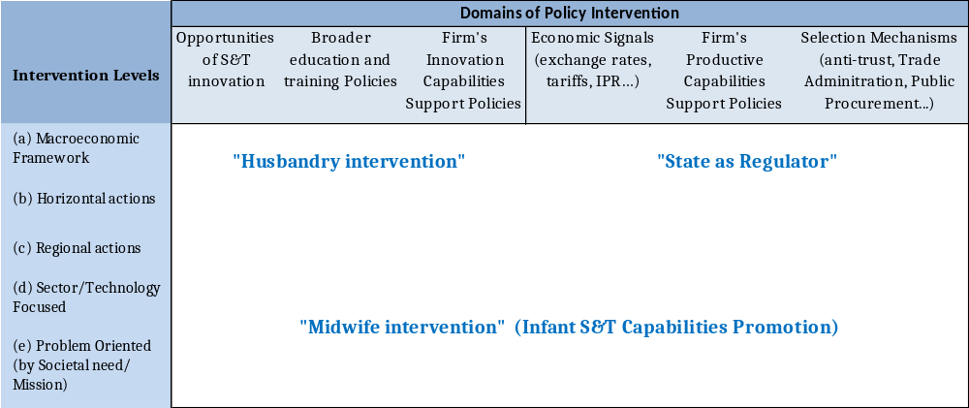
Industrial Policy: intervention pattern evolution
Horizontal S&T Firm’s capability support
‘90: Ant Trust, Liiberalization, Privatization and deregulation
Competitive Exchange rate + export taxes to agribusiness
Old Regional Promotion
Selective Technology Policy
(Bio, TICs, Nano)
Problem Oriented Big Industrial and S&T Programs (Nuclear, satellital, Energy)

Slide 14
III. Design and Implementation Issues

Slide 15
Industrial Strategic Plan 2020
Objective Conception and Design
General Objective: assure sustainability of inclusive demand led growth (7% anual manufacture production growth needed to 5% GDP growth).
Participative method : sectoral goals defined by public-private interaction
11 value chain pre-selected: horizontal perspective (non strategic sector) ➔ 11 forums (one for each value chain )
Implementation
11 implementation tables (only one meeting each year)
Husbandry State : Market Faillure (information asimetry between policy supply and demand)
Objective mutation: import substitution rationale has become prioritary
Weak consistency between objectives and instruments
Weak inter-ministry coordination. Exception in sectors with previous public-private institutional learning (Health Biotechnology, software and Agricultural Machinery)

Slide 16
CyT Plan «Innovative Argentine 2020»
Objective Conception and Design
General Objective : promote innovation based on S&T opportinities
Specific Objectives: Strenghten S&T Opportinities and focusing innovative capabilities
35 «Socio-Productive Cores»: sectoral/technology/region Focused
Participtaive Design tables (private sector associations, universities and other Ministries)
Consulting and validating instance
Manufacturing
- Autopartts
- Medical equipment
- Electronic Components
Soustainable developpment
Agroindustry
- Biotech Seeds
- Biorefineries
- Agricultural Machinery
Energy
- Rational use
- Fracking
Implementation
35 Implementation tables (only 22 between 2012 and 2013)
Institutional Learning: from horizontal (ex post selectivity) actions to ex ante selectivity
Science Based sectors absorbing most of the ressources (Heath Biotech and Agrobiotech)
Weak support to Capital Goods and Big Projects (nuclear, aeroespatial)
Biosimilars
Infectious diseases
HEALTH
Some consistency objectives and instruments («Sectoral Funds» represent less than 20% of Ministry Support)
Weak interministry coordination (exception: agriculture ministry)

Slide 17
Conclusions: Lessons from Argentina
  Industrial Policy has been successful in limiting de-industrialization and it have enabled certain recovering of engineering intensive activities in the context of natural commodity price super-cycle. Several actions explained this performance:
    Competitive exchange rate cum export taxes favoring manufacture relatively to agribusiness
    Selection context (trade Administration , strategic IPR approach, public procurement)
  But it has not been enough in the context of technological acceleration: technology gap broadened in all sectors, but specifically in engineering intensive activities.
  Challenges :
    From horizontal Husbandry Approach to infant capability approach in new sectors
    Increase coordination between S&T policy and Industrial Policy
    Go beyond horizontal/selective instruments: Problem Focused Projects structuring different S&T and Industrial policy domains
Notes:
*

Slide 18
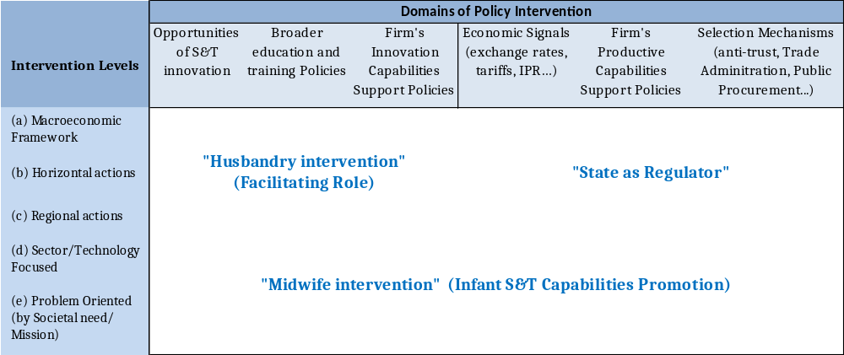
Industrial Policy: Different patterns of State Intervention

