Slide 1

PRODUCTION TRANSFORMATION POLICY REVIEWS (PTPRS)
A POLICY ASSESSMENT AND GUIDANCE TOOL FOR POLICY DIALOGUE AND KNOWLEDGE SHARING
ECA-ECLAC-OECD High Level Policy Dialogue
Africa and Latin America at a Crossroads: Addressing Structural Transformation in the New Global Landscape
Addis Ababa, Ethiopia, 10-11 December 2015
Dr. Annalisa Primi, Senior Economist, Head OECD Initiative for Policy Dialogue on GVCs, Production Transformation and Development, OECD Development Centre, annalisa.primi@oecd.org

Slide 2

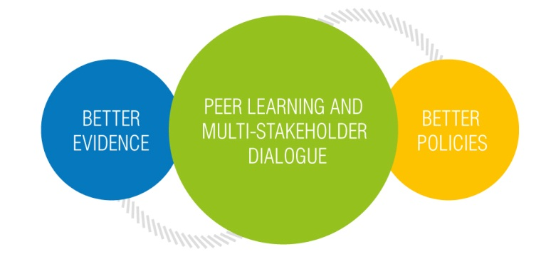











Slide 3
A new global socio-economic, political and technological landscape
Higher uncertainty, growing complexity and growing power pressures (reconfiguration of blocks/alliances/interests)
Experimentation and country (and local level) of new approaches and solutions to address the evolving and uneven impacts of globalisation

Slide 4
3 Premises
Development is a process of transformation of socio-economic structures (=> Production structure matters for development – what you produce, how you organise production and what and with whom you trade impact standards of living, job creation and degree of inclusiveness of growth patterns).
There are no natural reasons for a country or a region to be specialised in an activity/sector. Specialisation and diversification patterns are often determined by a combination of factors including market incentives, with ACTIVE and SELECTIVE public policies in a variety of fields and institution building. Variety of ways.
Globalisation & the past and on-going changes in the organisation of production have opened and are opening potential opportunities for production transformation in developing economies. But the current GVCs debate is happening in an evolving and different global economic context (different demands, aspirations and “worries” for different countries; almost 3 decades of accumulative changes in the re-organisation of production and growing cross-national [science, production and financial] interests and emerging new trends).

Slide 5
Increasing value added of domestic production
Creating better jobs (which requires better skills)
Promoting research, technological development and innovation to sustain competitiveness

Slide 6
Growing uncertainty and complexity => return of national industrial development strategies in global economies (challenge of defining the vision and clarifying the stakeholders)
New “values” for market and the society (inclusiveness and sustainability)
Behavioural patterns conducing to superior performance what do we know about it? (cooperation/collaboration/networks)
MNCs are changing strategies => relocation, benefits of co-location between manufacturing and innovation& services
SMEs facing specific challenges which require specific responses

Slide 7
Production Transformation Policy Reviews (PTPRs)
PTPRs Interpretative framework
5 Pillars for the PTPRs
Anticipation Capacity
Learning and Upgrading Potential
Interconnectedness Propensity
Adaptation Capacity
Embeddedness Potential
5 dimensions for assessing the potential of production and innovation systems and policies for transformation and upgrading
Source: Primi (2014)

Slide 8
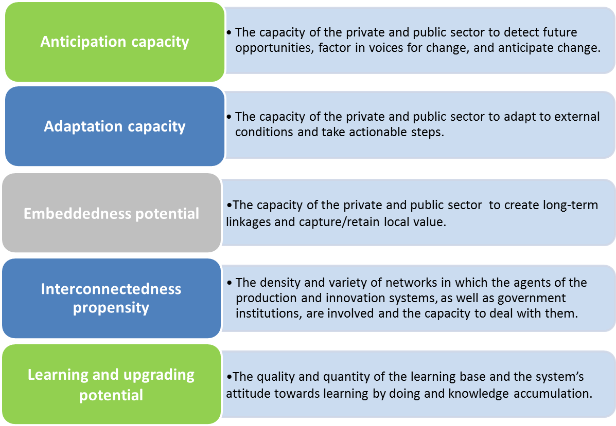
Definitions of the five pillars of the PTPRs

