Slide 1
SPECIAL ECONIMIC ZONES AS A TOOL FOR STRUCTURAL TRANSFORMATION
Policy Dialogue on Africa and Latin America at a Crossroads: Addressing Structural Transformation in the New Global Landscape: Production Transformation Strategies
10-11 December
Addis Ababa,

Slide 2
Background
The majority of economically successful countries have used industrialisation as a preferred route towards structural transformation;
Industrial development agendas are largely informed by a realisation that industrial development offers the most sustainable route towards economic prosperity and success;
Countries are increasingly adopting SEZ as one of the key instruments for Structural transformation; noting that this is not a panacea;
South African ’s industrial development agenda is clearly articulated in the Industrial Policy Framework (and Industrial Policy Action Plan) and National Development Plan, and SEZ is utilised as one of the tools to drive these policies.

Slide 3
INTRODUCTION
Key Objectives
Increase FDI and DDI
Increased beneficiation of the country’s resource endowments
Increase value added exports
Build targeted industrial clusters and value chains (local, regional and global networks)
Create new industrial hubs
Technology and skills transfer
Key Interventions
SEZ policy and strategy
Build industrial infrastructure
Market and promote designated zones and host regions
One stop Centers
Incentives
Capacity building and institutional development

Slide 4
DEFINITION: SPECIAL ECONOMIC ZONES
Industrial Development Zones Programme, 1999 - an incentive programme to establish IDZs
Industrial Development Zone: a type of special economic zone providing special provisions to develop industrial growth in particular geographical areas
IDZ Programme has performed below expectation
Policy review process 2006 - to review the challenges experienced by the IDZ Programme
Geographic areas of a country or region set aside for designated economic and industrial activities; which are supported through special measures.

Slide 5
SEZ FRAMEWORK
Special Economic Zones
Sectoral development dimension
Regional development dimension
Land development dimension
Industrial capabilities
Regional Innovation Systems
Administrative processes/approvals
Support system:
Resources
Education
Infrastructure
Research/Innovation
Health/Housing
Determine or prioritise:
Industries
Value chains
Clusters
Products
EIAs
Licences/Permits
Taxes
Registration
Visas
Special Support Measures: Tax Financial Non-financial Incentives across all spheres of government.
FDI
New Industrial Know-how
Growth
Value-Added Exports
Jobs
Innovation

Slide 6
COMPONENTS OF AN SEZ
SEZ
Industrial
Production
Component
Industrial Development Zones
Export Processing Zones
Sector Development Zones
Enterprise Development Zones
Science and Technology Parks
Corridor development Zones
Industrial
Support
System
Component
Education: Universities, Vocational training
Infrastructure
Research and development
Human settlements
Health facilities
Logistics
Incubation

Slide 7
UNDERSTANDING REGIONS AT SUBNATIONAL LEVEL
REGIONS at Subnational level
Leading
Regions
Characteristics
Competitive industries/firms
Infrastructure
Education
Innovation
Poverty nodes
Needs
Industrial upgrading
Competitiveness
Skills
Diversification
Advanced industries
Inclusion
Strategy
Inter-mediate
Regions
Characteristics
Strong industrial base
Some educational institutions
Social infrastructure
Poverty nodes
Needs
Industrial upgrading
Competitiveness
Skills
Diversification
Advanced industries
Inclusion
Strategy
Under-developed
Regions
Characteristics
No infrastructure
No education inst.
No research inst.
Natural resources
Poverty
Needs
Infrastructure
Tertiary education
Housing
Health facilities
Strategy

Slide 8
POLICY APPROACH
Greater focus on desired industrial capabilities – clarifying which sectors, industries, value chains, clusters and products are strategic and capable of anchoring broader and long-term industrial development,
Understanding and creating responsive administrative arrangements to support investments and development,
Long-term planning, coordinated across and between spheres,
Greater focus on host areas rather than fenced-in areas,
Special support measures to make those areas special,
Flexible and broader design that caters for diverse regional needs,
Comprehensive support beyond just world-class industrial infrastructure.

Slide 9
REQUIRED SUPPORT SYSTEM
Industrial Infrastructure | Education and Training | Logistics | Research, development and innovation | Incubation
Productivity Support | Finance and incentives | Human settlements, health facilities and social infrastructure and security | Marketing: Export promotion and development | Investment facilitation

Slide 10
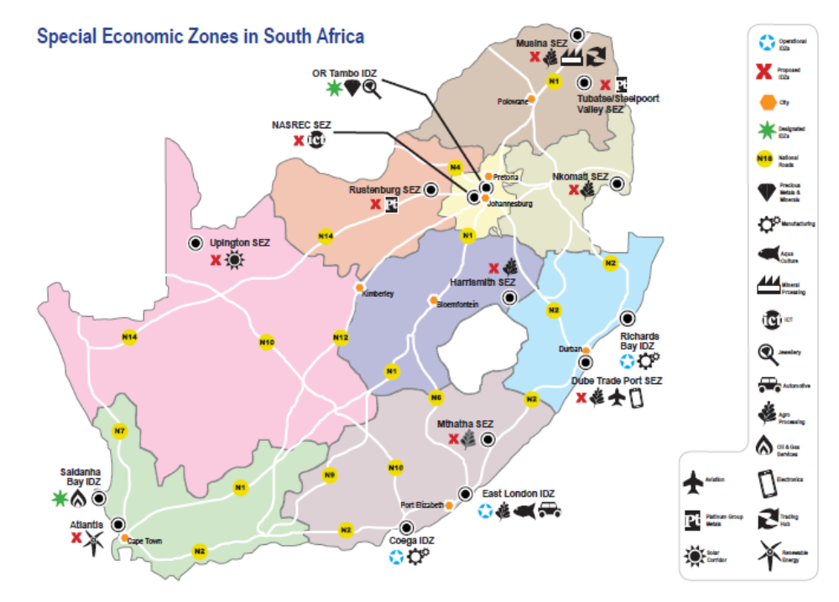
NB: only 4 are operational at the moment
Geographic Spread of the Zones in SA

Slide 11
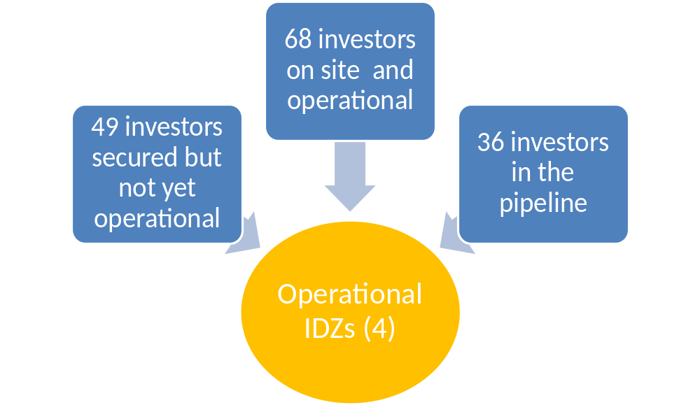
SEZ INVESTMENT PERFORMANCE OVERVIEW TO 2015
Number of Operational, Secured and Pipeline Investors in 4 operational IDZs

Slide 12
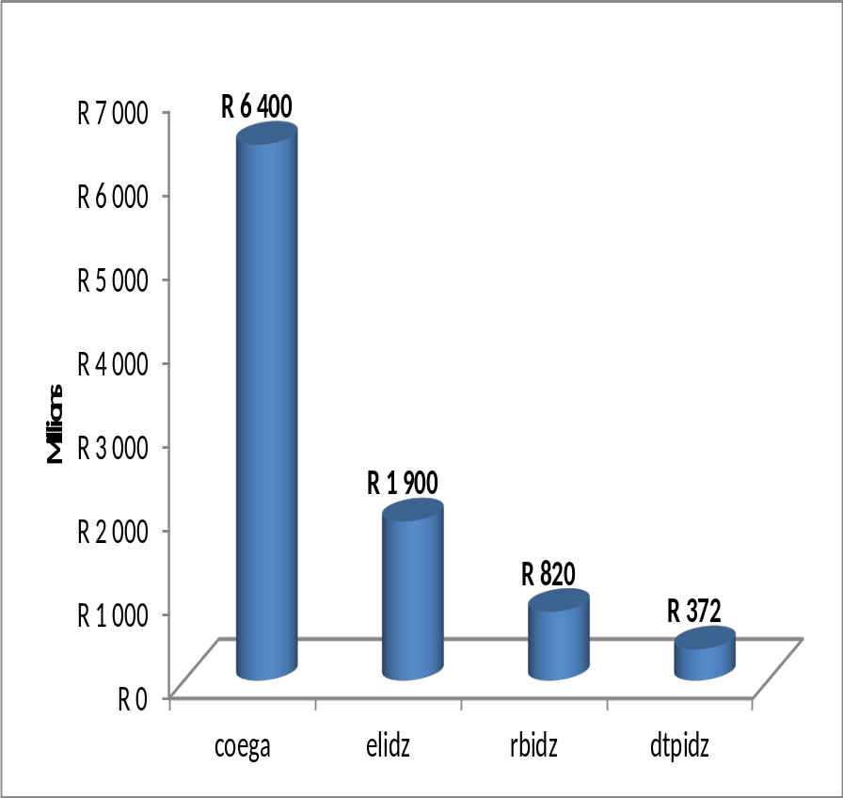
SEZ INVESTMENT PERFORMANCE OVERVIEW TO 2015
Number of Operational, Secured and Pipeline Investors in 4 operational IDZs
Value of Operational Investments in 4 operational IDZs

Slide 13
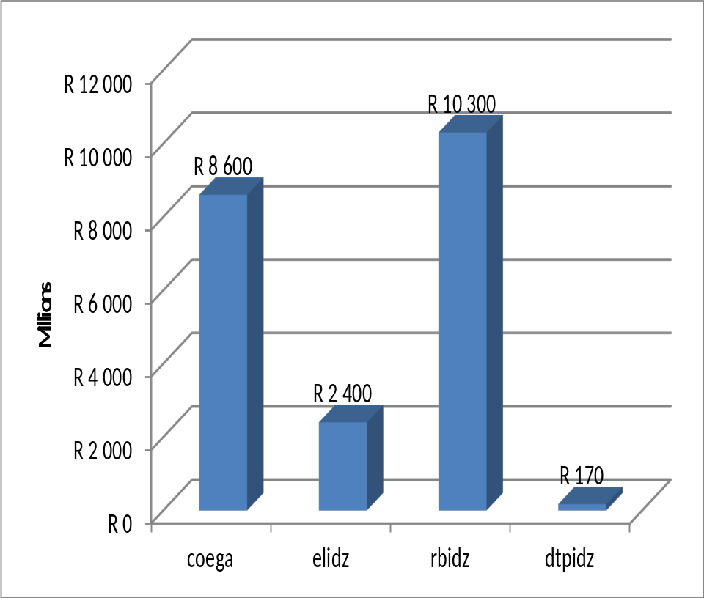
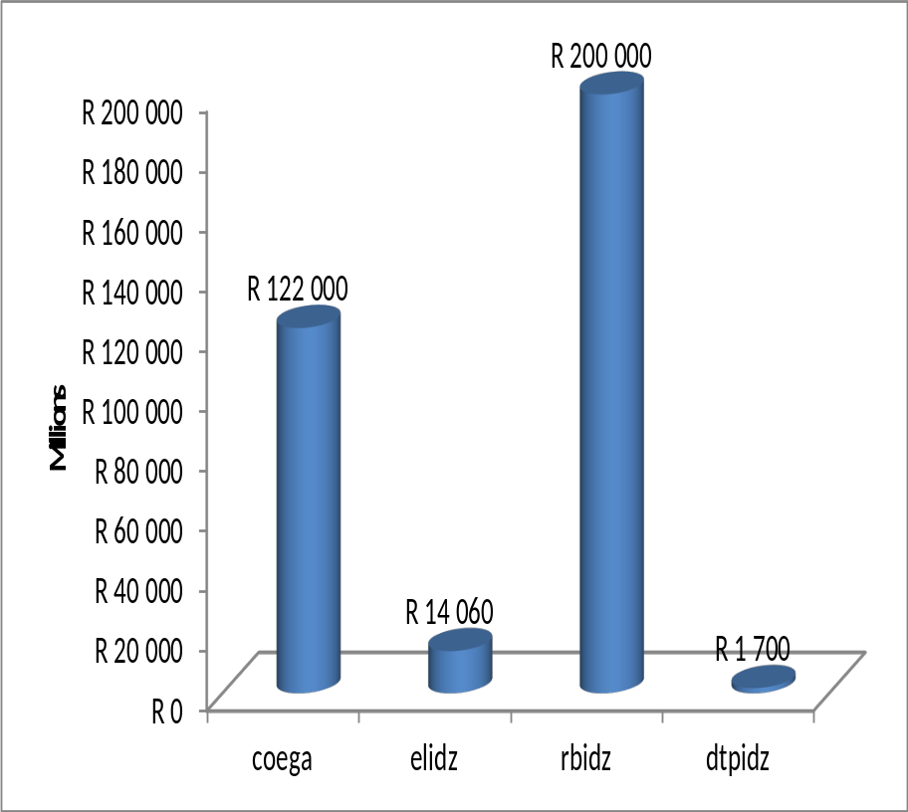
SEZ INVESTMENT PERFORMANCE OVERVIEW TO 2014
Value of Secured but not Operational Investments in 4 operational IDZs
Value of Pipeline Investments in 4 operational IDZs

Slide 14
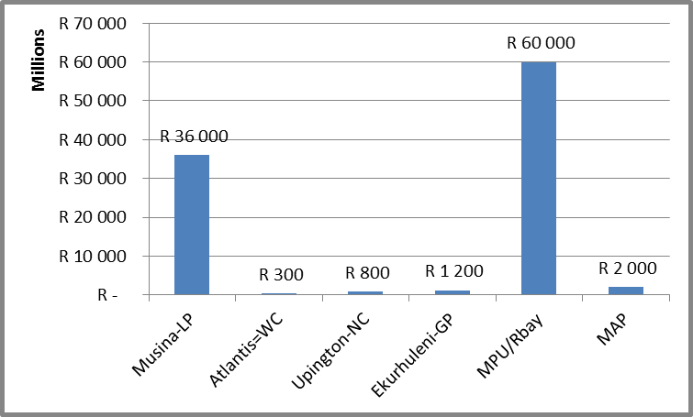
PROPOSED SEZs: INVESTMENT PIPELINE

Slide 15
APPROVED SEZ INCENTIVES IN SOUTH AFRICA
  15% corporate tax incentives for investors in SEZs
  Building Tax Allowance
  Employment Tax Incentive
  VAT exemption and Duty Free

Slide 16
LESSONS LEARNT AND IMPLICATIONS FOR AFRICA
Long term planning;
Competitive Incentive package and Industrial financing
Targeted sectors and value chains;
Beneficiation strategies for natural resource endowments;
Need for Investment in primary agriculture ;
Land availability: becoming a major challenge in may regions;
Strong leadership at national and subnational level for project preparations, packaging and implementation;
Joint planning, alignment and implementation of activities across and within spheres of government;

Slide 17
LESSONS LEARNT AND IMPLICATIONS FOR AFRICA
Strategic partnership with other countries;
Strengthening the country’s image
Regional Integration for value chain development across borders ;
Environmental Sustainability Management plans;
Shift towards renewable energy;
Skills development , particularly on Artisanship;
Continuous Investment Performance Monitoring & Evaluation;
One stop shop facilities for investment facilitation.
Public Private Partnerships (PPP)

Slide 18
THANK YOU
Maoto Molefane
Director: SEZ Policy and Planning
The Department of Trade and Industry
Government of South Africa
Email: mmolefane@thedti.gov.za

