Slide 1


Long-term Finance in Africa: The Next Frontier
David Ashiagbor
Making Finance Work for Africa (MFW4A)

Slide 2
Contents
About MFW4A
Africa’s Financing Needs
Who is Financing Africa?
Financing Trends in Africa
Looking Forward

Slide 3

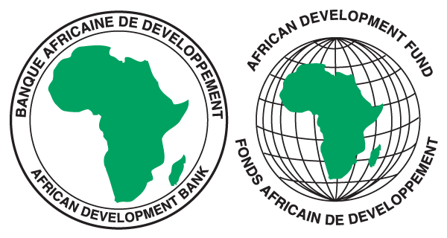





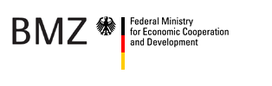
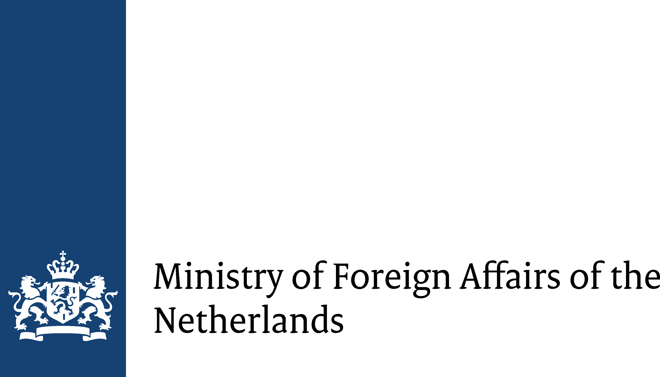





1. About MFW4A
The Making Finance Work for Africa (MFW4A) Partnership is a G8 initiative launched in October 2007. Its mission is the establishment of a common platform for the harmonization and facilitation of financial sector development and knowledge sharing in Africa.
The Partnership brings together donor partners, African governments, the private sector, and other financial sector stakeholders with the aim of unleashing the full potential of Africa's financial sector in order to drive private investments, economic growth, employment creation.
Development Partners
Strategic Priorities
Long Term Finance
Financial Inclusion
Financial Stability and Governance
Knowledge Management & Advocacy

Slide 4
2. Africa’s Financing Needs
Source: World Bank, WDI Database
Notes:
Considerable progress has been made during the past decade on short-term finance: Access to financial services has been enhanced through traditional sources– Banks, Short-term Government Securities, MFIs, Savings and Credit Cooperatives, and innovative solutions such as mobile money providers
Less Progress in Developing Long-term Finance: the graph shows the depth of capital markets in Sub-Saharan Africa (excluding South Africa) falls far short of other developing regions

Slide 5
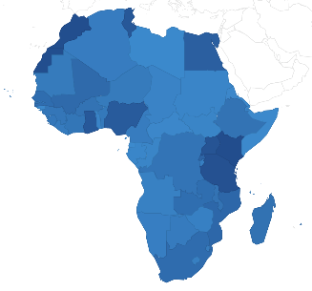
2. Africa’s Financing Needs - Infrastructure
Key facts
Africa’s infrastructure financing needs estimated at $US95 billion
More than 30 African countries are now experiencing power shortages
Africa invests only 4% of its collective GDP in infrastructure, compared with China’s 14%
Transportation costs increase the prices of African goods by 75%

Slide 6
2. Africa’s Financing Needs - Infrastructure
Infrastructure and Investment Gap
Power
Bridging Infrastructure Investment Gaps
Transport
Boost Africa’s Growth Rates by 2%
ICT
Water & Sanitation
Notes:
The annual financing needs of Africa’s infrastructure is 95 billion, of which only 45 billion is being invested by each year by African governments, DFIs, and the private sector.

Slide 7
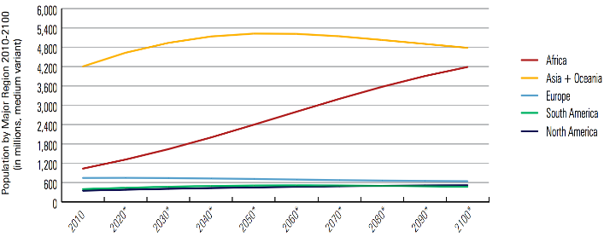
2. Africa’s Financing Needs - Housing
Projected Population by Major Region 2010-2100 (In Millions)
Source: UN Habitat – The State of African Cities 2014
Housing Deficit
Nigeria: Current housing shortage estimated at 17 million
Ghana: 170,000 housing units are required every year for the next 10 years
Kenya: 2 million housing units are required every year for the next 10 years
Notes:
Projections indicate that by 2030, Africa’s population will exceed that of Europe, South and North America combined (UN Habitat).
Africa’s population, 1.1 billion people today is expected to reach 2.4 billion by 2050 (AfDB Development Effectiveness Report 2014)
Rapid urbanization: African urban dwellers is projected to rise from 11.3% in 2010 to 20.2 % by 2050.
Over a quarter of the fastest growing cities in the world are in Africa.

Slide 8
2. Africa’s Financing Needs - MSMEs
Source: IFC, 2013, Closing the Credit Gap for Formal and Informal Micro, Small and Medium Enterprises
Notes:
The financing gap for formal SMEs (excluding informal business) amounts to 70-90 bn per year in Sub-Saharan Africa. Although it is not the largest in absolute terms, it is the largest in relative terms
Sub-Saharan Africa and Middle East and North Africa would require more than 300 percent increase in outstanding SME credit to close this financing gap, compared to 7 to 8 percent in East Asia and the Pacific, and 25 and 30 percent in Europe and Central Asia

Slide 9
3. Who is Financing Africa?
Source: ICA 2013 Report on Infrastructure Trends in Africa
Notes:
China dominates investment in Africa’s infrastructure, accounting for more than Europe and North America together and exceeding the combined efforts of all the multilateral and regional development banks.
Some of the issues in financing infrastructure:
- Issue of transparency/information: challenges remains in obtaining accurate information about projects,
Despite strong engagement from key players like China and the US, there remains a big gap between what’s committed and what’s received
Paradox of Africa’s infrastructure finance: plenty of private-sector interest but few project-preparation skills to turn prospects into bankable state.
Key bottlenecks: lack of early stage funding to pay for relevant studies ro to engage public agencies.
Early-stage project preparation is the point of highest risk in the project development cycle, as it is the farthest point from the project’s actual implementation.
The time lag between investments and returns leads to a problem of asymmetric information and heightens the investment risk.

Slide 10
4. Financing Trends in Africa – Sovereign Bonds
Source: Dealogic
Notes:
Before 2006, only South Africa had issued sovereign bond in sub-Saharan Africa. Since then, 12 other countries have issued a total of $15 billion in sovereign bonds compared to South Africa’s $10.9 billion.

Slide 11
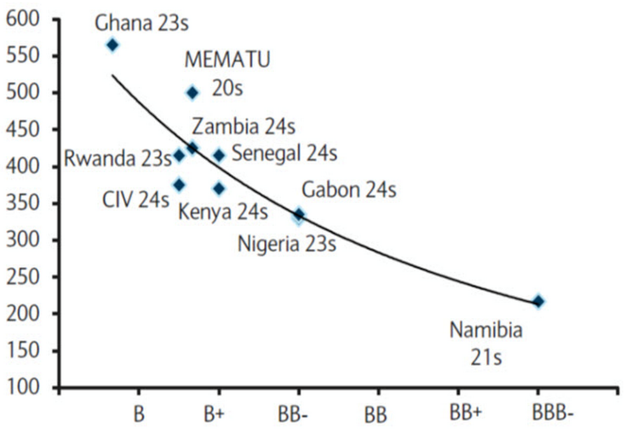
4. Financing Trends in Africa – Sovereign Bonds
Sovereign Spreads and Credit Ratings
(In Basis Points as of October 2014)
Source: Bloomberg L.P. and Barclays Research
Notes:
Fiscal sustainability is proving to be challenging for many countries.
Lower oil prices will have a negative impact on oil-exporting countries as their surpluses are sharply reduced. Also, sub-Saharan countries will face a higher cost of borrowing.
Ghana for example, has been able to retain international sovereign bond market access but at the cost of increased cost of borrowing. Ghana is now paying the highest spread among sub-Saharan issuers.

Slide 12
4. Financing Trends in Africa – Domestic Sources
Source: Kenya Financial Stability Report, 2013
Notes:
Insurance and pension penetration remain low in most African countries.
In Kenya, insurance accounts for 8.9% and pension assets account for 17%

Slide 13
4. Financing Trends in Africa – Pension Funds
Notes:
SA accounts for the largest share of pension assets in Africa with penetration rate of 70% of GDP in the last 10 years

Slide 14
4. Financing Trends in Africa – Pension Funds

Slide 15
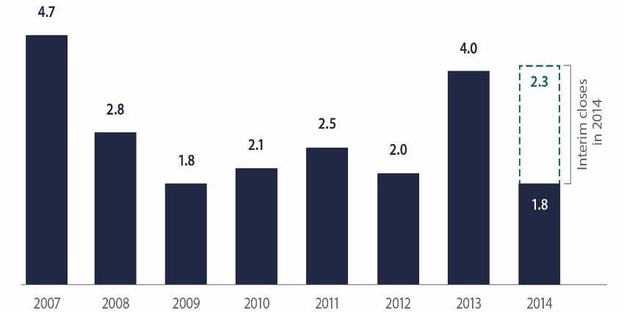
4. Financing Trends in Africa – Private Equity
Africa PE fundraising reached $4.1bn in 2014
Total Value of Africa Private Equity Funds by Year of Final Close, in US$bn
Source: AVCA

Slide 16
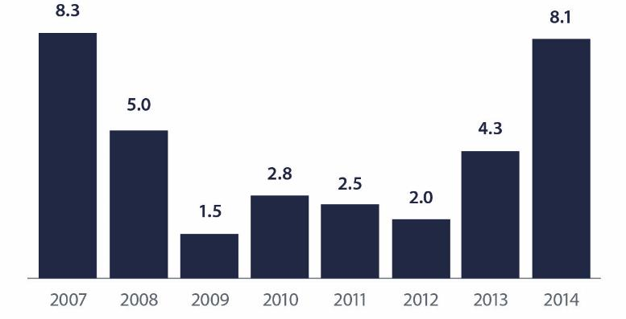
4. Financing Trends in Africa – Private Equity
Africa PE deal value reached a 7-year high in 2014
Total Value of Private Equity Deals in Africa, by year US$bn
Source: AVCA

Slide 17
Key Messages
Improved financial inclusion in Africa has been critical for financial sector development, and provides the basis for addressing the continents challenges in providing adequate long term finance;
Africa’s development agenda is crowded with opportunities waiting for appropriate financing and risk management strategies. Addressing these needs requires innovative financing solutions and appropriate regulation
There is a need for financial sector development policies at the national level, encompassing all areas of finance, including inclusion, financial literacy and capital markets development in order to support long-term finance in Africa.

Slide 18
Thank you !
David Ashiagbor
d.ashiagbor@afdb.org
Making Finance Work for Africa (MFW4A)
www.mfw4a.org

