Slide 1
Third African Road Safety Conference
Midterm review of the African Road Safety Action Plan
Road Safety Data Management Panel
9 July 2014
Addis Ababa, Ethiopia
Kidist Bartolomeos WHO/Geneva Department of NCDs Management, Disability and Violence & Injury Prevention

Slide 2
Rationale
Rationale
Globally there is a big gap in the quality and coverage of data that countries collect and report on RTI.
Under-reporting of RTI deaths remains a big problem in many countries.
Lack of harmonization on definition of RTI indicators limits the use of existing national data.
Reliable data on deaths and non-fatal injuries are needed by countries in order to:
  assess the scope of their road traffic injury problem
  target responses
  Monitor and evaluate the effectiveness of intervention measures

Slide 3
Road traffic injury data system
Core Data Elements
RTI DATA
SYSTEM
PERSON
RELATED
CRASH
RELATED
VEHICLE
RELATED
ROADWAY
RELATED
TRAFFIC
RELATED
COST
RELATED

Slide 4
Road traffic injury data improvement is a shared responsibility
RTI DATA
SYSTEM
STATISTICS
OFFICE
Vital
registration
TRAFFIC
POLICE
crash data
HEALTH
Injury/Person
data
TRANSPORT
Vehicle data
PLANNING &
FINANCE
Investment
data
OTHERS??

Slide 5
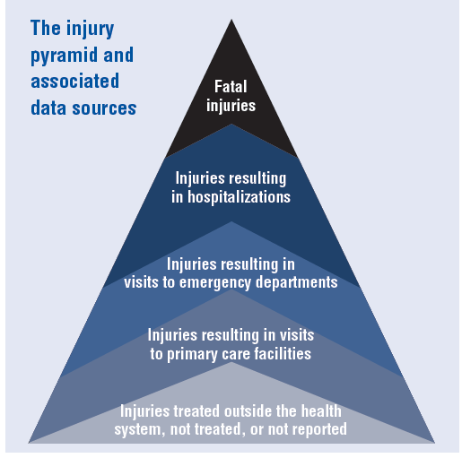

Slide 6
Health data sources
 |  | No injury | Mild | Moderate | Severe | Fatal
Community based | Household (community) survey
Health facility-based | Health clinic records
 | Doctors (GPs) records
 | Emergency departments registers
 | Ward admission registers
 | ICU admission registers
Mortuary-based | Forensic investigation
Vital registration | Death certificate/Vital Statistics

Slide 7
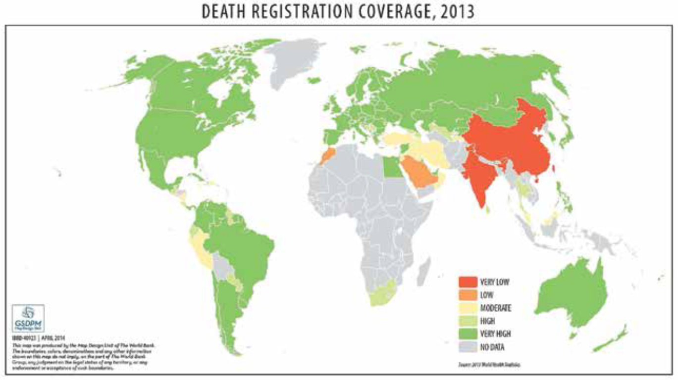
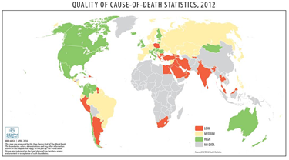
Only 40% Member States can report usable data on deaths and cause of death

Slide 8
Rationale
Several issues with available VR data
  Approx 120 (62%) countries reporting VR data to WHO
  Quality of data varies
  Death registration data containing usable information on the cause of death missing in 82 (43%) of countries
  Problem is worse in SSA
    Estimates show 17% of global injury deaths occur in Africa.
Data usually collected in ad hoc manner
  Often manual: limits access, data analysis and dissemination
  Misclassification to "other" categories
  Collected data under-utilized
  Limited access because of bureaucracy, ownership claims and limited knowledge of use

Slide 9
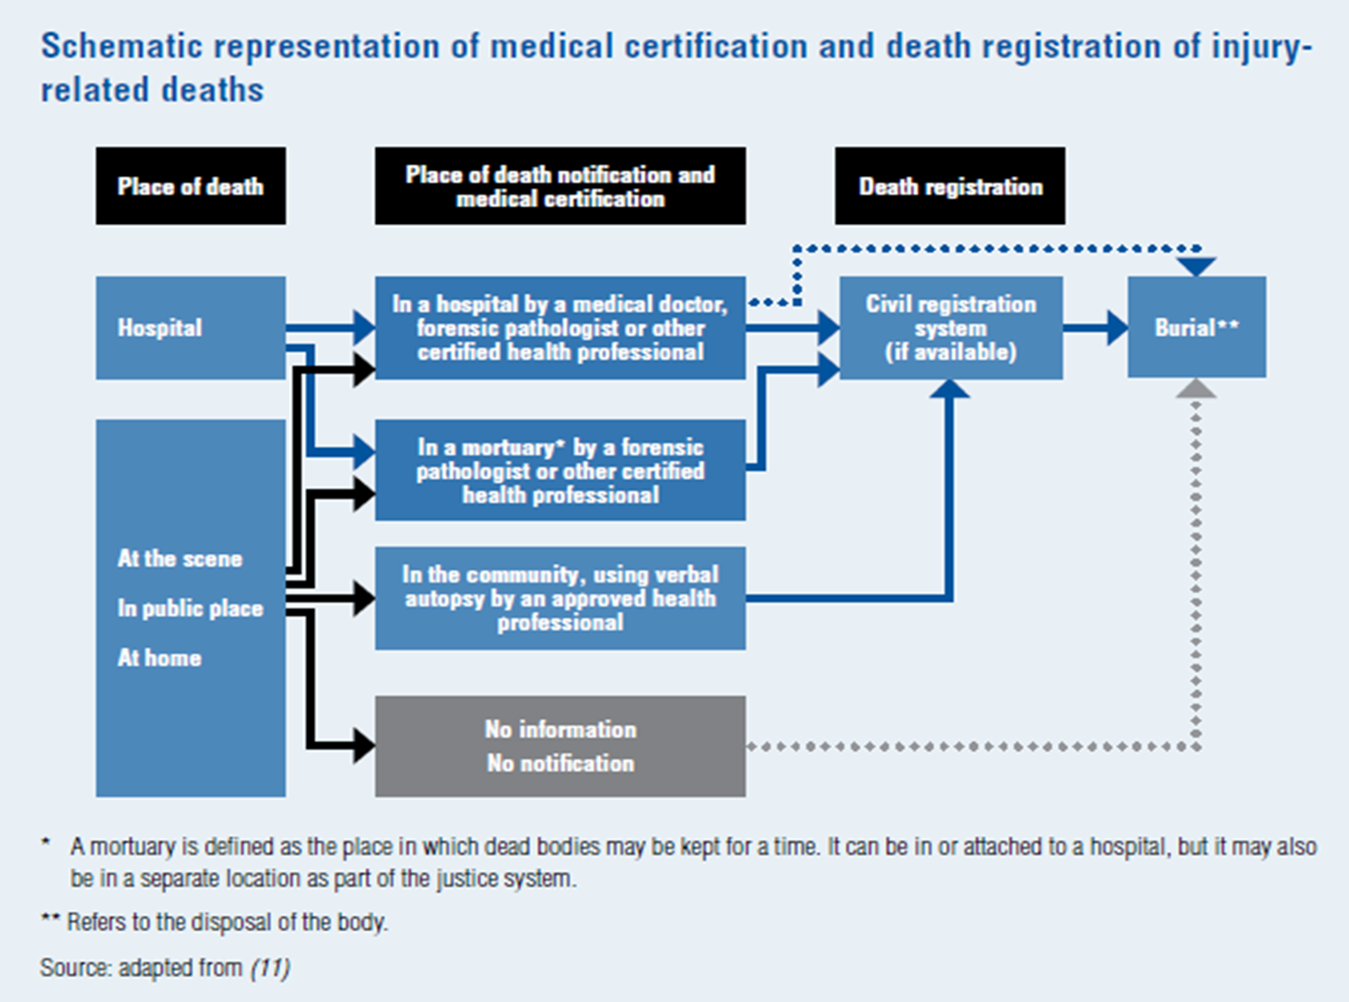

Slide 10
Rationale
The need for autopsy on deaths due to external causes makes mortuary a potential source of fatal injury data
A feasible, standardized data system could:
  Be effective in documenting deaths from external causes
  Reduce differences in classification, coding and variable aggregation
  Possible data source for testing on other diseases

Slide 11
Mortuary-based surveillance
National CRVS improvement plan
Communities/DSS sites
Verbal Autopsy-Injury module
Mortuaries
(Fatal injury surveillance system implementation)

Slide 12
Other regional activities
Strengthenging data systems:
  Bloomberg Global Road Safety Program (2010-2012)
Capacity Development
  CDC Field Epidemiology Program

