Slide 1
Plenary Session:
Road User Behaviour
Pillar 4
Addis Ababa
9 July 2015
Kathleen Elsig & Brett Bivans
IARD

Slide 2
Decade of Action 2011-2020
African Action Plan – Pillar 4
CORE ACTION AREAS
Educated General Public (Road Users) (11 activities)
Use of Helmets (3 activities)
Seat Belts (7 activities)
Alcohol (4 activities)
Mobile Phone Use (1 activity)
Speeding (2 activities)

Slide 3
Decade of Action 2011-2020
African Action Plan – Pillar 4
OBSERVATIONS
FUNDAMENTAL road safety objectives
Decades of evidence from all geographies and all socio-economic level shows that addressing these factors contributes to reductions in incidence and severity of crashes.
Action Plan highlights activities in the follow domains
  Legislation
  Targeted Campaigns / Education
  Enforcement
  Monitoring
Measurable targets
Roles for different actors / stakeholders
Opportunities for establishing regional Standards of Practice, Focal Points, Shared Programs

Slide 4
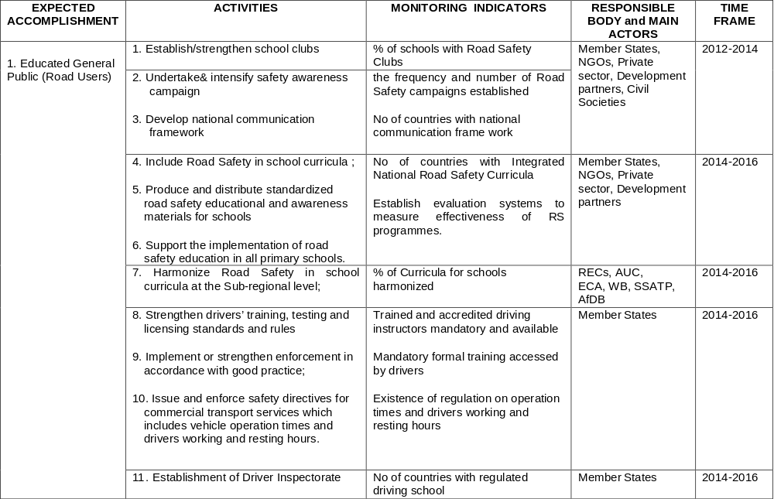

Slide 5
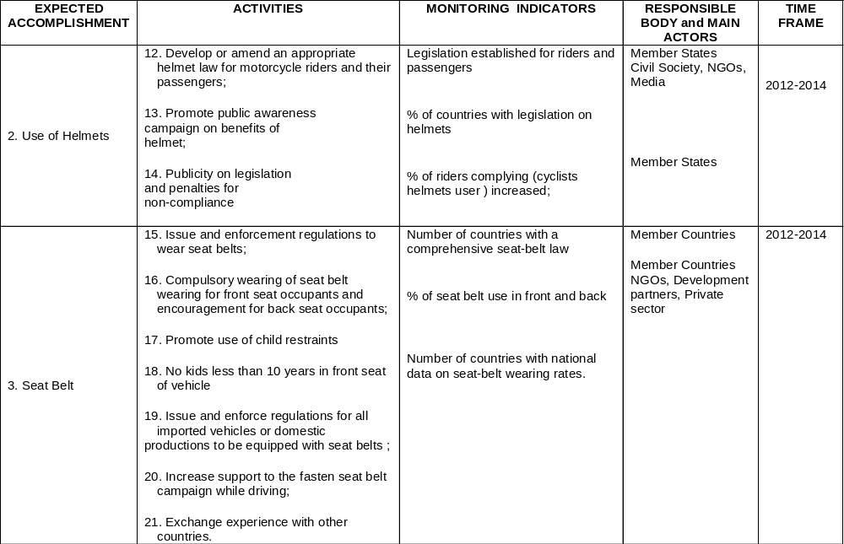

Slide 6
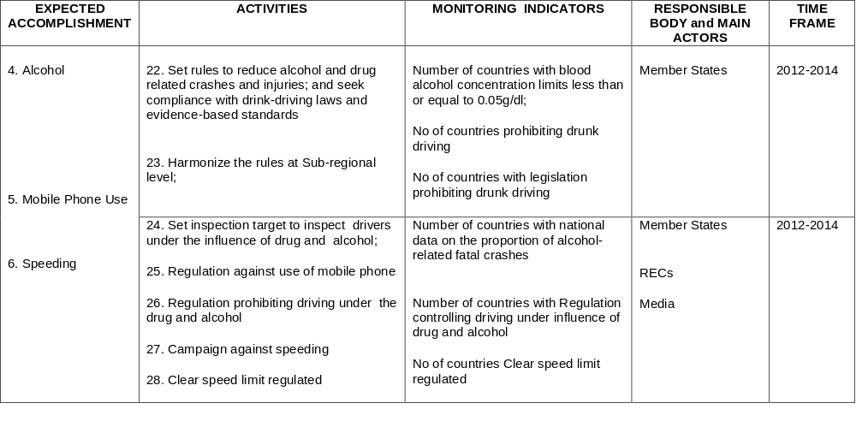

Slide 7
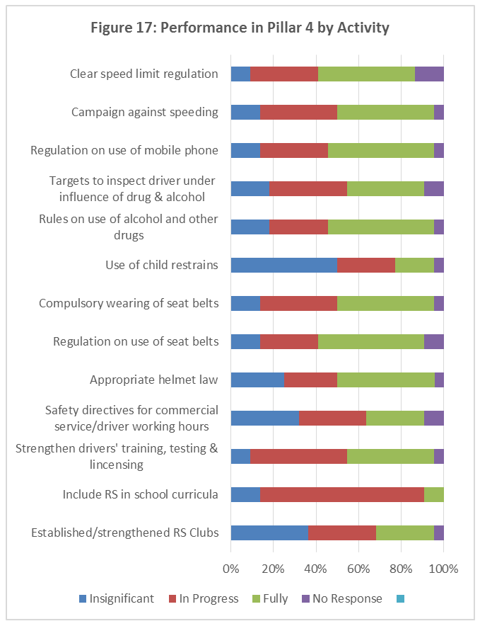
Pillar 4

Slide 8
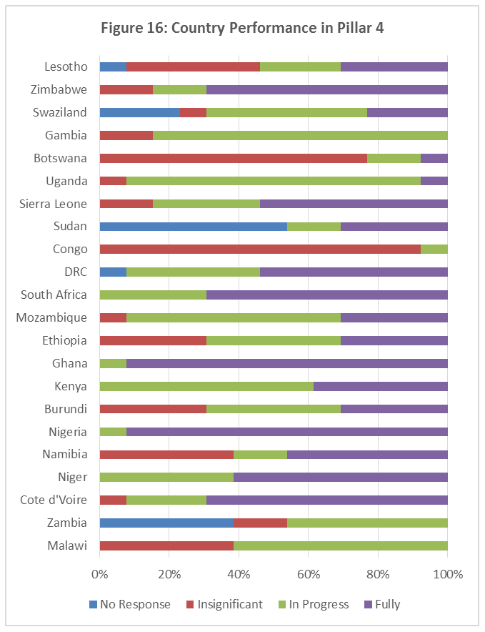
Pillar 4

Slide 9
Ranking of Countries by Performance

Slide 10


Slide 11
VOLET 4 : SECURITE DES USAGERS DE LA ROUTE
Education et formation à la sécurité routière
Formation d’un noyau de 550 enseignants pour la formation des formateurs ;
Élaboration de 5000 Guides du formateur à la sécurité routière ;
Élaboration de 10000 exemplaires de Code de la route simplifié qui s’appuie sur les images réelles du Mali ;
Institution de l’enseignement de la sécurité routière dans les cycles primaire et secondaire des écoles publiques et privées ainsi que des centres d’alphabétisation en cours.

Slide 12
PORT DE CASQUE DE PROTECTION
Législation sur le port de casque et sur l’homologation existe déjà ;
Vaste campagne de sensibilisation sur le port de casque depuis le lancement de la décennie, le 11 mai 2011 avec distribution gratuite des casques ;
Élaboration d’un plan d’actions de promotion du port de casque avec trois volets : une phase sensibilisation (60 diffusions de spot, 125 diffusions de microprogrammes, 15 diffusions d’info plus, 20 diffusions de sketch et 1 film), une phase contrôle et sensibilisation et une phase contrôle/sanction.
Une communication verbale a été adoptée en Conseil des Ministres du 19 septembre 2012 pour le port obligatoire de casque à partir du 01 octobre 2012 ;
Étude d’évaluation est en cours de réalisation.

Slide 13
PORT DE LA CEINTURE DE SECURITE
Relecture du Code de la route pour prendre en charge le port de la ceinture de sécurité en milieu urbain ;
Vaste campagne de sensibilisation lancée depuis novembre 2014 ;
Des contrôles sont effectués sur les routes en interurbain par la Gendarmerie et des amendes sont infligées aux contrevenants.

Slide 14
ALCOOL ET STUPEFIANTS AU VOLANT
Législation en la matière existe déjà ;
En plus des alcootests à usage unique, l’ANASER a acquis 11 éthylotests complets de dernière génération au profit de la Police et de la Gendarmerie (embouts à usage unique) ;
Des contrôles d’alcolemie sont couramment effectués notamment à l’occasion des fêtes et évènements majeurs avec une accentuation lors des fêtes de fin d’année ;
D’autres éthylotests sont en cours d’acquisition.

Slide 15
VITESSE EXCESSIVE
La relecture du Code de la route a infligé des amendes plus lourdes==➔ vitesse excessive première cause des accidents graves ;
Quatre radars disponibles pour les contrôles/sanctions effectués par la Gendarmerie sur les routes interurbaines et internationales ;
Acquisition en cours de radars plus performants pour accentuer le contrôle/sanction.

Slide 16
TELEPHONE AU VOLANT
Législation en la matière existe déjà ;
Vaste campagne de sensibilisation lancée depuis novembre 2011 et se poursuit cette année ;
Des contrôles/sanctions sont couramment effectués sur tous les tronçons routiers en milieu urbain et des amendes sont infligées aux contrevenants.

Slide 17

BY
Boboye Oyeyemi mfr,mni
Corps Marshal and Chief Executive,
Federal Road Safety Corps, Nigeria
July, 2015
1

Slide 18
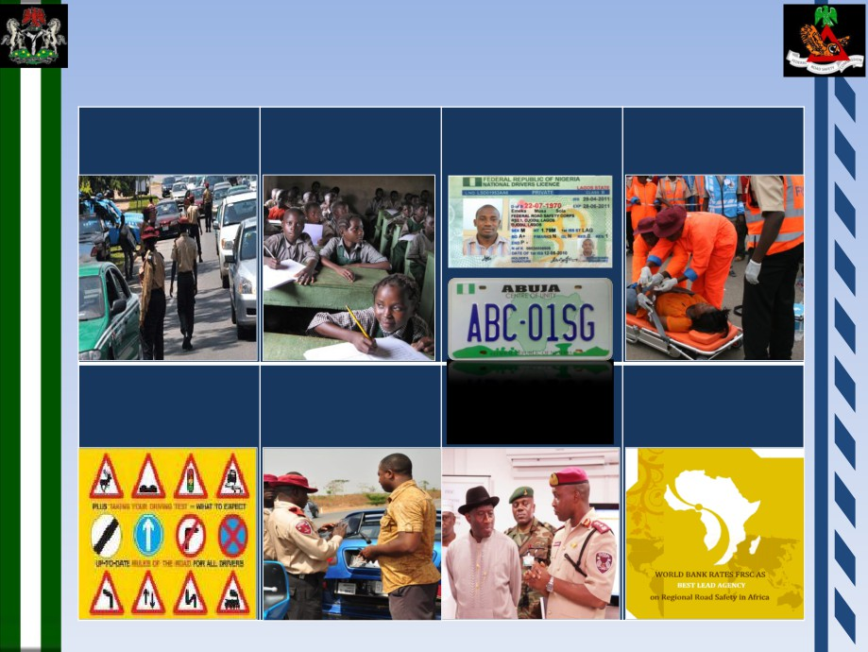
Functions of Federal Road Safety Corps, Nigeria
Targeted
General Road
Production of
Emergency Services
Enforcement
Safety Education
Drivers Licenses
and Number Plates
Highway Codes and
Recommend Works
Overall direction,
Regulations
and Devices
coordination and
management
4

Slide 19
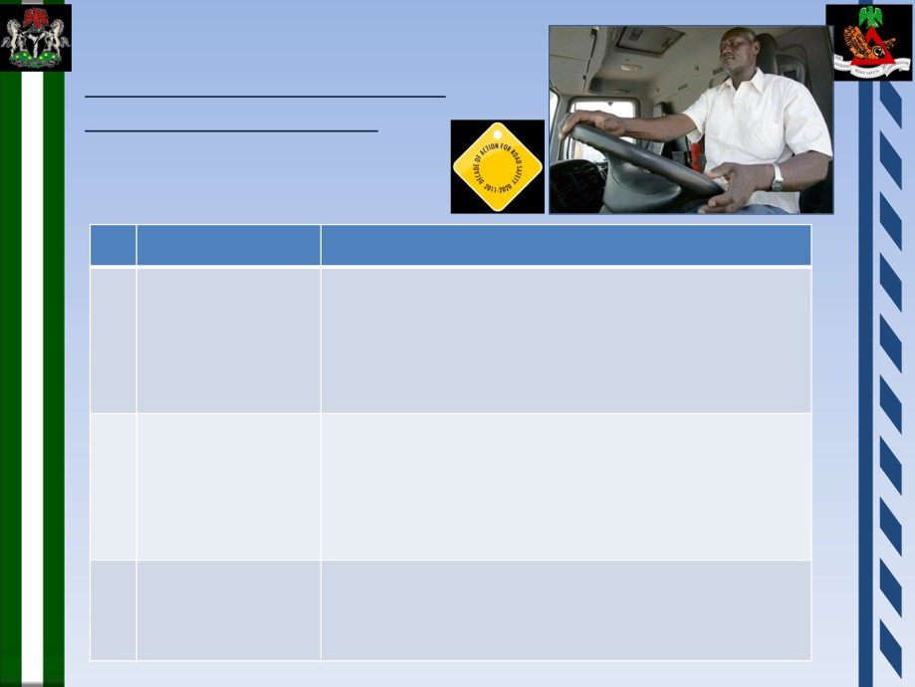
Significant Initiatives of the Corps
UN Decade of Action for Road Safety
Pillar Four: Road User Behavior
Item
FRSC Initiative
1.
Education
a. Development of Road Safety curriculum in
schools
b. Rebranding of Road Safety Club in schools
c. Rebranding of Special Marshals to include:
• Celebrity Special Marshals
• Diaspora Special Marshals
2.
Compliance to
a. Compliance to speed limits, overloading and
laws
pedestrian laws
b. Compliance to drink-driving laws
c. Enforcement of usage of Safety helmets by
cyclists
d. Increase pedestrian protection regulation
3.
Drivers’ license
a. Promote establishment of graduated Driver
Licensing systems for novice drivers
b. Set and regulate standards for driving schools
c. Upgrade of the National Drivers License
10

Slide 20

Build on international and regional efforts and momentum
UN Third Global
Road Safety Week
Africa Action Plan 2011-2020 adopted Luanda 2012
  Laws
  Management and planning
  BAC blood alcohol limits
  Enforcement
  Behavioral measures
Notes:
Road Safety Action Plan 2011-2020 adopted by Heads of States Luanda 2012
African Road Safety Charter gives priority to road safety management & quantified plans
International Development Corridors & Regional Cooperation set
2 countries with no drunk driving laws
Togo, Sao Tome & Principe
9 countries with blood alcohol concentration of 0.5g/L driving limits
Benin, Democratic Republic of Congo, Equatorial Guinea, Liberia, Mali, Mauritius, Nigeria, South Africa, Swaziland
2 countries with alcohol limits for high risks, young, novice & professional drivers
Ghana & Malawi
8 countries estimate number of road deaths caused by alcohol impairment
from 4.7% in Swaziland to 60% in Equatorial Guinea
63% of pedestrian deaths in alcohol related crashes in SA
1 country has an effective enforcement of drink-driving law
Botswana
3 PIDA International Corridors with major road safety initiative,
CEMAC, West Africa Road Safety Organization WARSO, Eastern Corridor SAFEWAY RIGHTWAY,

Slide 21
Identify the Issue to be Addressed
Alcohol Policies & Implementation
Behavior Influences
Infrastructure Improvement
Community / Stakeholders Practice
Societal Norms
Notes:
Carry out a pilot project to ensure effectiveness of actions
Set 3 measurable objectives 3 clear Targets performance indicators with community participation & in consultation with stakeholders
Infrastructure Improvement
*visibility & crossing (ex South Africa Arrive Alive & publicity materials by DOT

Slide 22
Alcohol Policies & Implementation
Initiative | How it works
Alcohol Sales Licensing | Helps reduce drink driving by limiting where alcohol is sold
Legal Drinking Age | Limits the number who can drink alcohol. If drinking age is older than driving age, reduces number of drink drivers
Legal BAC Law | Major drink driving control, often 0.05BAC. Allows objective enforcement of law. Key in deterring drink driving.
Alcohol Purchase Hours | Often part of liquor licensing. Can help reduce drink driving by limiting consumption
Licensed Premises Regulations | Establishes standards for how premises serve alcohol. Not a bit effect on drink driving.
Alcohol Content Regulations | Can help reduce impairment of drivers without reducing the volume of intake. Often a marketing initiative.

Slide 23
Behavior Influences
Initiative | How it works
Random stopping & preliminary breath testing | Deters effectively by creating threat of being caught. Testing allows large numbers of drivers to be assessed.
Vehicle alcohol interlocks | Prevents drink driver from starting vehicle. Used effectively for repeat offenders.
Targeted enforcement | Preliminary testing at known alcohol consumption locations. Useful for hot spots of excessive consumption
Graduated penalties | Reflects greater crash risk with higher BAC. Helps deterrence Allows tough penalties for serious offences.
Mandatory penalties | Often linked to graduated penalties. Prevents judicial discretion. Deters by creating certainty of being penalized.
License loss penalty | Major penalty concern for many drivers. Effective deterrent. threat. May increase unlicensed driving if used for minor cases.
Road Engineering | Improved visibility & protection for drivers & other road users – roadside barriers, centre line barriers - reduce all injury levels.

Slide 24
Societal Norms
Initiative | How it works
Behavior change | Linked to random stopping enforcement; adds to deterrence to reduce drink driving. Campaigns focusing on consequences of drink driving also help. Offence consequences content: Life-style changes & inconvenience. Loss of license. Crash consequences content: Injury to loved ones & Injury to self is not a strong motivator
Agenda setting | Campaigns for general community to advise about consequences of drink driving. Conducive to community views in support of tough initiatives
Information | Campaigns providing specific information if research shows drivers are ignorant. First step to deterrence. Link to enforcement.
School Curriculum | School programs regarding alcohol, impairment and drink driving. Useful for long-term changes in attitudes of future drivers & riders.
Public Relations | Press releases, articles, radio talk back, spokesperson press conferences, all add to community understanding. Costs less than advertising.
Campaign promotions | Events, posters, stickers and other materials often displayed at drinking venues. Valuable additions but not central if budget is tight.

Slide 25
Community / Stakeholders Practice
Initiative | How it works
Private Sector Led Safe Fleet Management | Companies commit to abide to self defined standards often higher than national law & demand same from subcontractors.
On Premise Education | Provides Information in context. Better if linked to enforcement. Targets group knowledge gaps (e.g penalty, new law)
Designated Drivers | Formalizes a safe arrangement depending on volunteer
Alternative Transport | Provides an alternative safe transportation. Is limited by the access constraints and cost
BAC Education | Builds Knowledge about BAC need, implementation and enforcement
Recidivist | Provides a procedure for informing and motivating recidivist drivers as part of penalty and recovery of driving rights

Slide 26
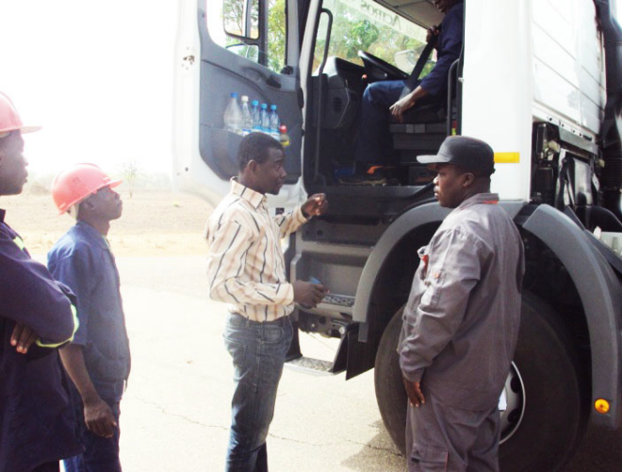
RECOMMENDATIONS
Design 3-5 year Work Program
design with your partners
set a baseline status (use your situational assessment)
specify your objectives and targets and performance indicators
clarify roles and responsibilities (who does what)
secure funding
include high priority measures
include monitoring, evaluation, communications to stakeholders about performance and progress
SWRW 2014
Notes:
Significant safety interventions need external investment. External loan funding has been successful in Nigeria and Argentina
African Heads of State have signed off on the allocation of 10% of road development expenditure and 5% of road maintenance expenditure on road safety. The level of funding or road safety needs to be challenged.
Positive engagement with the road agency when it exists: entities may see safety as a threat to current budgets.
Propose planning budget with three to five-year safety investment plan set out with the assistance and input from the road agency, and key partners.
Private corporations willing to support stronger responses at national level & Public Private partnership models
NGOs & civil society make major in –kind contributions
Make sure the delivery agency adopts Performance Indicators
E.g Police for random stopping numbers
Hospitals for blood alcohol readings
Education for curriculum hours on drink driving issue
Alcohol industry for ‘responsible server’ details

Slide 27

RECOMMENDATIONS
Implement Yearly Plan
Monitor performance
Flag risks
Make adjustments
Communicate progress and performance
Source SWRW 2014
Notes:
Plan With participation of Stakeholders
Define the programme in terms of one year plan
Monitor activities
Evaluate impact using performance indicators

