Slide 1
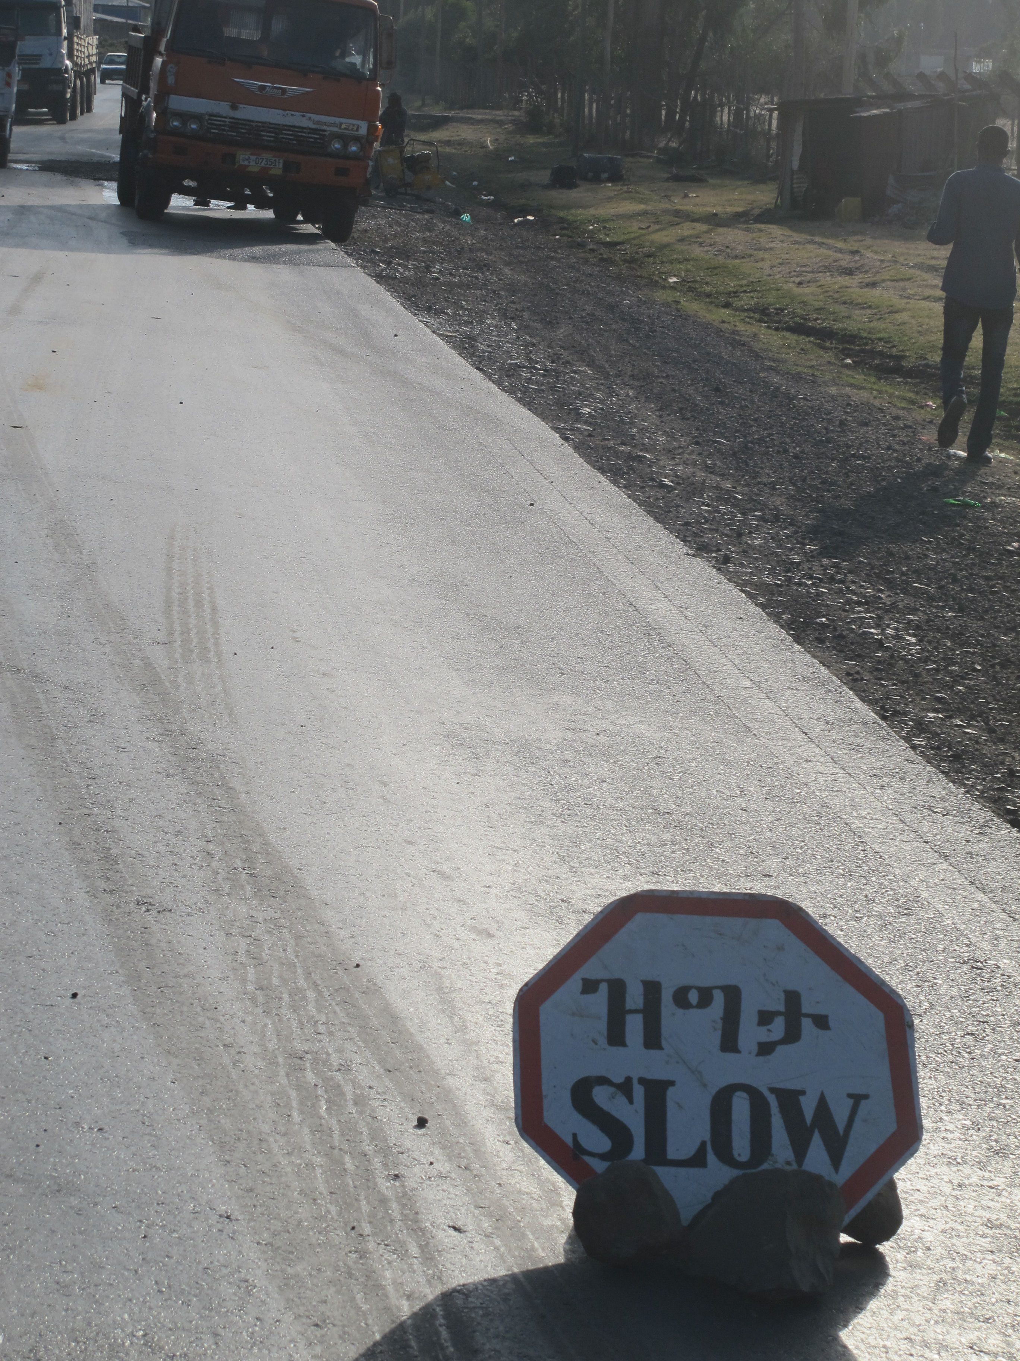
United Nations road safety conventions and the Decade of Action for Road Safety
Robert Nowak, Transport Division
Addis Ababa, 9 July 2015
Notes:
This is a sample Title Slide with Picture ideal for including a dark picture with a brief title and subtitle.

Slide 2
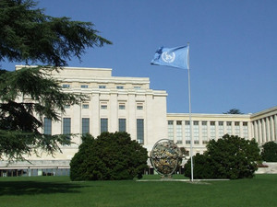
Policy dialogue
Negotiation of international legal instruments
Development of standards and norms
Exchange of best practices
Technical cooperation

Slide 3
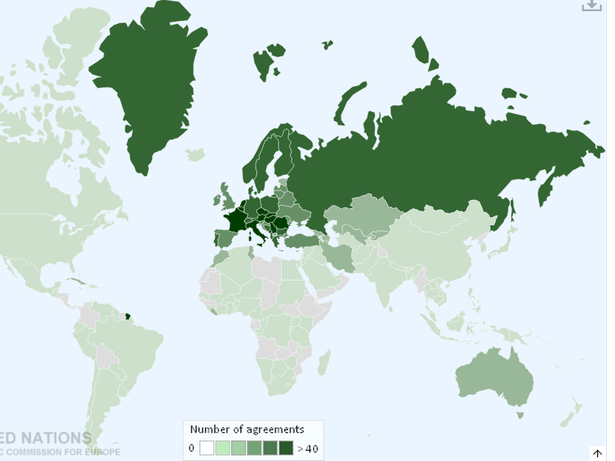
UNECE Transport Division
International platform
Regulatory
Analytical
Technical assistance
where global solutions are shaped for you

Slide 4
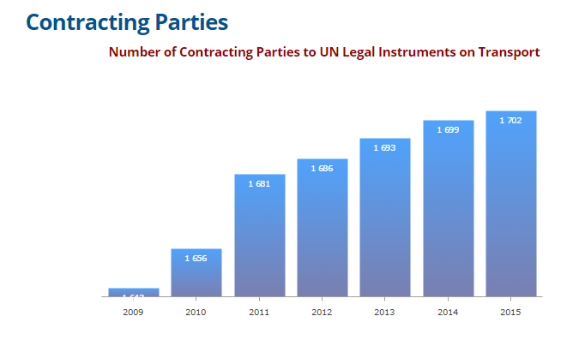

Slide 5

Global conventions
Traffic rules
Signs and signals
Dangerous goods
Construction and periodic inspection of vehicles
Driving times and rest periods for professional drivers
Road infrastructure
Regional Conventions
UNECE – a 360 degree approach to road safety

Slide 6
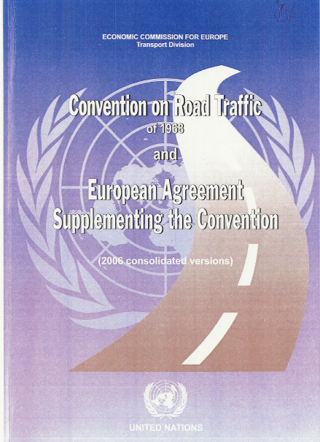

1968 Conventions on Road Traffic and on Road Signs and Signals
Admission to international traffic,
A set of agreed road traffic rules
Mutual recognition of vehicle certificates, driving permits
Reference for national legislation
Facilitates international traffic, trade, tourism
Enhances road safety
A system of agreed sign classification
Over 250 reference signs
Facilitates international road traffic, trade, tourism
Enhances road safety

Slide 7
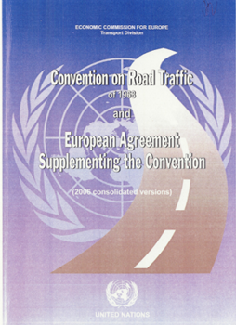
To facilitate international road traffic and to
increase road safety through the adoption of uniform traffic rules

Slide 8
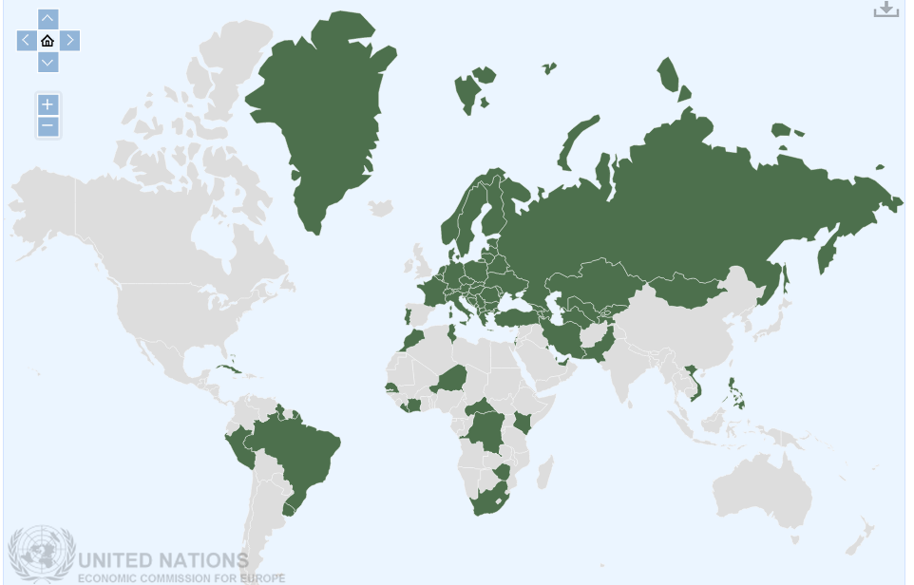
73 Contracting Parties

Slide 9
International uniformity of road signs, signals and symbols and of road markings is necessary in order to facilitate international road traffic and to increase road safety

Slide 10
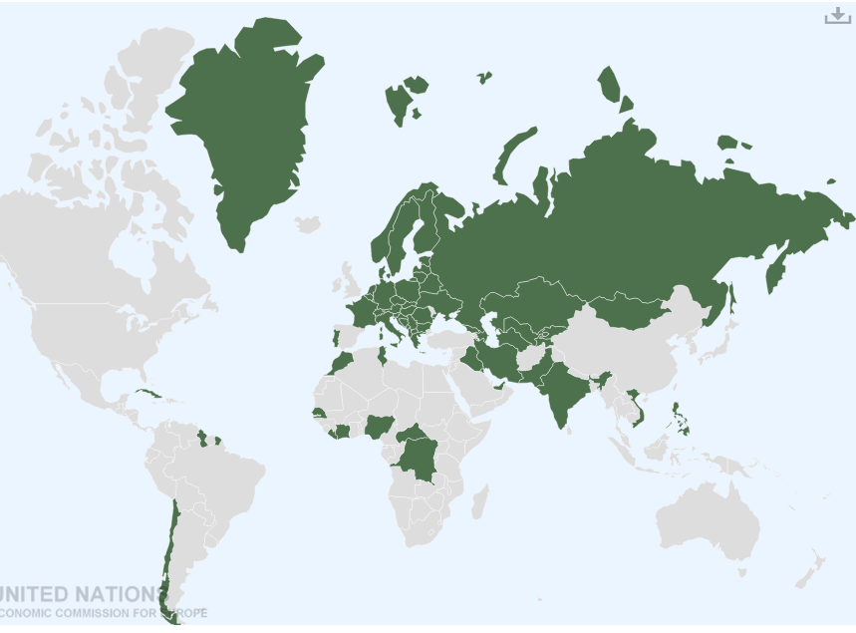
63 Contracting Parties

Slide 11




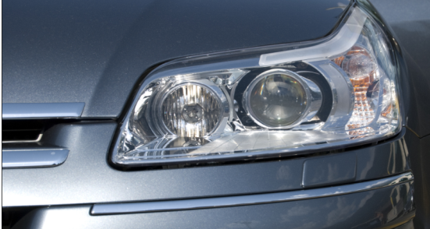
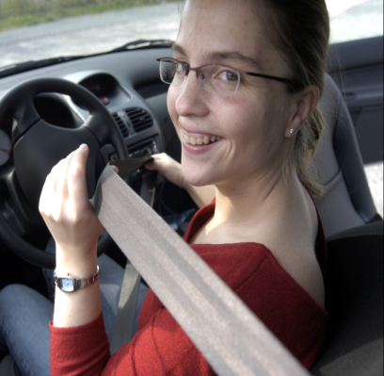
Vehicle Regulations

Slide 12
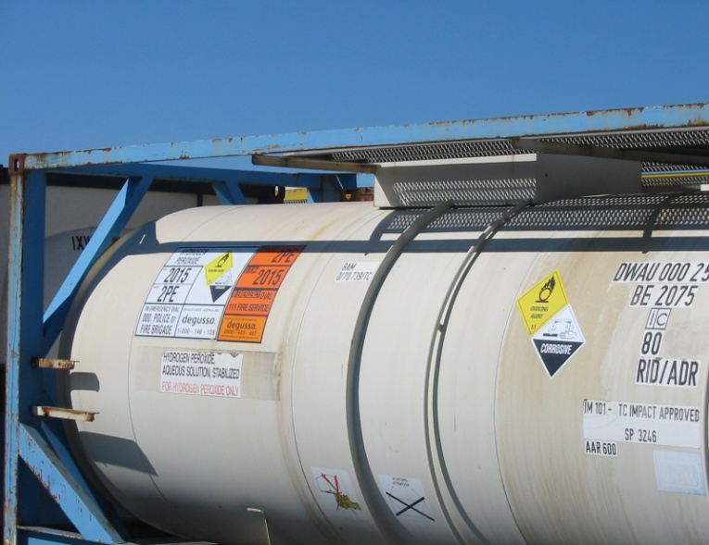
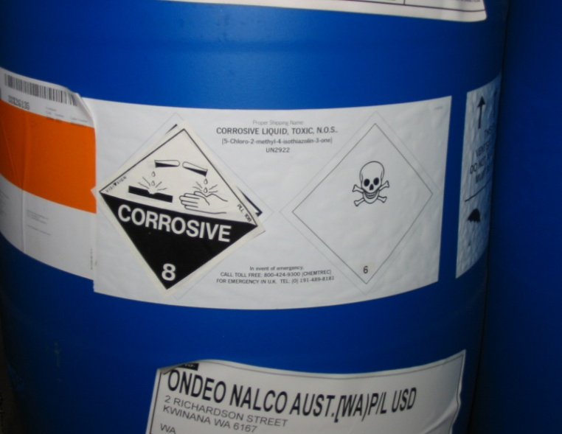

Transport of Dangerous Goods
Uniform requirements to ensure a high level of safety of international transport of dangerous goods

Slide 13
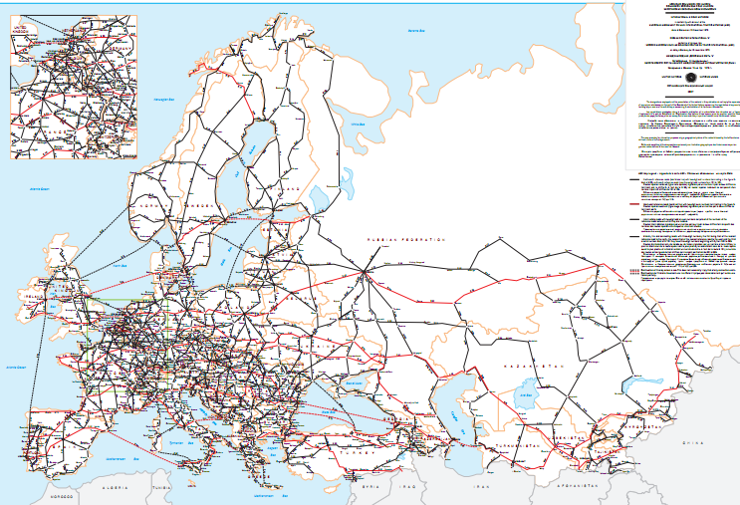
Infrastructure: road, railway, inland waterways, combined transport
Legal frameworks for the development of coherent international
infrastructure networks

Slide 14
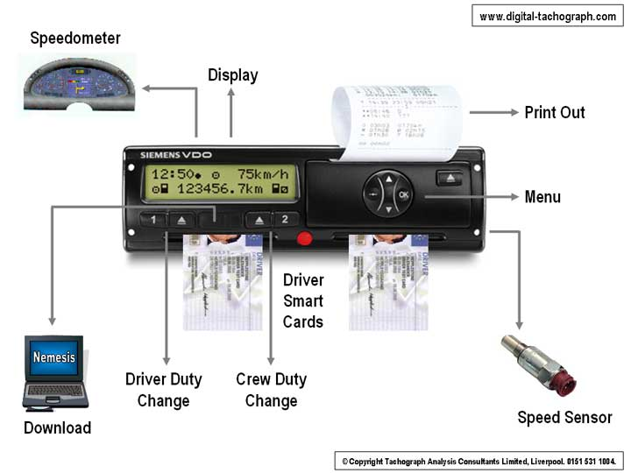
Hours and Conditions of Work (AETR)
Uniform working conditions for drivers of commercial vehicles engaged in international road transport
Digital Tachograph

Slide 15


Slide 16
PLAN OF ACTION
Goal: to halt or reverse the increasing trend in road traffic fatalities
1
2
3
4
5
Activities
Activities
Activities
Activities
Activities
Activities
National activities
International activities
Funding
Monitoring
Five pillars
Five activities
1
2
3
4
5
6
Indicators
Indicators
Indicators
Indicators
Indicators
Indicators
Five pillars
International

Slide 17
PLAN OF ACTION
Goal: to halt or reverse the increasing trend in road traffic fatalities
1
2
3
4
5
Activities
Activities
Activities
Activities
Activities
Activities
National activities
International activities
Funding
Monitoring
Five pillars
Five activities
1
2
3
4
5
6
Indicators
Indicators
Indicators
Indicators
Indicators
Indicators
Five pillars
International

Slide 18
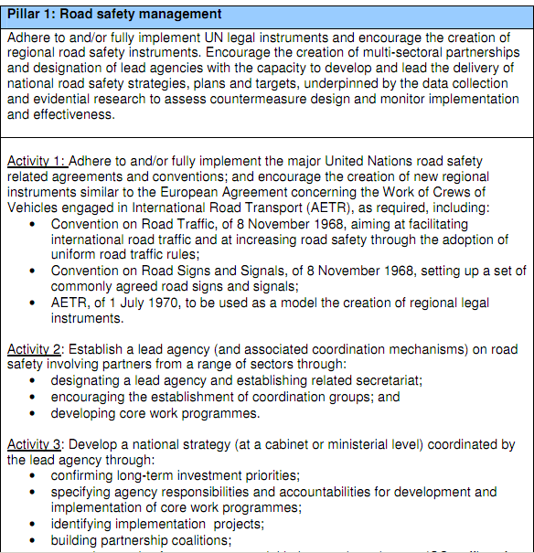
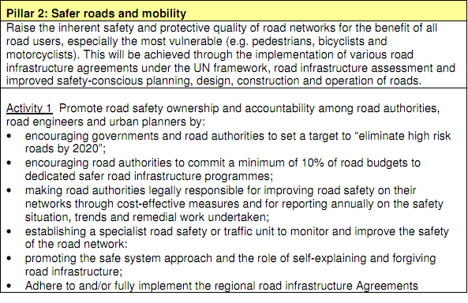
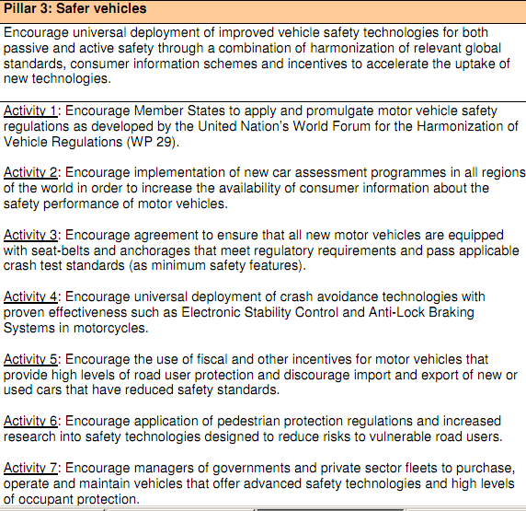
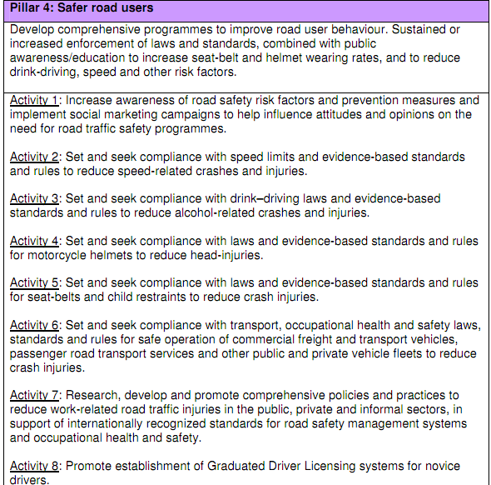
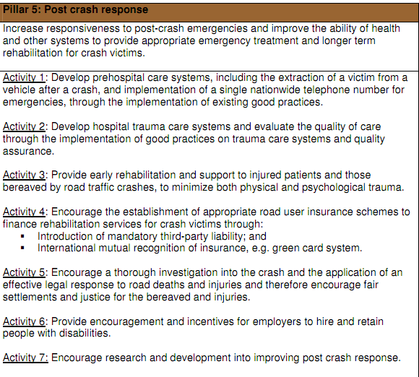
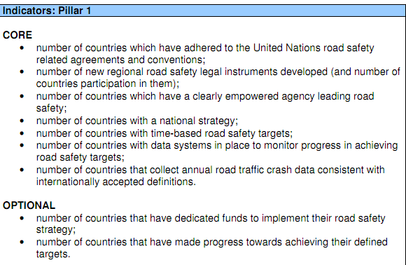

Slide 19


Slide 25
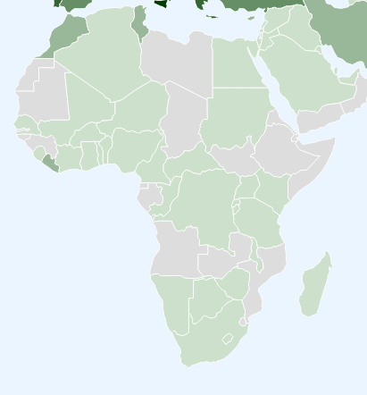
Contracting Parties in Africa
15
16
9
6
4
3
7
2
1
1
7
3
1
8
5
6
10
3
1
5
1
1
5
3
1
3
2
2
1
1
1
5

Slide 26
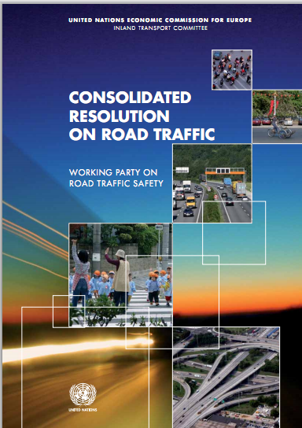

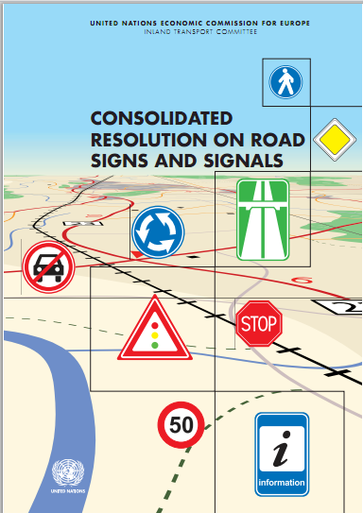

Consolidated resolutions
Sets of good or best practices
Non-binding

Slide 27
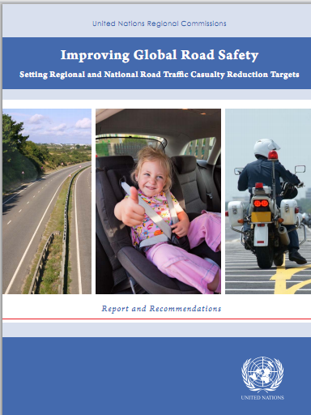
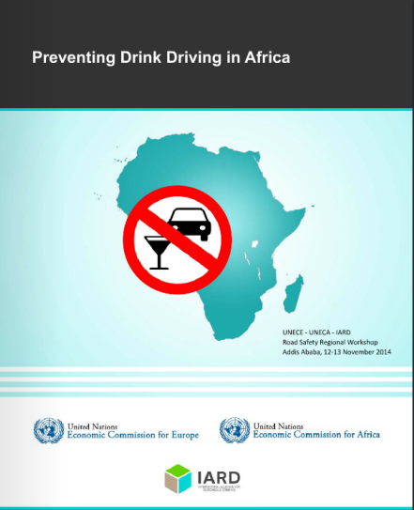
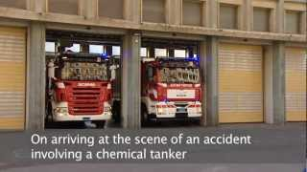
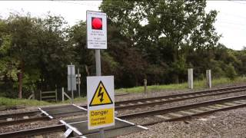

Slide 28
Road infrastructure
Road signs
Traffic rules
Enforcement

Slide 29
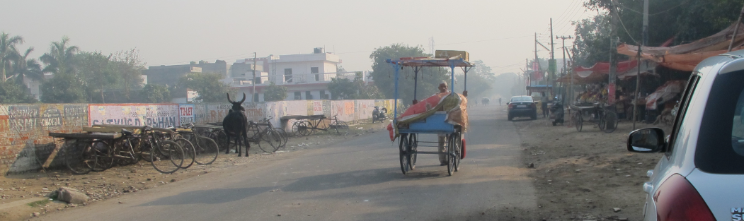
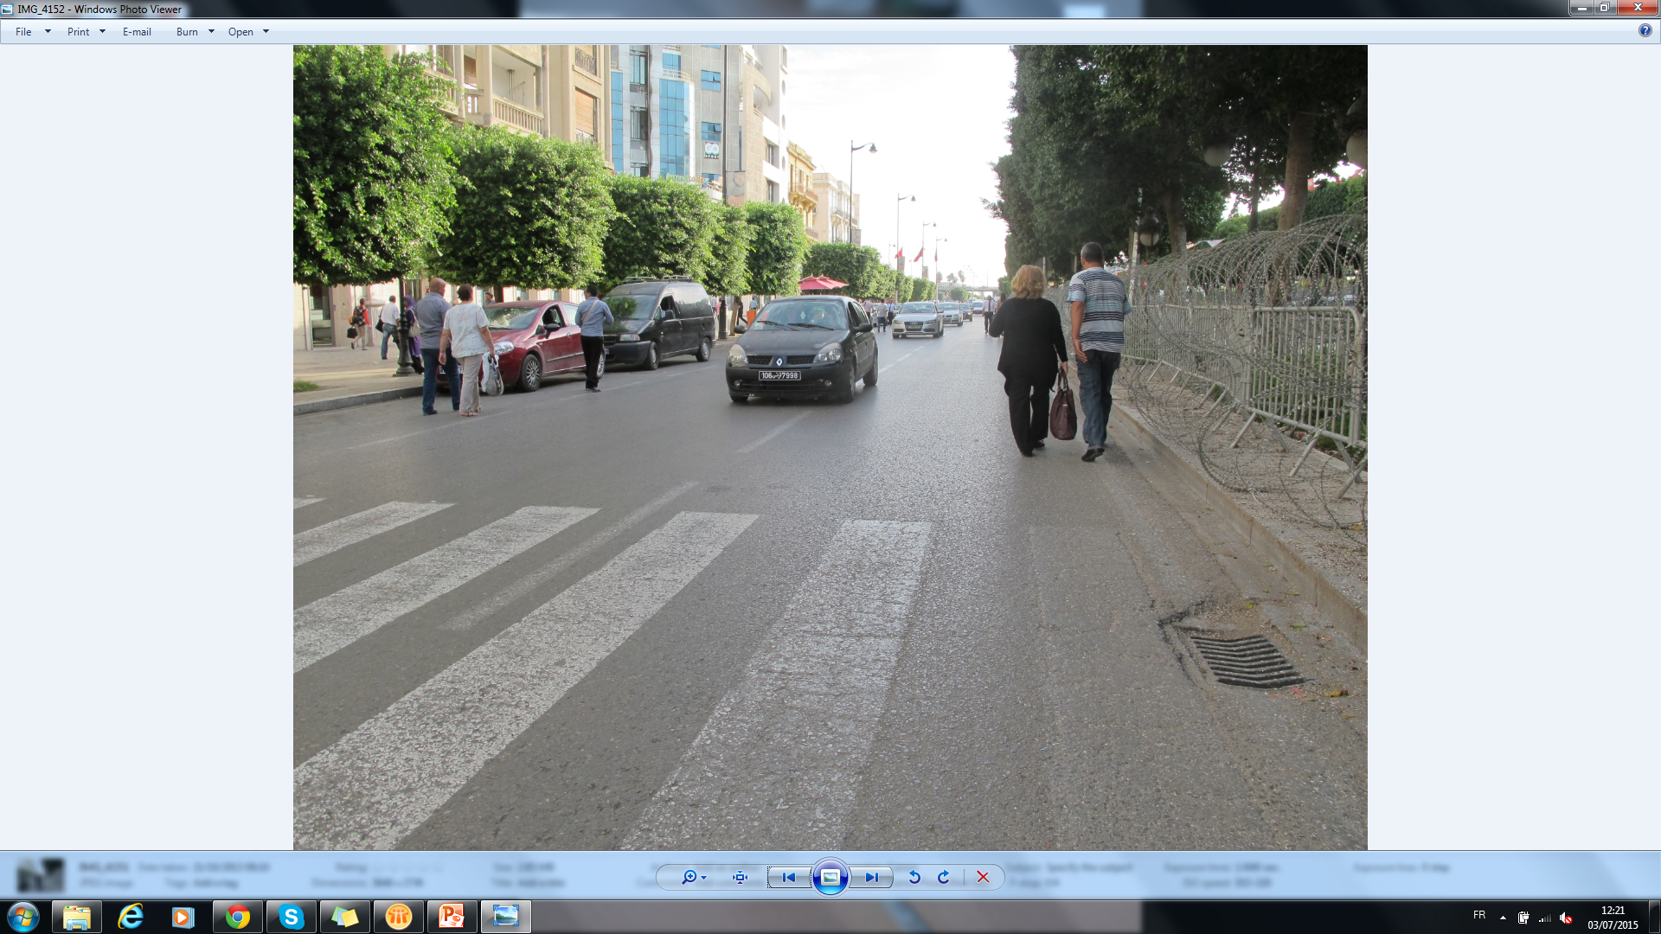
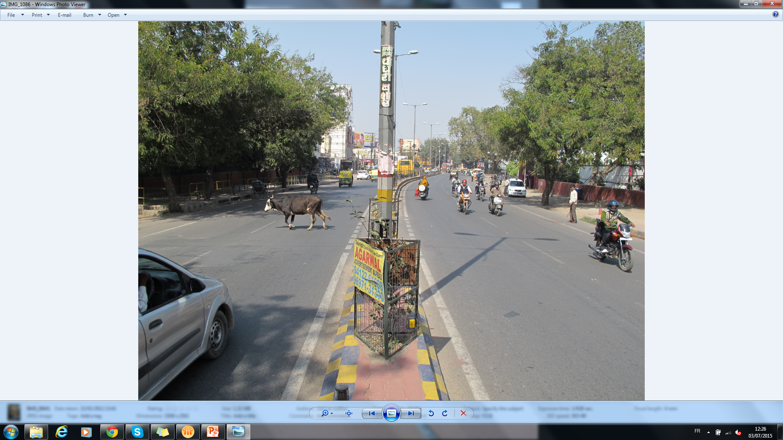
Road infrastructure

Slide 30
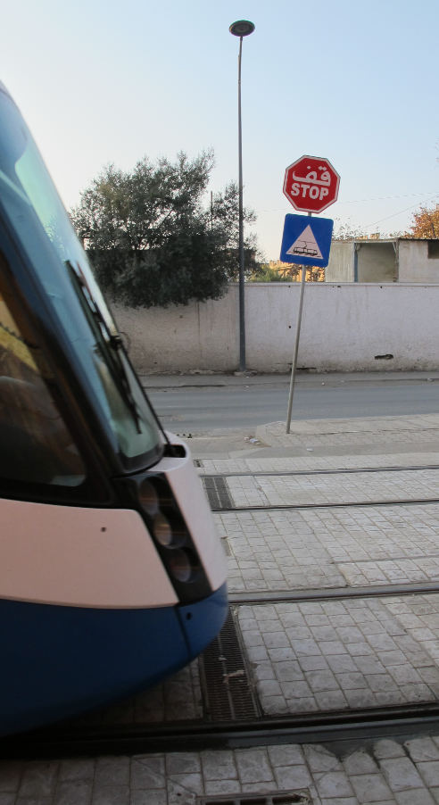
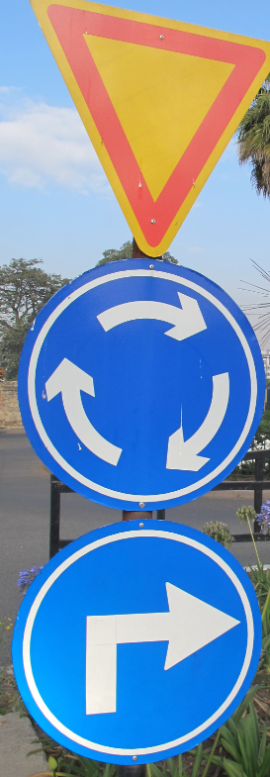
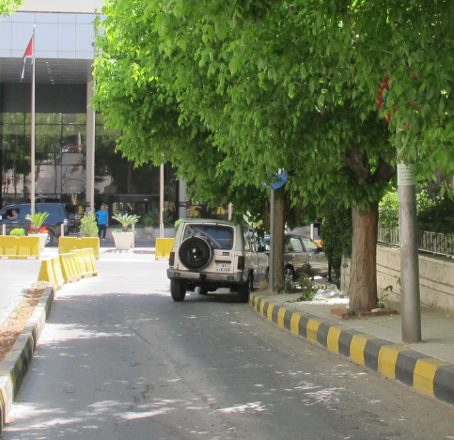
Road signs

Slide 31
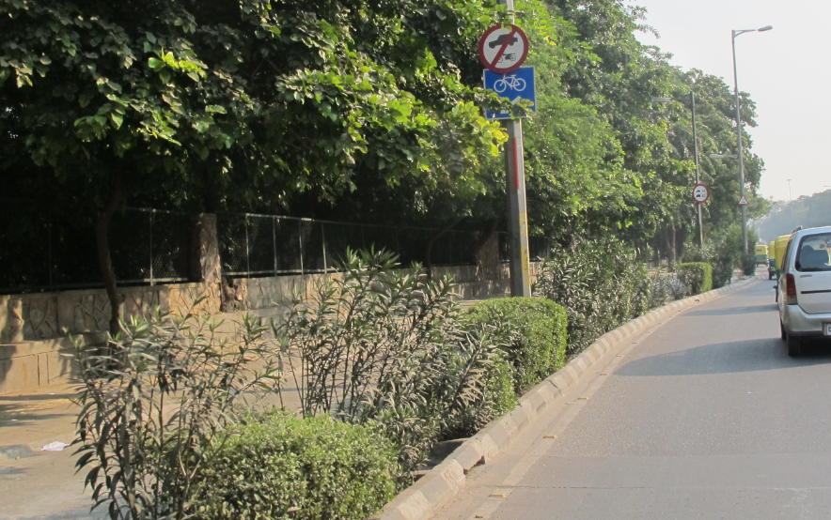
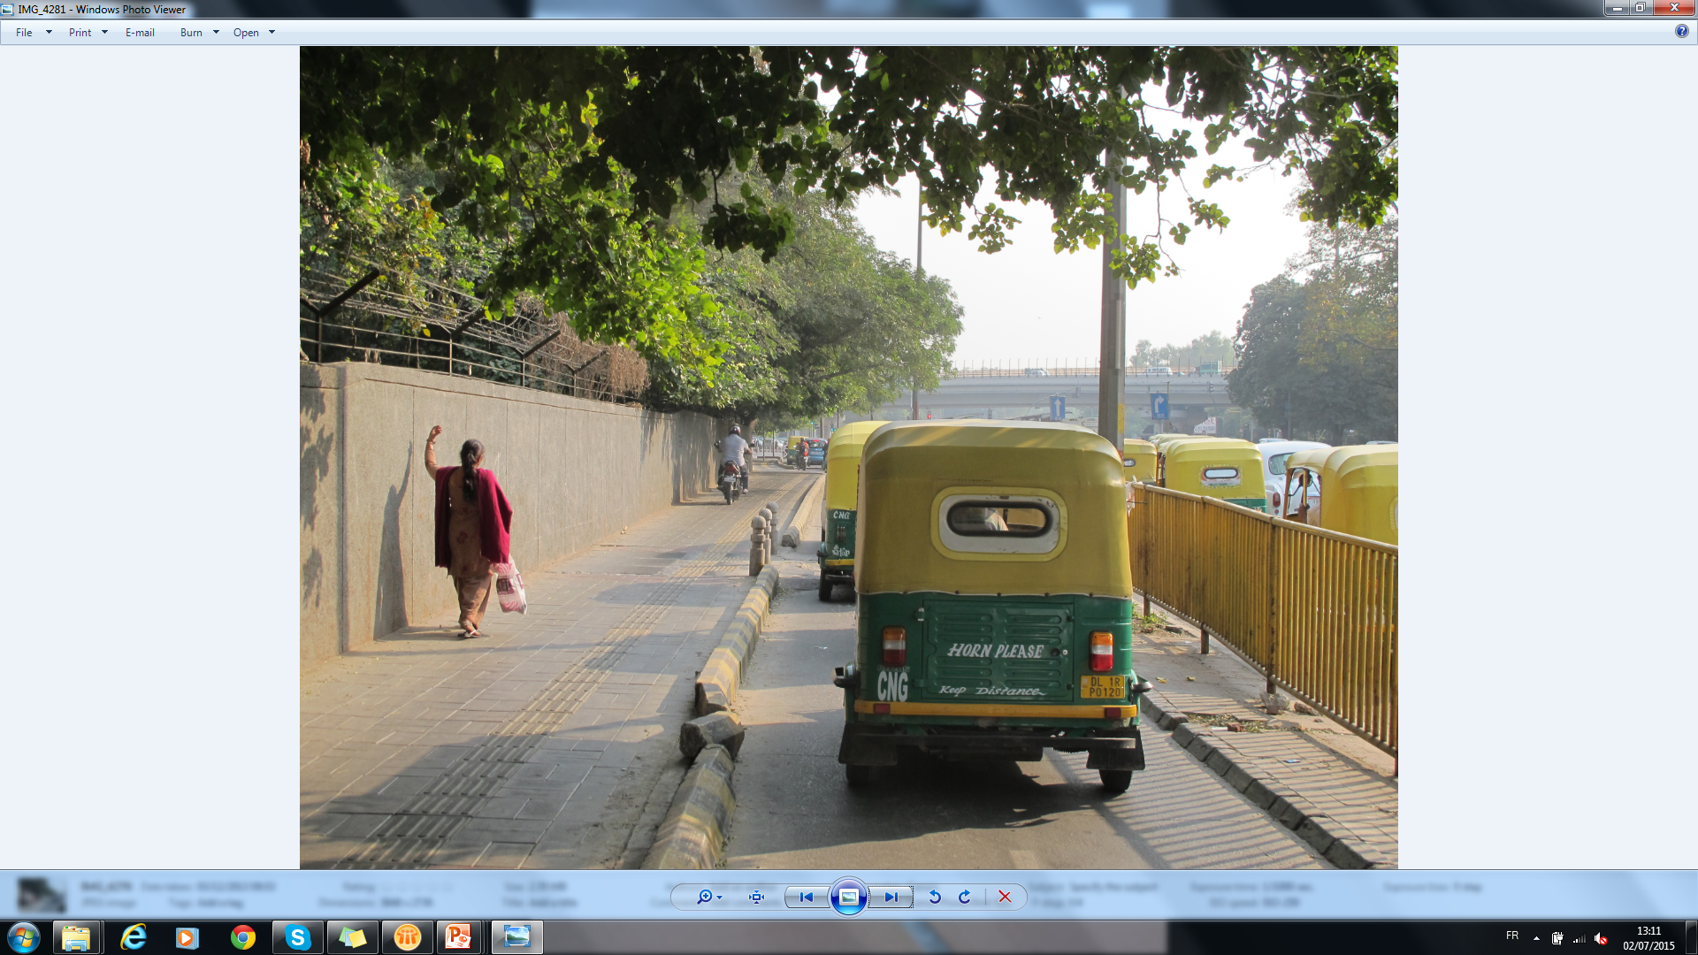
Traffic rules

Slide 32
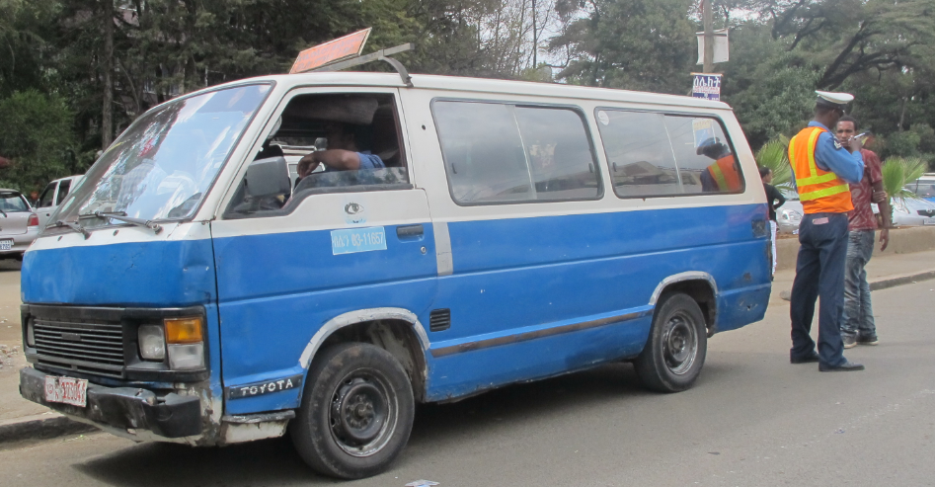
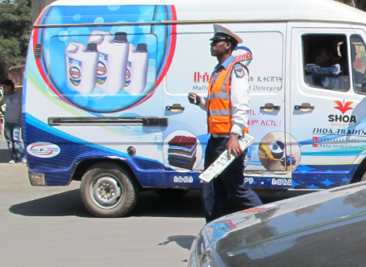
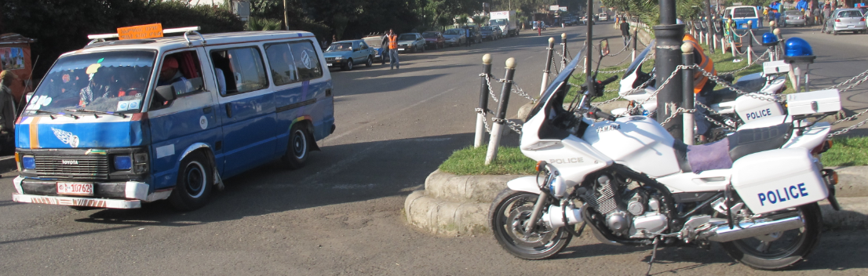
Enforcement

Slide 33
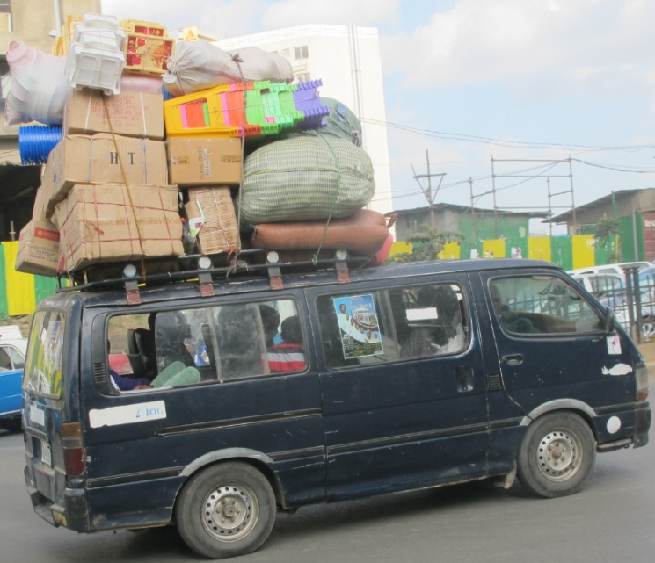
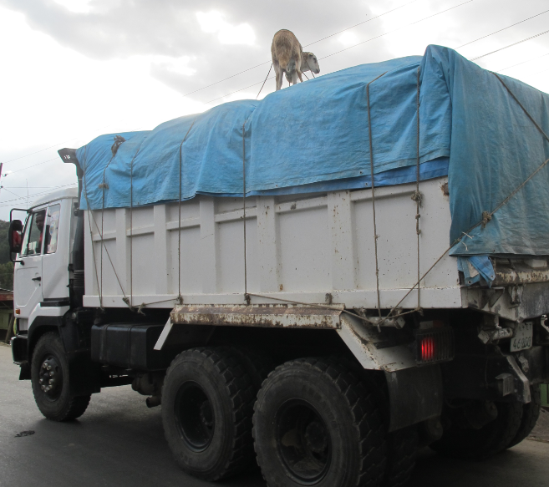
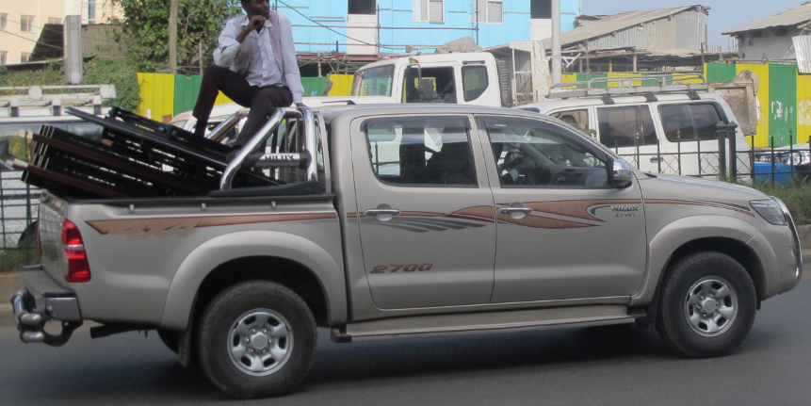
Lack of enforcement

Slide 34

CULTURE
EATS
FOR BREAKFAST
STRATEGY

Slide 35
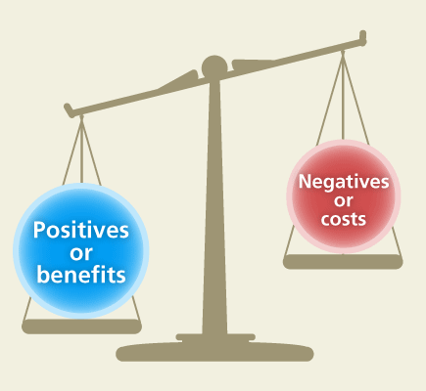
Accessions to UN conventions may yield substantial benefits to Contracting Parties

Slide 36
Consider the net benefits of acceding
Undertake the necessary national legal steps/procedures for accession
Deposit an instrument of accession with the UN Secretary-General
Contact Robert.Nowak@unece.org for info and/or capacity building

Slide 37
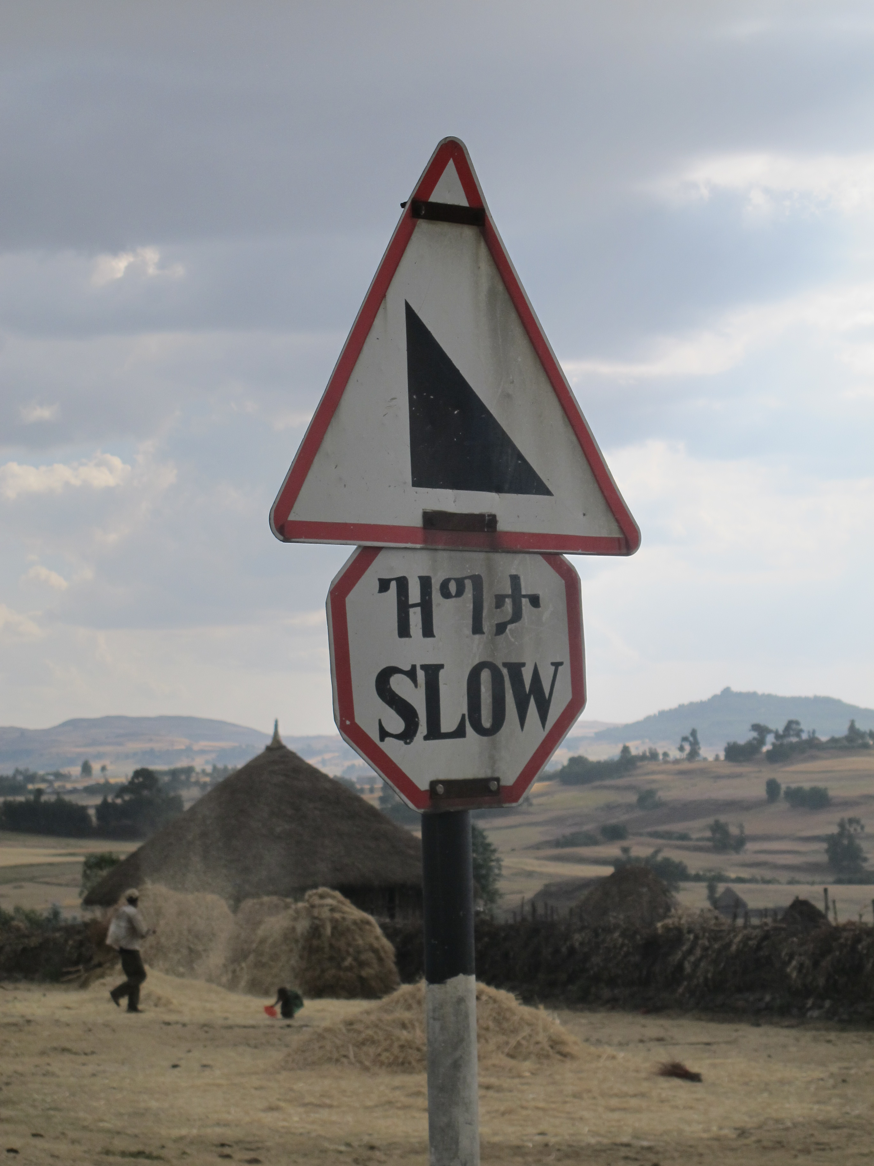
www.unece.org
Notes:
This is a sample Title Slide with Picture ideal for including a dark picture with a brief title and subtitle.

