Slide 1
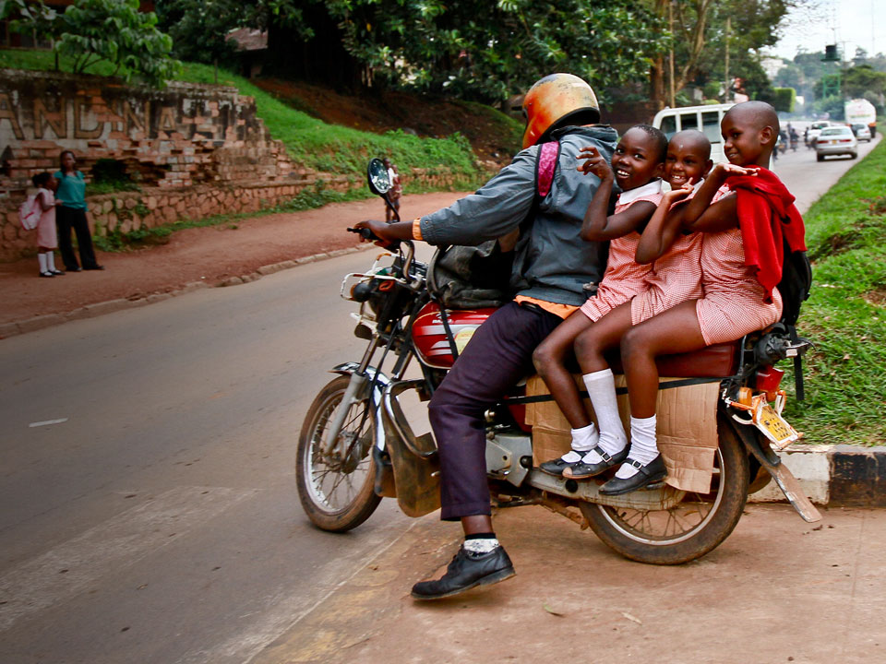

SAFE ROADS FOR ALL:
PARTNERSHIPS FOR SAFER CITY STREETS IN AFRICA
SAUL BILLINGSLEY
DIRECTOR GENERAL

Slide 2
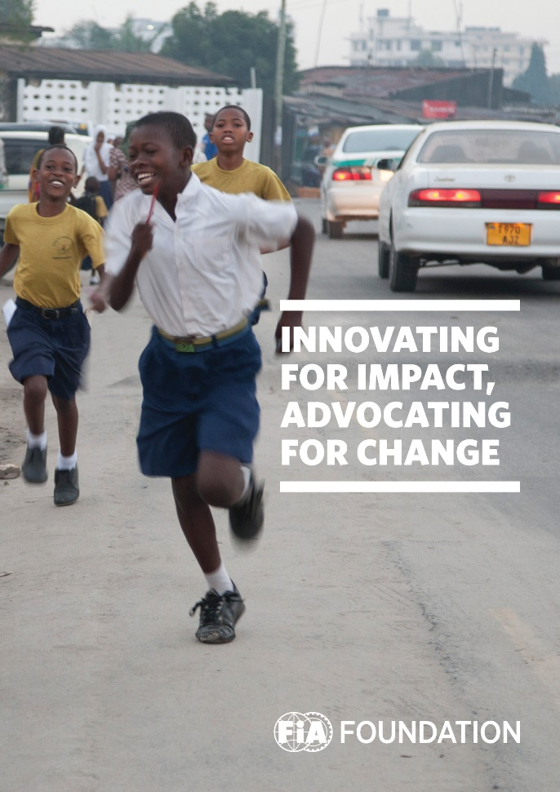


Road safety philanthropy
THE FIA FOUNDATION - OUR MISSION
To promote public safety and public health, the protection and preservation of human life, and the conservation, protection and improvement of the physical and natural environment.

Slide 3
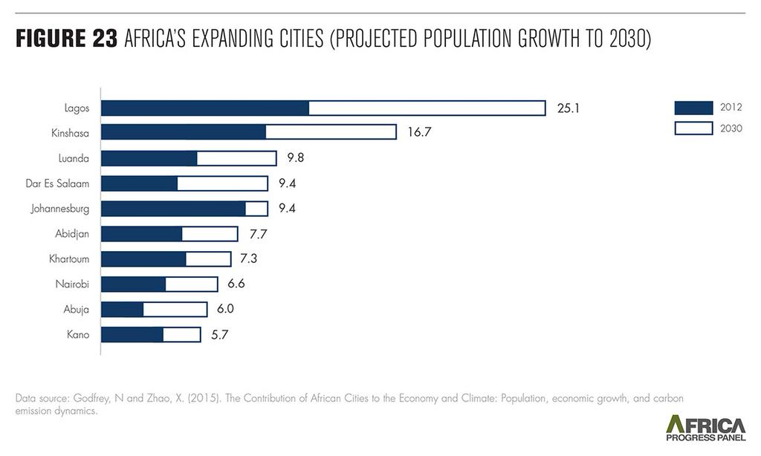
Road safety philanthropy
LIVEABLE CITIES MUST BE A POLICY PRIORITY

Slide 4
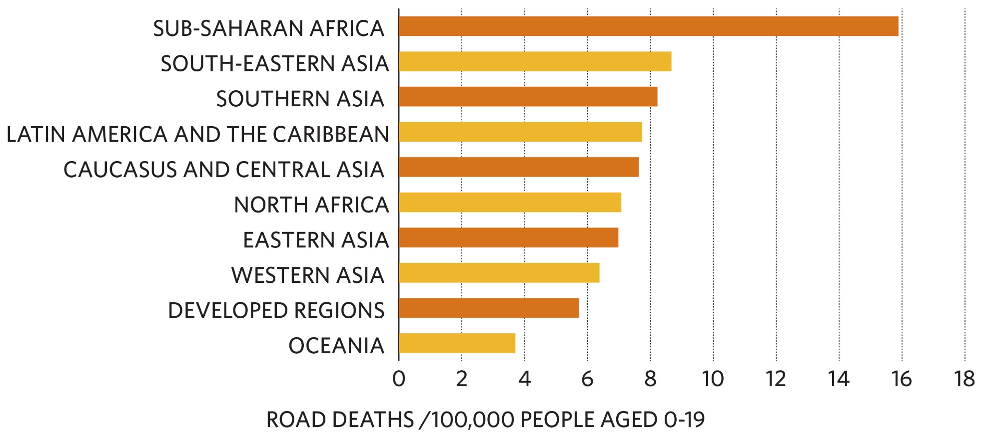
Road safety philanthropy
CHILD ROAD DEATHS IN WORLD REGIONS
Source: FIA Foundation analysis based on UN population projections and IHME Global Burden of Disease data

Slide 5
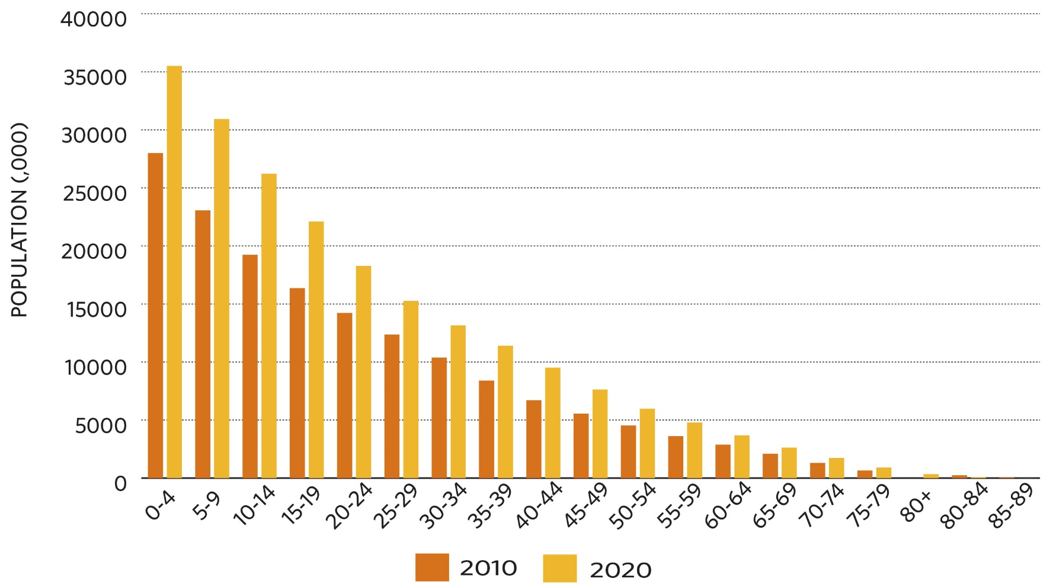
Road safety philanthropy
NIGERIA: PROJECTED DEMOGRAPHIC CHANGE
Source: FIA Foundation analysis of UN population projections

Slide 6
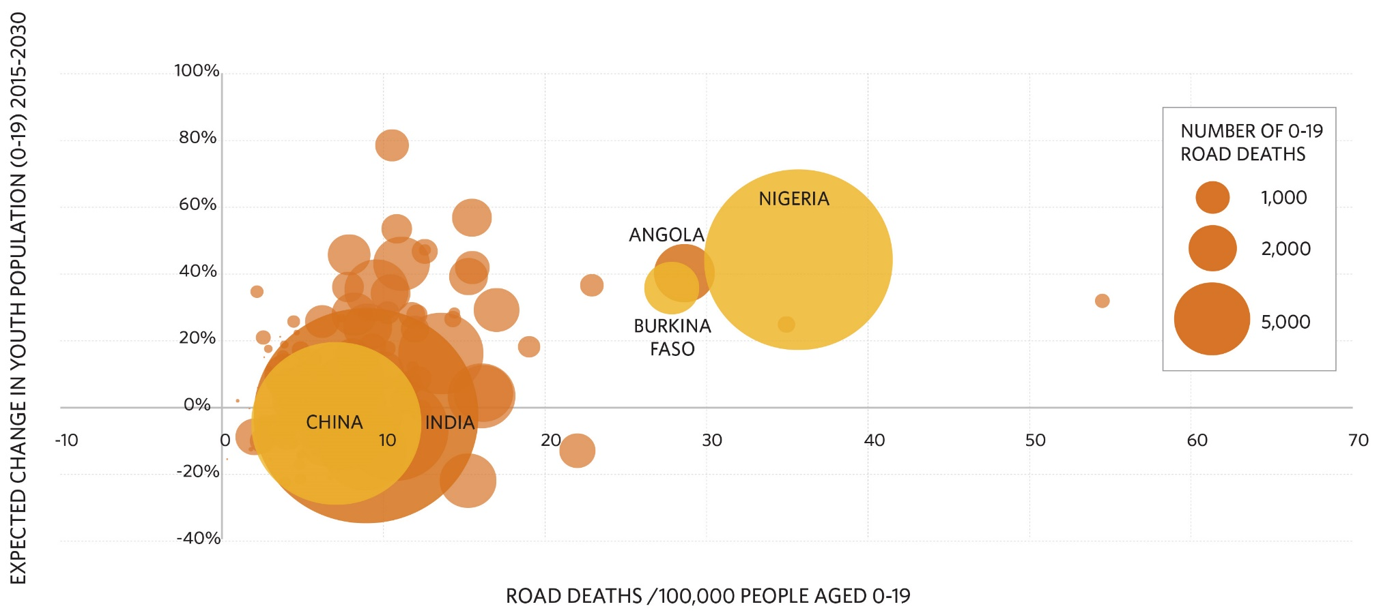
Road safety philanthropy
PROJECTED YOUTH POPULATION CHANGE IN COUNTRIES WITH HIGH CHILD ROAD FATALITIES
Source: FIA Foundation analysis based on UN population projections and IHME Global Burden of Disease data

Slide 7
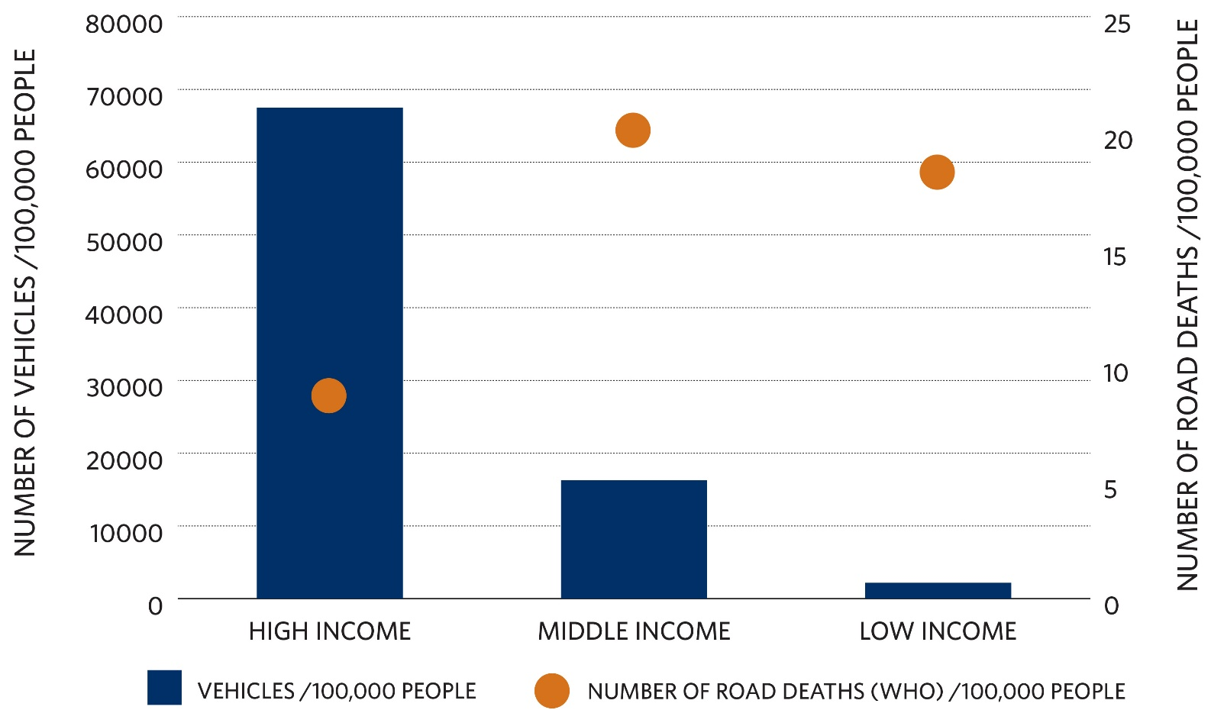
Road safety philanthropy
NUMBER OF VEHICLES AND ROAD DEATHS BY COUNTRY INCOME LEVEL
Source: FIA Foundation analysis based on WHO data on number of deaths and registered vehicles

Slide 8

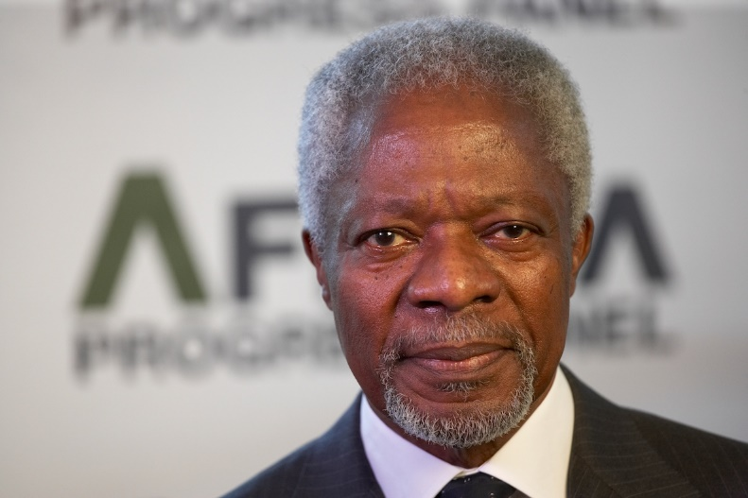
Road safety philanthropy
A CROSS-CUTTING ISSUE FOR CLIMATE, HEALTH AND ROAD TRAFFIC INJURY PREVENTION
“Road traffic problems reinforce the costs of pollution. Sub-Saharan Africa has the world’s lowest levels of car ownership, but the highest levels of road death…and some of the world’s most congested cities.”
Africa Progress Panel, 2015

Slide 9
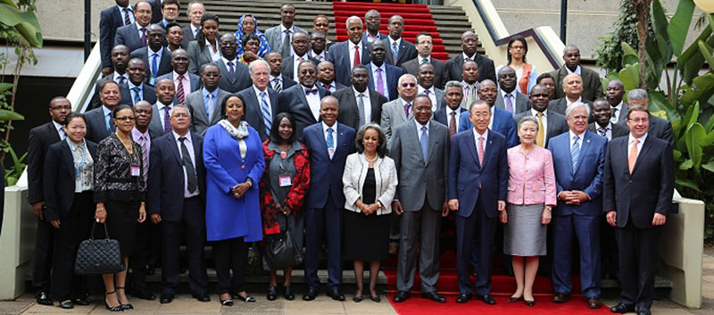
Road safety philanthropy
AFRICA SUSTAINABLE TRANSPORT FORUM
“More than half of Africa’s people have no option than to walk long distances, at times in unsafe conditions, to work, school or hospital.”
Ban Ki Moon, UN Secretary General

Slide 10

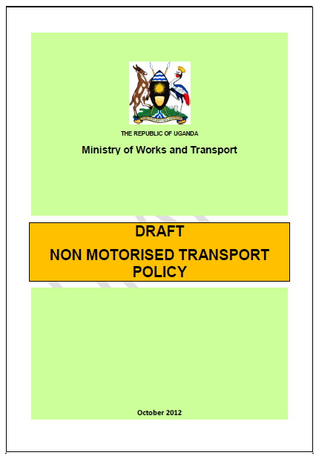
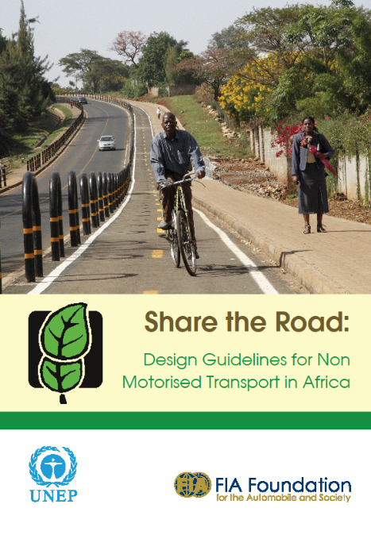

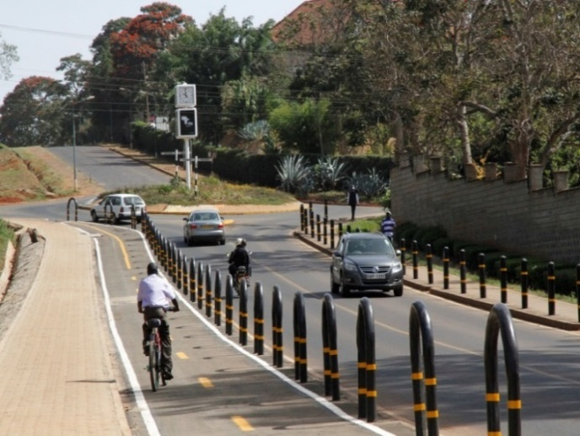
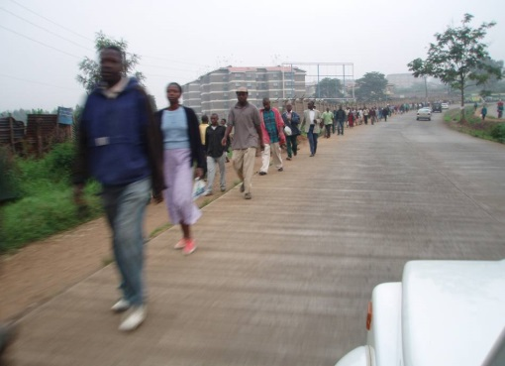
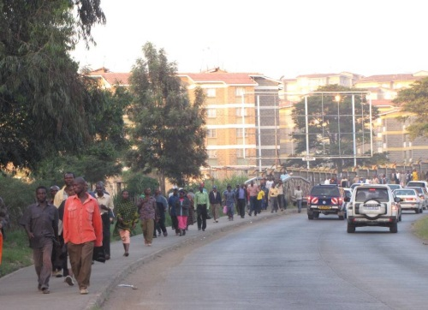
Incubating innovation: liveable cities
LIVEABLE CITIES – EAST AFRICA
Tools and Guidelines
National policy support
Before
Pilots
After

Slide 11
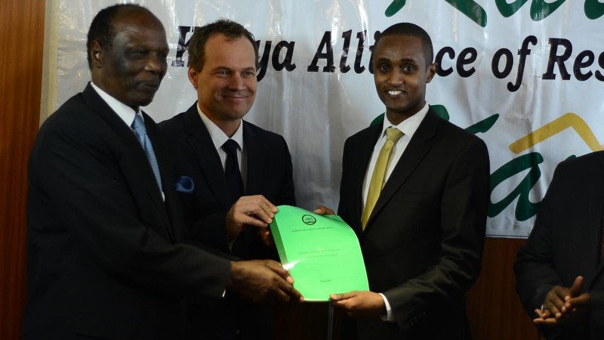

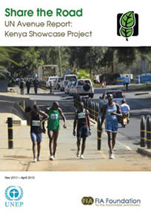
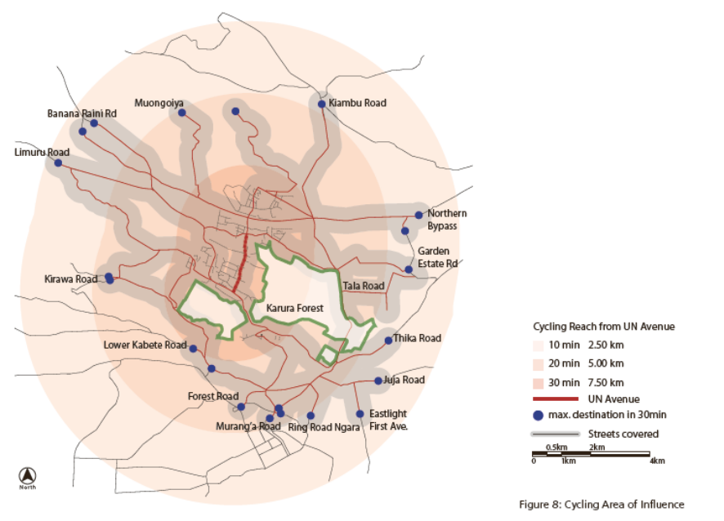
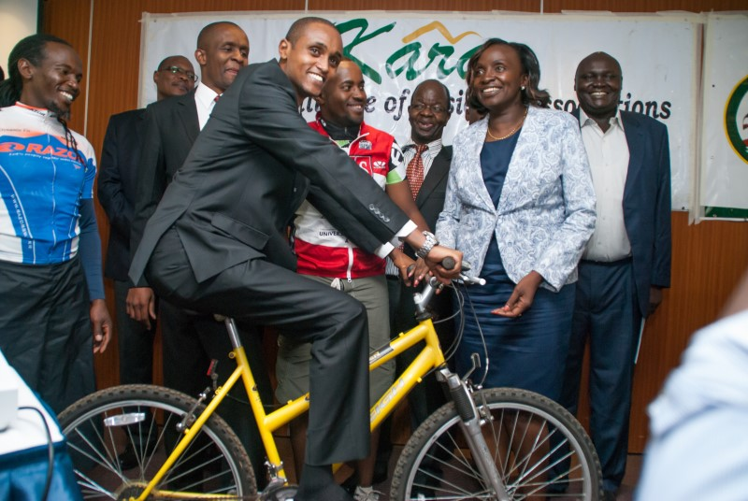
Incubating innovation: liveable cities
LIVEABLE CITIES – EAST AFRICA
Supported development of new Nairobi NMT strategy
National policy support

Slide 12
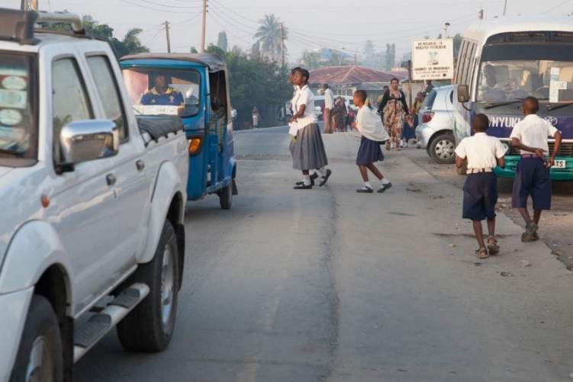
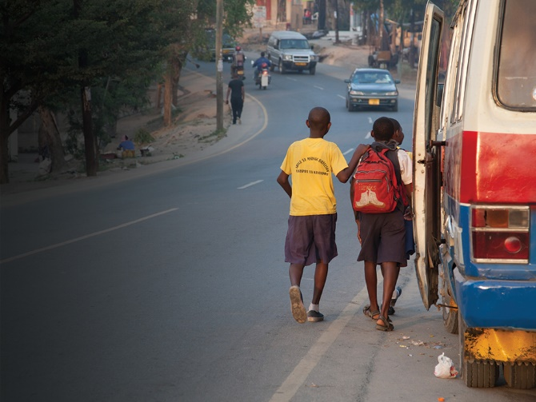
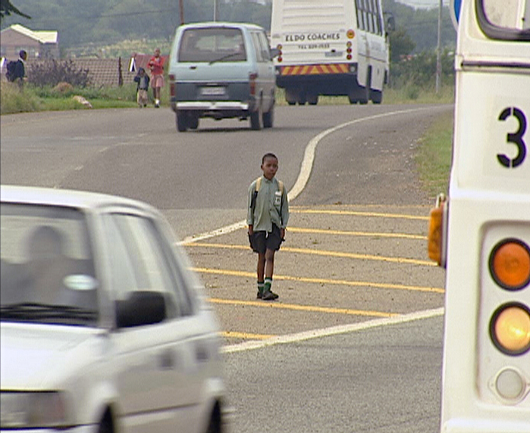
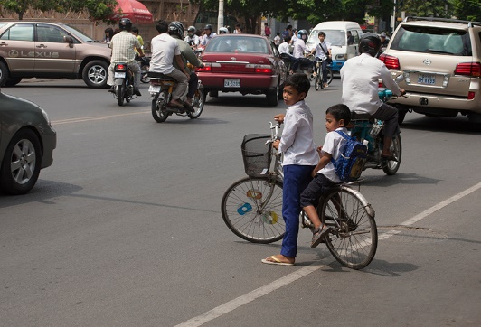
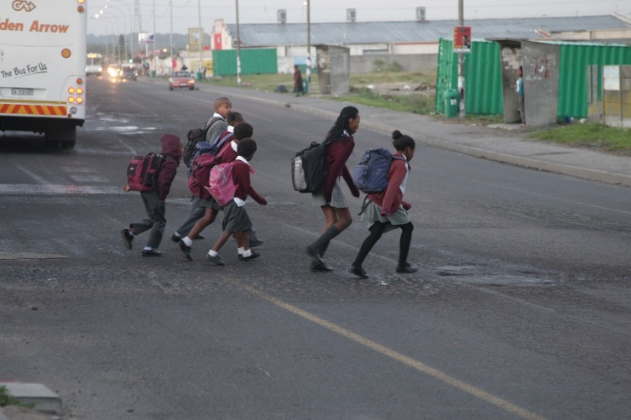
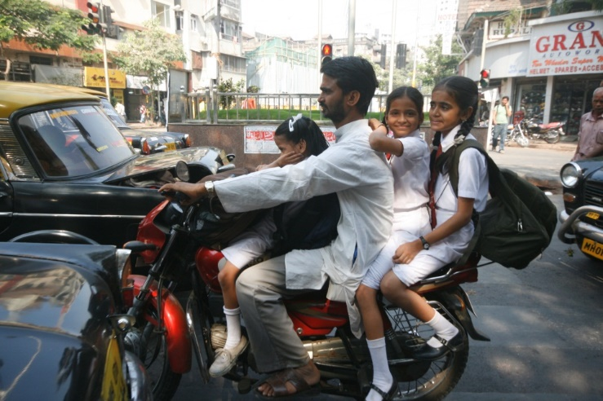
Road safety philanthropy
MILLIONS OF DANGEROUS
SCHOOL JOURNEYS EVERY DAY

Slide 13

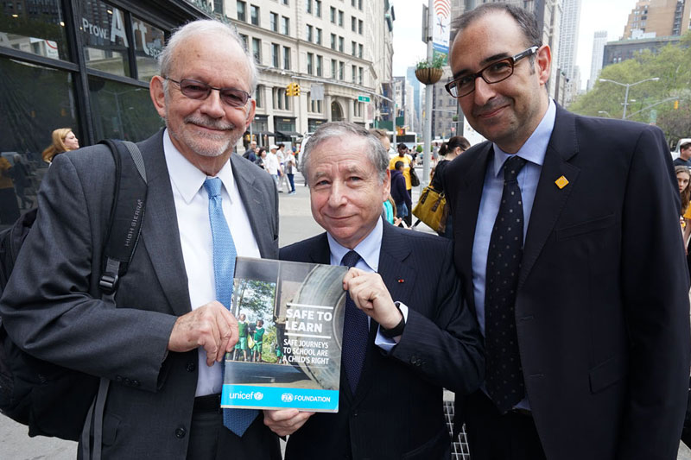

UNICEF PARTNERSHIP
Joint report with UNICEF focused on safe routes to school
Launched with UNICEF Executive Director & new UN Special Envoy for Road Safety

Slide 14
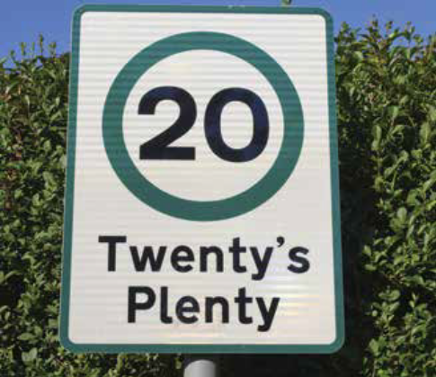
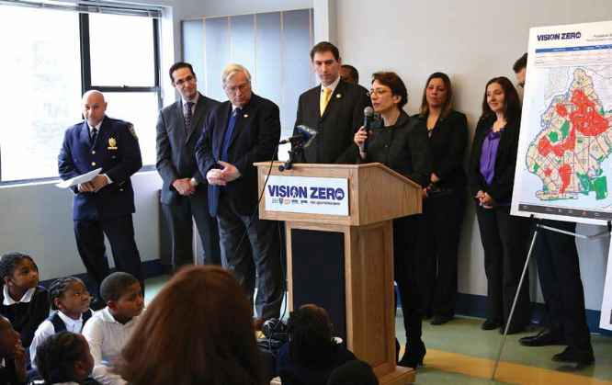
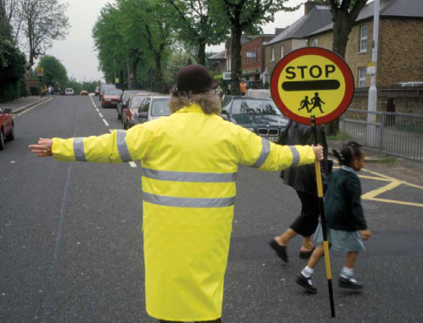
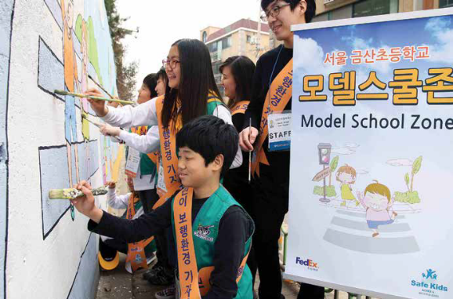
UNICEF PARTNERSHIP
Highlights success and aims to build advocacy & practical delivery in LMICs

Slide 15

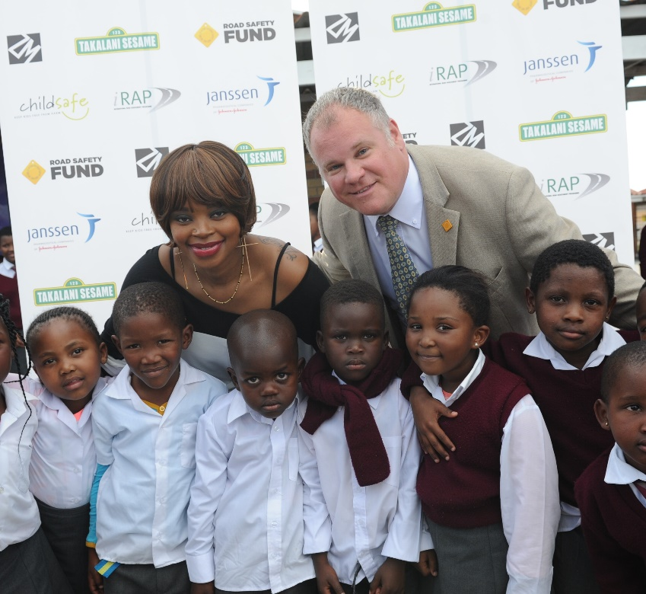
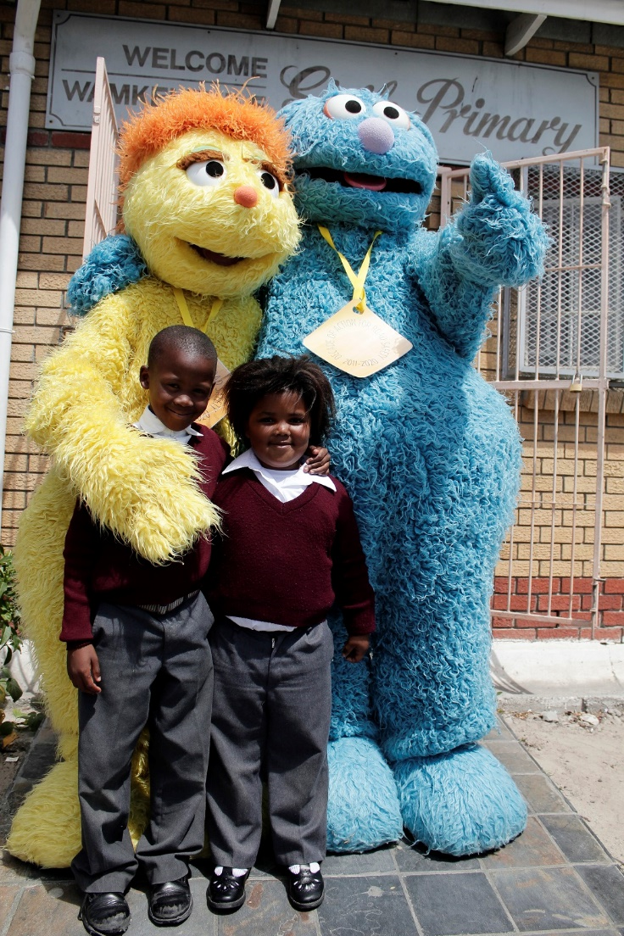







PILOTING SAFE ROUTES TO SCHOOL

Slide 16
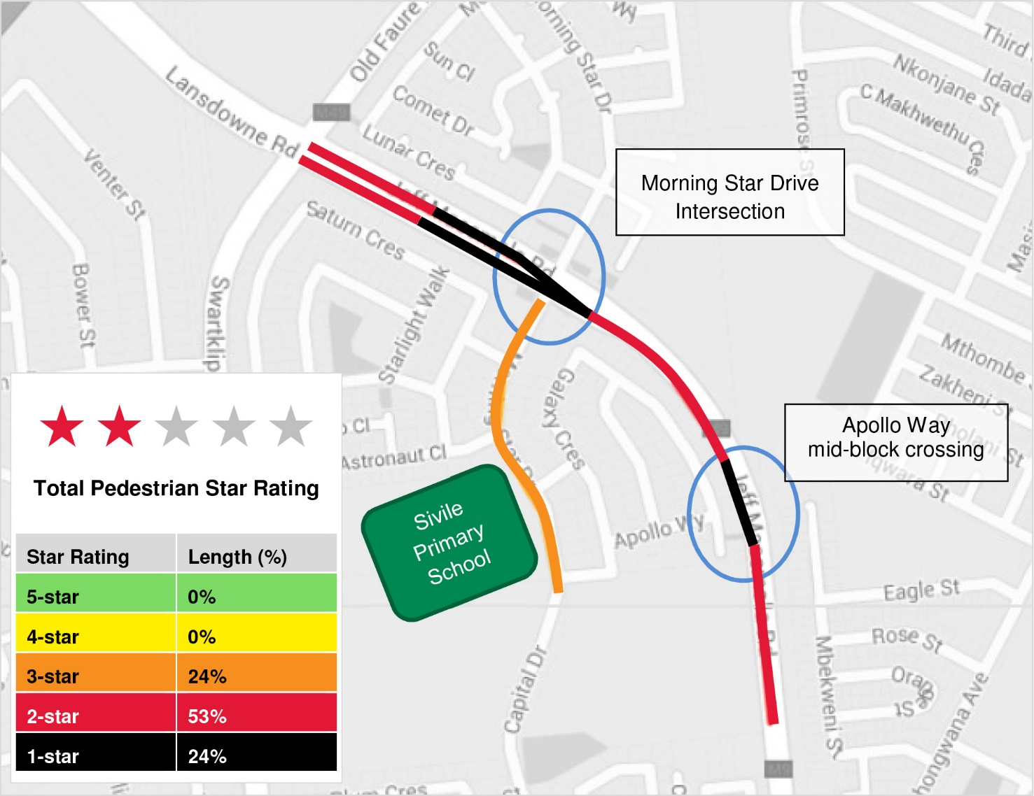
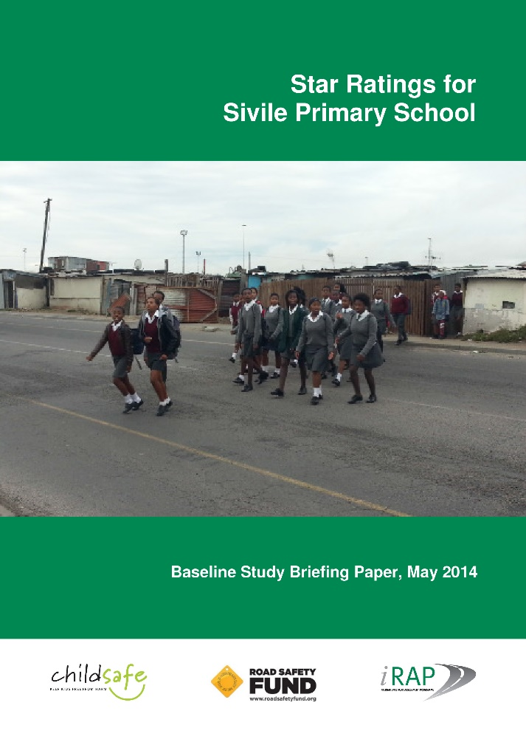
South Africa pilot project
CAN STAR RATING SUPPORT ADVOCACY?
‘Safe Schools’: piloting road improvements & speed reduction

Slide 17
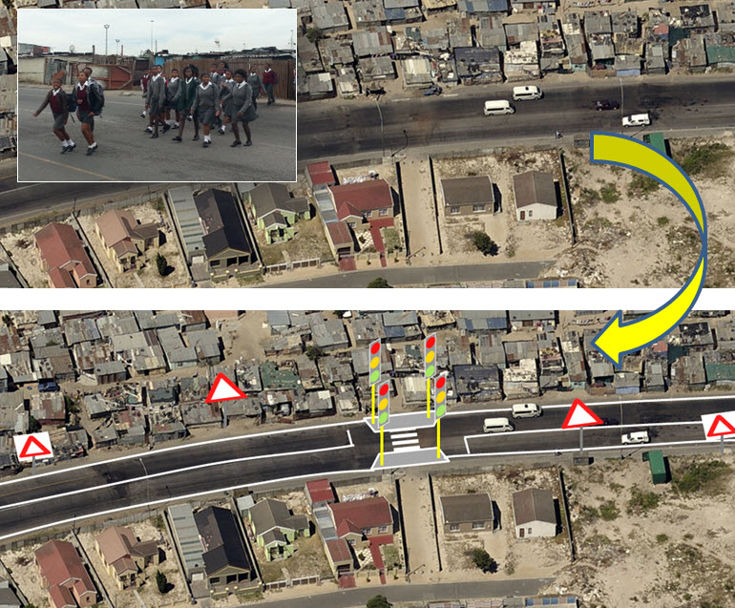
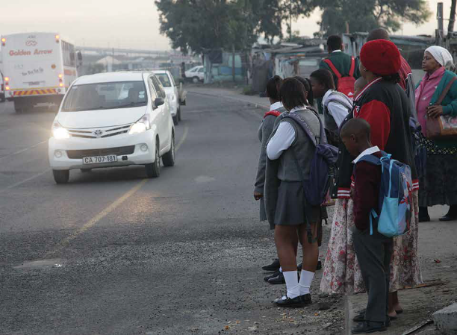
CAN STAR RATING SUPPORT ADVOCACY?
UPGRADE OPTIONS
Pedestrian fences
Low cost pedestrian refuges
Kerb build-outs
Raised crossings
Supervisors
Signalisation
Grade separation
$
$
$

Slide 18
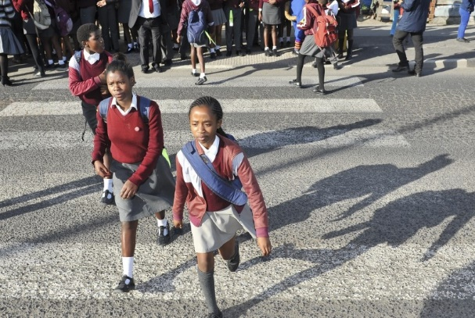
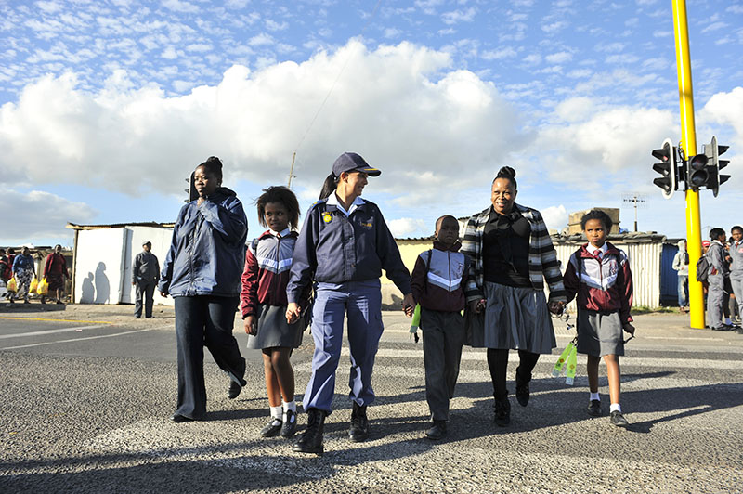
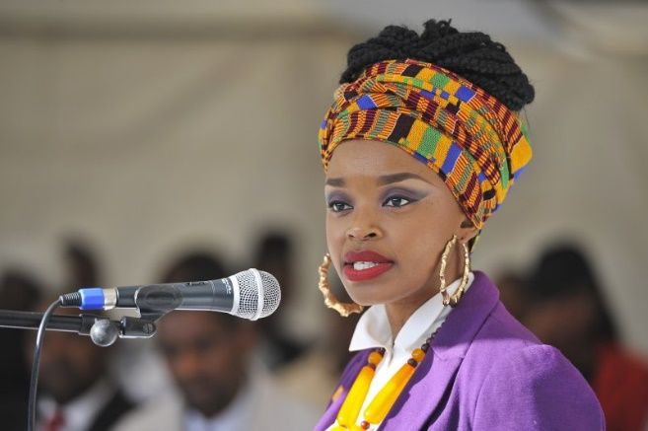
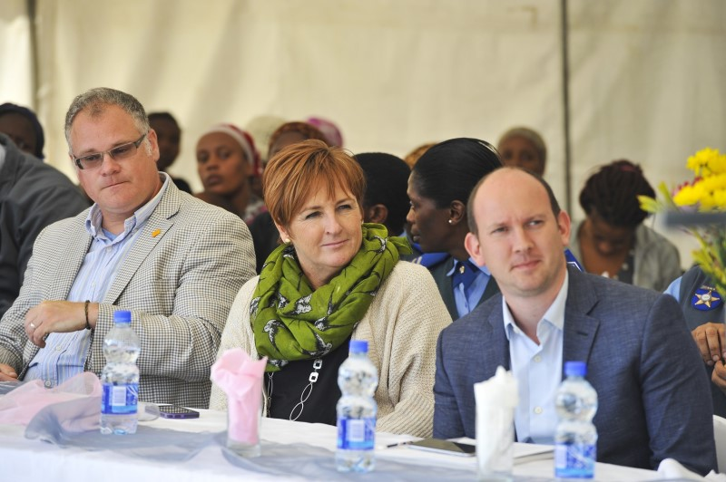
CAN STAR RATING SUPPORT ADVOCACY?
New lights controlled crossing part of improvements estimated to reduce risk by 80%
Janssen Pharmaceuticals co-funding larger second phase, 10 school, project

Slide 19
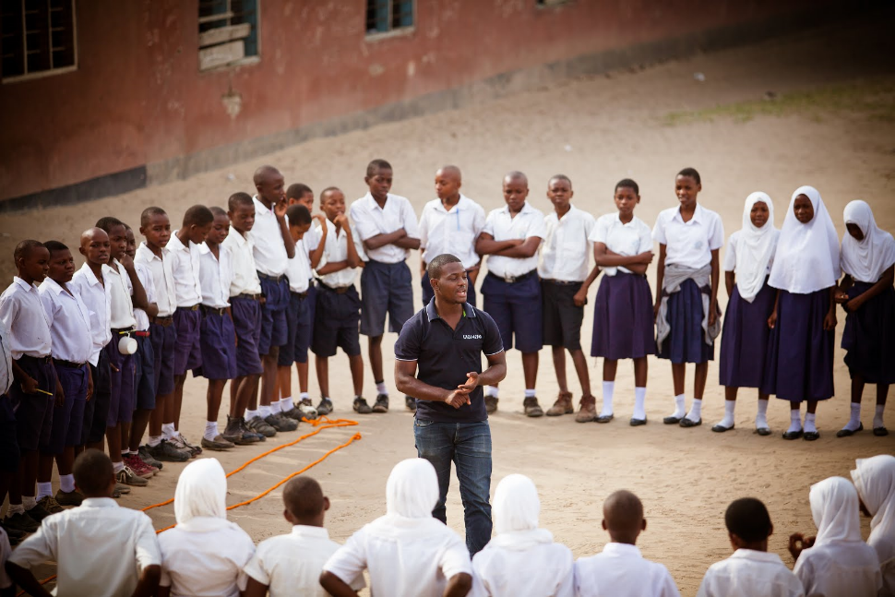
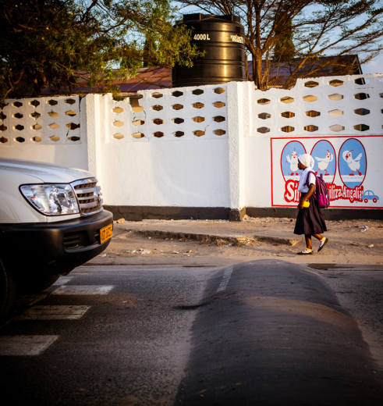



BUILDING EVIDENCE BASE ACROSS AFRICA
20+ school research project
in Dar Es Salaam

Slide 20
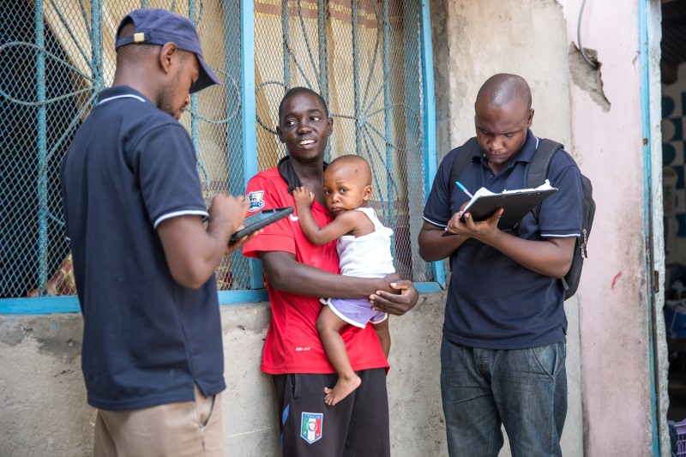
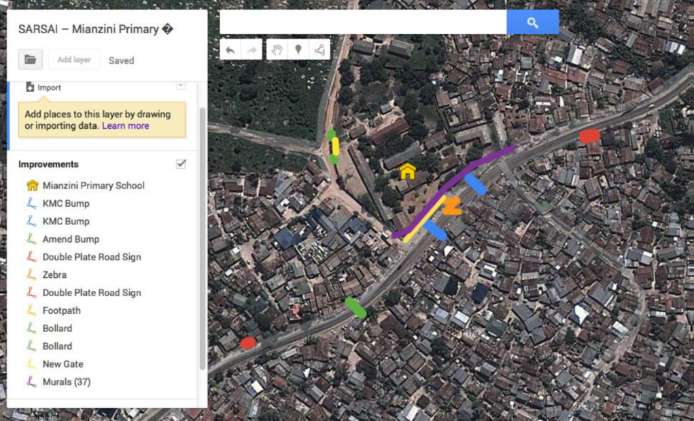
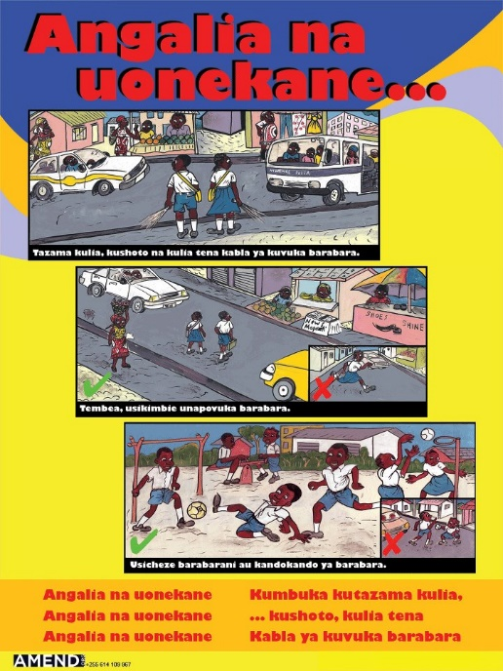
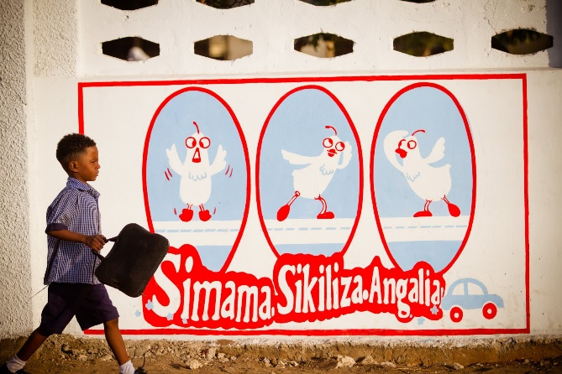
TANZANIA ‘SAFE SCHOOL AREAS’ RESEARCH
Infrastructure Countermeasures
Baseline injury data collection
Community engagement & education

Slide 21
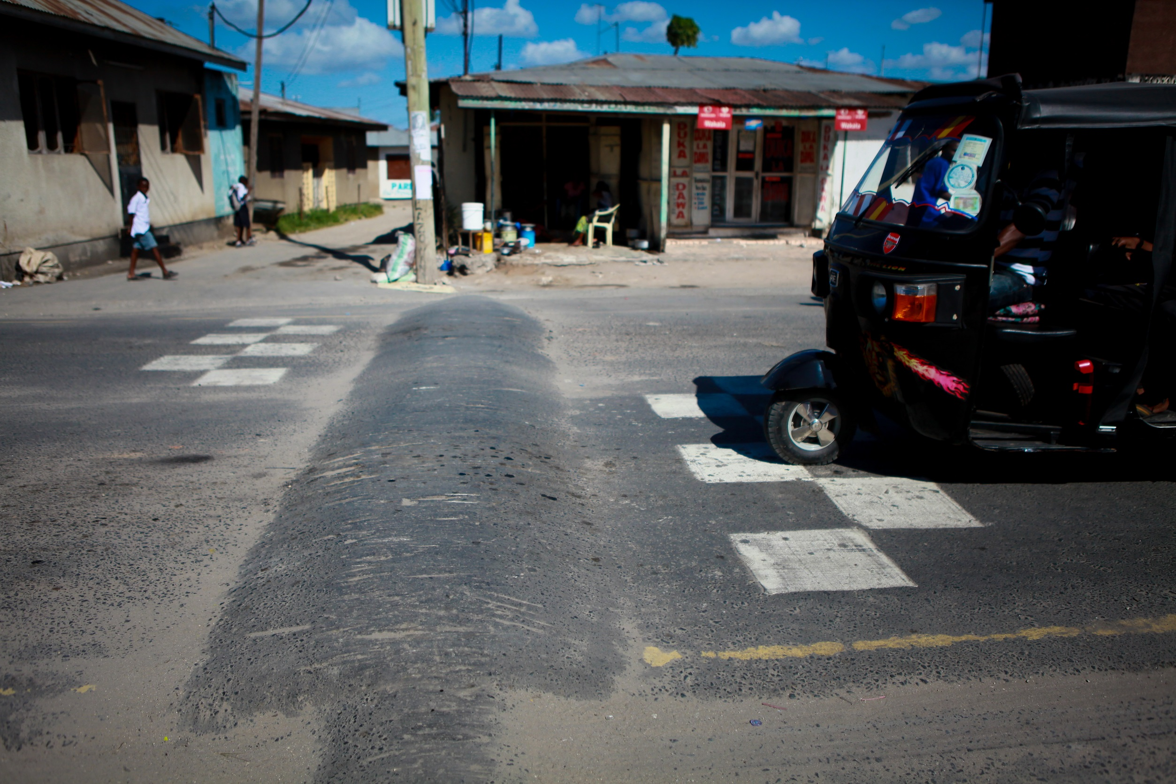
“Protection for the urban poor”

Slide 22
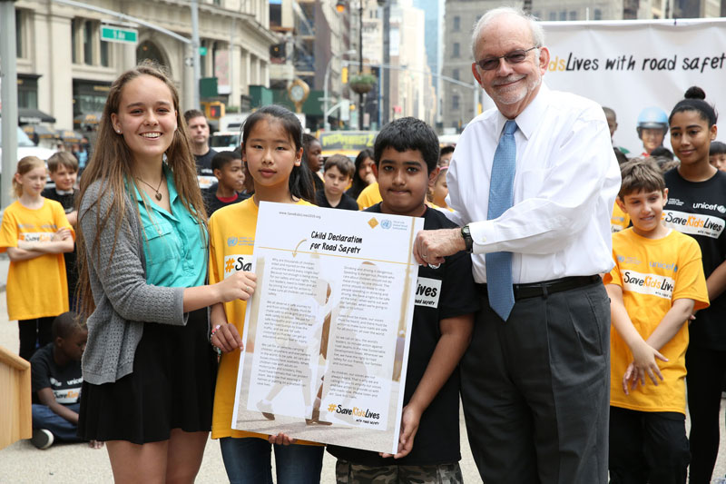

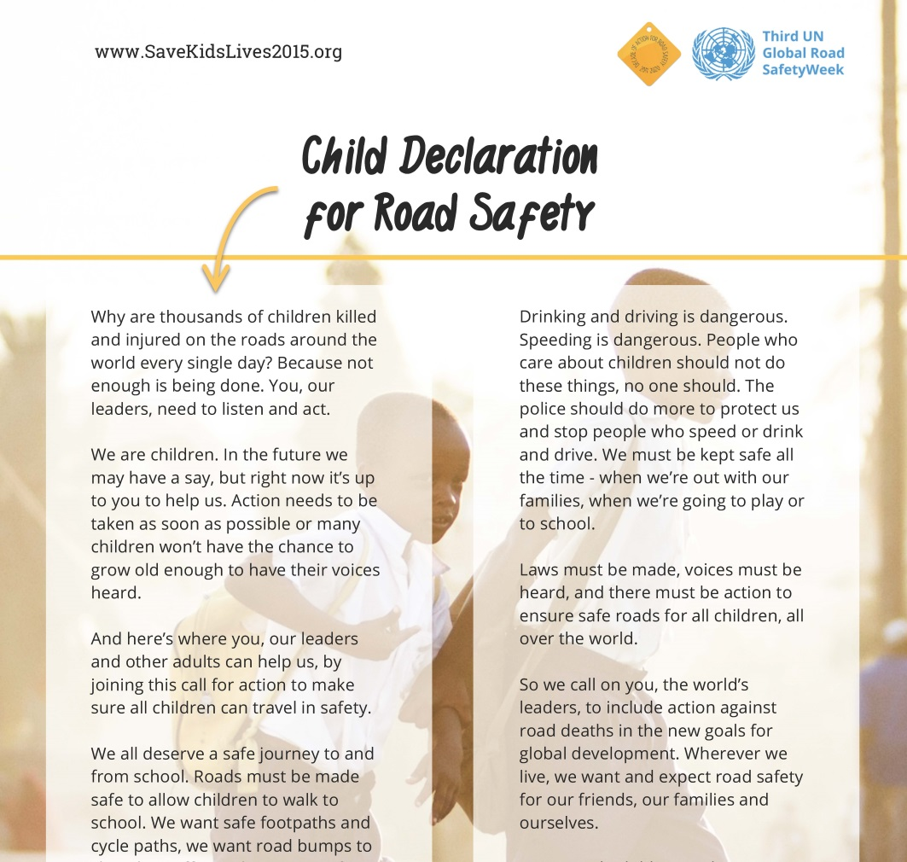
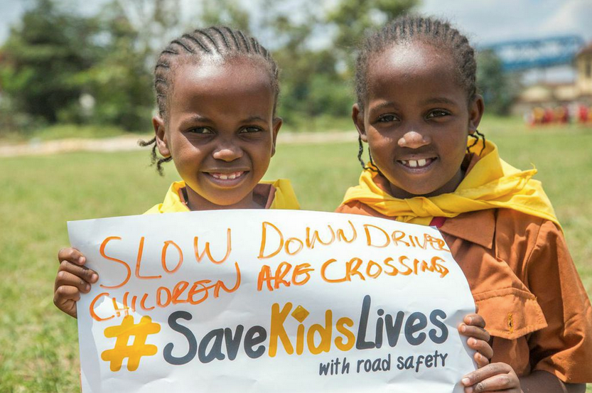
BUILDING A MOVEMENT

Slide 23
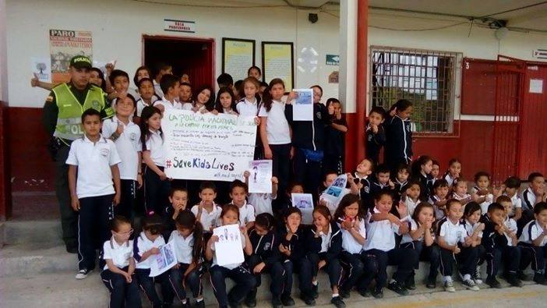











BUILDING A MOVEMENT
Child Declaration signed by 600,000+ people so far
Let’s get to 1,000,000 by the Brasilia Ministerial

Slide 24



Road safety philanthropy
THE SDG OPPORTUNITY
Use new Sustainable Development Goal road safety targets to forge alliances

Slide 25



MOMENTUM AT BRASILIA 2015
Ensure Brasilia High Level Conference makes safe urban mobility a policy priority
FIA Foundation contributing €200,000 to WHO travel fund for LIC government ministers

Slide 26


CATALYTIC FINANCING FOR ROAD SAFETY

Slide 27

@FIAfdn
www.fiafoundation.org

