Slide 1

UNECA Conference
11 July 2015. Addis Ababa
Caro Smit
Psychiatric Social Worker/
Alcohol & Drug Educator &Counsellor carosmit@sadd.org.za 082 8213673

Slide 2
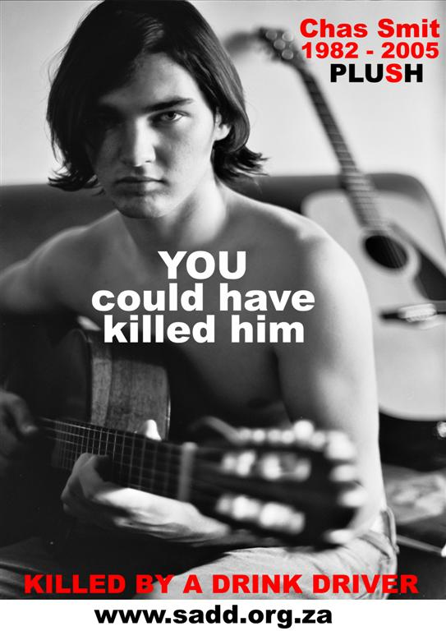
Who are SADD?
SADD is a Road Safety NPO specializing in Drink
driving – modeled on Mothers Against Drunk Driving in USA (MADD).
SADD was founded by the Psychiatric social worker, Caro Smit, who is also an alcohol and drug educator, following the death of her son – killed by a driver who had been drinking (2005).
SADD primarily focuses on alcohol education – for professionals, the public and the media. SADD also monitors and encourages enforcement of the laws pertaining to Road Safety and especially drink driving. SADD offers support, advice and counselling to the victims of road crashes.
Challenges: Few experts in road safety in SA. Best practices not being adopted. Alcohol & drink driving not understood.

Slide 3




SADD is part of:
1. The U.N.’s “Decade of Action for Road Safety”
2. Global Road Safety Partnership- ZA Funder :
Project: “Safer Roads 4 Youth”
3. “Global Alliance of NGO’s Advocating for Road Safety and Road Victims” - one of 130 world wide recognized NGOs who accepted/mentored by W.H.O.
Project:
Funder: Global Alliance
Challenge: Reaching the goal of deaths/injuries down by 50%

Slide 4
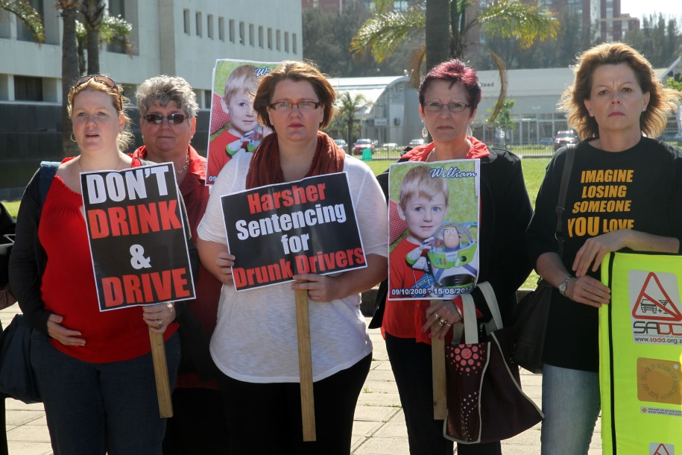
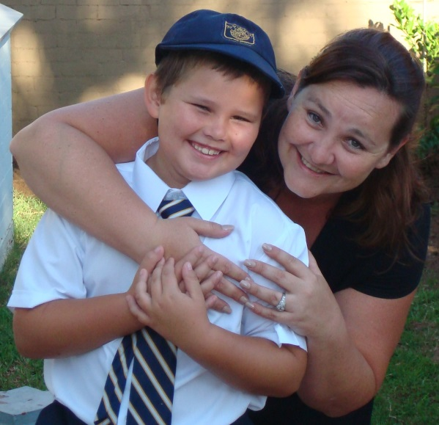
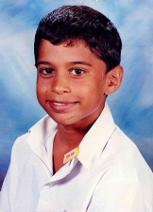
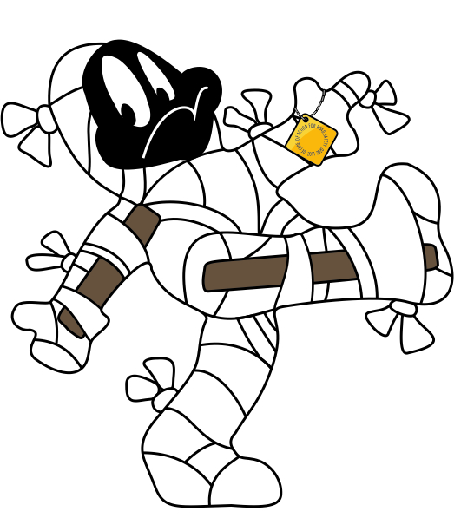
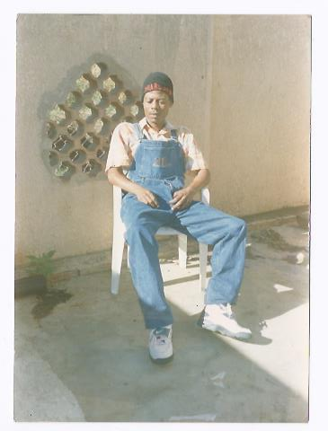
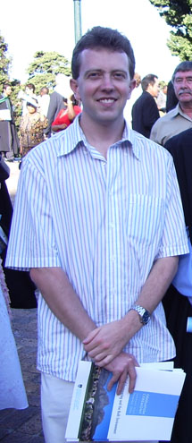
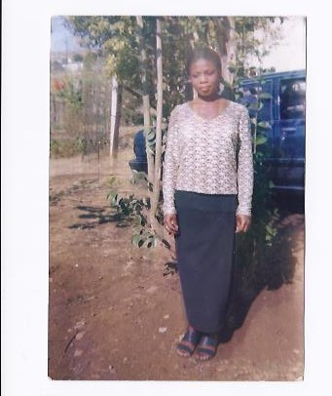
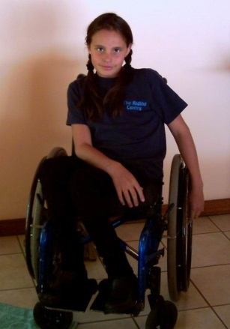
SADD Support victims in Court cases and “World Day Of Remembrance” events in November
Challenges: Too many victims. Not enough emotional or Court support for victims and their families. Very few rights for them.

Slide 5

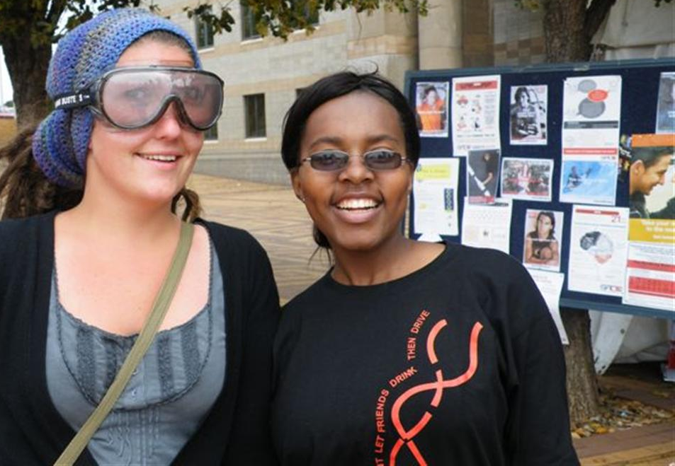

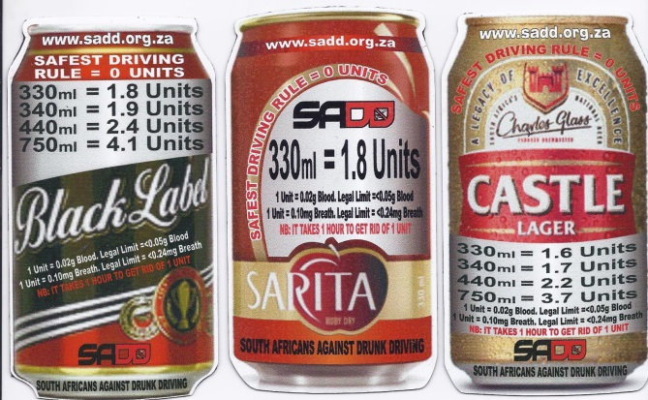
University responsible alcohol use; drink driving and basic road safety Project.
14 Universities around SA. Winner “Prince Michael of Kent International Award” 2012
Challenges: Youth age 15-29 highest death/injury rate.
Drinking excessively seen as normal.
Not enough testing of alcohol for drink driving
Funder: SAB

Slide 6
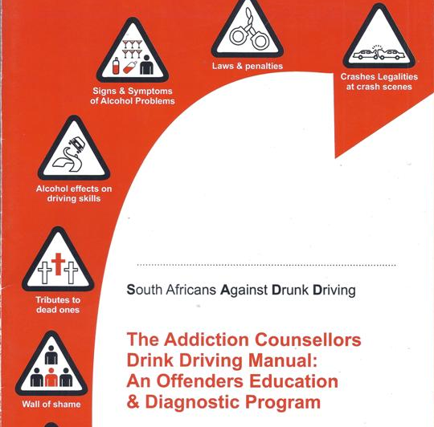


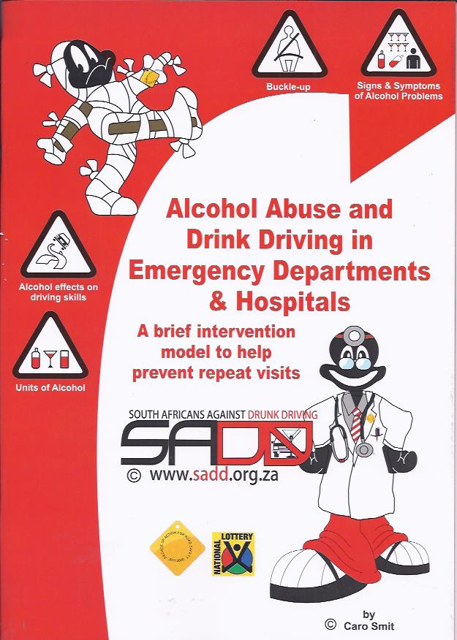
Projects: Dr.’s (Private Hospitals)
& Addiction Counsellors Manuals.
Funders: brandhouse & Lotto
Challenges
Post crash care/alcohol education in State Hospitals not reached as they are too busy
Still great deal of sympathy for drink drivers/Diversion programs
2/10 enforcement drink driving

Slide 7
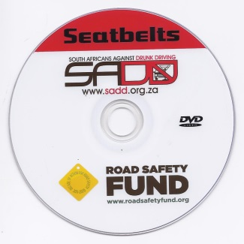
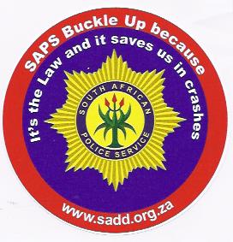

Seatbelt Project
Funder: Road Safety Fund
Challenges
Seatbelt Laws are not enforced by Government
SA scores 1/10 for enforcement
Police do not buckle up (only 4% do)
Preventable deaths & injuries continue because of lack of enforcement

Slide 8

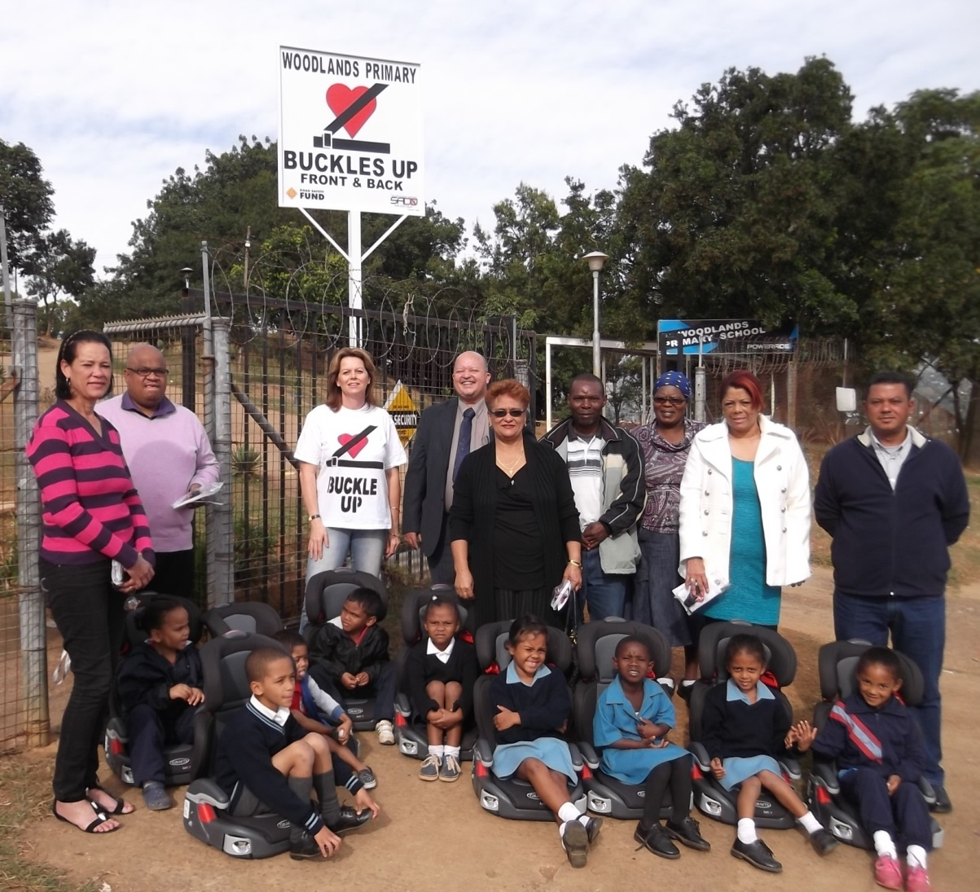
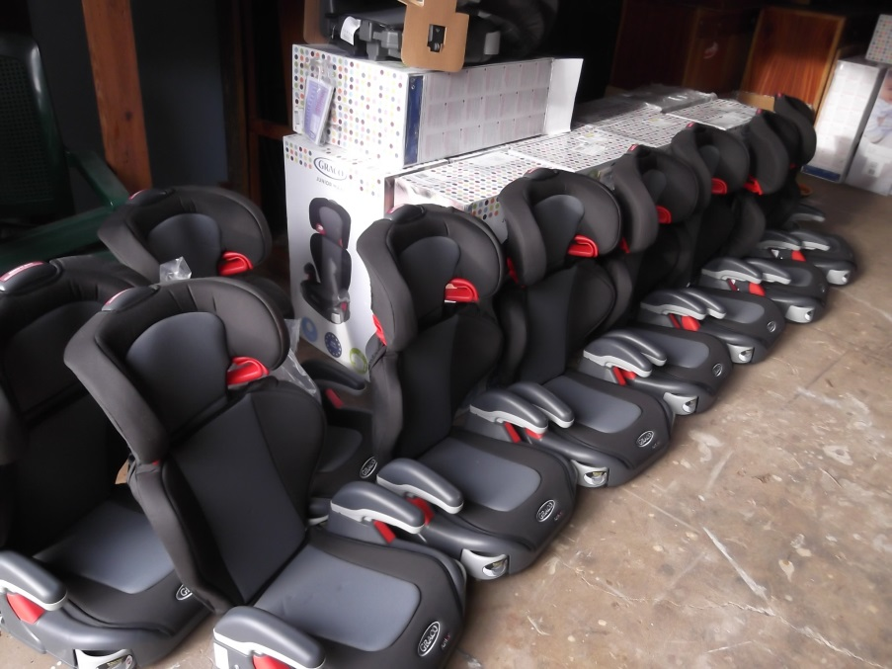
Distribution seats
Funder: Imperial

Slide 9


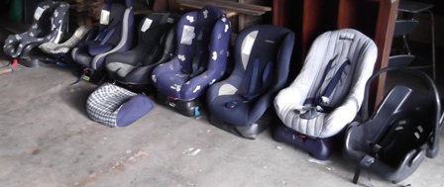
Public /private participation
Old seats donated to NGOs . Refurbished and given to needy people
Challenges: Not enough seats for the many poor people who need them

Slide 10
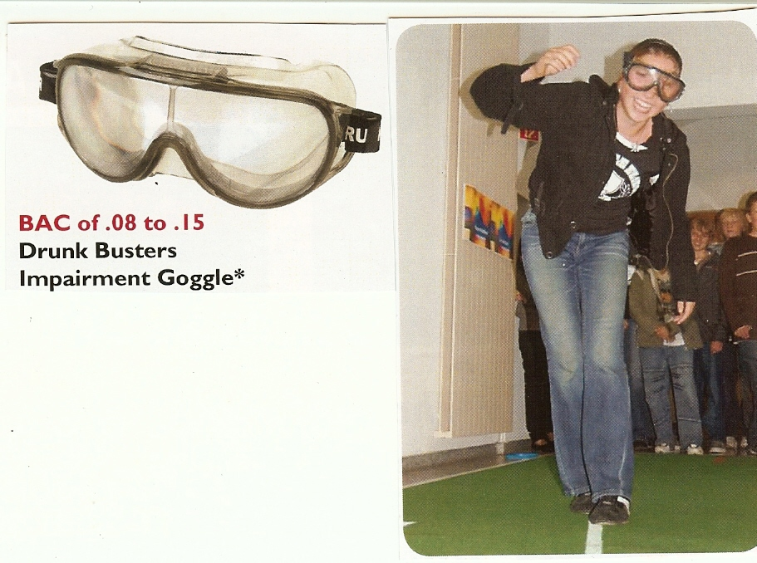
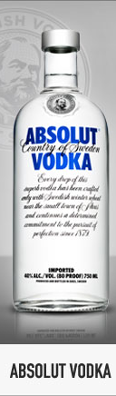
Drunk Busters Impairment Goggles
Set to BAC of 0.08 to 0.15
Which is equal to: 4 Units to 8 Units
2 -> 4 Double Tots of Whiskey/ Vodka/ Brandy
1 ->2 Quarts of Beer (750ml)
2 -> 8 Glasses of Wine
4 -> 8 Tots (25ml)of Tequila
1 -> 4 Cocktails
Challenges: People don’t know strength of alcohol
& elimination rates.Basic alcohol education needed..

Slide 11
Drunk Goggles- order from SADD.
Internationally popular prevention tool.
To learn about the consequences of alcohol abuse & misuse.
Experience a realistic simulation of impairment.
Experience of the following effects of alcohol:
  Lack of muscular coordination
  Reduced alertness
  Confusion
  Reduction of peripheral vision
  Double vision
  Slower reaction time
  Poor judgement & decision-making
  Alteration of depth & distance perception

Slide 12


Thank You. Any questions!
South Africans Against Drunk Driving
NPO 055 255
www.sadd.org.za
082 82 136 73
carosmit@sadd.org.za
Twitter SADD_SA

