Slide 1

3rd AFRICAN ROAD SAFETY CONFERENCE
  AfDB’S SUPPORT
  FOR
  ROAD SAFETY ACTIVITIES IN AFRICA
Zerfu Tessema, Chief Transport Engineer
ADDIS ABABA, ETHIOPIA
10 July 2015

Slide 2
OUTLINE OF PRESENTATION
The Bank
Road safety management
Safer roads and mobility
Safer road users
Post crash management
Cross-cutting issues
Way forward

Slide 3
i) THE BANK
Financing Products
Type of Intervention
Grants & Concessional Lending
Loans & Equity Investments
Technical Assistance & Policy-based Lending
Projects & program-based operations
Non-project activities

Slide 4
Building the Continent’s Transport Infrastructure
  Expand and improve National and Regional Connectivity
  An average annual approval over the last six years (2009-2014) for Transport and ICT Sector was about USD 1.6 billion
  Road safety is identified as key issue in the transport policy of the Bank
  Capacity building
  Promoting Policy dialogue

Slide 5


Assessment of Road safety management in Africa conducted (2013);
Review of Road Safety management and development of national road safety strategy and action plan ( Tunisia).
Children's road safety park;
Capacity Building in road safety:
Pilot road safety project (Dar es Salaam – Morogoro road);
TA for lead agencies;
Strengthening road safety unit of road agencies ( Kenya, Uganda).
Monitoring and evaluation of road safety impacts of projects (baseline data, at opening of the road, three years after opening);
Collaboration with international & regional organizations, and development partners.

Slide 6
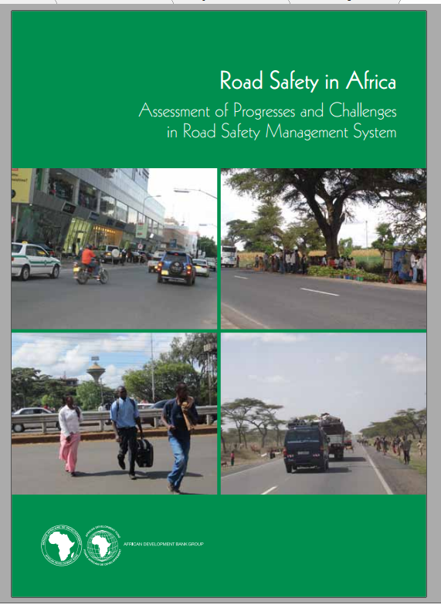
  Some of the findings
  Road safety initiatives and commitments are encouragingly improving but not to the required level;
  Capacity limitations on safety education and effective campaigns;
  Low level of enforcement of laws and regulations;
  Need to improve road crash recording and database management;
  Limited coverage of reliable emergency services.

Slide 7
Pilot Road Safety Project (Dar es Salaam-Morogoro Road 193 km)
Main objectives
To accelerate the transfer of road safety knowledge and build local capacity;
To demonstrate how road safety stakeholders organize and coordinate to achieve specific road safety targets;
To achieve quick results and obtain performance benchmark to convince decision makers and expand in a national road safety programme; and,
To contributes to the regional road safety knowledge building.
(enforcement, road infrastructure safety, road safety education and publicity, and rescue and emergency services)

Slide 8
iii) SAFER ROAD AND MOBILITY
Road safety manuals are prepared (Design, construction and operation) (TRL and BRRC), training conducted;
New roads and schemes: Road safety audit
Existing roads: Proactive approach
Existing roads: Reactive approach
Introducing road safety audits for Bank financed projects;
Axle load controls (improving the facilities at weigh stations, studies for axle load management, provision of additional weigh bridges);

Slide 9
iii) SAFER ROAD AND MOBILITY…Cont.
Emphasis on road maintenance (use of locally available material, inclusions of maintenance as part of the construction contracts, agreeing with the Governments to immediately consider completed projects under maintenance contracts, dialogue to improve allocation for maintenance);
Costs to road safety (inclusion of road safety measures in the works contracts, road safety audits, Pilot road safety project, speed monitoring cameras);
User friendly designs (consultation with road users, strengthening road safety unit of the road authorities, construction of town by-passes, pedestrian bridges, walkways and cycle lanes, traffic calming measures, animal crossings).

Slide 10
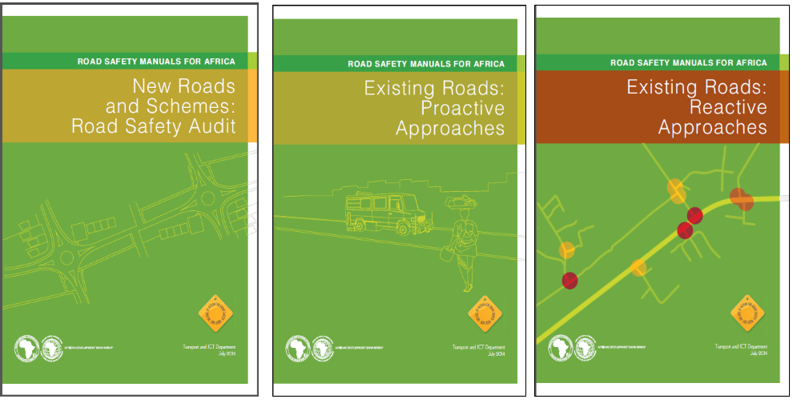
AfDB Road Safety Manuals for Safer Roads in Africa

Slide 11
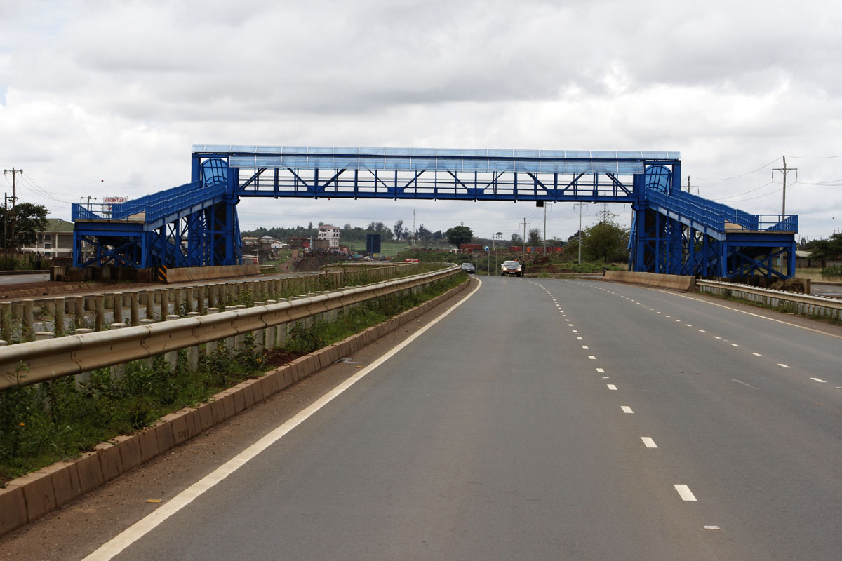

Slide 12
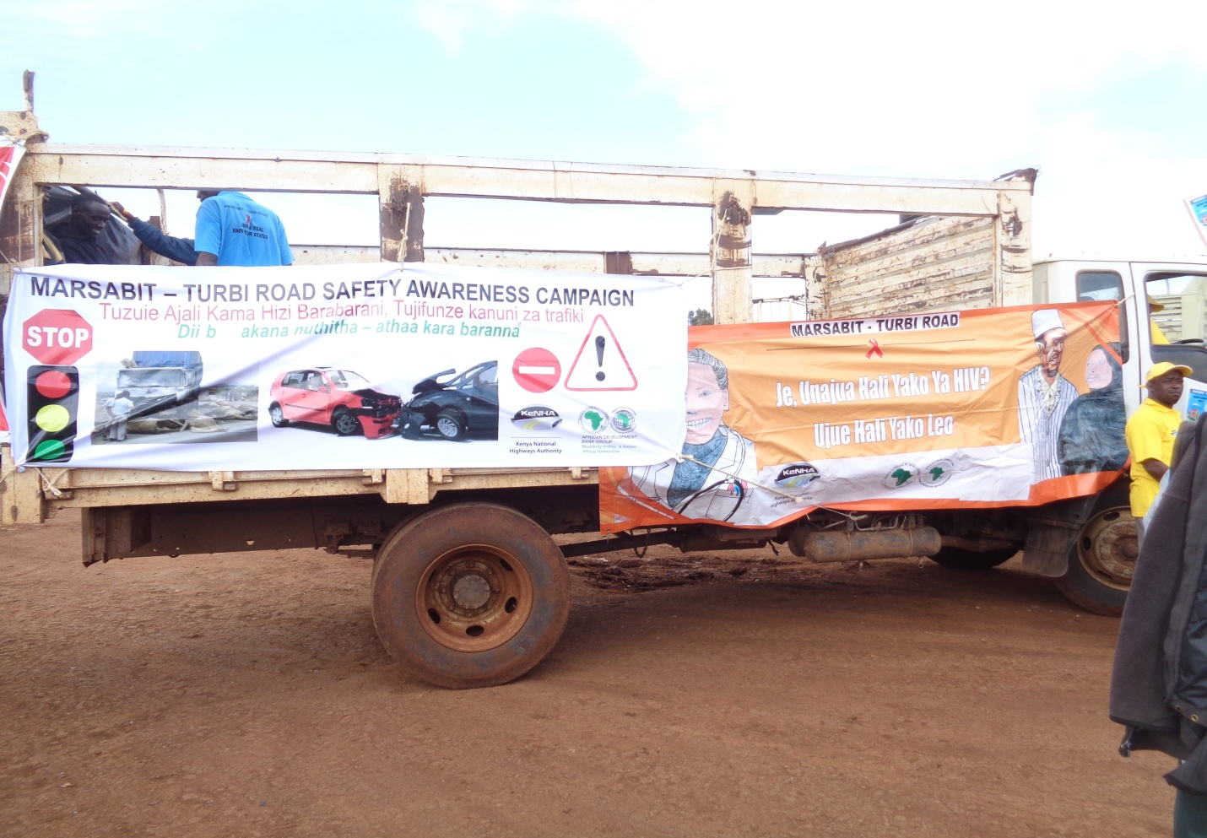
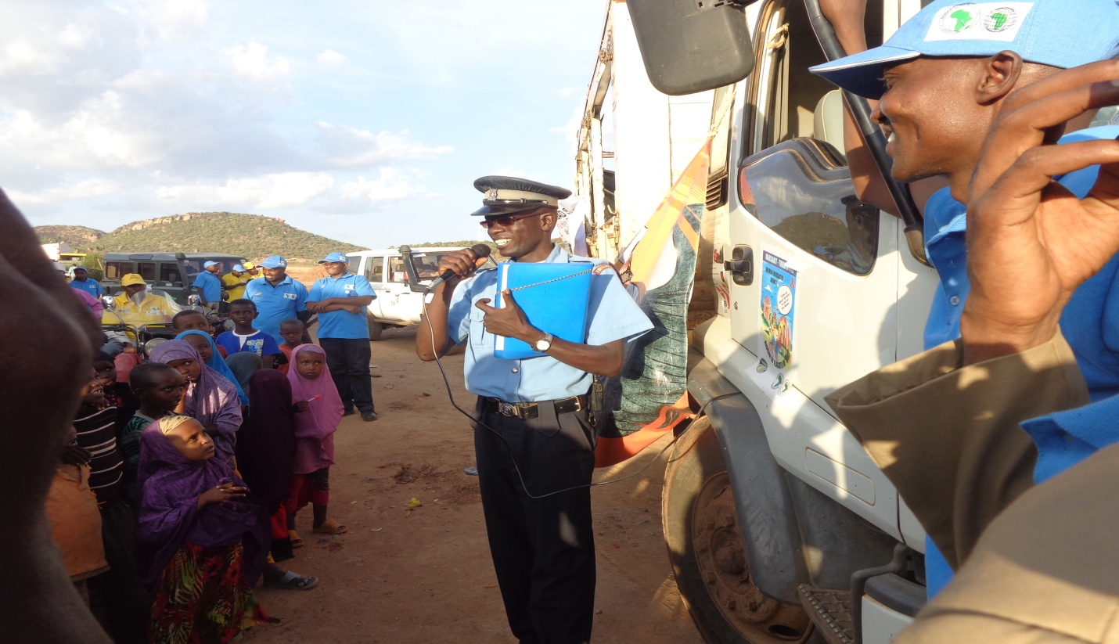
iv) SAFER ROAD USERS
Awareness campaigns/ trainings in road projects
Road safety plans during the construction period

Slide 13
v) POST CRASH MANAGEMENT
Supporting medical centers along the project corridor for handling emergencies (Togo, Burkina Faso, Ghana, etc.) Kenya and Uganda under preparation;
Better road accident management during construction (first aid training, first aid facilities, support);
Insurance coverage during construction period.

Slide 14
CROSS CUTTING ISSUES
Road safety audits on access roads (as feeder roads to main roads);
Sensitization of rural population on road safety (the project area community, awareness campaign);
Safety features in planning and construction of rural roads.

Slide 15
vi) WAY FORWARD
Disseminate and embed road safety manuals in African countries (workshop, training of road safety professionals);
Through dialogue, the Bank intends to ensure road safety audits will be the normal practices in Africa;
Enhanced support to the road safety lead agencies;
Scaling up financing on road safety related activities;
Sensitization on road safety to be done continuously.

Slide 16

AfDB is committed to support national, regional and continental efforts to address road safety issues.

Slide 17
THANK YOU

